Slide 1
Kalman-Filter

Slide 2
Overview
introduction
g-h-filter
kalman-filter
extended and unscented kalman filters

Slide 3
Introduction
introduction
g-h-filter
kalman-filter
extended and unscented kalman filters

Slide 4
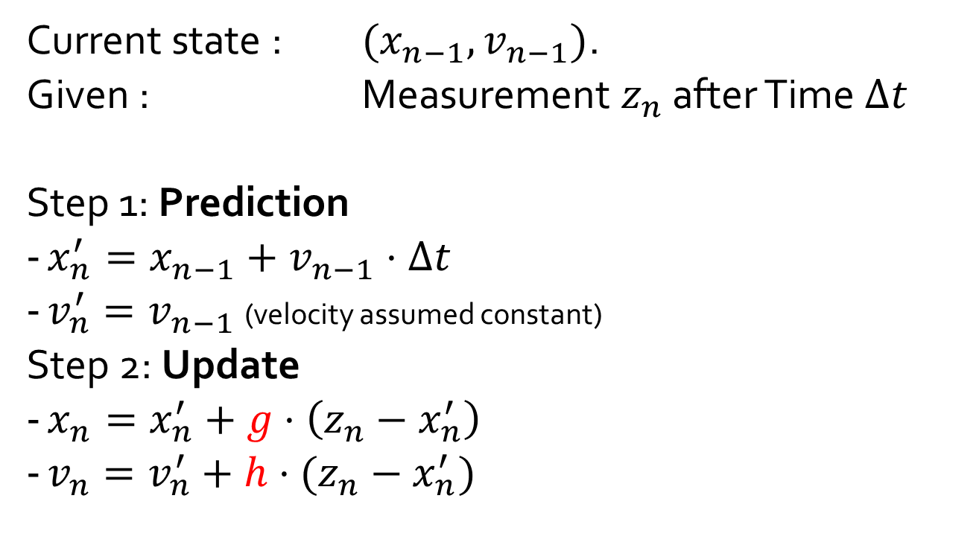
G-H-Filter
Current state : $(x_{n−1},v_{n−1})$.
Given : Measurement $z_{n}$ after Time $Δt$
Step 1: Prediction
$x_{n}^{′}=x_{n−1}+v_{n−1}⋅Δt$
$v_{n}^{′}=v_{n−1}$ (velocity assumed constant)
Step 2: Update
$x_{n}=x_{n}^{′}+g⋅\left(z_{n}−x_{n}^{′}\right)$
$v_{n}=v_{n}^{′}+h⋅(z_{n}−x_{n}^{′})$

Slide 5
Kalman-Filter

Slide 6
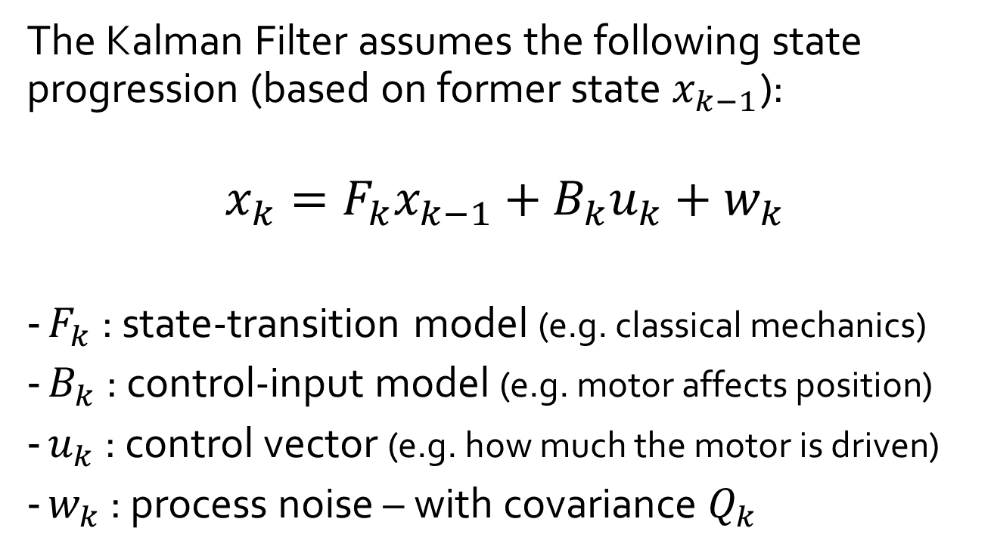
World model
The Kalman Filter assumes the following state progression (based on former state $x_{k−1}$):
$$x_{k}=F_{k}x_{k−1}+B_{k}u_{k}+w_{k}$$
$F_{k}$ : state-transition model (e.g. classical mechanics)
$B_{k}$ : control-input model (e.g. motor affects position)
$u_{k}$ : control vector (e.g. how much the motor is driven)
$w_{k}$ : process noise – with covariance $Q_{k}$
Notes:
Even assuming the reality would follow the Kalman Filter‘s model, the process noise $w_{k}$ makes it necessary to use a filter instead of running the equation over and over…

Slide 7
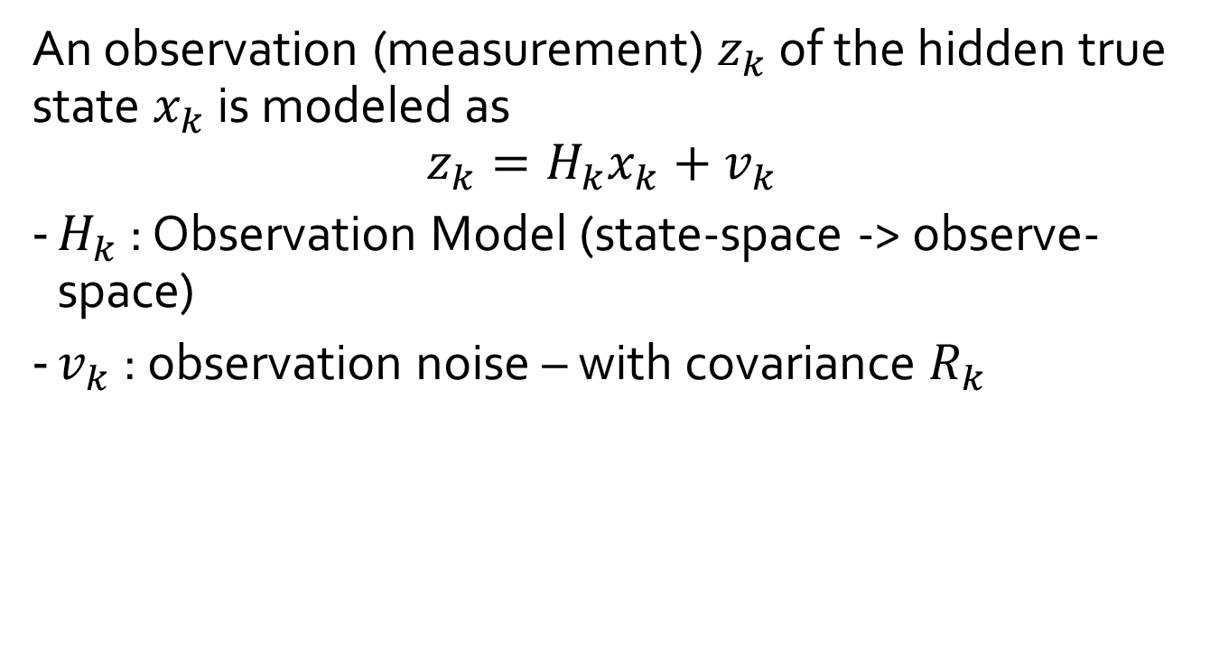
Observation Model
An observation (measurement) $z_{k}$ of the hidden true state $x_{k}$ is modeled as
$$z_{k}=H_{k}x_{k}+v_{k}$$
$H_{k}$ : Observation Model (state-space -> observe-space)
$v_{k}$ : observation noise – with covariance $R_{k}$

