Slide 1
Kalman-Filter

Slide 2
Overview
introduction
g-h-filter
kalman-filter
extended and unscented kalman filters

Slide 3
Introduction
EXAMPLE HERE

Slide 4
G-H-Filter
past state
prediction
weight
best estimate
sensor readings

Slide 5

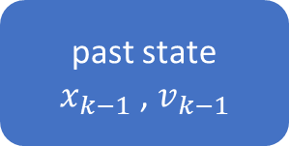
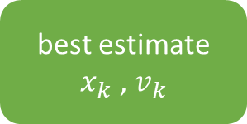
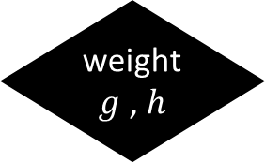
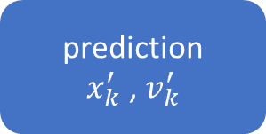
G-H-Filter
past state
$x_{k−1}$ , $v_{k−1}$
prediction
$x_{k}^{′}$ , $v_{k}^{′}$
weight
$g$ , $h$
best estimate
$x_{k}$ , $v_{k}$
sensor readings
$$z_{k}$$

Slide 6
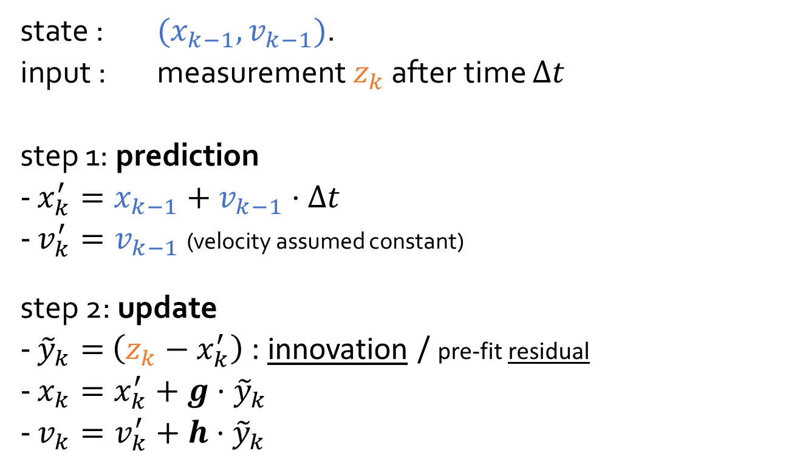
G-H-Filter
state : $(x_{k−1},v_{k−1})$.
input : measurement $z_{k}$ after time $Δt$
step 1: prediction
$x_{k}^{′}=x_{k−1}+v_{k−1}⋅Δt$
$v_{k}^{′}=v_{k−1}$ (velocity assumed constant)
step 2: update
${\tilde{y}}_{k}=$ $\left(z_{k}−x_{k}^{′}\right)$ : innovation / pre-fit residual
$x_{k}=x_{k}^{′}+g⋅$ ${\tilde{y}}_{k}$
$v_{k}=v_{k}^{′}+h⋅{\tilde{y}}_{k}$

Slide 7
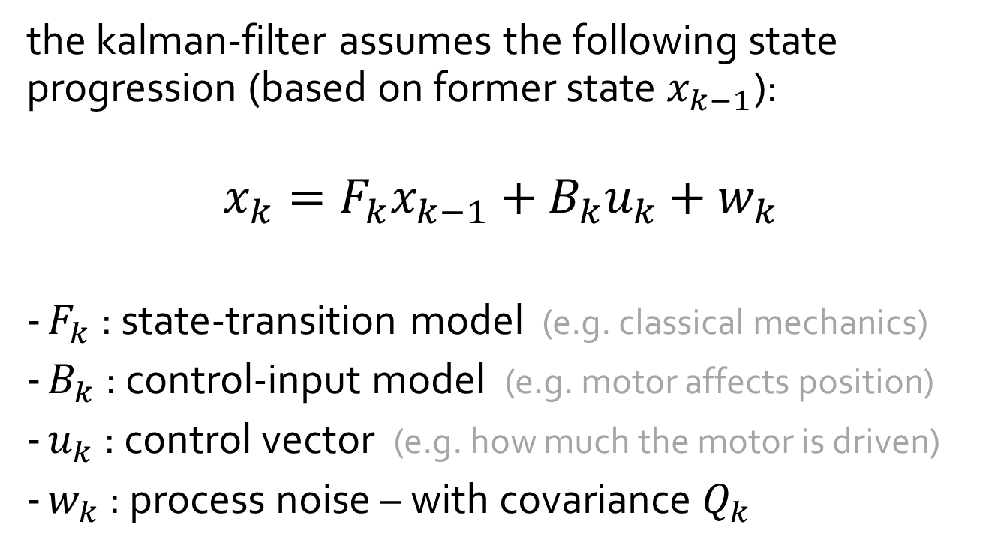
World Model
the kalman-filter assumes the following state progression (based on former state $x_{k−1}$):
$$x_{k}=F_{k}x_{k−1}+B_{k}u_{k}+w_{k}$$
$F_{k}$ : state-transition model (e.g. classical mechanics)
$B_{k}$ : control-input model (e.g. motor affects position)
$u_{k}$ : control vector (e.g. how much the motor is driven)
$w_{k}$ : process noise – with covariance $Q_{k}$
Notes:
Even assuming the reality would follow the Kalman Filter‘s model, the process noise $w_{k}$ makes it necessary to use a filter instead of running the equation over and over…

Slide 8
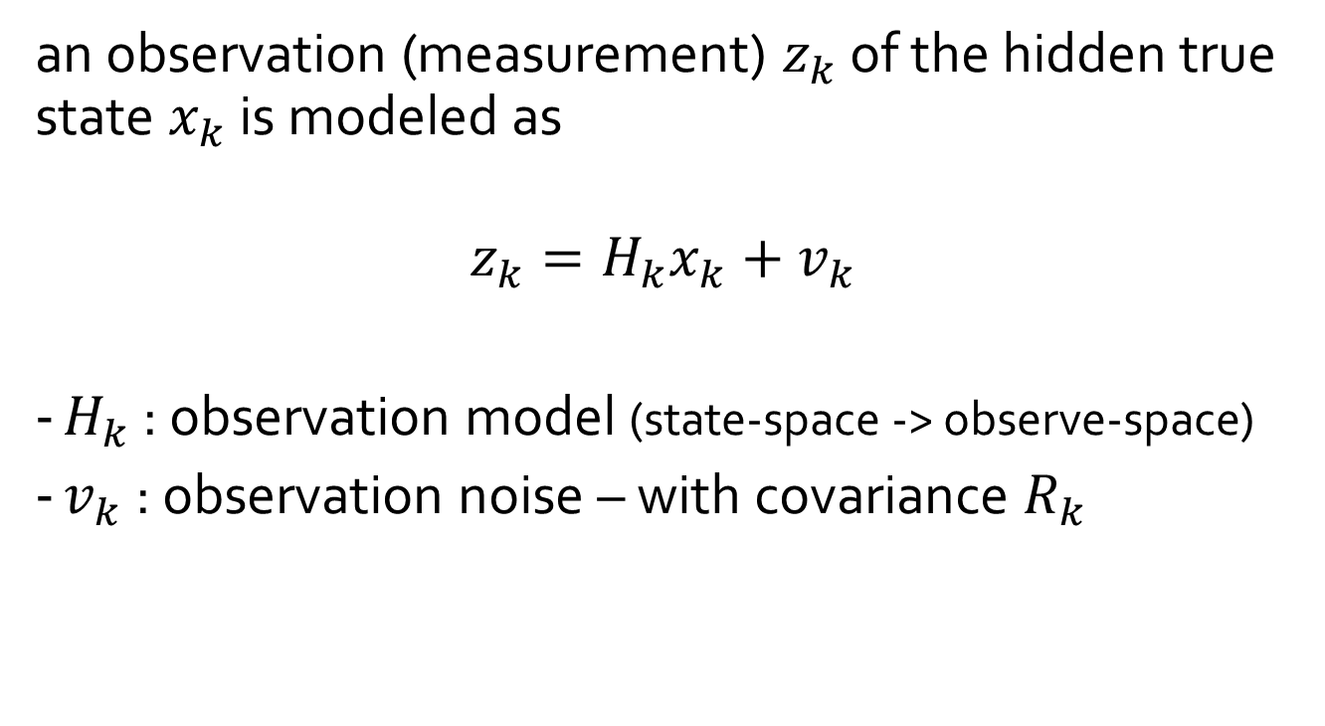
Observation Model
an observation (measurement) $z_{k}$ of the hidden true state $x_{k}$ is modeled as
$$z_{k}=H_{k}x_{k}+v_{k}$$
$H_{k}$ : observation model (state-space -> observe-space)
$v_{k}$ : observation noise – with covariance $R_{k}$

Slide 9




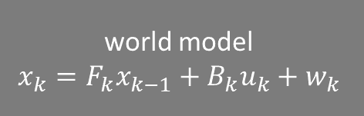


Kalman Filter Models
reality
(hidden)
filter
real past state
$$x_{k−1}$$
estimated past state
$${\hat{x}}_{k−1}$$
world model
$$x_{k}=F_{k}x_{k−1}+B_{k}u_{k}+w_{k}$$
sensor readings
$$z_{k}$$
KALMAN FILTER
real present state
$$x_{k}$$
observation model
$$z_{k}=H_{k}x_{k}+v_{k}$$
estimated present state
$${\hat{x}}_{k}$$

Slide 10
Kalman-Filter
past state
prediction
weight
best estimate
sensor readings

