Slide 1
Kalman-Filter

Slide 2
Overview
introduction
g-h-filter
the hidden markov model
kalman-filter
extended and unscented kalman filters

Slide 3




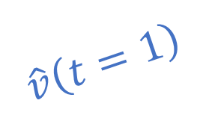

Introduction
$$x_{1}$$
$$\hat{x}\left(t=2\right)$$
$$\hat{v}\left(t=1\right)$$
innovation
$$\hat{x}\left(t=1\right)$$
$$\vec{y}(t=2)$$
$$x_{2}$$

Slide 4
Introduction
$$x_{1}$$
$$\hat{x}\left(t=2\right)$$
$$\hat{v}\left(t=1\right)$$
result
$$\hat{x}\left(t=1\right)$$
$$\vec{y}(t=2)$$
$$x_{2}$$

Slide 5


Introduction
$$\hat{x}\left(t=2\right)$$
$$x_{1}$$
$$\hat{v}\left(t=1\right)$$
innovation
$$\hat{x}\left(t=1\right)$$
$$\vec{y}(t=2)$$
$$x_{2}$$

Slide 6
Introduction
$$\hat{x}\left(t=2\right)$$
$$x_{1}$$
$$\hat{v}\left(t=1\right)$$
result
$$\hat{x}\left(t=1\right)$$
$$\vec{y}(t=2)$$
$$x_{2}$$

Slide 7
G-H-Filter
past state
prediction
update
best estimate
sensor readings

Slide 8

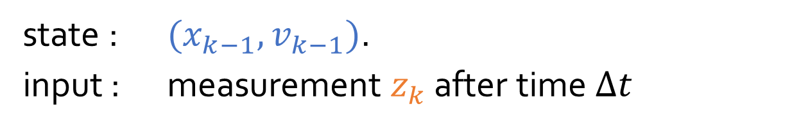
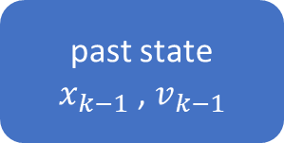
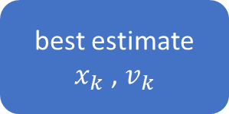

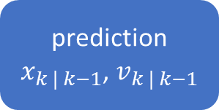
G-H-Filter
state : $(x_{k−1},v_{k−1})$.
input : measurement $z_{k}$ after time $Δt$
past state
$x_{k−1}$ , $v_{k−1}$
prediction
$x_{k | k−1}$, $v_{k | k−1}$
update
$g$ , $h$
best estimate
$x_{k}$ , $v_{k}$
sensor readings
$$z_{k}$$

Slide 9
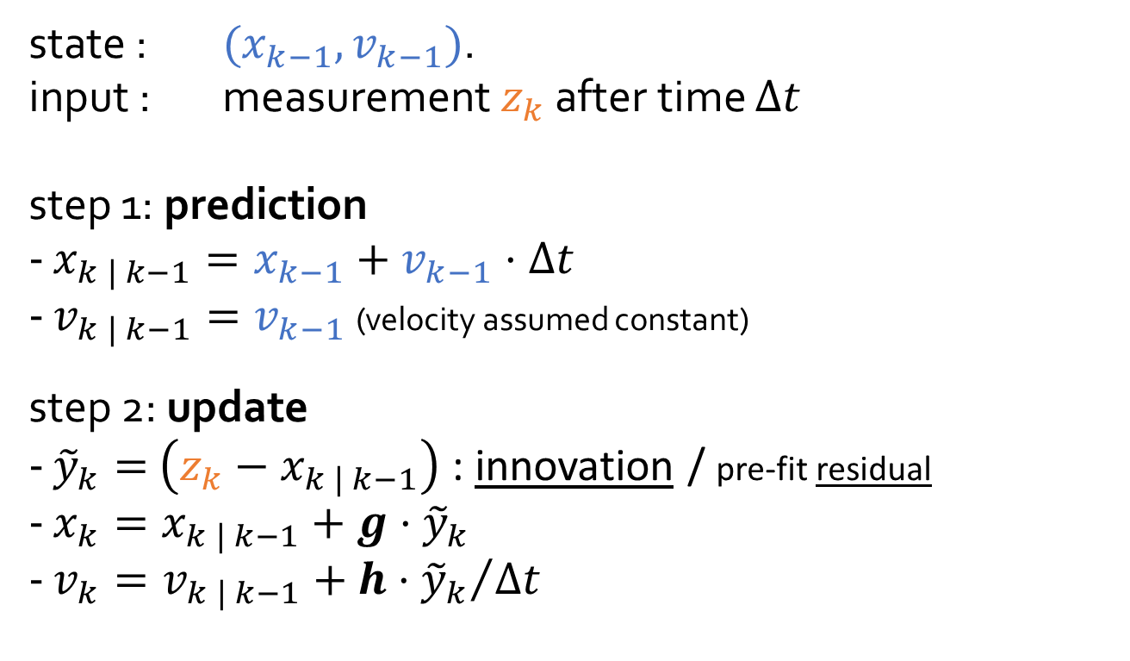
G-H-Filter
state : $(x_{k−1},v_{k−1})$.
input : measurement $z_{k}$ after time $Δt$
step 1: prediction
$x_{k | k−1}=x_{k−1}+v_{k−1}⋅Δt$
$v_{k | k−1}=v_{k−1}$ (velocity assumed constant)
step 2: update
${\tilde{y}}_{k}=$ $\left(z_{k}−x_{k | k−1}\right)$ : innovation / pre-fit residual
$x_{k}=x_{k | k−1}+g⋅$ ${\tilde{y}}_{k}$
$v_{k}=v_{k | k−1}+h⋅{{\tilde{y}}_{k}}/{Δt}$

Slide 10
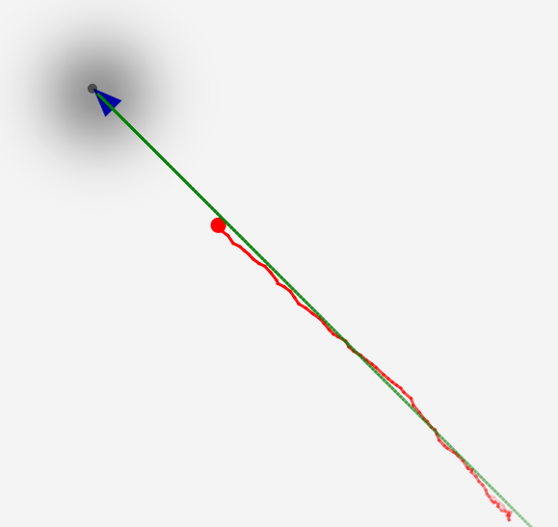
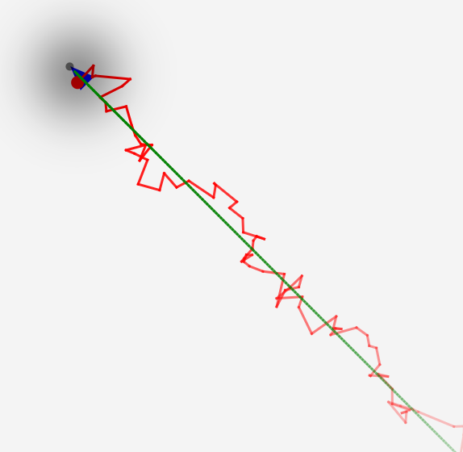
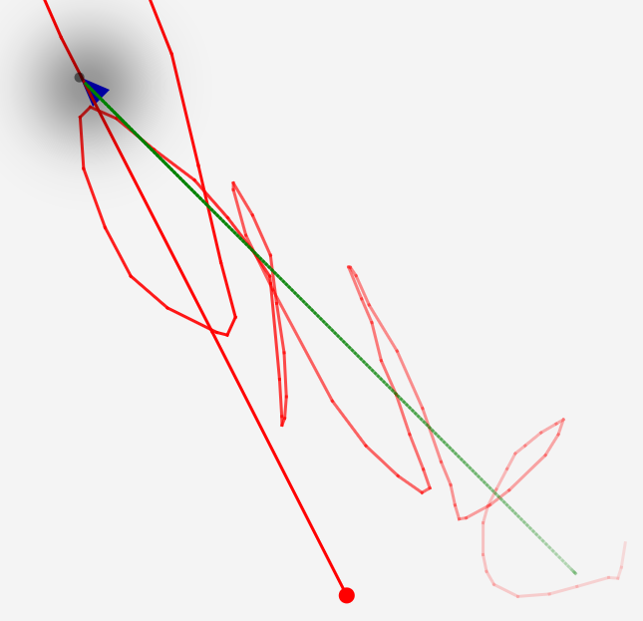
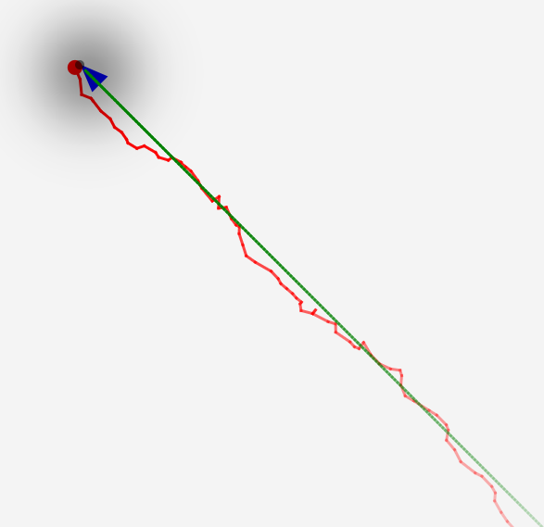






Choice of $g$ and $h$
$$g=0.1$$
$$h=0.0$$
$$g=0.5$$
$$h=0.0$$
benedict-bordner
filter
$$h=\frac{g^{2}}{2−g}$$
$$g=0.0$$
$$h=0.2$$
$g=0.1$
$h=0.005$

Slide 11
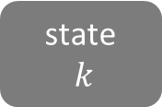







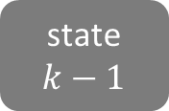


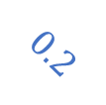

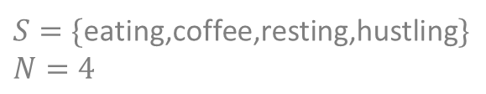
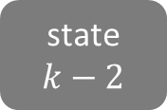


Markov Chain
model
(observable)
$N$ possible states $x_{k}∈S$
probabilities:
$F_{ij}=p\left(x_{k}=j \right| x_{k−1}=i)$
(markov-matrix) $∈ℝ^{N×N}$
state $k−2$
$$F_{k−1}$$
$$0.1$$
markov-
property
eating
$$0.5$$
coffee
transition
probabilities
state $k−1$
$$0.5$$
$$0.3$$
$$0.9$$
$$0.4$$
$$F_{k}$$
$$0.7$$
$$0.2$$
resting
hustling
state
$k$
$$0.3$$
time
$S=\{$eating,coffee,resting,hustling$\}$
$N=4$
$$0.1$$

Slide 12
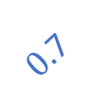

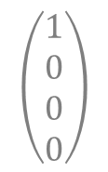
Markov Chain
model
(observable)
$N$ possible states $x_{k}∈S$
probabilities:
$F_{ij}=p\left(x_{k}=j \right| x_{k−1}=i)$
(markov-matrix) $∈ℝ^{N×N}$
state $k−2$
$$F_{k−1}$$
$$0.1$$
$$t=1$$
eating
$$0.5$$
coffee
transition
probabilities
state $k−1$
eating
coffee
resting
hustling
$$\left(\begin{aligned}1 \\ 0 \\ 0 \\ 0\end{aligned}\right)$$
$$0.5$$
$$0.3$$
$$0.9$$
$$0.4$$
$$F_{k}$$
$0.$7
$$0.2$$
resting
hustling
state
$k$
$$0.3$$
time
$S=\{$eating,coffee,resting,hustling$\}$
$N=4$
$$0.1$$

Slide 13
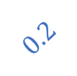

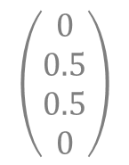
Markov Chain
model
(observable)
$N$ possible states $x_{k}∈S$
probabilities:
$F_{ij}=p\left(x_{k}=j \right| x_{k−1}=i)$
(markov-matrix) $∈ℝ^{N×N}$
state $k−2$
$$F_{k−1}$$
$$0.1$$
$$t=2$$
eating
$$0.5$$
coffee
transition
probabilities
state $k−1$
eating
coffee
resting
hustling
$$\left(\begin{aligned}0 \\ 0.5 \\ 0.5 \\ 0\end{aligned}\right)$$
$$0.5$$
$$0.9$$
$$0.4$$
$$F_{k}$$
$$0.2$$
$$0.2$$
resting
hustling
state
$k$
$$0.3$$
time
$S=\{$eating,coffee,resting,hustling$\}$
$N=4$
$$0.1$$

Slide 14

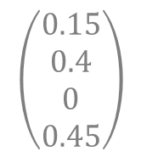
Markov Chain
model
(observable)
$N$ possible states $x_{k}∈S$
probabilities:
$F_{ij}=p\left(x_{k}=j \right| x_{k−1}=i)$
(markov-matrix) $∈ℝ^{N×N}$
state $k−2$
$$F_{k−1}$$
$$0.1$$
$$t=3$$
eating
$$0.5$$
coffee
transition
probabilities
state $k−1$
eating
coffee
resting
hustling
$$\left(\begin{aligned}0.15 \\ 0.4 \\ 0 \\ 0.45\end{aligned}\right)$$
$$0.5$$
$$0.3$$
$$0.9$$
$$0.4$$
$$F_{k}$$
$$0.7$$
$$0.2$$
resting
hustling
state
$k$
$$0.3$$
time
$S=\{$eating,coffee,resting,hustling$\}$
$N=4$
$$0.1$$

Slide 15

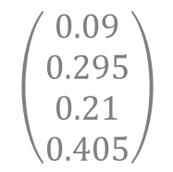
Markov Chain
model
(observable)
$N$ possible states $x_{k}∈S$
probabilities:
$F_{ij}=p\left(x_{k}=j \right| x_{k−1}=i)$
(markov-matrix) $∈ℝ^{N×N}$
state $k−2$
$$F_{k−1}$$
$$0.1$$
$$t=4$$
eating
$$0.5$$
coffee
transition
probabilities
state $k−1$
eating
coffee
resting
hustling
$$\left(\begin{aligned}0.09 \\ 0.295 \\ 0.21 \\ 0.405\end{aligned}\right)$$
$$0.5$$
$$0.3$$
$$0.9$$
$$0.4$$
$$F_{k}$$
$$0.7$$
$$0.2$$
resting
hustling
state
$k$
$$0.3$$
time
$S=\{$eating,coffee,resting,hustling$\}$
$N=4$
$$0.1$$

Slide 16







Hidden Markov Model
reality
(hidden)
model
(observable)
$N$ possible states
probabilities:
$F_{ij}=p\left(x_{k}=j \right| x_{k−1}=i)$
(markov-matrix) $∈ℝ^{N×N}$
$T$ possible observations
probabilities:
$H_{i , j}=p\left(z_{i} | x=j\right)$
(markov-matrix) $∈ℝ^{T×N}$
state $k−2$
$$H_{k−2}$$
observation
$$z_{k−2}$$
$$F_{k−1}$$
emission
probabilities
transition
probabilities
state $k−1$
$$H_{k−1}$$
observation
$$z_{k−1}$$
$$F_{k}$$
state
$k$
$$H_{k}$$
observation
$$z_{k}$$
time

Slide 17





Kalman Filter Models
reality
(hidden)
filter
real past state
$$x_{k−1}$$
estimated past state
$${\hat{x}}_{k−1}$$
world model
sensor readings
$$z_{k}$$
KALMAN FILTER
real present state
$$x_{k}$$
observation model
estimated present state
$${\hat{x}}_{k}$$

Slide 18
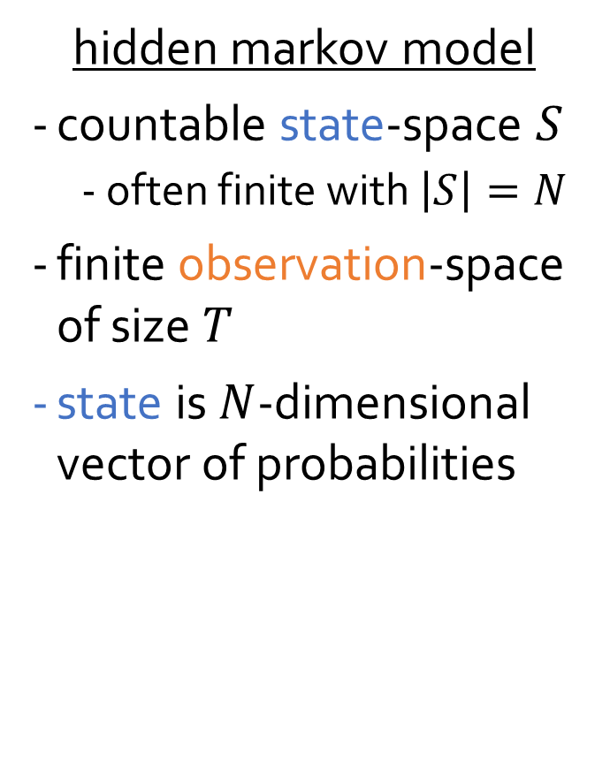
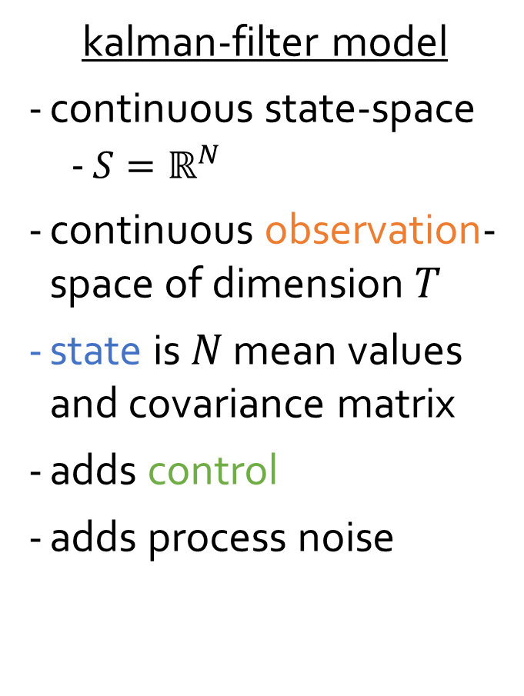
From Markov to Kalman
hidden markov model
countable state-space $S$
often finite with $\left|S\right|=N$
finite observation-space of size $T$
state is $N$-dimensional vector of probabilities
kalman-filter model
continuous state-space
$S=ℝ^{N}$
continuous observation-space of dimension $T$
state is $N$ mean values and covariance matrix
adds control
adds process noise
Notes:
Even assuming the reality would follow the Kalman Filter‘s model, the process noise $w_{k}$ makes it necessary to use a filter instead of running the equation over and over…

Slide 19
From G-H to Kalman
past state
prediction
weight
best estimate
sensor readings
reality

Slide 20
From G-H to Kalman
control vector
past state
prediction
weight
best estimate
process noise
sensor readings
reality

Slide 21
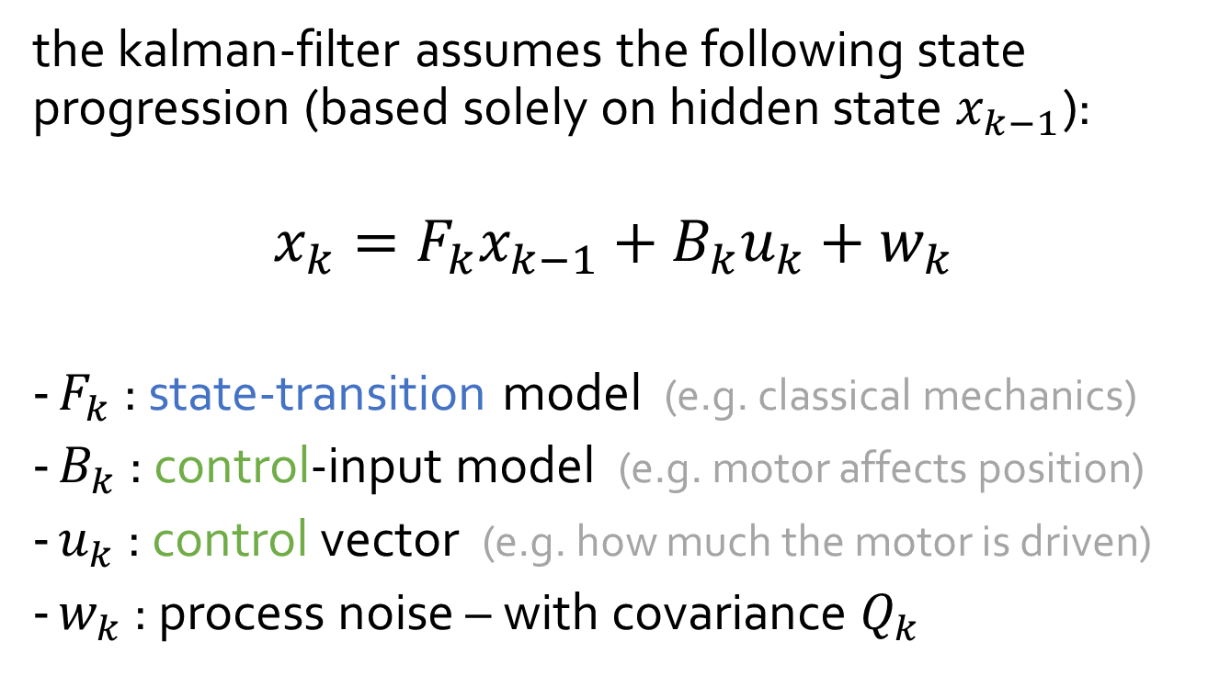
Kalman Filter: World Model
the kalman-filter assumes the following state progression (based solely on hidden state $x_{k−1}$):
$$x_{k}=F_{k}x_{k−1}+B_{k}u_{k}+w_{k}$$
$F_{k}$ : state-transition model (e.g. classical mechanics)
$B_{k}$ : control-input model (e.g. motor affects position)
$u_{k}$ : control vector (e.g. how much the motor is driven)
$w_{k}$ : process noise – with covariance $Q_{k}$
transition
control
noise
Notes:
Even assuming the reality would follow the Kalman Filter‘s model, the process noise $w_{k}$ makes it necessary to use a filter instead of running the equation over and over…

Slide 22
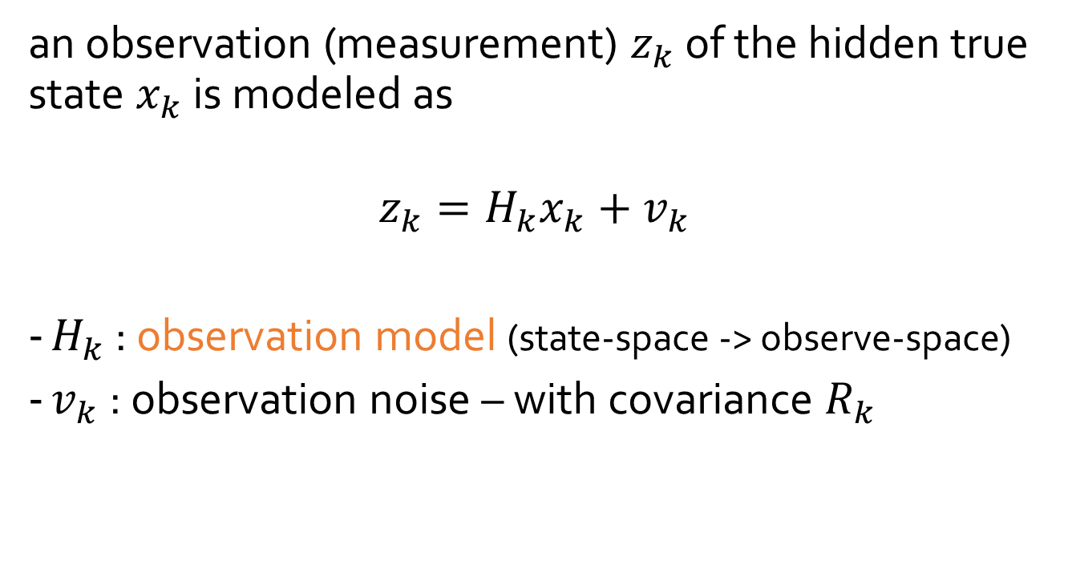
Kalman Filter: Observation Model
an observation (measurement) $z_{k}$ of the hidden true state $x_{k}$ is modeled as
$$z_{k}=H_{k}x_{k}+v_{k}$$
$H_{k}$ : observation model (state-space -> observe-space)
$v_{k}$ : observation noise – with covariance $R_{k}$
observation
noise

Slide 23
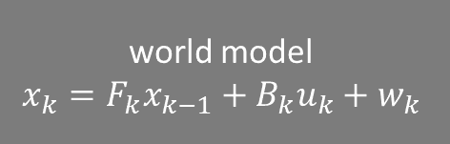


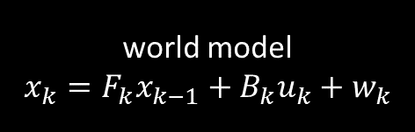
Kalman Filter Models
reality
(hidden)
filter
real past state
$$x_{k−1}$$
estimated past state
${\hat{x}}_{k−1}$ , $P_{k−1}$
world model
$$x_{k}=F_{k}x_{k−1}+B_{k}u_{k}+w_{k}$$
sensor readings
$$z_{k}$$
KALMAN FILTER
real present state
$$x_{k}$$
observation model
$$z_{k}=H_{k}x_{k}+v_{k}$$
estimated present state
$${\hat{x}}_{k}$$

Slide 24



Kalman Filter: 0. Past state
reality
Mean
${\hat{x}}_{k −1}$
Covariance
$P_{k −1}$
real past state
$$x_{k−1}$$
estimated past state
${\hat{x}}_{k−1}$ , $P_{k−1}$

Slide 25

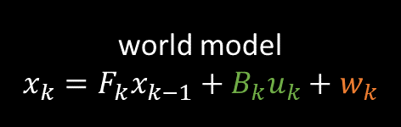


Kalman Filter: 1. Prediction
reality
real past state
$$x_{k−1}$$
Mean
${\hat{x}}_{k | k−1}=F_{k}{\hat{x}}_{k−1}+B_{k}u_{k}$
Covariance
$P_{k | k−1}=F_{k}P_{k−1}F_{k}^{T}+Q_{k}$
world model
$$x_{k}=F_{k}x_{k−1}+B_{k}u_{k}+w_{k}$$
real present state
$$x_{k}$$

Slide 26




Kalman Filter: 2. Update
reality
Innovation Mean
${\tilde{y}}_{k}=z_{k}−H_{k}{\hat{x}}_{k | k−1}$
Innovation Covariance
$S_{k}=R_{k}−H_{k}P_{k | k−1}H_{k}^{T}$
Kalman Gain
$K_{k}=P_{k | k−1}H_{k}^{T}S_{k}^{−1}$
sensor readings
$$z_{k}$$
$$S_{k}$$
observation model
$$z_{k}=H_{k}x_{k}+v_{k}$$
inverse covariance
aka precision

Slide 27

Kalman Filter: 2. Update
reality
Mean (used as estimate)
${\hat{x}}_{k}={\hat{x}}_{k | k−1}+K_{k}{\tilde{y}}_{k}$
Covariance
$P_{k}=\left(I−K_{k}H_{k}\right)P_{k | k−1}{\left(I−K_{k}H_{k}\right)}^{T}$ $+K_{k}R_{k}K_{k}^{T}$
innovation mean ${\tilde{y}}_{k}$
kalman gain $K_{k}$
sensor readings
$$z_{k}$$
observation model
$$z_{k}=H_{k}x_{k}+v_{k}$$

Slide 28
1-d Example??
Notes:
Even assuming the reality would follow the Kalman Filter‘s model, the process noise $w_{k}$ makes it necessary to use a filter instead of running the equation over and over…

Slide 29










Kalman-Filter
control vector
$$u_{k}$$
$$B_{k}$$
past state
${\hat{x}}_{k−1}$ , $P_{k−1}$
$$F_{k}$$
prediction
${\hat{x}}_{k | k−1}$ , $P_{k | k−1}$
weight
$$K_{k}$$
best estimate
${\hat{x}}_{k}$ , $P_{k}$
$$Q_{k}$$
process noise
sensor readings
$z_{k}$ , $R_{k}$
$$H_{k}$$
reality

