Slide 1
Prototyp 1
Sebastian Chlup
Korbinian Christl
Michael Lazarus
Veronika Lomasow

Slide 2
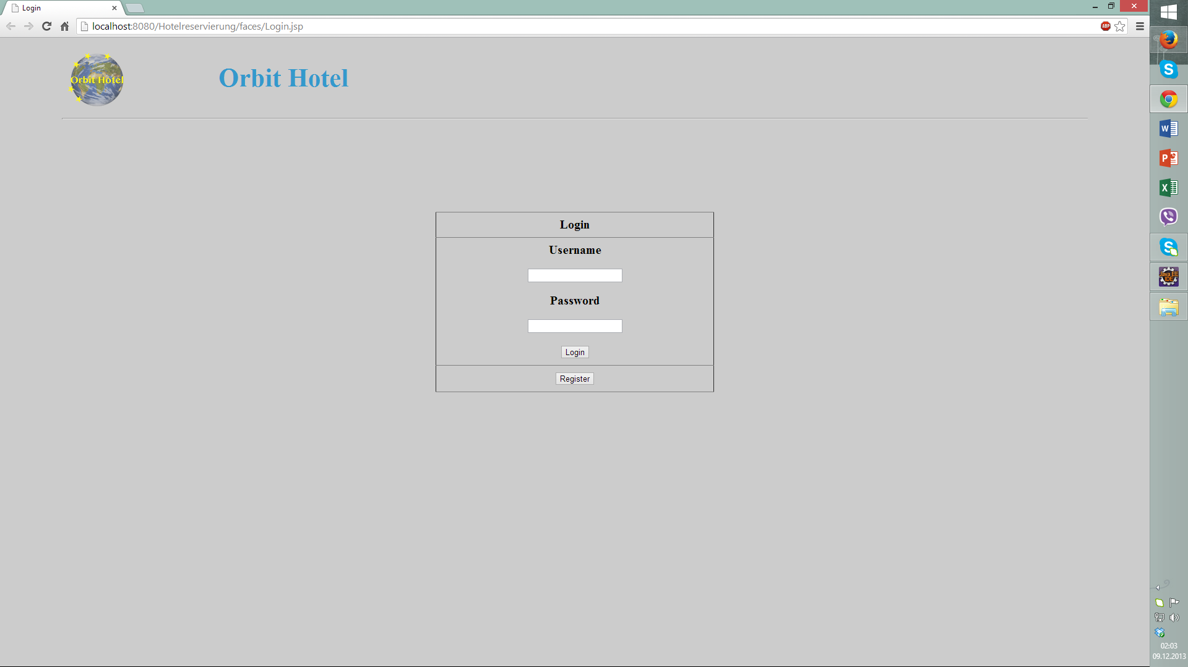
Login Fenster

Slide 3
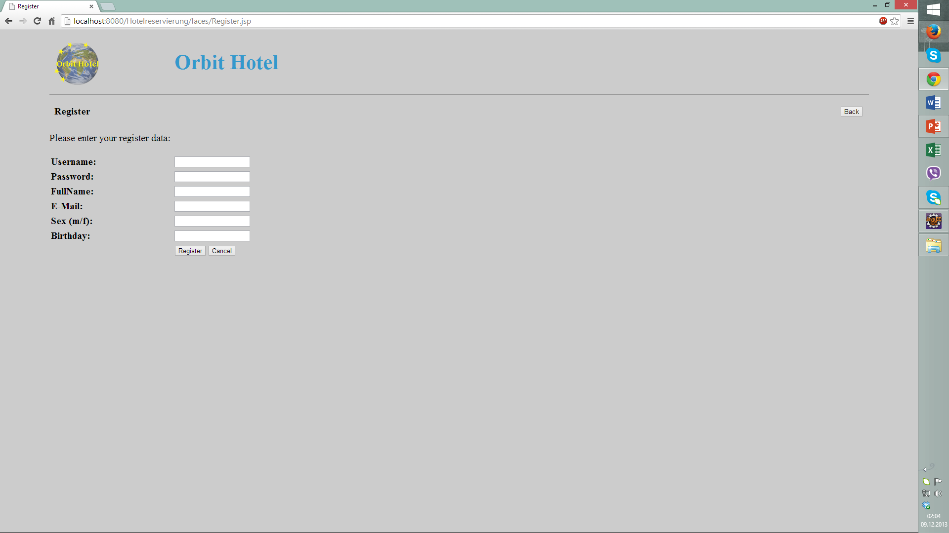
Register Fenster

Slide 4
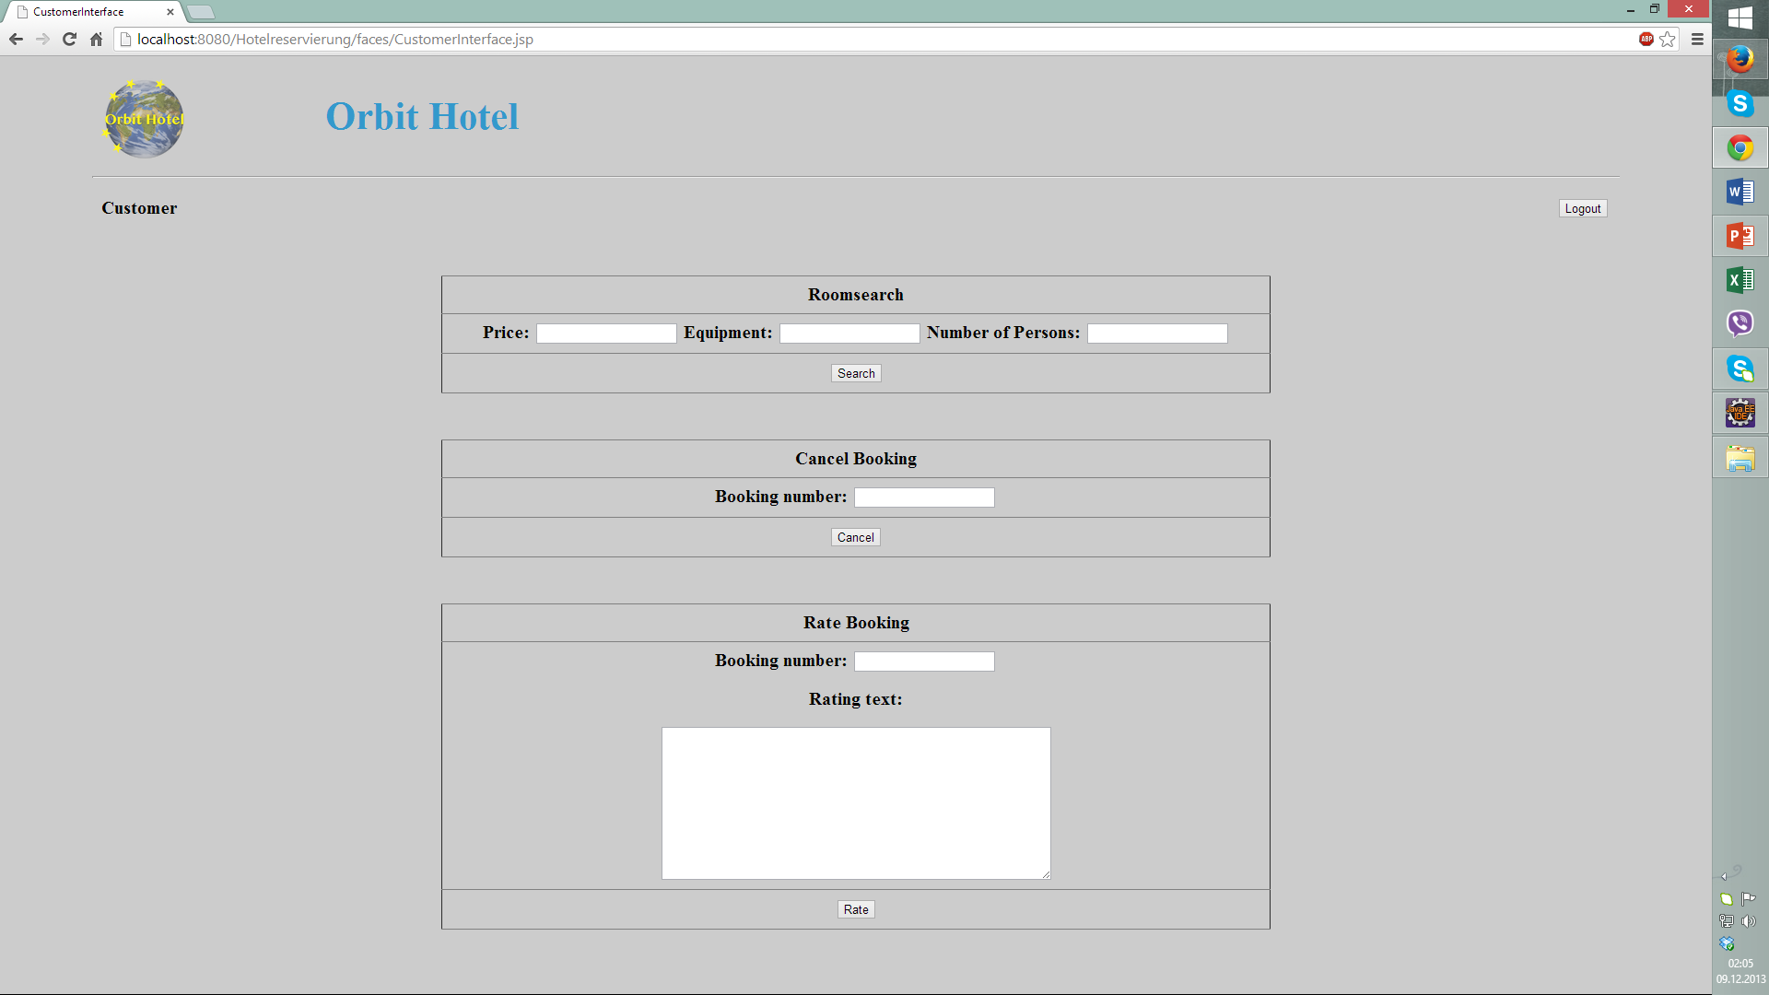
Customer Interface

Slide 5
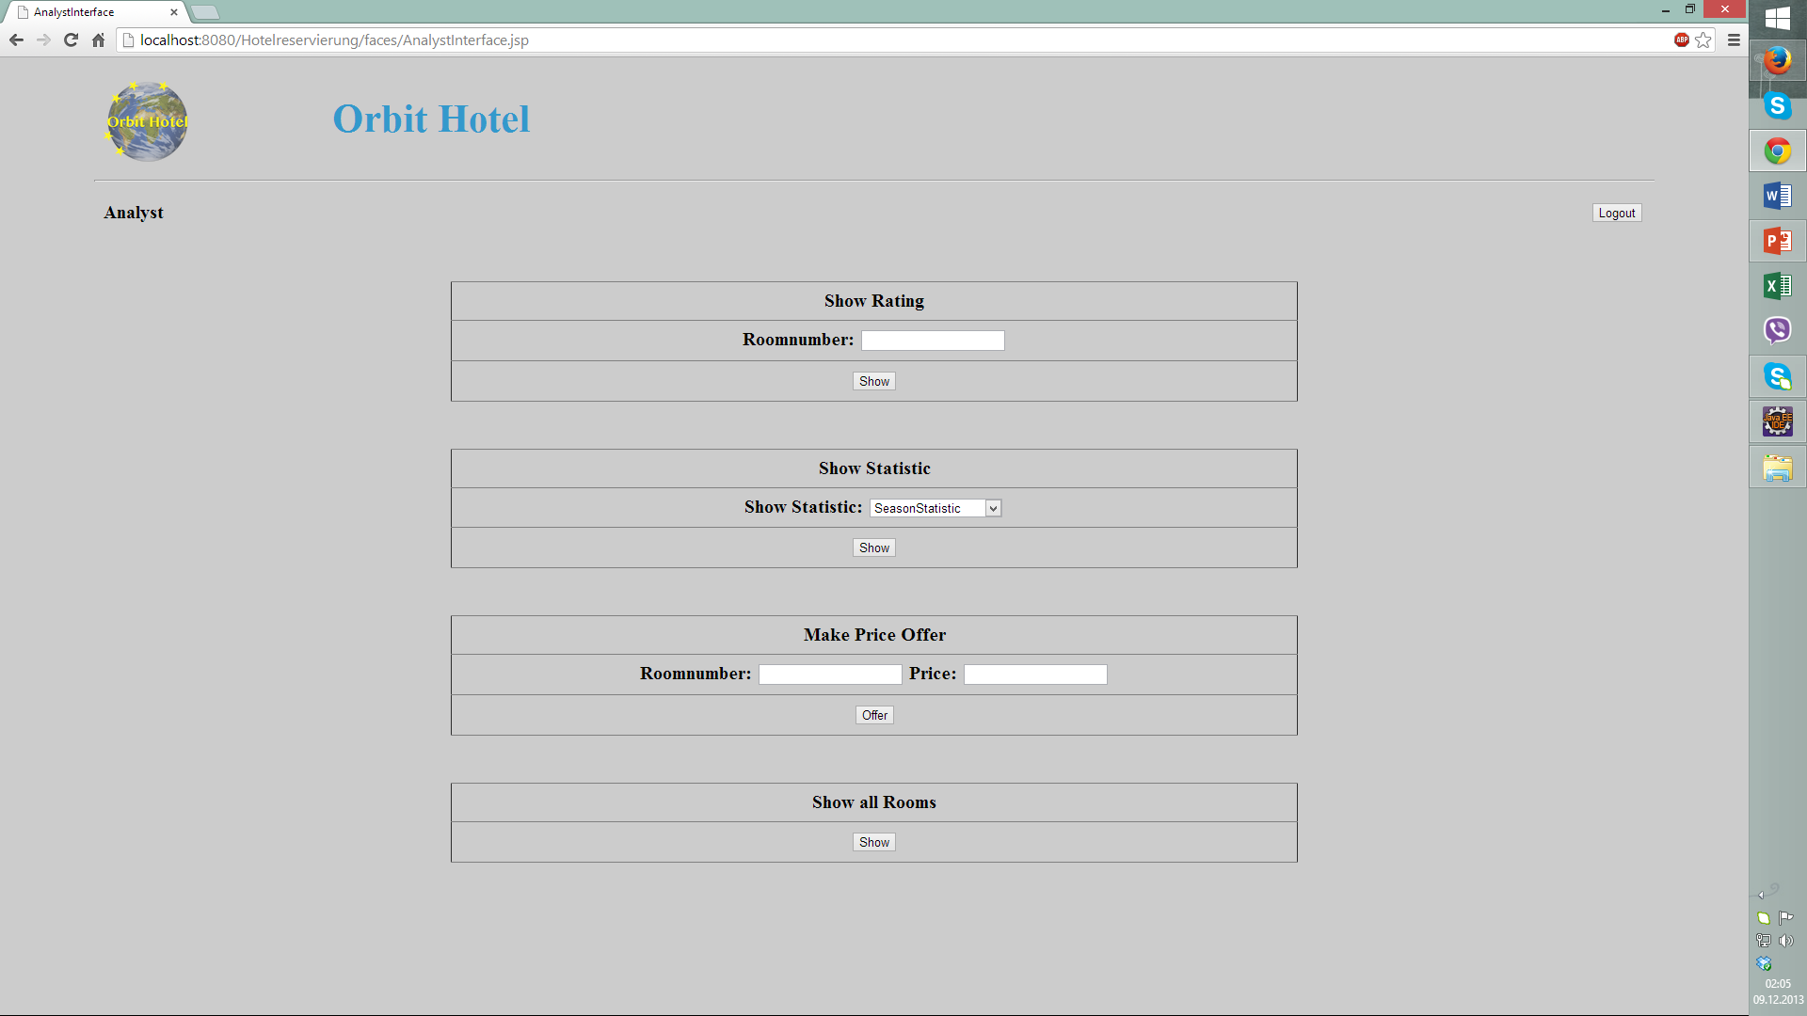
Analyst Interface

Slide 6
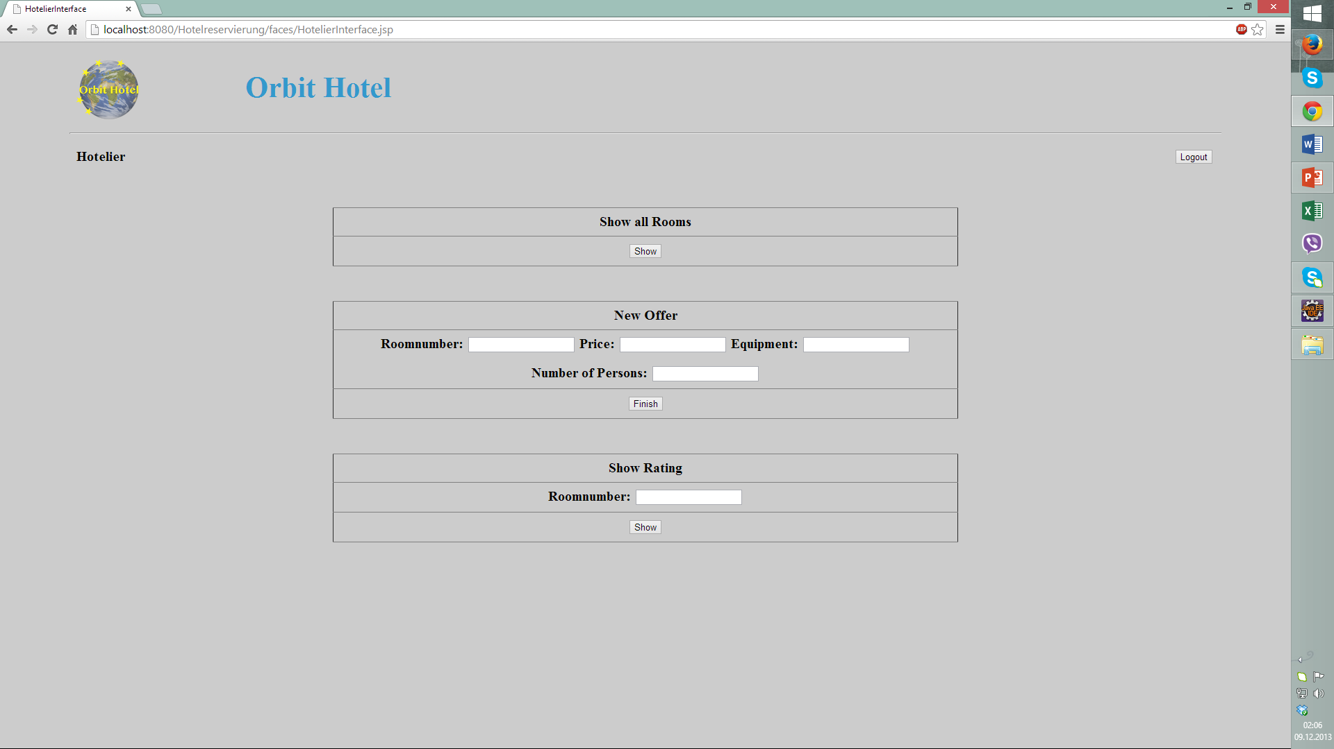
Hotelier Interface

