Slide 1

Self-contained & maintainable Build-Scripts
with
Deno & TypeScript

Slide 2



JavaScript Runtime Environment Overview
 | Node.js | Deno | Bun | AWS LLRT
Since | 2009 | 2018 | 2022 | 2024
Runtime Engine | V8 | V8 | JavaScriptCore | QuickJS
Written in | JavaScript, C++, Python, C | TypeScript, JavaScript, Rust, C++ | Zig
Runs TypeScript directly | no (not yet) | yes | yes
package manager (npm, yarn, pnpm…) included | no | yes | yes
separate library file (e.g. package.json) optional | no | yes | no
secure by default | no | yes | no (different builds planned)
Website | https://nodejs.org/ | https://deno.com/ | https://bun.sh/
These are for servers, in general there are more:
Chrome (V8), Edge (V8), Firefox (SpiderMonkey), Safari (JavaScriptCore), React Native (Hermes), …

Slide 3

Deno
Like Node.js: Runtime for JavaScript and TypeScript
Also like Node.js: co-created by Ryan Dahl
Key Takeaways:
2. URLs for loading dependencies, module specifiers like npm: and node: to import NPM or Node.JS modules.
Node.js also added --experimental-network-imports.
3. Does not require a package manager like npm.
4. Runs TypeScript out of the box.
6. Restricts file system and network access by default in order to run sandboxed code.
See https://en.wikipedia.org/wiki/Deno_(software)
https://deno.com/

Slide 4
Should I use Deno?
Most npm: and node: dependencies work out of the box
Not sure about bigger projects yet
Use Deno for Scripts (instead of bash or JavaScript)
Run maintainable TypeScript directly

Slide 5

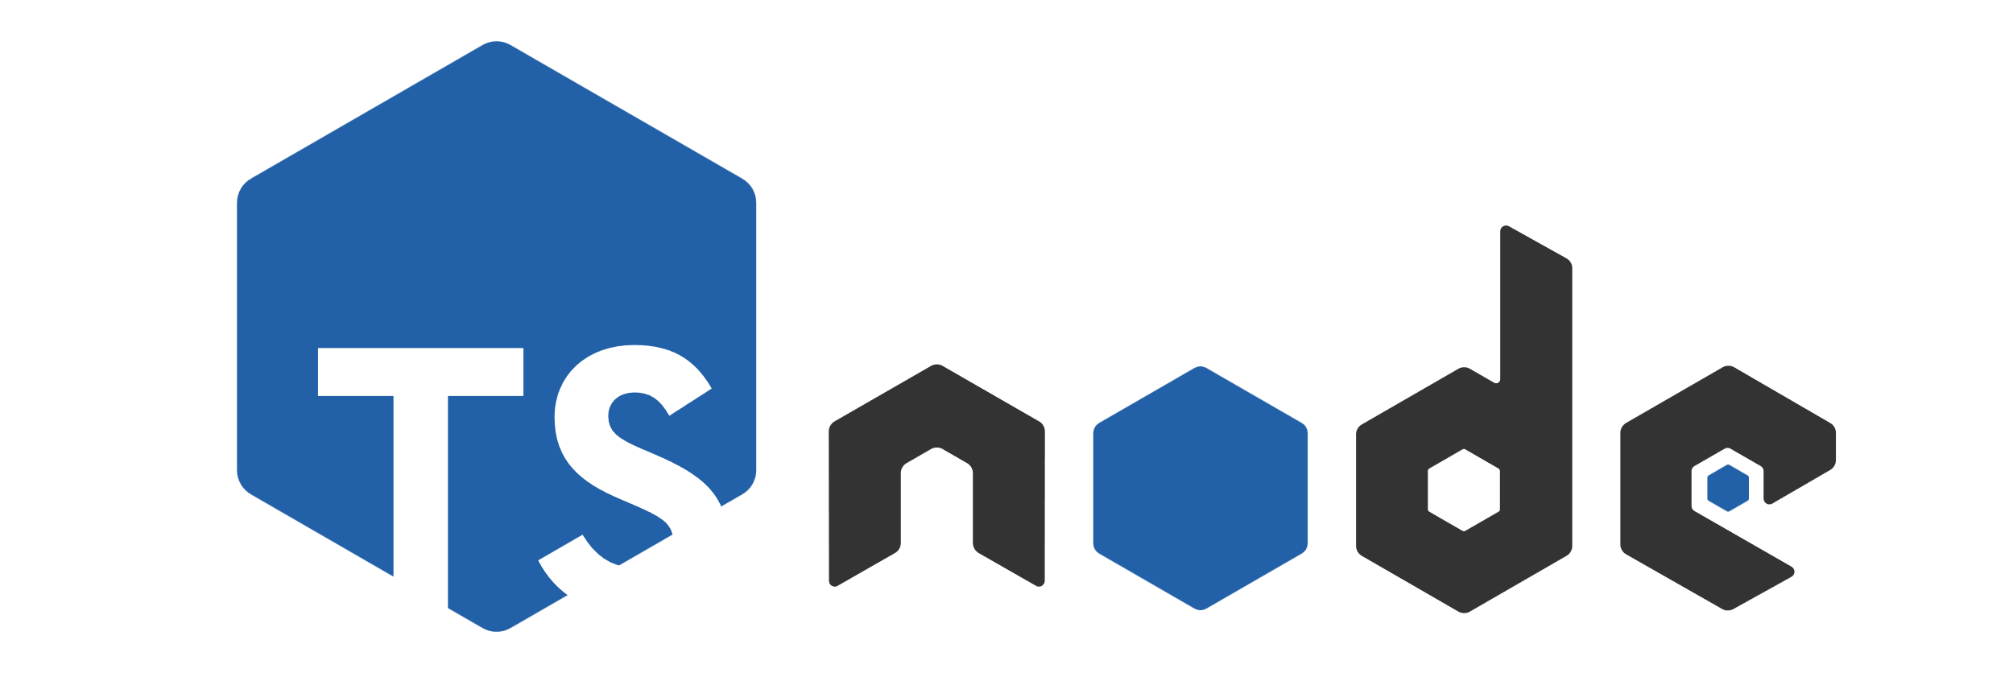

How to write scripts
 | Bash | Groovy | JavaScript | TypeScript
Run | bash script.sh | groovy script.groovy | node script.js | ts-node script.ts | deno run script.ts
Build | Bashly | Gradle | npm, yarn, pnpm, … |  | not needed
Library versions |  |  | package.json, node_modules |  | Part of import or deno.lock
Type safety | no | no | no | yes | yes
Sandboxing / secure by default |  |  | no | no | yes

Slide 6
Use Deno for Scripts in existing projects
Better maintainable than Bash, Groovy or JavaScript but as simple
No config, no package.json, no build step required
TypeScript is commonly used by developers
Deno can be used via npm:
npm install --save-dev deno-bin
https://www.npmjs.com/package/deno-bin

