Slide 1

TypeScript everywhere: Eine neue Ära von Skripten mit Deno

Slide 2

TypeScript everywhere: Eine neue Ära von Skripten mit Deno oder Node

Slide 3
TypeScript everywhere
Web standards are most open and competitive
Lots of libraries, runtime engines
JavaScript/TypeScript ubiquitous
First app of many is written in JavaScript/TypeScript, HTML, CSS
Everybody knows JavaScript/TypeScript
Runs on every platform
This talk is especially about what possibilities TypeScript opens up for scripts
More to expand horizon and give ideas, not so much a deep dive

Slide 4
TypeScript everywhere
JavaScript Runtime Environment Overview
Deno (with examples)
When to use Deno
Comparison of languages for scripts
Bash, Groovy, JavaScript, TypeScript
Node.js is catching up
Recent developments of Node.js
Advantages of using Deno for Scripts
Discussion and further examples

Slide 5



JavaScript Runtime Environment Overview
 | Node.js | Deno | Bun | AWS LLRT
Since | 2009 | 2018 | 2022 | 2024
Runtime Engine | V8 | V8 | JavaScriptCore | QuickJS
Written in | JavaScript, C++, Python, C | TypeScript, JavaScript, Rust, C++ | Zig, C++, TypeScript | Rust, JavaScript, TypeScript
Runs TypeScript directly | no (experimental) --experimental-strip-types default since Node 23 | yes | yes
package manager (npm, yarn, pnpm…) included | no | yes | yes
separate library file (e.g. package.json) optional | no | yes | no
secure | no --permission since Node 20, stable since 23 | yes (by default) | no (different builds planned)
Website | https://nodejs.org/ | https://deno.com/ | https://bun.sh/ | https://github.com/awslabs/llrt
These are for servers, in general there are more:
Chrome (V8), Edge (V8), Firefox (SpiderMonkey), Safari (JavaScriptCore), React Native (Hermes), …

Slide 6


Deno
Like Node.js: Runtime for JavaScript and TypeScript
Also like Node.js: co-created by Ryan Dahl
Key Takeaways:
2. URLs for loading dependencies.
3. Does not require a package manager like npm.
4. Runs TypeScript out of the box.
6. Restricts file system and network access by default to run sandboxed code.
See https://en.wikipedia.org/wiki/Deno_(software)
10 Things I Regret About Node.js - Ryan Dahl - JSConf EU
https://www.youtube.com/watch?v=M3BM9TB-8yA
https://deno.com/

Slide 7
When to use Deno
Most npm: and node: dependencies work out of the box
Not sure about bigger projects yet
Maybe Node.js catches up and supports most features of Deno
Use Deno for Scripts (instead of bash or JavaScript)
Run maintainable TypeScript directly
#! deno run and mark as executable

Slide 8
Important properties for scripts
No build/compile steps
Self contained
Execute like an executable file

Slide 9

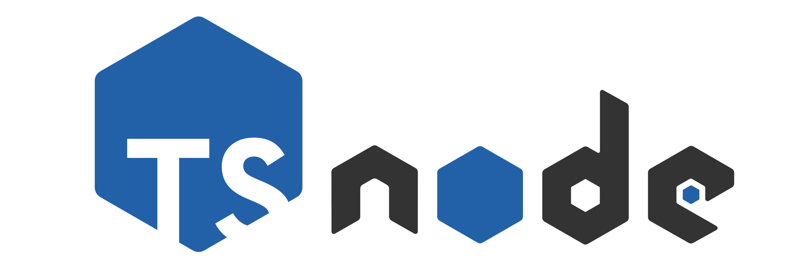

Comparison of languages for scripts
 | Bash | Groovy | JavaScript | TypeScript
Run | bash script.sh | groovy script.groovy | node script.js | ts-node script.ts | deno run script.ts
Library managment |  |  | npm, yarn, pnpm, … |  | not needed
Library versions |  |  | package.json, node_modules |  | Part of import or deno.lock
Type safety | no | no | no | yes | yes
Sandboxing / secure by default |  |  | no | no | yes
* Node.js caught up and since version 23 --experimental-strip-types is default and Node.js can run TypeScript directly as well

Slide 10
Node.js is catching up
TypeScript support
Node.js added --experimental-strip-types
Experimental since v22.6.0 (August 2024)
Stable and default since v23.6.0 (January 2025)
--no-experimental-strip-types to prevent type stripping
Replaces TypeScript syntax with whitespaces
(--experimental-transform-types for TypeScript-only syntax like enums)
https://nodejs.org/api/typescript.html#type-stripping
Node.js added --experimental-network-imports
But removed it in v22.6.0 (August 2024)
https://github.com/nodejs/node/pull/53822
Security
Node.js has now a Permission Model
Experimental since v20.0.0 (April 2023)
Stable since v23.5.0 (December 2024)
Example: node --permission --allow-fs-read=/folder/ script.ts
https://nodejs.org/api/cli.html#--permission

Slide 11
Advantages of using Deno for Scripts
Better maintainable than Bash, Groovy or JavaScript but as simple
No config, no package.json, no build step required
TypeScript is commonly used by developers
Deno can be used via npm:
npm install --save-dev deno-bin
https://www.npmjs.com/package/deno-bin
Examples used in Demo:
https://github.com/MichiSpebach/denoexamples

