Slide 1



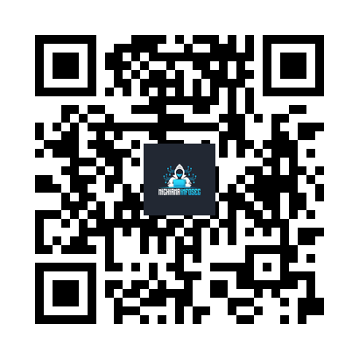




CYBER SECURITY
Table-top Games
A HANDS-ON FUN & GAMES DAY
Nov
Saturday, November 15, 2025
Noon – 4:00 PM
15
South Bend Technology Resource Center Suite 100
1165 Franklin St, South Bend, IN 46601
RSVP: https://msec.club/meet
WHAT TO EXPECT:
Card & tabletop games
Free pizza & drinks
Networking & community building
Ages 13+ no experience needed

