Slide 1
Master AAI Expert Workshops — Session 1
Michiel Bontenbal, MSc · Rick van Kersbergen, MSc
Introduction Tech Workshop Curriculum
Intro CV — Master AAI
1/25

Slide 2
Curriculum Overview
No.
Date
Lecturer
Subjects
1
Thu Sep
Rick + Michiel
AI assisted coding, Data exploration, Faces
2
Thu Sep
Michiel
Object Detection, Video, CNN advanced
3
Thu Sep
Rick
Evaluations, Build an app
4
Thu Sep
Michiel
Embeddings (SSL, CLIP, Search) & prep tech reviews
5
Thu Oct
Rick + Michiel
Tech reviews
6
Thu Oct
Rick
ML Ops + topics based on student questions
7
Thu Oct
Michiel
Vision Language Models (VLMs) + topics based on student questions
Intro CV — Master AAI
2/25

Slide 3
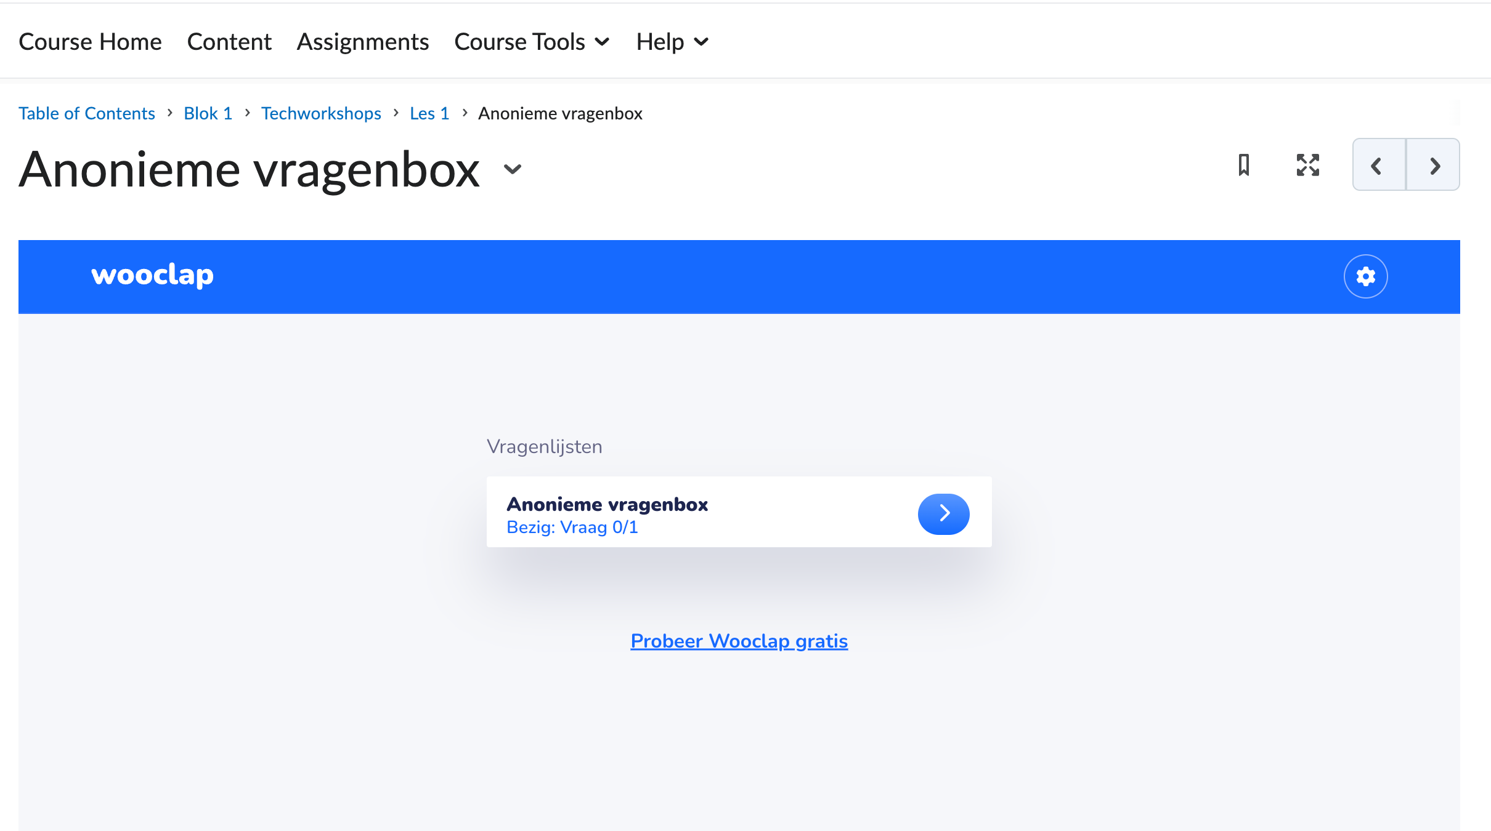
Vragenbox op DLO
Intro CV — Master AAI
3/25

Slide 4
Techreview week 5
Assessment on the technical aspect of your project up till that point. Outcomes A2, B1, B2, B3, C2
You hand in on DLO:
Relevant part of your project report (see study guide)
Link to your up-to-date Git repo (make it navigable)
Intro CV — Master AAI
4/25

Slide 5
Usage of Generative AI
AI Assessment Scale Level 3: AI mag gebruikt worden ter ondersteuning bij specifieke taken. Je wordt altijd
verplicht om AI-gegenereerde content kritisch te evalueren en indien nodig aan te passen (Zie Techworkshop
DLO).
Verantwoording van keuzes in eigen woorden om begrip aan te kunnen tonen — Gen AI niet toegestaan voor
schrijven uiteindelijke uitleg in rapport.
Intro CV — Master AAI
5/25

Slide 6
AI Assisted Coding
Intro CV — Master AAI
6/25

Slide 7
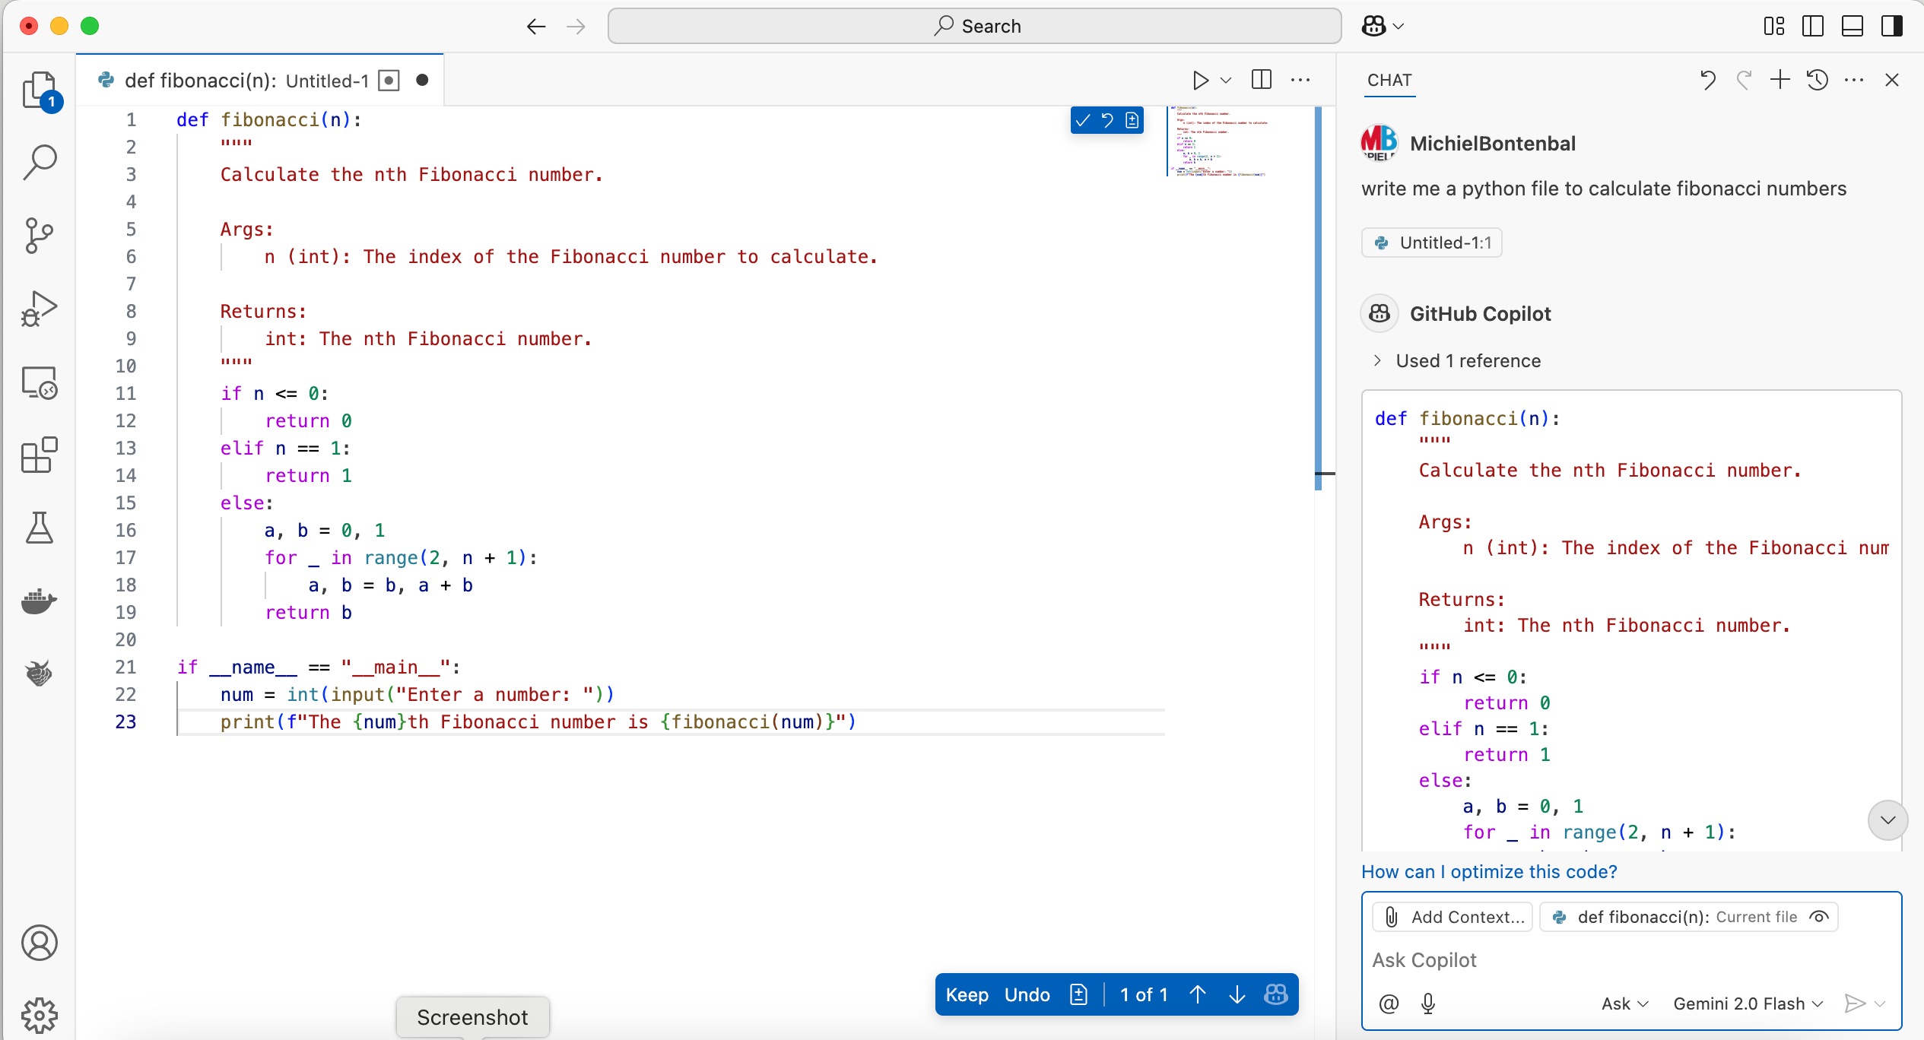
AI Assisted Coding in VS Code
Try a different model!
Intro CV — Master AAI
7/25

Slide 8

Do you get the right response? ‘Alignment’
Intro to Alignment: aligned.substack.com — blog by Jan Leike
Intro CV — Master AAI
8/25

Slide 9
Tips for Better Prompting
Write a better prompt
Understand the response
Think before you prompt
Be aware of mistakes
Try different prompts
Ask “Explain this code to me”
For beginners: add “write simple code…”
Decide if you want to use the code or try again
Intro CV — Master AAI
9/25

Slide 10
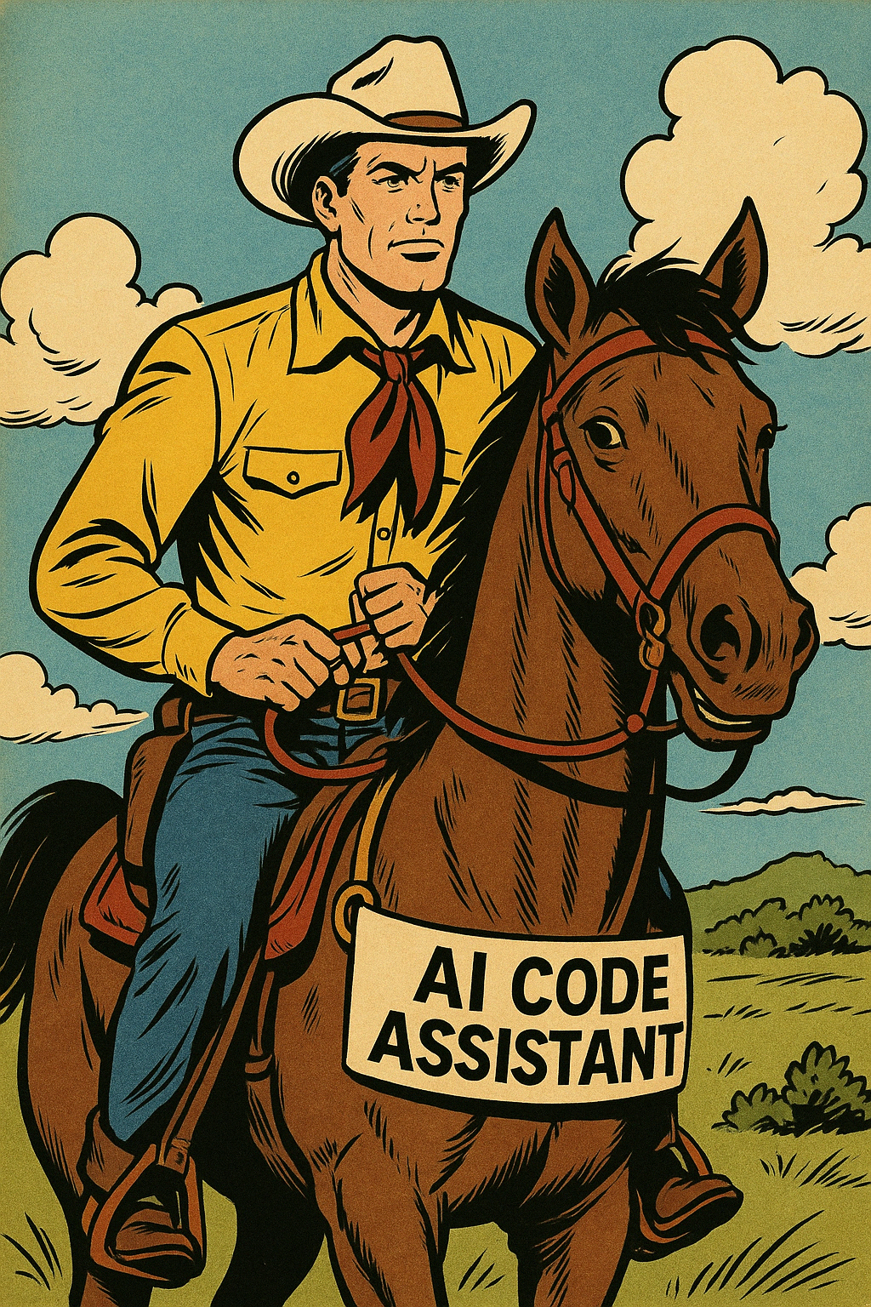
Human–AI Pair Programming
Work together with the AI — your new best buddy!
Intro CV — Master AAI
10/25

Slide 11
The AI can make mistakes, you have to guide it. Do not give up.
Active Learning is Better!
Writing code is more effective than reading code. Why?
You remember it better
You are more critical
You are more engaged
Intro CV — Master AAI
11/25

Slide 12
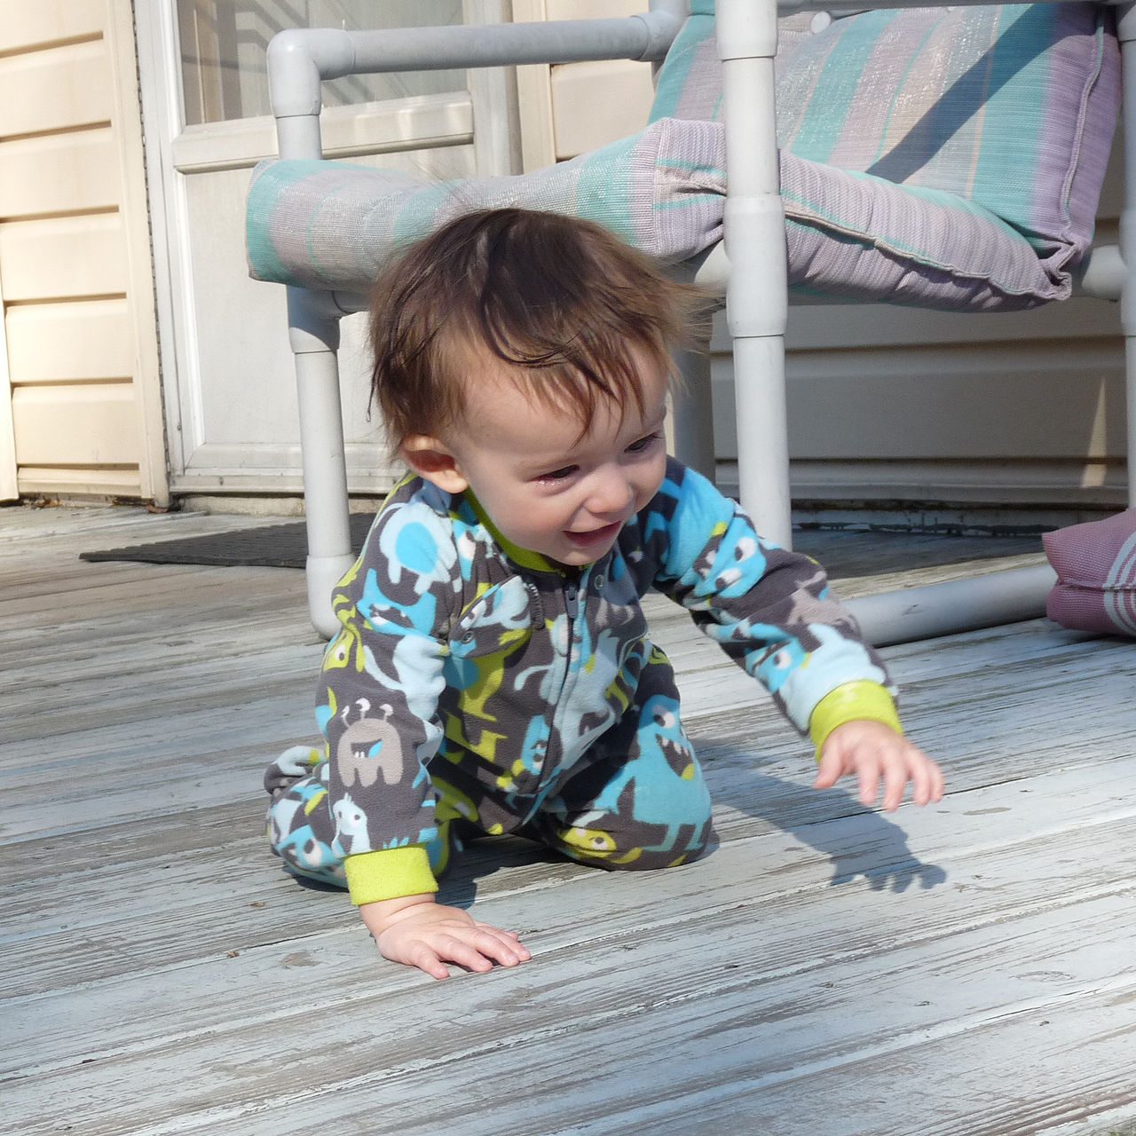
First Learn to Walk Before You Learn to Run
Intro CV — Master AAI
12/25

Slide 13
To Do / Exercises
Beginners
Experienced
Set up Copilot in VS Code
Compare: Claude.ai vs Copilot
Write code to calculate Fibonacci numbers
Try uploading an image to generate code
Create a front-end app with HTML/JS/CSS
(multiple files)
Intro CV — Master AAI
13/25

Slide 14
Data Exploration and Initial Analysis
Intro CV — Master AAI
14/25

Slide 15
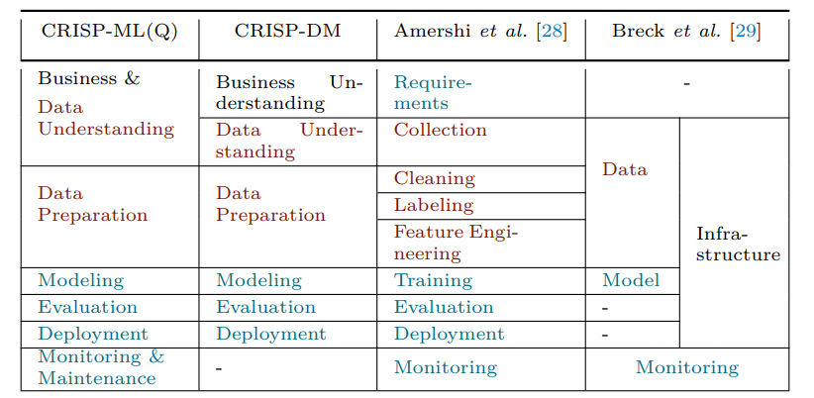
The Life-Cycle of MLOps: CRISP-ML(Q)
Intro CV — Master AAI
15/25

Slide 16
Choosing a Dataset
Always first concern yourself with Data Provenance
Source, collection process — might any of these be biased?
Then check Data Description
Size, contents, label quality
Where to find data?
Similar research, Kaggle, Hugging Face
Intro CV — Master AAI
16/25

Slide 17
Initial Exploration and Visualisation
Visualisation is an integral part of the data exploration phase
First look at different distributions: feature distributions, bivariate/multivariate exploration
Use histograms, boxplots, scatterplots, etc.
Also check technical details:
Target leaking
Image quality (resolution, brightness, cropping)
Label noise (incorrect ages, approximations)
Ask yourself: what makes this data predictive?
Intro CV — Master AAI
17/25

Slide 18
Data Bias When Using People
Algorithms do not care about your data at all
They just want to “win” by solving your problem
Winning = minimising your chosen loss function
By finding any pattern that might contribute to this
Representation is therefore unimaginably important
Intro CV — Master AAI
18/25

Slide 19
Feature Engineering
When you know your data, you can start engineering:
Face alignment / Cropping
Grayscaling
Over- and Undersampling of classes
Normalisation of the data
Regression vs Classification framing
Don’t just ask yourself what — but more importantly why.
Intro CV — Master AAI
19/25

Slide 20
Other Important Subjects
Data leakage / test data invalidation
Data splitting strategies (random, stratified, etc.)
Think already about evaluation metrics (MAE, RMSE, Fairness metrics)
Reproducibility of your workflow
The iterative nature of it (learning outcome B4)
Intro CV — Master AAI
20/25

Slide 21
Practicum ~45 min
Make groups of four students. Perform data analysis on the UTKFace dataset (see notebook on DLO).
Questions to answer:
Distribution: What distributions should be checked? Balanced or skewed?
Quality: Any errors, anomalies, missing data, unrealistic images?
Bias: What kind of biases are present? How would you fix them?
Image inspection: Lighting, angles, cropping, etc.
In the end we recap: surprises? concerns? take-aways for the project?
Intro CV — Master AAI
21/25

Slide 22
Faces
Intro CV — Master AAI
22/25

Slide 23
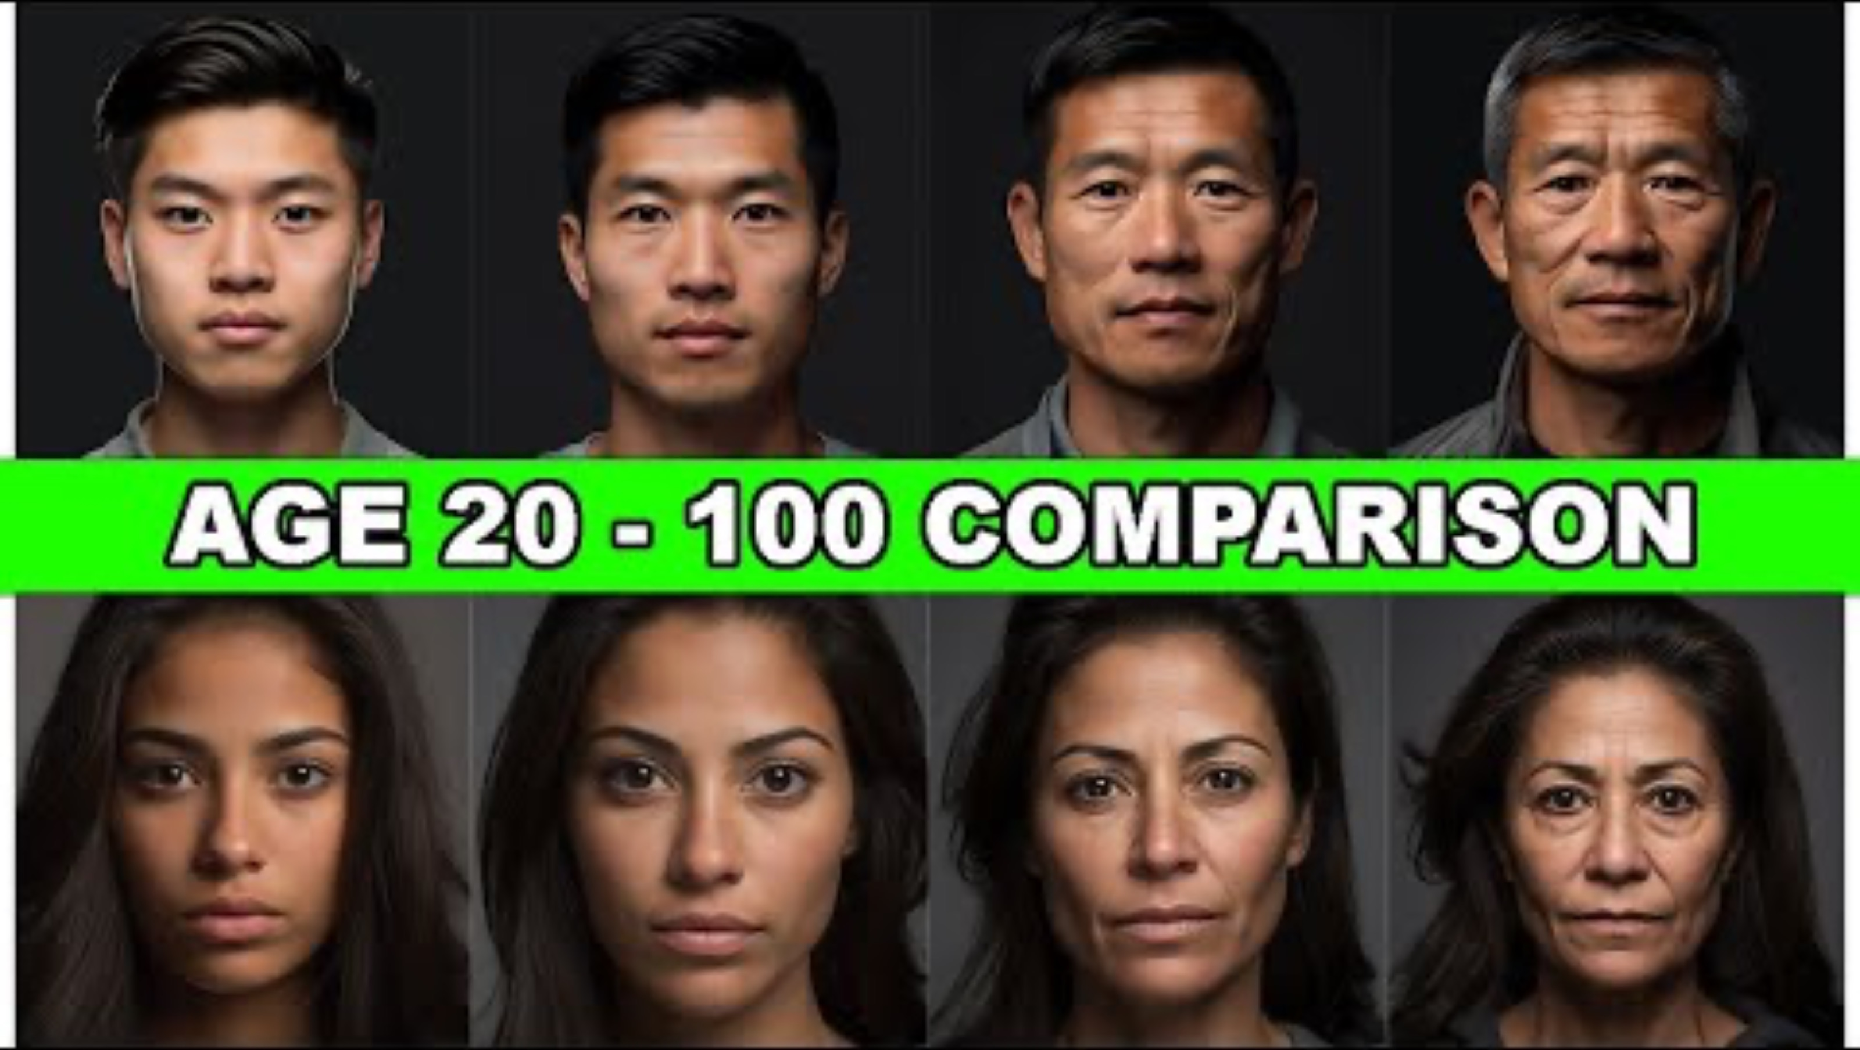
Faces — Time Lapse
Intro CV — Master AAI
23/25

Slide 24
Python Packages for Faces
No
Name
Description
Link
1
MTCNN
CNN model for face detection
pypi.org/project/mtcnn
2
Deepface
CNN model for age estimation
pypi.org/project/deepface
3
face-recognition
Face recognition library
pypi.org/project/face-recognition
Intro CV — Master AAI
24/25

Slide 25
Exercise Notebooks
Gezichtsdetectie_with_cnn.ipynb
Age_estimation_Deepface.ipynb
Intro CV — Master AAI
25/25

