Slide 1

Master Applied Artificial Intelligence Expert Workshops – Session 1 Lecturers Michiel Bontenbal, MSc Rick van Kersbergen, MSc

Slide 2
Agenda
Introduction Tech workshop curriculum
AI-assisted coding
Data Exploration and Initial Analysis: How To
Faces

Slide 3
Introduction Tech Workshop Curriculum

Slide 4
No. | Date | Lecturer | Subjects
1 | Thu 4 Sep | Rick + Michiel | AI assisted coding, Data exploration, Faces
2 | Thu 11 Sep | Michiel | Object Detection, Video, CNN advanced
3 | Thu 18 Sep | Rick | Evaluations, Build an app
4 | Thu 25 Sep | Michiel | Embeddings (SSL, CLIP, Search) & preparation tech reviews
5 | Thu 2 Oct | Rick + Michiel | Tech reviews
6 | Thu 9 Oct | Rick | ML Ops + onderwerpen obv vragen studenten
7 | Thu 16 Oct | Michiel | Vision Language Models (VLM’s) + onderwerpen obv vragen studenten

Slide 5
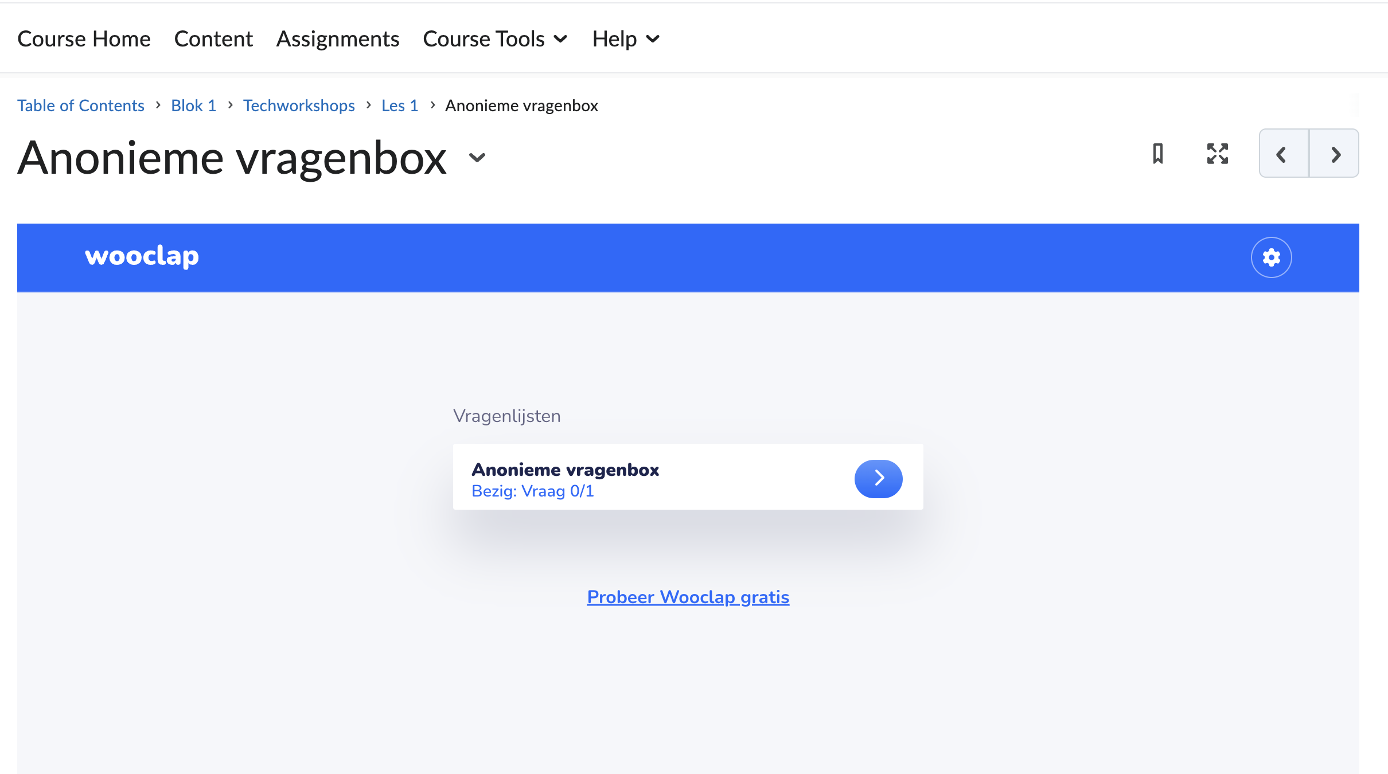
Vragenbox op DLO

Slide 6
Techreview
Assessment on the technical aspect of your project up till that point. Outcomes A2, B1, B2, B3, C2
You hand in on the DLO:
Relevant part of your project report (see study guide)
Link to your up-to-date Git repo (make it navigable)
See it as a feedbackmoment on your progress, not as a test

Slide 7
Usage of Generative AI within this module
AI Assessment Scale Level 3: AI mag gebruikt worden ter ondersteuning bij specifieke taken. Je wordt altijd verplicht om AI-gegenereerde content kritisch te evalueren en indien nodig aan te passen (Zie Techworkshop DLO)
Verantwoording van keuzes in eigen woorden om begrip aan te kunnen tonen – Gen AI niet toegestaan voor schrijven uiteindelijke uitleg in rapport.

Slide 8
AI assisted Coding

Slide 9
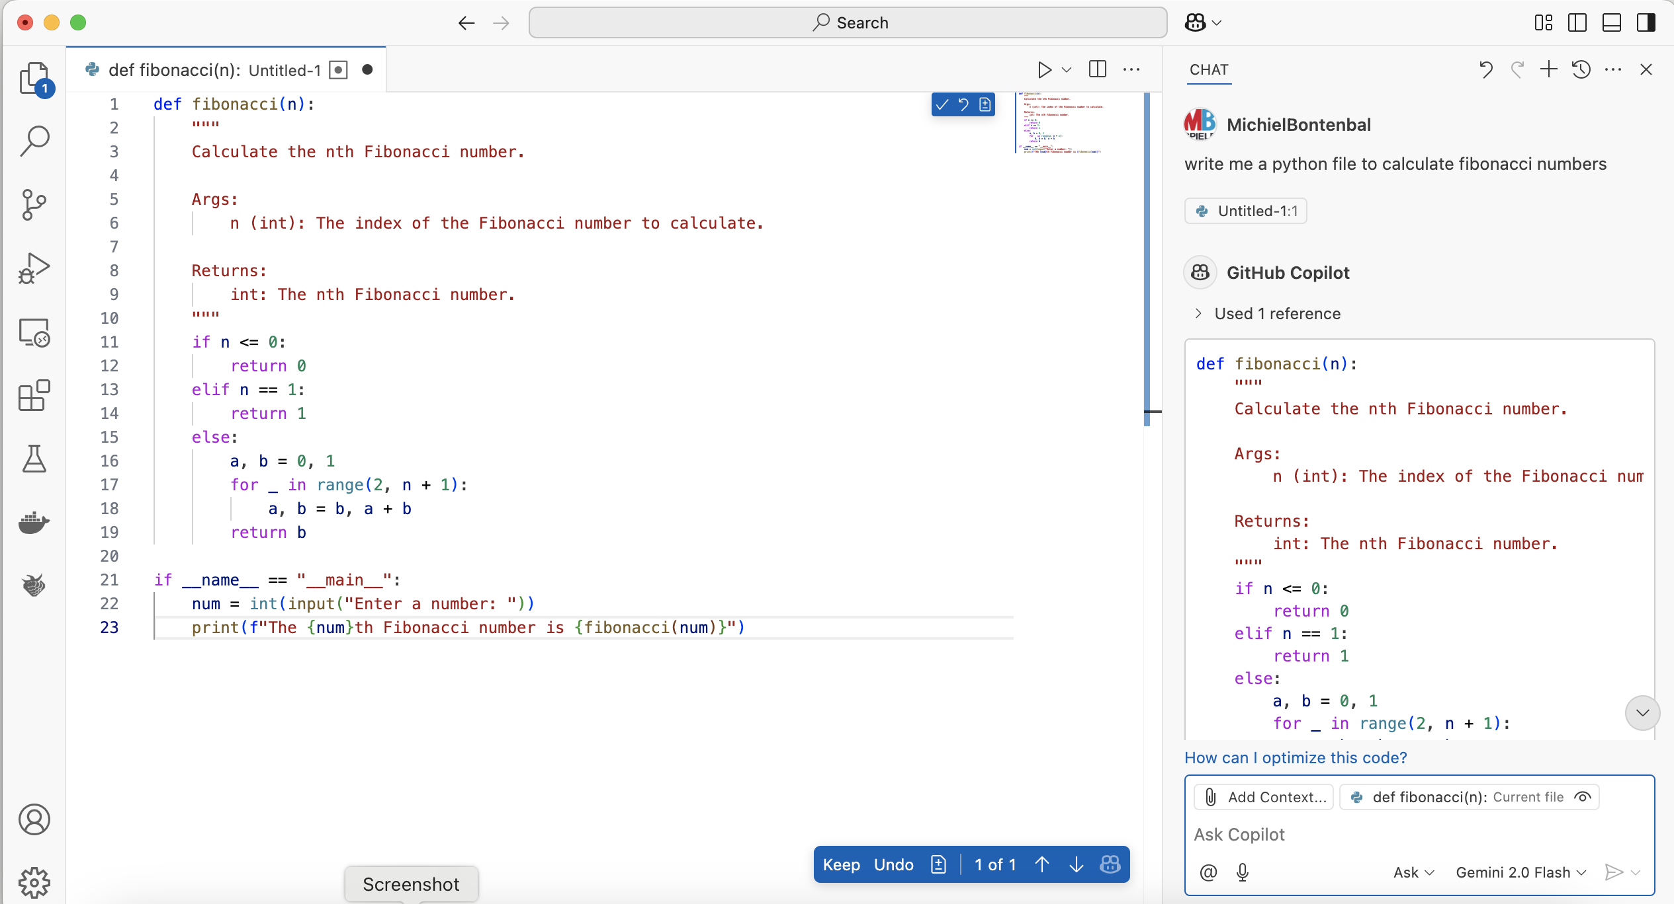
AI Assisted Coding in VS Code
<-- Try a different model!

Slide 10


Do you get the right response? ‘Alignment’
LLM
Prompt
Response
Intro to Alignment: https://aligned.substack.com/p/what-is-alignment, blog by Jan Leike

Slide 11

Tips for better prompting in AI coding
LLM
Prompt
Response
Write a better prompt
Think before you prompt
Try different prompts
For beginnners, you can add ‘write simple code…’
Understand the response
Be aware of mistakes.
Ask questions like “Explain this code to me”
Decide if you want to use the code or start again with a differerent prompt.
iterate

Slide 12
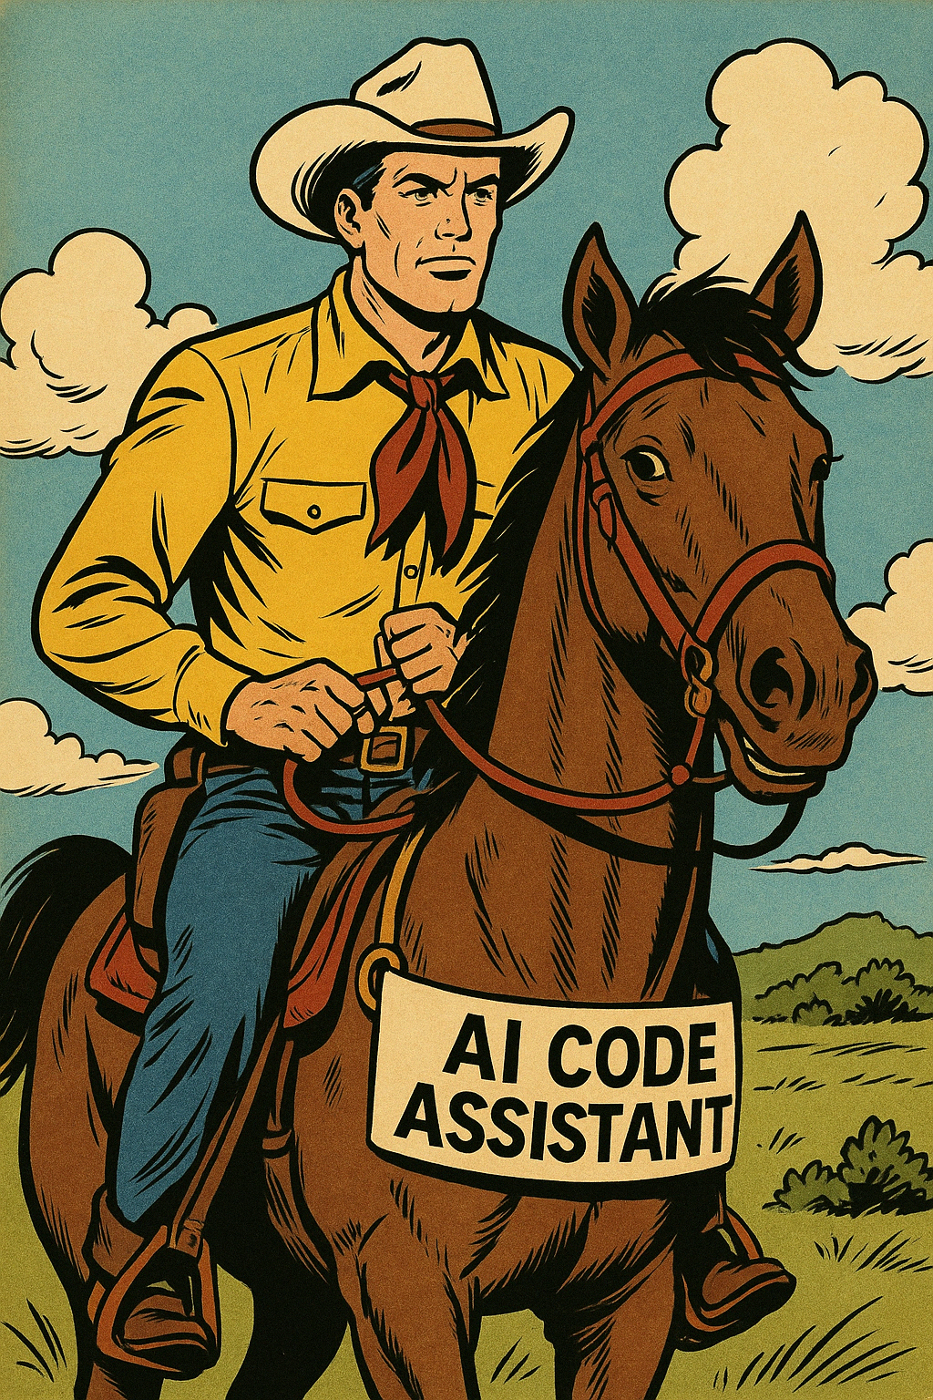
Human – AI
pair programming
Work together with the AI, your new best buddy!
The AI can make mistakes, you have to guide it. Do not give up.

Slide 13
But remember active learning is better!
Eg. writing code is more effective than reading code. Why?
You remember it better
You are more critical
You are more engaged

Slide 14
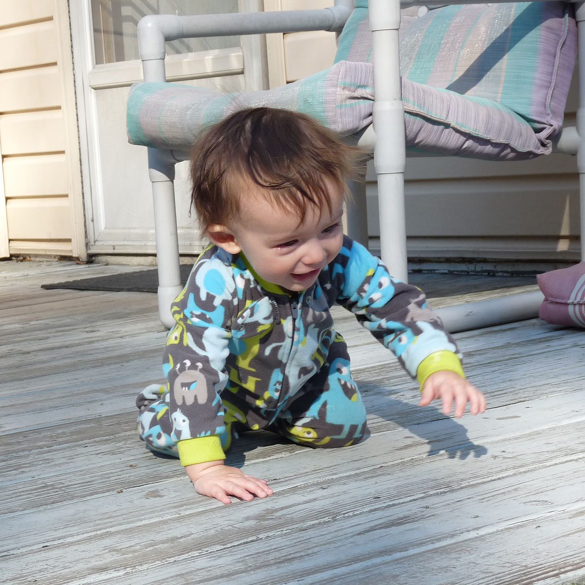

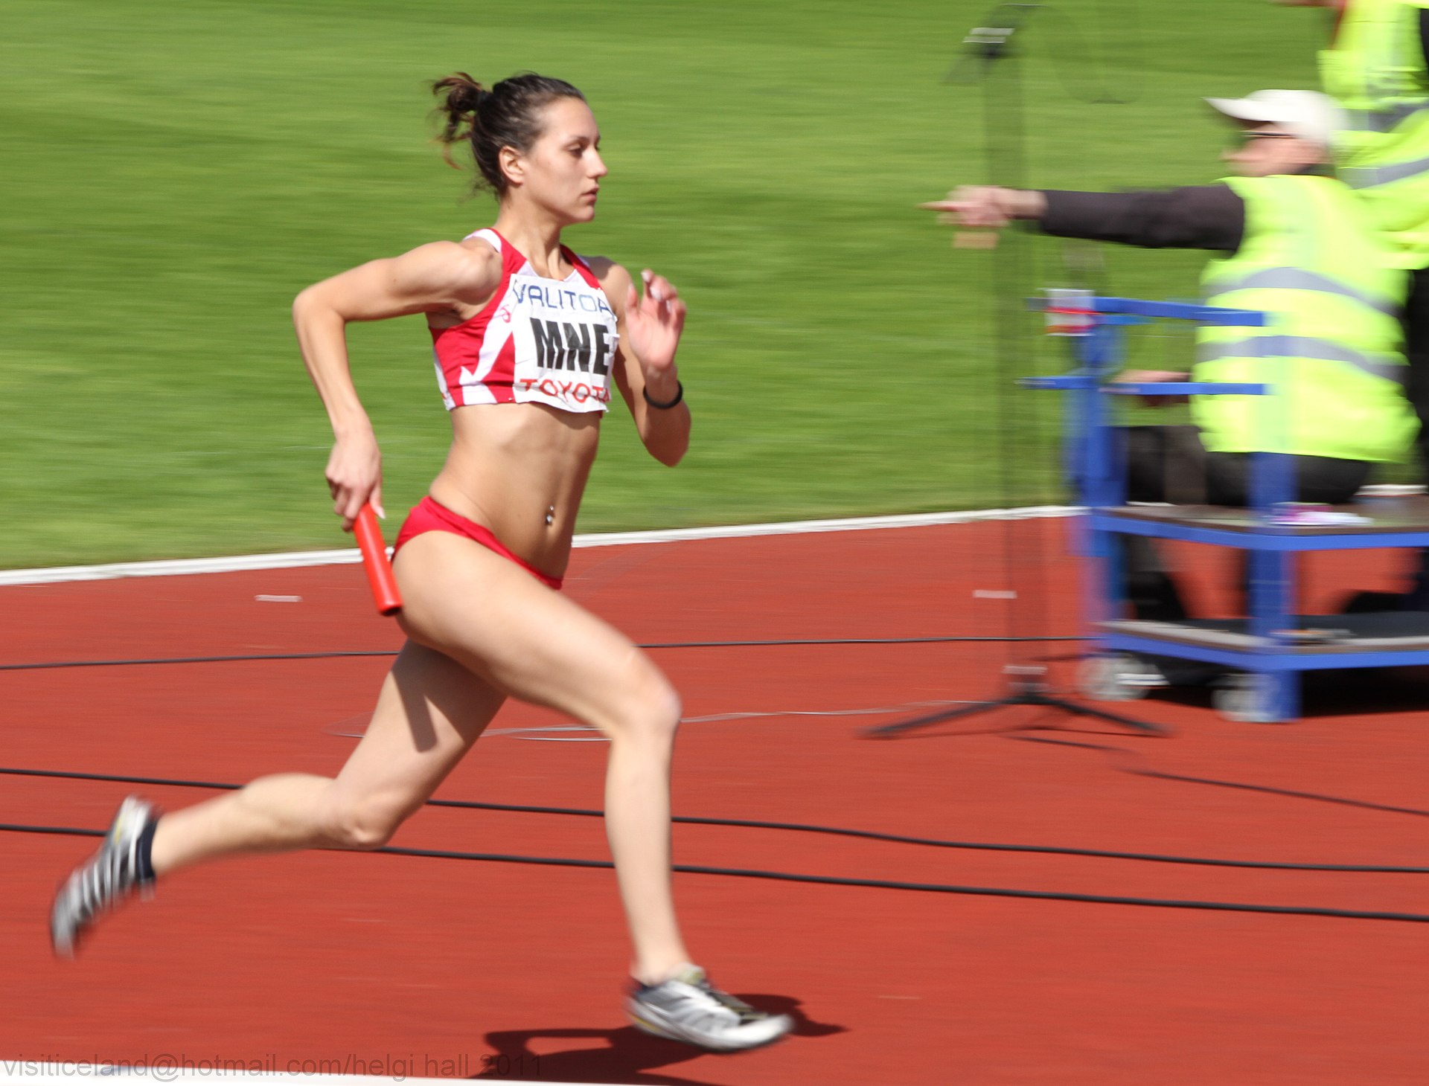
First learn to walk before you learn to run!

Slide 15
To do / exercises
Beginners:
Set up Copilot in VS Code (ask your favorite AI to help you out)
Write code to calculate fibonacci numbers
Experienced
Compare code from:
Claude.ai vs Copilot
Try uploading an image to create code
Try to create a front-end app with HTML / JS / CSS (= multiple files)

Slide 16
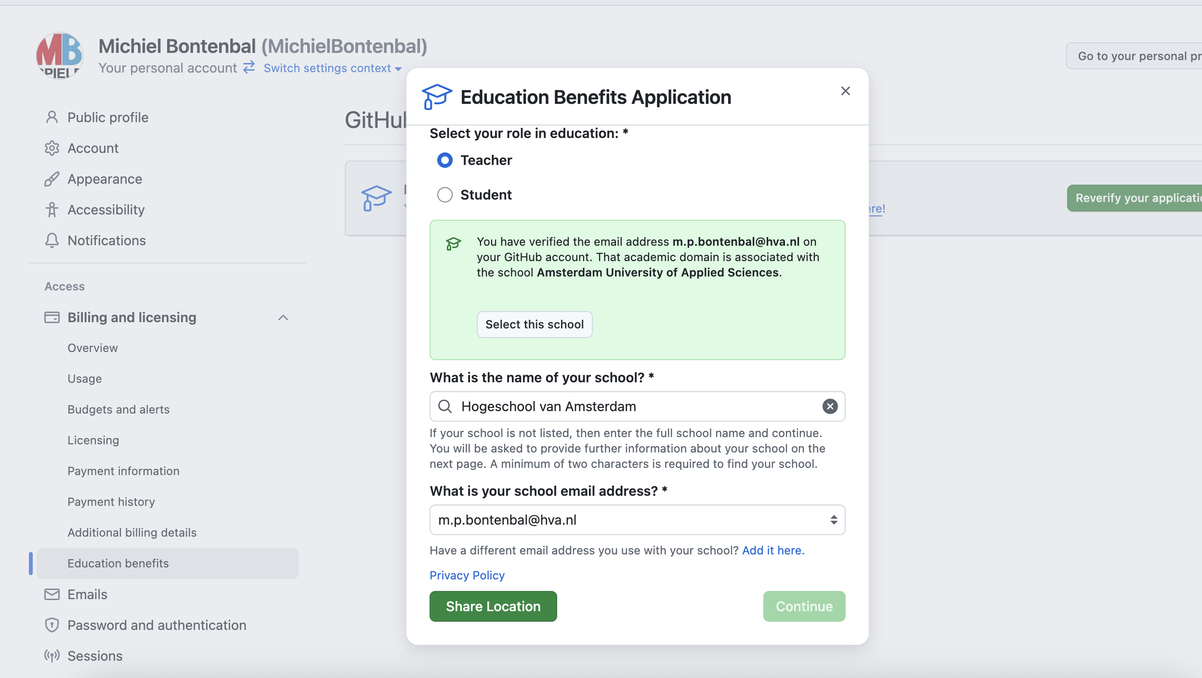

Slide 17
Data Exploration and Initial Analysis
A2
B1
D1

Slide 18
Je stelt voor een AI-oplossing juridische, ethische, organisatorische, functionele en technische requirements op.
A2
Je verkent en prepareert een dataset voor het trainen en testen van een AI-model en kan de voor- en nadelen van het gebruik van een bestaande dataset onderbouwen, rekening houdend met technische en ethische randvoorwaarden.
B1
Je verzamelt en verwerkt actief feedback over de eigen kennis, vaardigheden en ontwikkeling en laat zien deze feedback te kunnen gebruiken om je werk te verbeteren.
D1
Notes:
Leg uit dat we in deze sessie drie leeruitkomsten behandelen. Practicum als bewijsmateriaal.

Slide 19
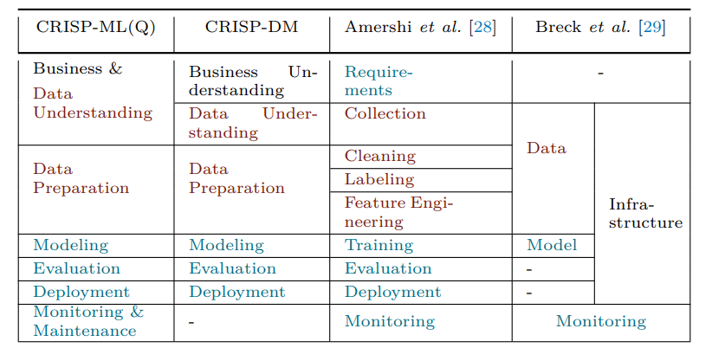
The life-cycle of MLOps: CRISPML(Q)
Notes:
We hanteren CRISPML(Q).
Zie hoe business & data understanding samenvallen. Leg uit waarom (requirements naar data en andersom)
Nadruk op goede exploration -> minder problemen later
Geef alvast kleine hint dat het niet alleen gaat om technische accuracy.

Slide 20
Choosing a dataset
Always first concern yourself with Data Provenance
Source, collection process, might any of these be biased?
Then, check Data Description
Size, Contents, Label quality (especially target feature for age estimation!)
Where?
Similar Research, Kaggle, Huggingface
Notes:
Data Provenance -> herkomst van data. Bron, hoe verzameld, eventuele biases al van tevoren
Data Description -> Is er een beschrijving? Grootte, inhoud, labeling format (continues vs age groups)
Leg uit waar ze wellicht kunnen beginnen met zoeken

Slide 21
Initial Exploration and Visualisation
Visualisation is an integral part of the data exploration phase!
You'll probably first want to look at different distributions
Feature distributions, Bivariate/Multivariate exploration
Use histograms, boxplots, scatterplots, etc.
Also check more technical details
Target leaking
image quality (resolution, brightness, cropping issues)
Label noise (incorrect ages, approximations)
Ask yourself what makes this data predictive?
Notes:
Benadruk dat visualiseren van data super belangrijk is
Leg distributies uit, waarom en hoe
Leg technische details die moeten worden gecheckt uit
Hint naar volgende slide met de vraag

Slide 22
Data bias when using people
Algorithms do not care about your data at all!
They just want to 'win' by solving your problem
Winning in this case is minimizing your chosen loss function
By finding any pattern that might contribute to this
Representation is therefore unimaginably important
Notes:
Leg uit dat het enige wat algoritmes doen is een foutmaat minimaliseren met welk patroon dan ook.

Slide 23
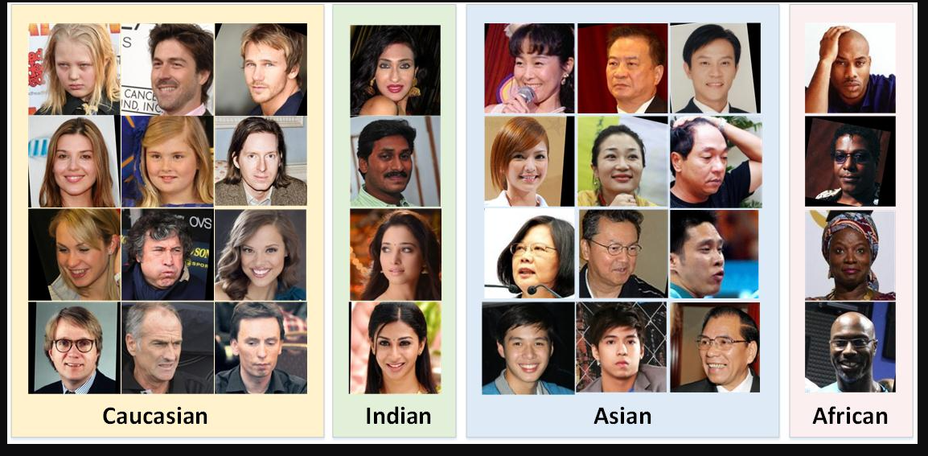
Notes:
Geef voorbeeld adhv afbeelding
Ethniciteit? Welke vragen moet je stellen
Overige mogelijke klassen?

Slide 24
Feature Engineering
When you know your data, you can start engineering
Possible engineering steps:
Face alignment / Cropping
Grayscaling
Over- and Undersampling of classes
Normalisation of the data for simpler representations
Regression vs Classification framing
Don't just ask yourself what, but more importantly why
Notes:
Leg uit wat mogelijke feature engineering stappen zijn

Slide 25
Other important subjects:
Data leakage / test data invalidation (I can't stress you enough about this)
Data splitting strategies (random, stratified, etc)
Think already about evaluation metrics (MAE, RMSE, Fairness metrics)
Reproducability of your workflow
And the iterative nature of it (learning outcome B4)
Notes:
Leg nadruk op deze onderwerpen

Slide 26
Practicum ~ 45 min
Make groups of four students (avoid your project members). As a group, perform data analysis on the UTKFace dataset (see notebook on DLO).
In general, answer: what can we say about this data, and which feature engineering steps might be necessary? Use data visualisations!
Some questions to get you started:
Distribution: What distributions should be checked? Are they balanced or skewed?
Quality: Any errors, anomalies, missing data, unrealistic images, etc
Bias: What kind of biases are present? How would you fix these?
Image inspection: What factors might mess with prediction? Lighting, angles, cropping etc
In the end we recap:
Surprises? Concerns? Take-aways for the project?

Slide 27
Faces

Slide 28
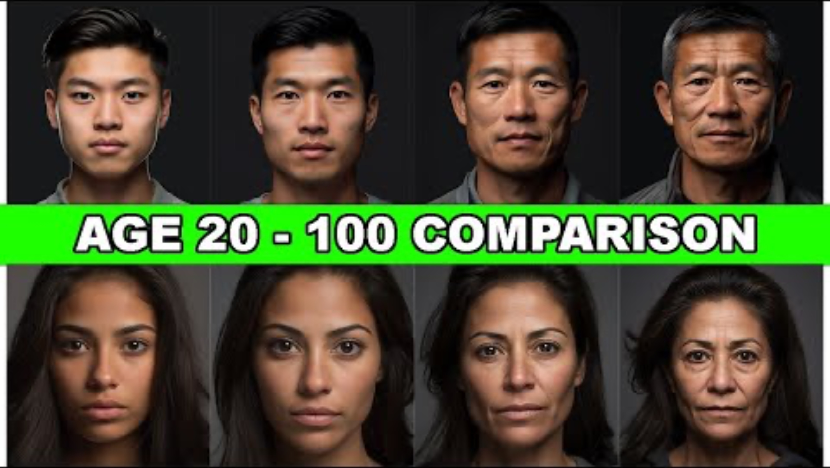

Slide 29
Python packages
In Python it is relatively easy to create a package / library.
Below three examples for faces.
No | Name | Description | Link
1 | MTCNN | A CNN model for face detection | https://pypi.org/project/mtcnn/
2 | Deepface | A CNN model for age estimation | https://pypi.org/project/deepface/
3 | Face-recognition |  | https://pypi.org/project/face-recognition/

Slide 30
Exercise notebooks
Gezichtsdetectie_with_cnn.ipynb
Age_estimation_Deepface.ipynb

