Slide 1
Classify Audio with CLAP

Slide 2

How can computers find the relationship between an audio sample and a given label?
‘Claxon’
‘vector embeddings’
Read more: https://www.geeksforgeeks.org/what-are-embeddings-in-machine-learning/

Slide 3

How can computers find the relationship between an audio sample and a given label?
‘Claxon’
‘vector embeddings’
Read more: https://www.geeksforgeeks.org/what-are-embeddings-in-machine-learning/

Slide 4
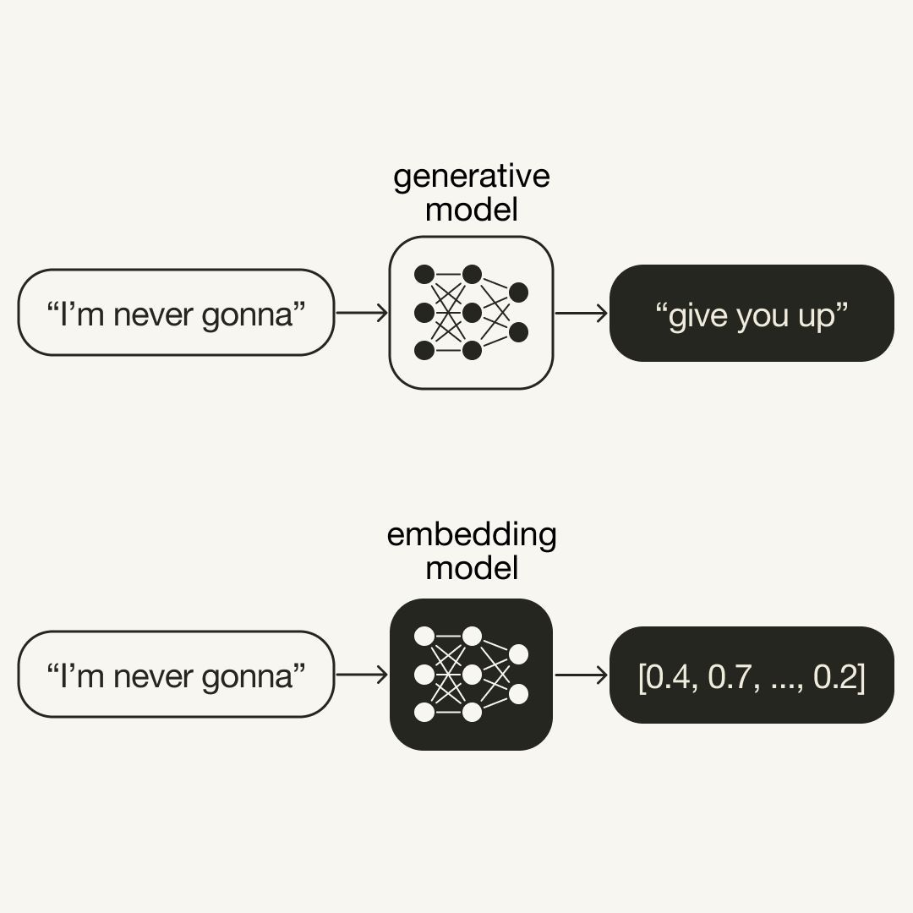
With CLAP we turn audio and text into vectors with an ‘embedding model’. These embeddings capture the meaning.
[0.5, 0.3, …, 0.7]
Compare vectors
‘Claxon’
[0.4, 0.3, …, 0.6]

Slide 5
In ‘vector space’ audio samples that have similar meaning are close.
Two claxons
Two gunshots
We can calculate the similarity in vector space.
(these vectors have many dimensions)

Slide 6
In ‘vector space’ texts and images
with similar meaning are close.
‘Claxon’
‘gun shot’
We can calculate the similarity in vector space.
(these vectors have many dimensions)

Slide 7
We use a model called CLAP with text-audio pairs Contrastive Language-Audio Pretraining
Trained on 630.000 pairs of audio, text
Published in 2022 by LAION, an EU research network
Inspired on OpenAI’s CLIP model for images, text
Sources:
CLAP: https://github.com/LAION-AI/CLAP
Paper: https://arxiv.org/abs/2211.06687
https://huggingface.co/docs/transformers/model_doc/clap
’Claxon’
Text
encoder
CLAP
Audio encoder

