Slide 1

Project Mathematical Engineering
Taoufik Benyahia, Michiel De Koninck
Faculty of Engineering Science
Mathematical Engineering 27/03/2019

Slide 2

Pear Project: Contents
1. Mathematical Problem
2. Description of FE method
3. Construction of linear system
4. Demonstration of result for linear system
5. Solving of nonlinear system
6. Demonstration of results of nonlinear problem

Slide 3
1. Mathematical Problem
Challenge: Simulate and predict internal gas concentrations/ distributions
Study the effect of controlled storage conditions on local oxygen and carbon dioxide concentrations
2

Slide 4
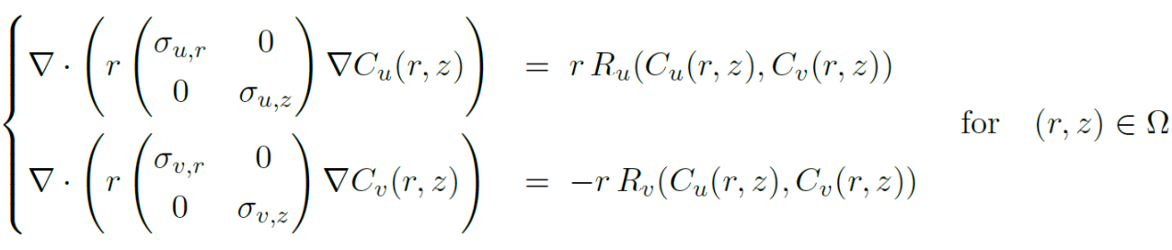
1. Mathematical Problem: Model
Model used for system:
Non-linear reaction-diffusion equations: in stationary regime
On two-dimensional bounded spatial domain
u: oxygen v:carbon-dioxide

Slide 5
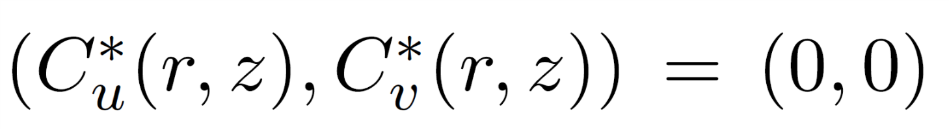
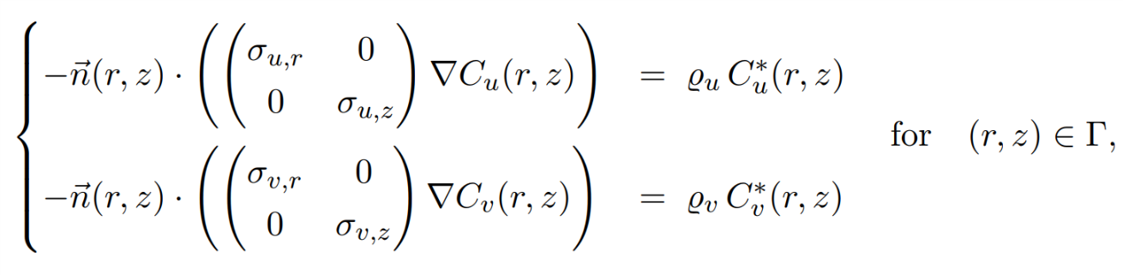

1. Mathematical Problem: Boundary Conditions
Boundary Conditions:
Internal Boundary:
External Boundary:
Ambient concentrations

Slide 6
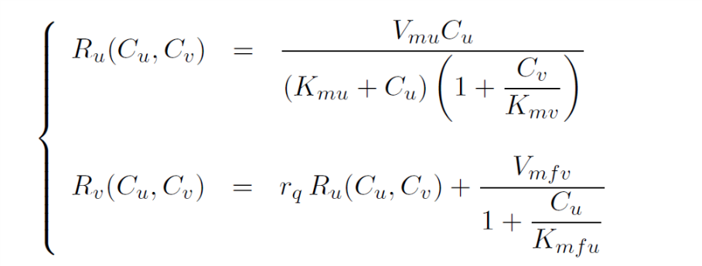
1. Mathematical Problem: Respiration kinetics
Respiration Kinetics:
Describe the evolution of the system through gas exchange with the environment

Slide 7
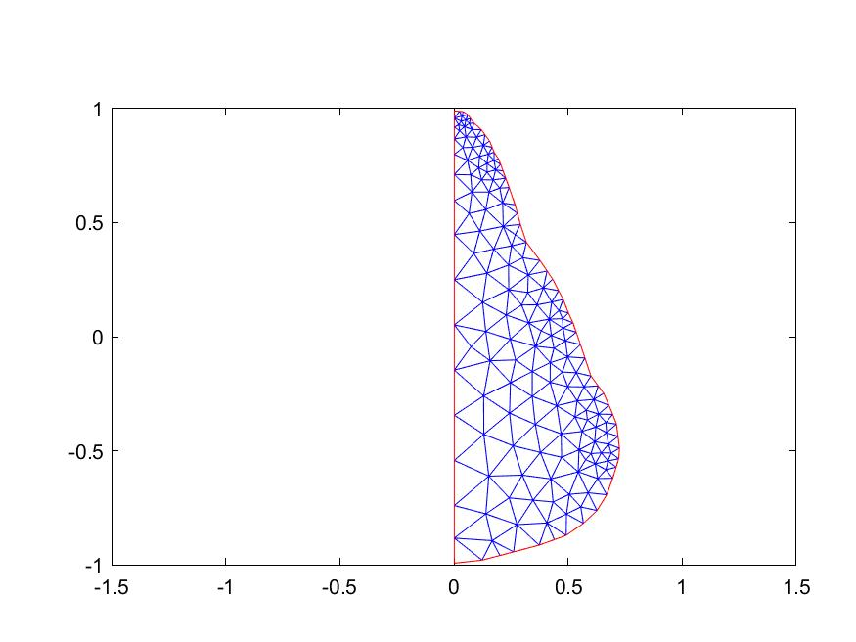



2. Description of FE-method
Domain is split up into triangles consisting of M nodes
We want to approximate the solutions at the nodes of our mesh by use of linear basisfunctions
In every triangle we use three basisfunctions to represent our solution.
On every edge we use two basisfunctions to represent our solution.

Slide 8
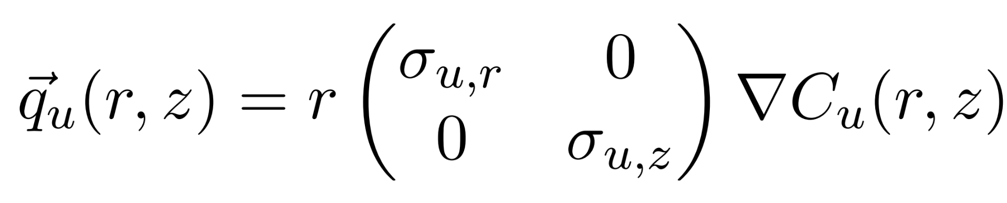
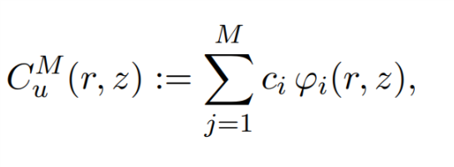
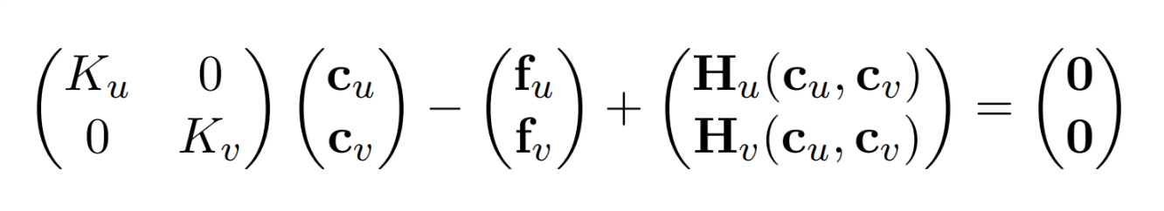
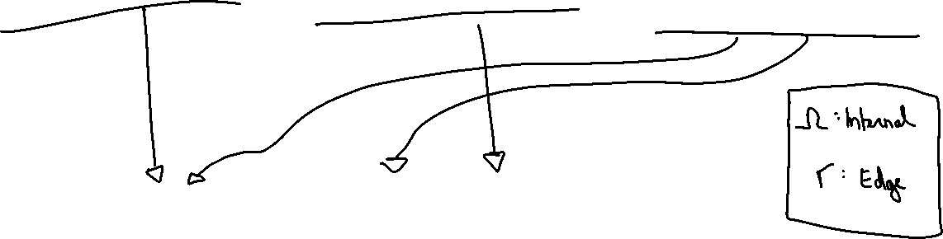
2. Description of FE-method
We solve these integrals by looping over all triangles/edges. The integral becomes a sum of integrals.

Slide 9
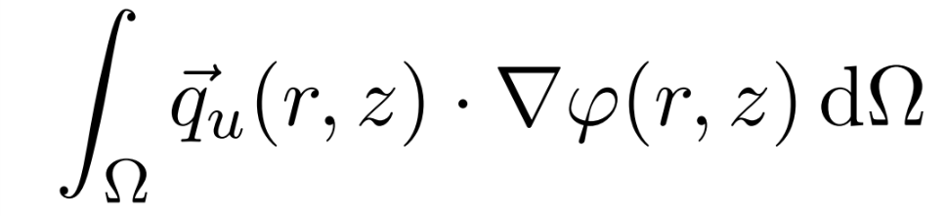
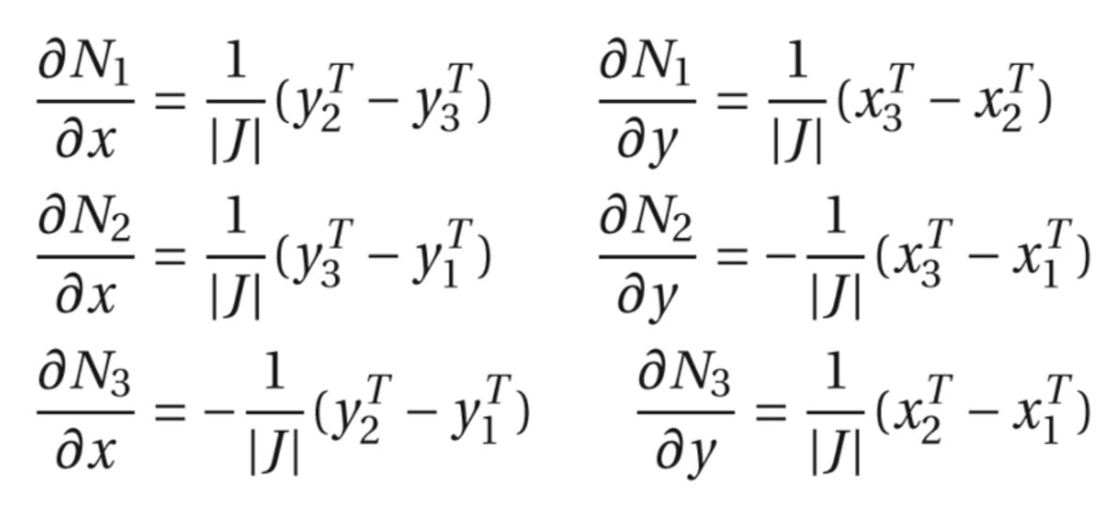
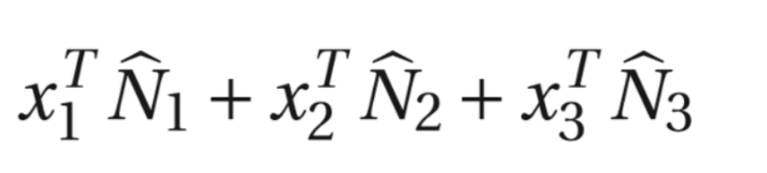
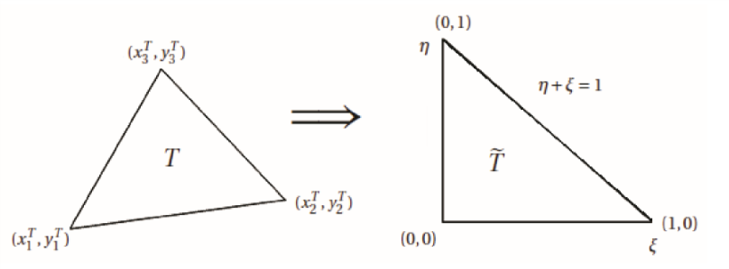
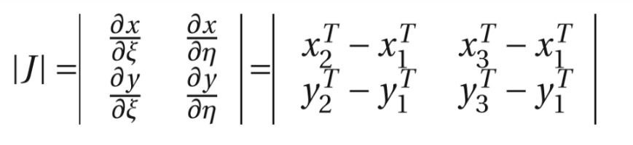
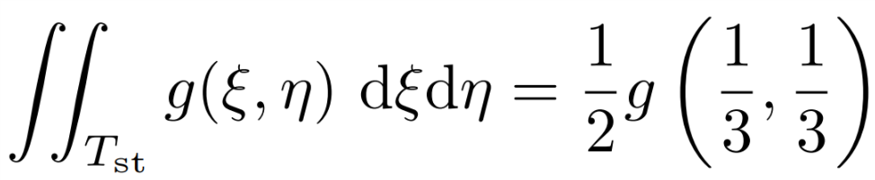
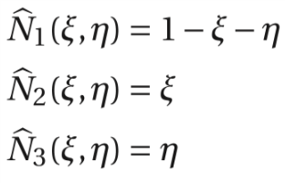
2. Description of FE-method
For example start from:
Each triangle is mapped onto standard triangle: with
With derivatives of basisfunctions in each triangle with:
Gaussian quadrature of degree 1

Slide 10
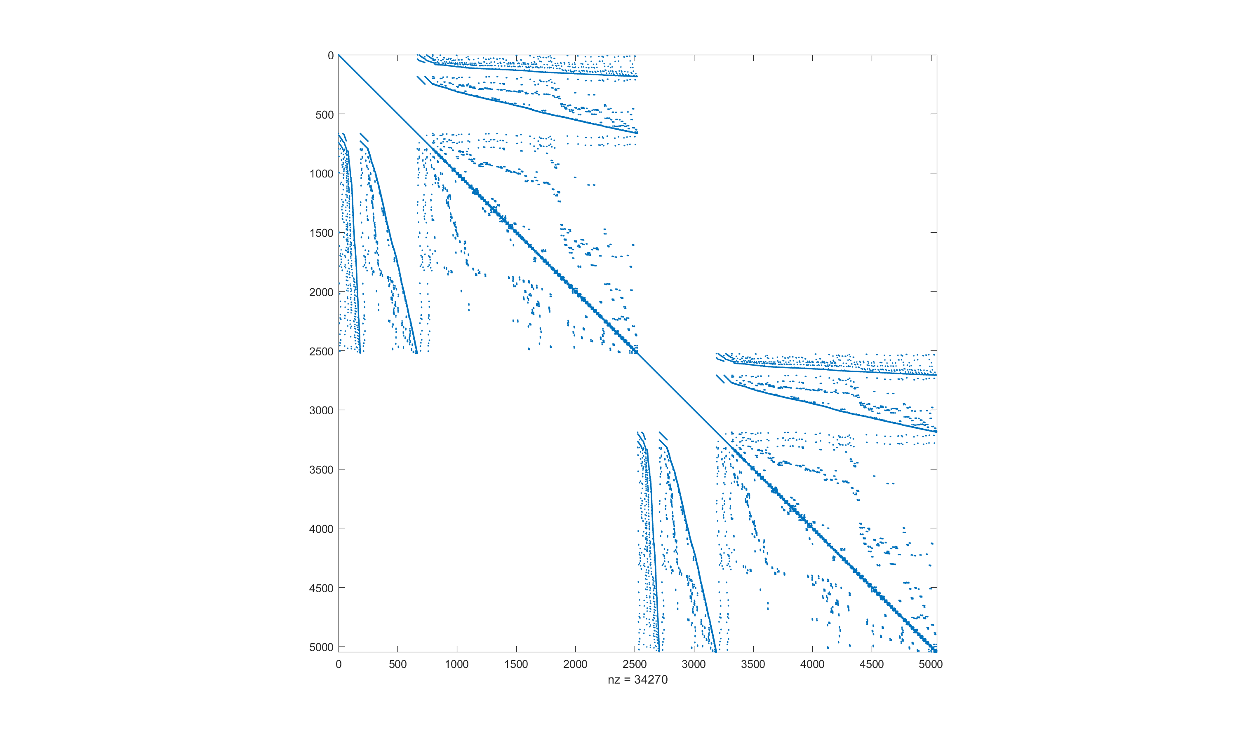
3. Construction of Linear System
Using this technique we fill the matrix of the linear system (K): -> 9 adjustments (combinations of 3 nodes) are made to Ku and Kv for every triangle handled.
Sparsity pattern is obtained:

Slide 11
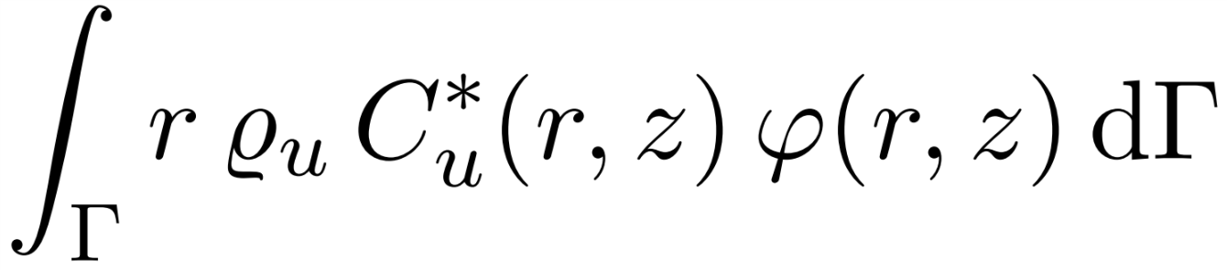
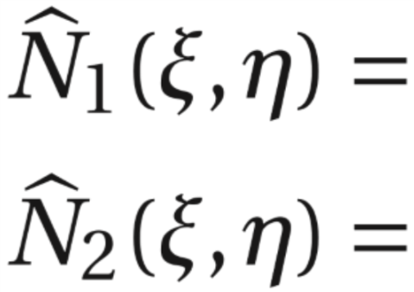
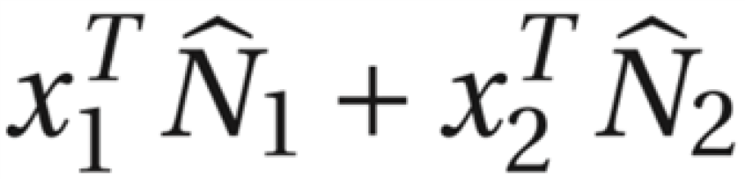

3. Construction of Linear System
Integral over edge:
Map edge onto standard line
Two basisfunctions instead of three:
Integral for one edge translates to:
This integral can be computed (mupad)
For every edge: two adjustments are made to Fu and Fv as well as to Ku and Kv
If we now calculate K*c = F (ignore H) then we find: c= [C_uamb…C_vamb…] (steady state)

Slide 12
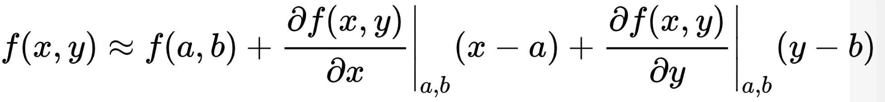
3. Construction of Linear System: Linearization
Goal: find initial values (c_u0,c_v0) to start newton iteration
Linearize H_u around C_uamb and H_v around C_vamb
This comes down to linearizing R_u and R_v -> Taylor:
This leads to:
Terms in function of C_u
Terms in function of C_v
Constant terms
Contribution to the K-matrix and f-vector

Slide 13
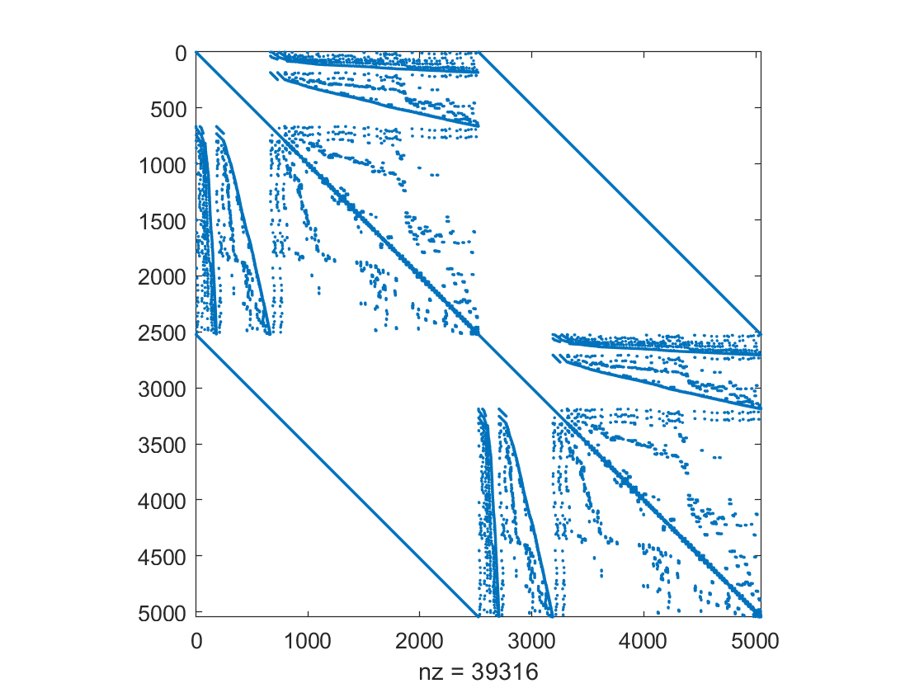
3. Construction of Linear System: Linearisation
The linearization causes changes to the diagonal elements of the blocks of the K-matrix
Using this we can solve the linear system: c0 = K\f

Slide 14
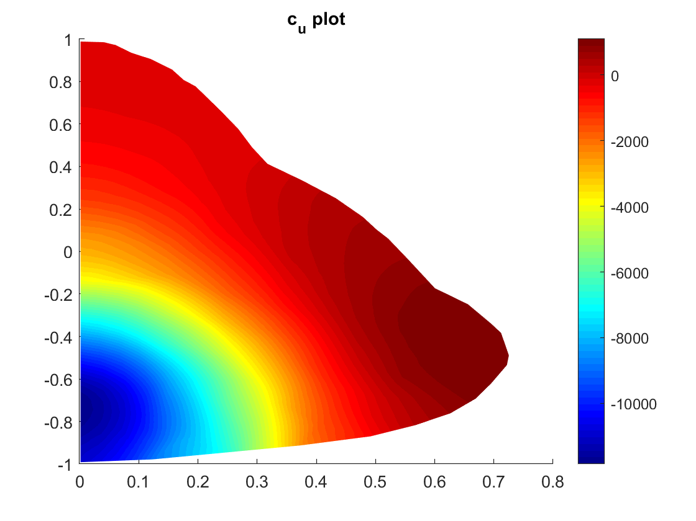
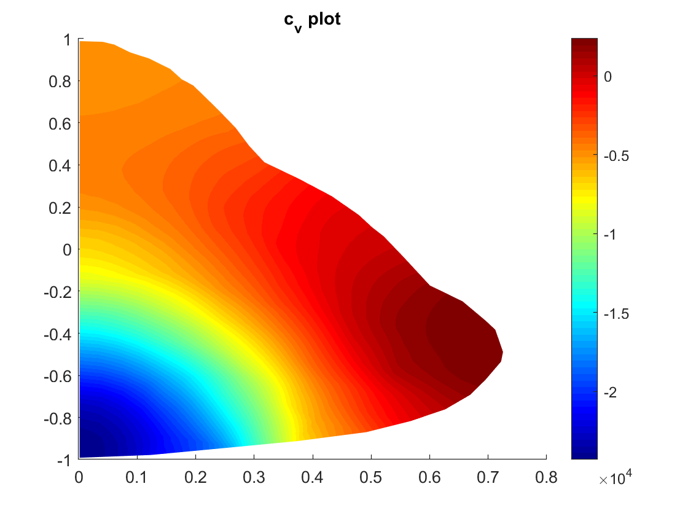
4. Demonstration of Result for Linear System
We got the initial concentration but the values are far from what is to be expected in the pear given the environment

Slide 15


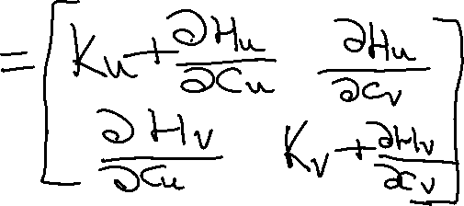







5. Solving Nonlinear System
We use the Newton-Raphson Iterative Algorithm

Slide 16
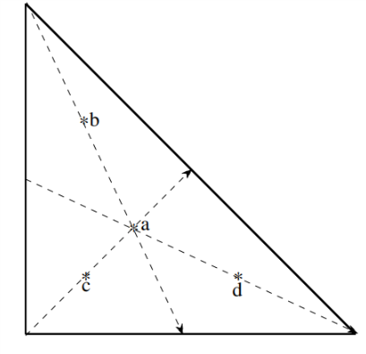

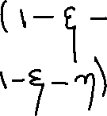


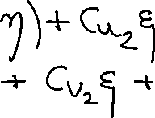









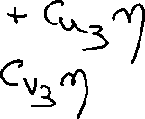









5. Solving Nonlinear System
Used Gaussian (degree 3 precision) quadrature formula to approximate integral
= known values in vertices from previous iteration

Slide 17
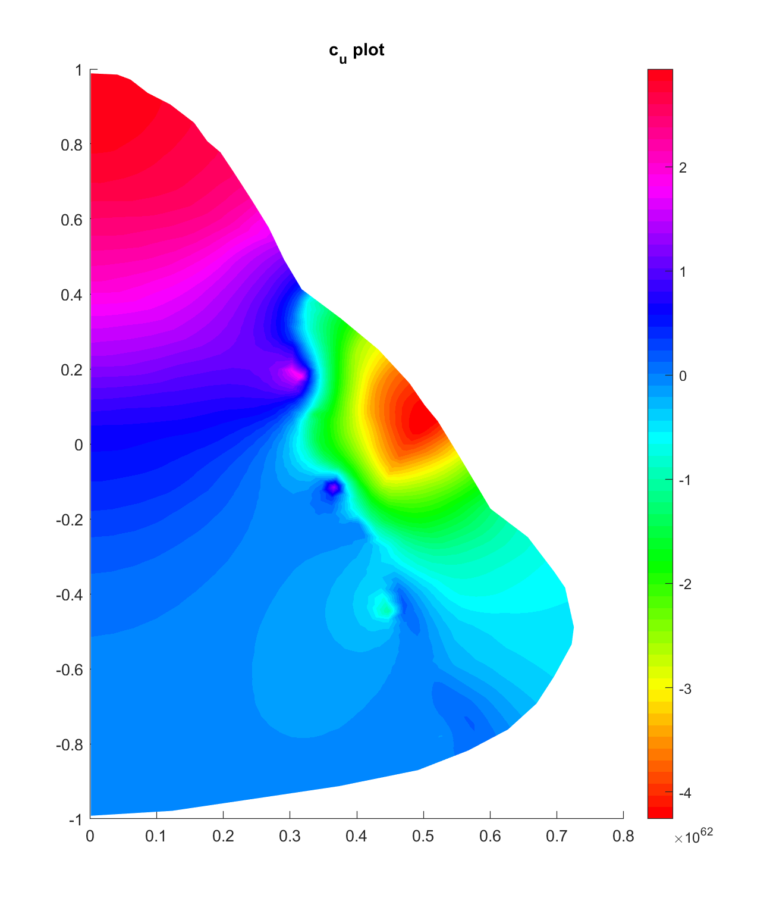
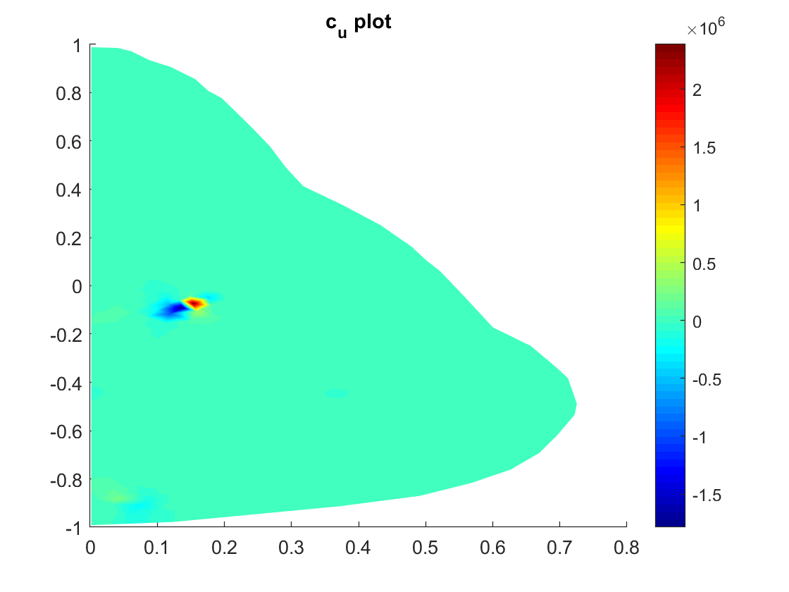
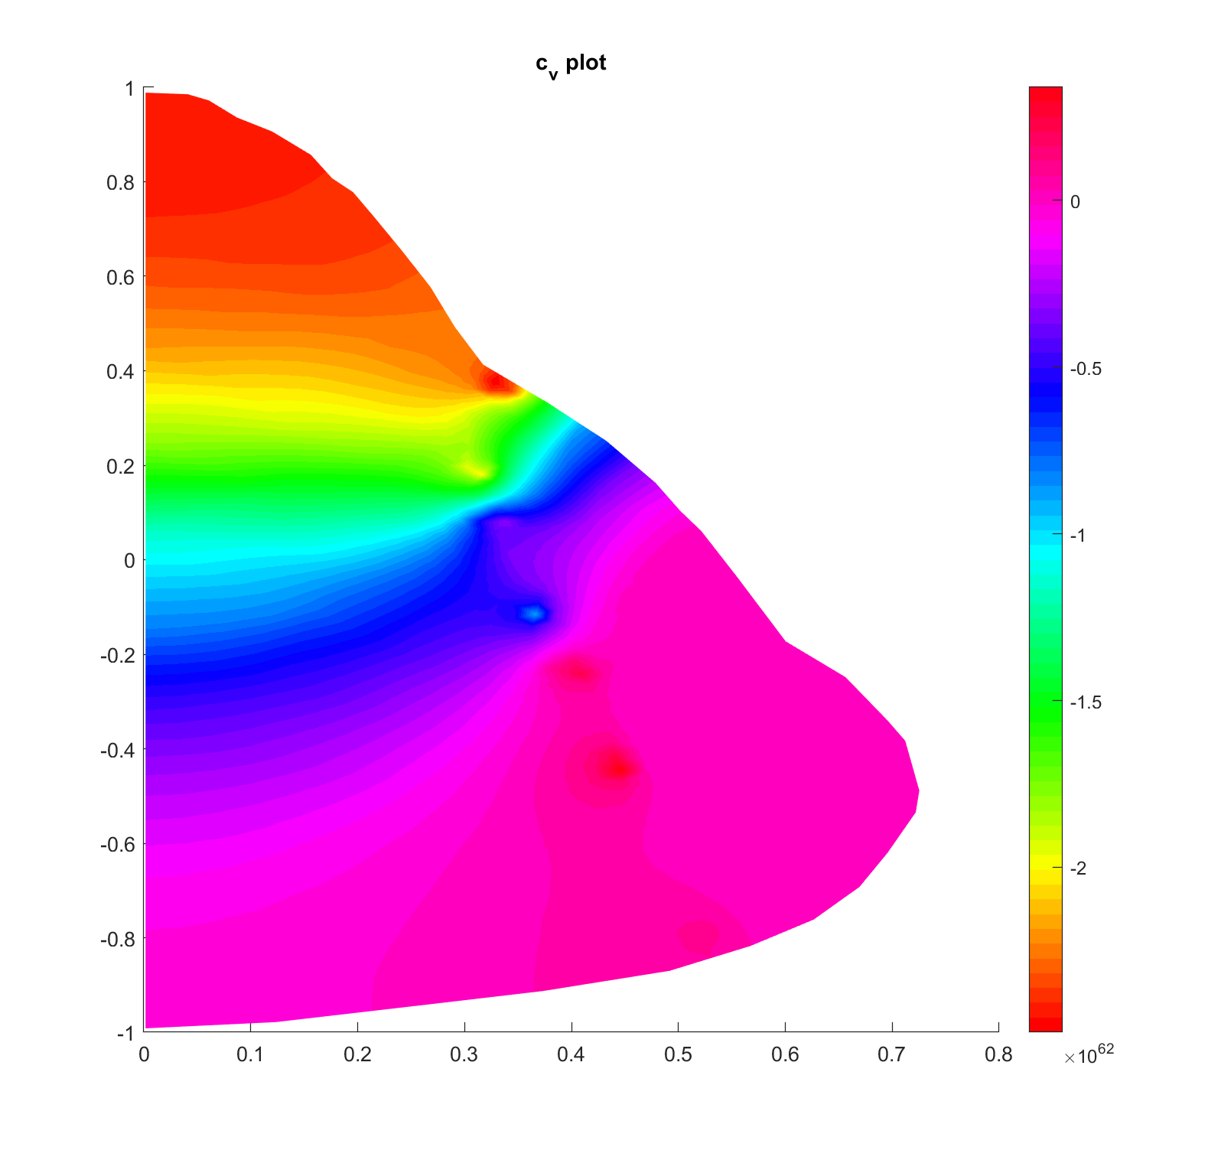
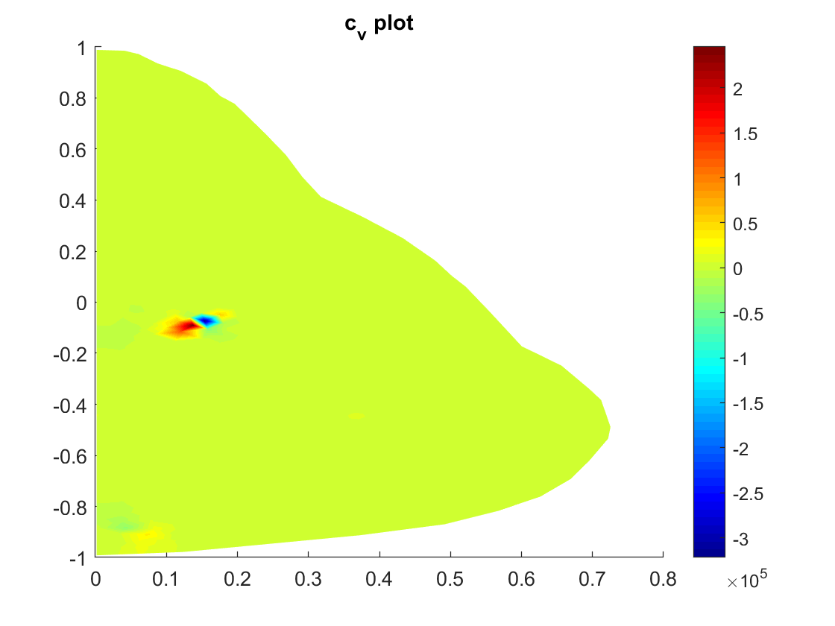
6. Demonstration of results of nonlinear problem
We used the wrong starting values from the previous slide, so we expect of course that the solution will be wrong
But even starting from ‘close’ values (e.g. all zero) we get wrong results
Expected: Concentrations to be
highest at the edge

Slide 18
Conclusion
Problems:
Incorrect initial concentrations (mistake in linearisation?)
Divergence (mistake in Newton method/Jacobian calculation?)
No library used to handle sparse matrices
No C++
…
Insights
More detailed understanding of Finite Element Method
Use of quadrature rules in practice
Structured MATLAB-programming

