Slide 1

Project Mathematical Engineering
Taoufik Benyahia, Michiel De Koninck
Faculty of Engineering Science
Mathematical Engineering 09/04/2019

Slide 2

Pear Project: Contents
1. Mathematical Problem
2. Description of FE method
3. Construction of linear system
4. Demonstration of result for linear system
5. Solving of nonlinear system
6. Demonstration of results of nonlinear problem

Slide 3
1. Mathematical Problem
Challenge: Simulate and predict internal gas concentrations/ distributions
Study the effect of controlled storage conditions on local oxygen and carbon dioxide concentrations
2

Slide 4
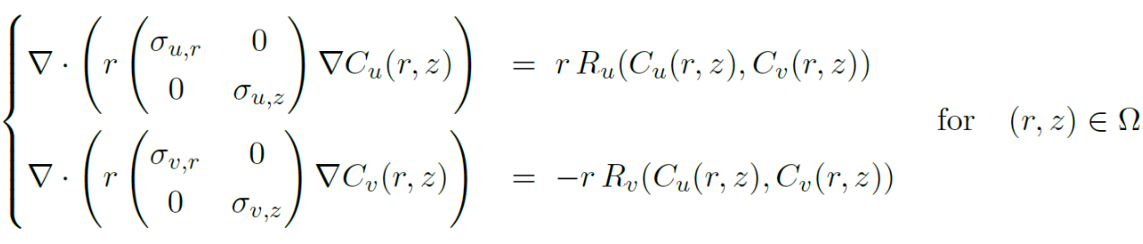
1. Mathematical Problem: Model
Model used for system:
Non-linear reaction-diffusion equations: in stationary regime
On two-dimensional bounded spatial domain
u: oxygen v:carbon-dioxide

Slide 5
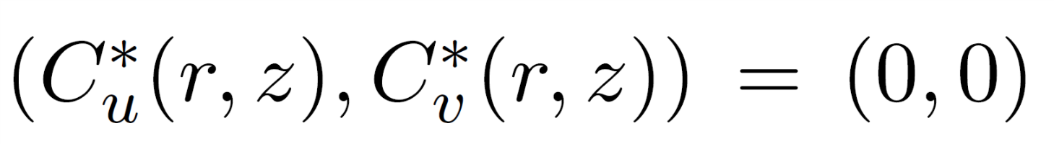
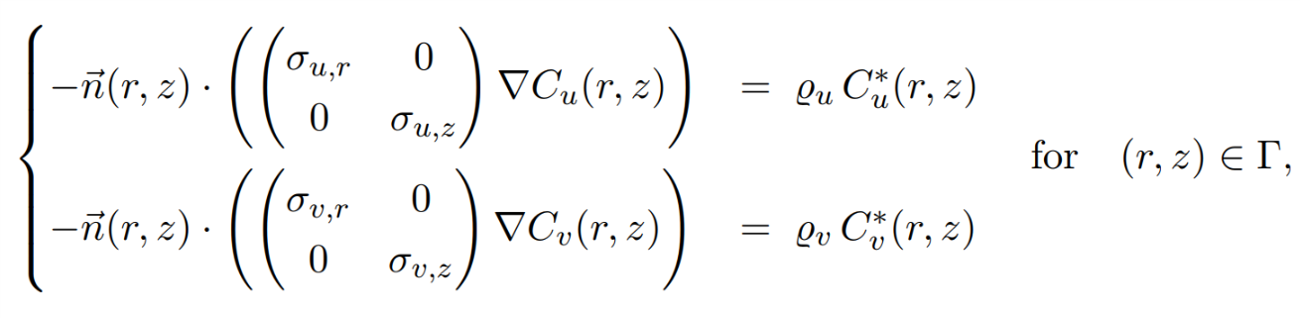

1. Mathematical Problem: Boundary Conditions
Boundary Conditions:
Internal Boundary:
External Boundary:
Ambient concentrations

Slide 6
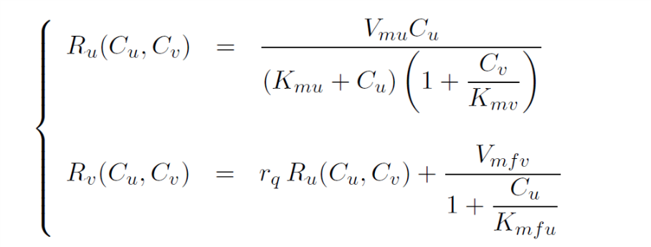
1. Mathematical Problem: Respiration kinetics
Respiration Kinetics:
Describe the evolution of the system through gas exchange with the environment

Slide 7
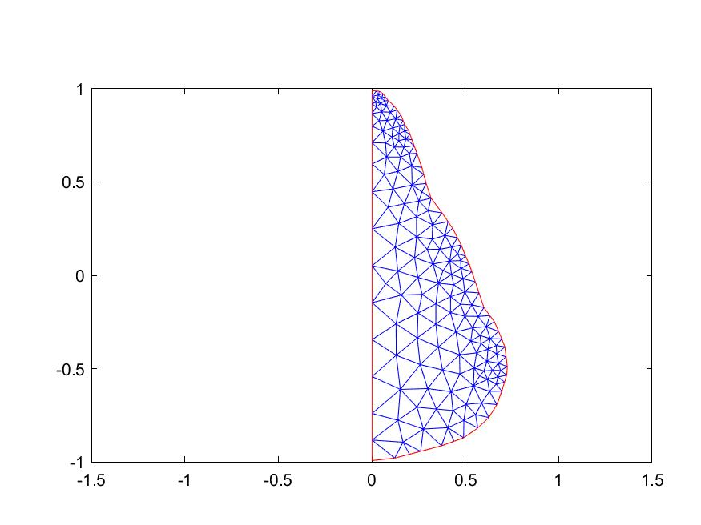



2. Description of FE-method
Domain is split up into triangles consisting of M nodes
We want to approximate the solutions at the nodes of our mesh by use of linear basisfunctions
In every triangle we use three basisfunctions to represent our solution.
On every edge we use two basisfunctions to represent our solution.

Slide 8
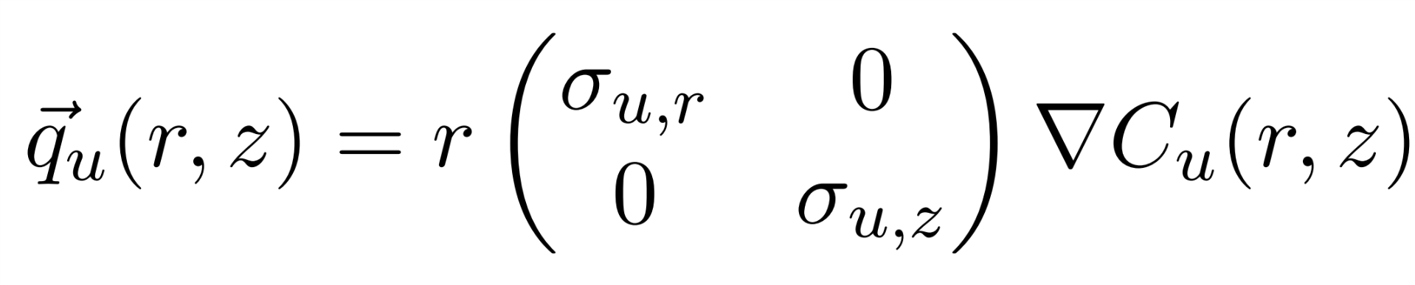
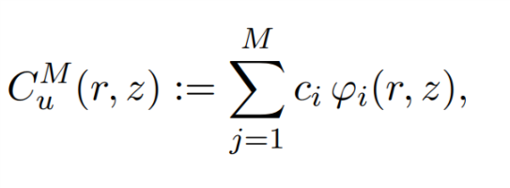
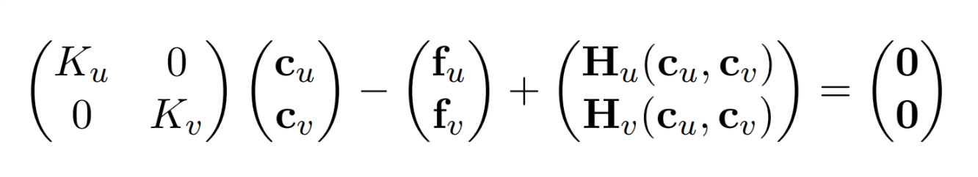
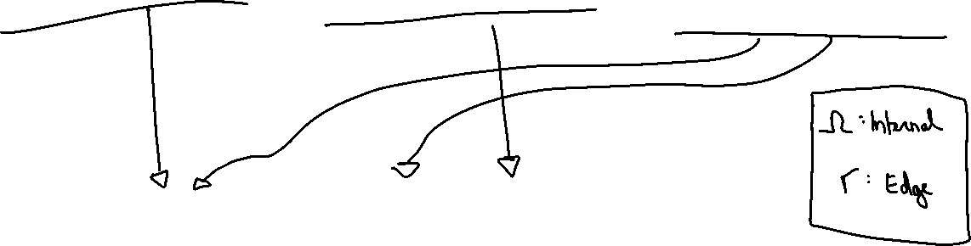
2. Description of FE-method
We solve these integrals by looping over all triangles/edges. The integral becomes a sum of integrals.

Slide 9
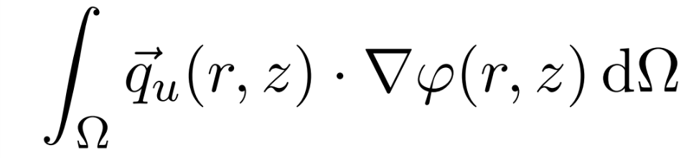
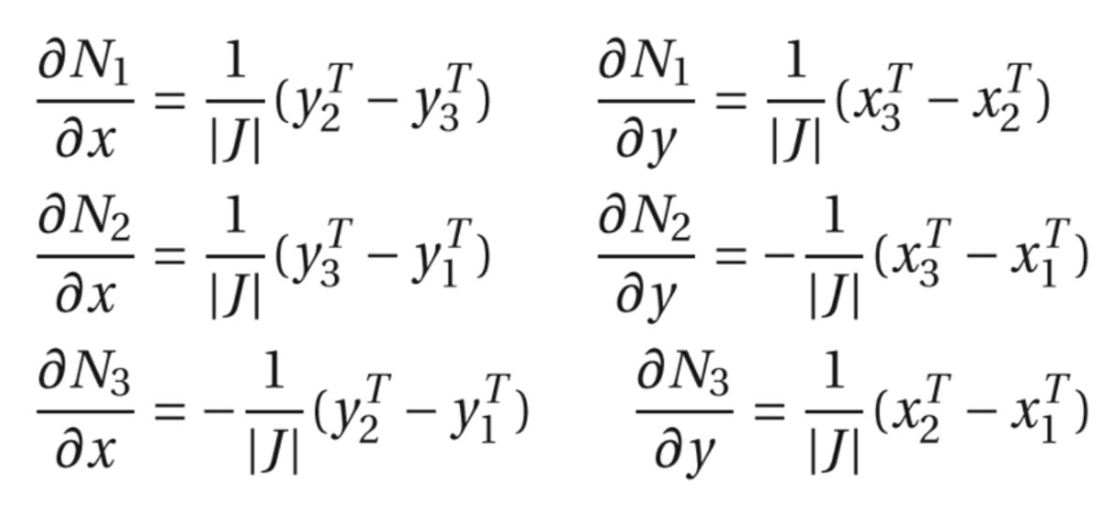
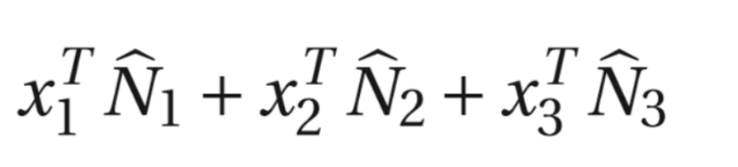
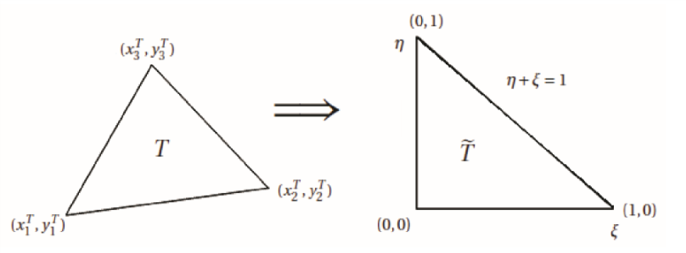
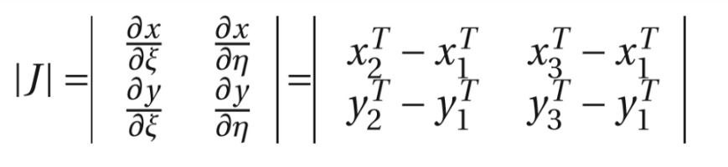
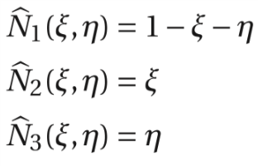
2. Description of FE-method
For example start from:
Each triangle is mapped onto standard triangle: with
With derivatives of basisfunctions in each triangle with:

Slide 10
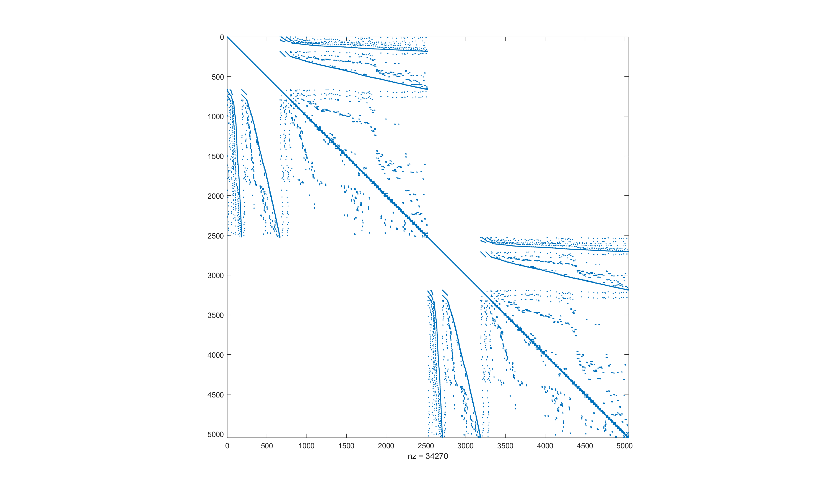
3. Construction of Linear System
Using this technique we fill the matrix of the linear system (K): -> 9 adjustments (combinations of 3 nodes) are made to Ku and Kv for every triangle handled.
Sparsity pattern is obtained:

Slide 11
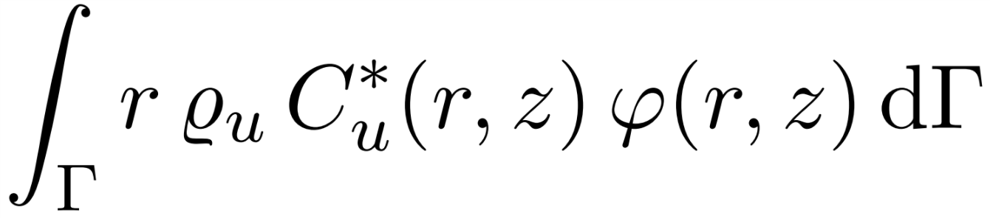
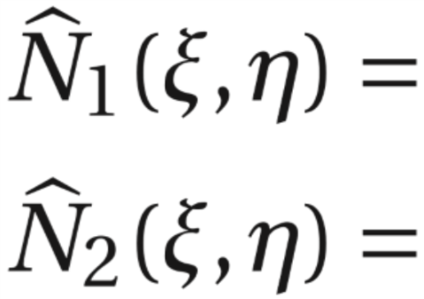
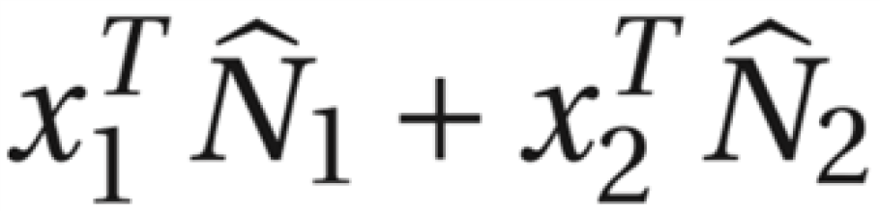

3. Construction of Linear System
Integral over edge:
Map edge onto standard line
Two basisfunctions instead of three:
Integral for one edge translates to:
This integral can be computed (mupad)
For every edge: two adjustments are made to Fu and Fv as well as to Ku and Kv
If we now calculate K*c = F (ignore H) then we find: c= [C_uamb…C_vamb…] (steady state)

Slide 12
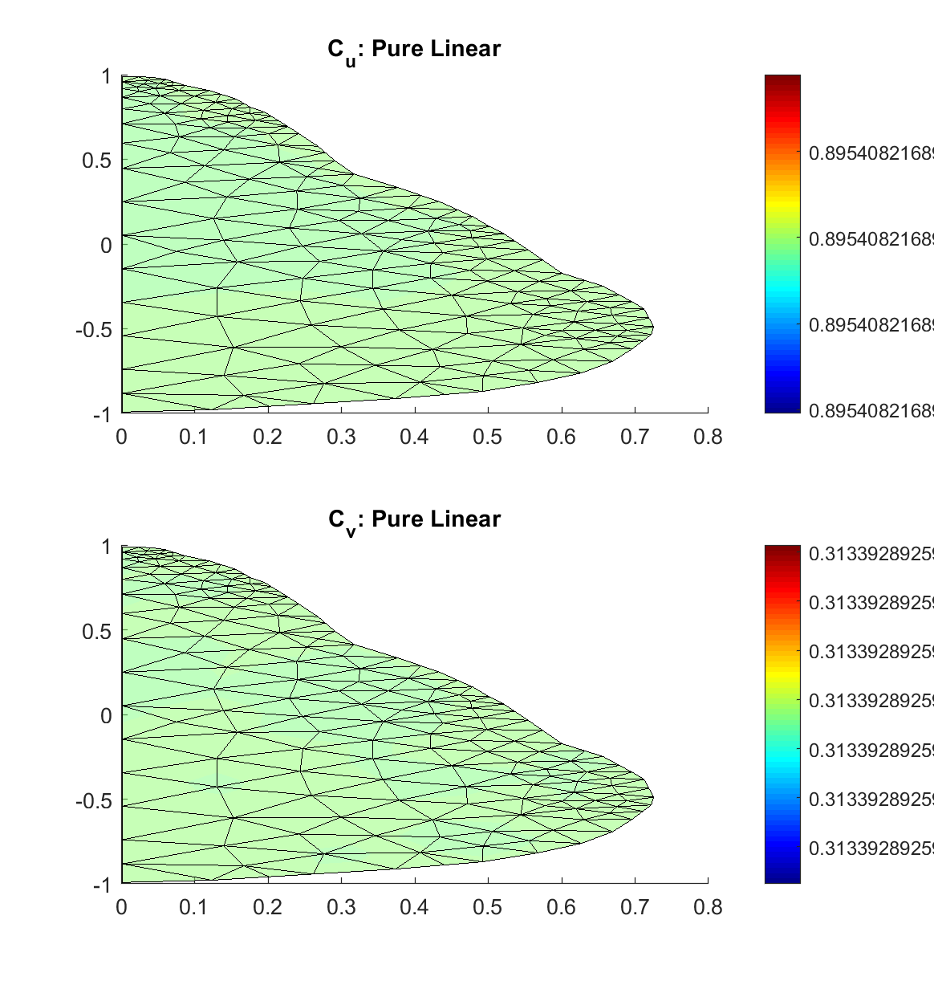
3. Demonstration of Result for Linear System
Initial plots give expected result
->values near the ambient O2 and CO2 concentration
Figure generated with data from FORTRAN

Slide 13
3. Construction of Linear System: Linearization
Goal: find initial values (c_u0,c_v0) to start newton iteration
Linearize H_u and H_v around Cu =0 (no oxygen within pear, because it is turned into CO2 really fast) -> This leads to a simple expression for R_u and R_v
Contribution to the K-matrix and f-vector after which system can be solved again

Slide 14
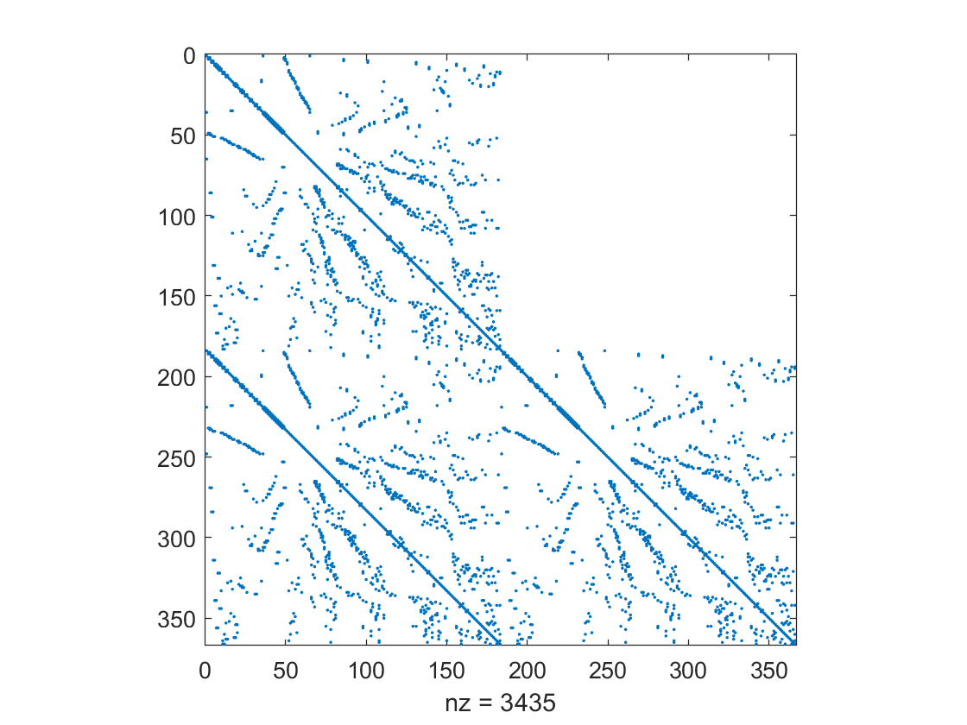
3. Construction of Linear System: Linearization
The linearization causes changes to the K-matrix; its form becomes:
Using this we can solve the linear system: c0 = K\f. In FORTRAN, this is solved by using a pivot-version of the Gauss algorithm.

Slide 15
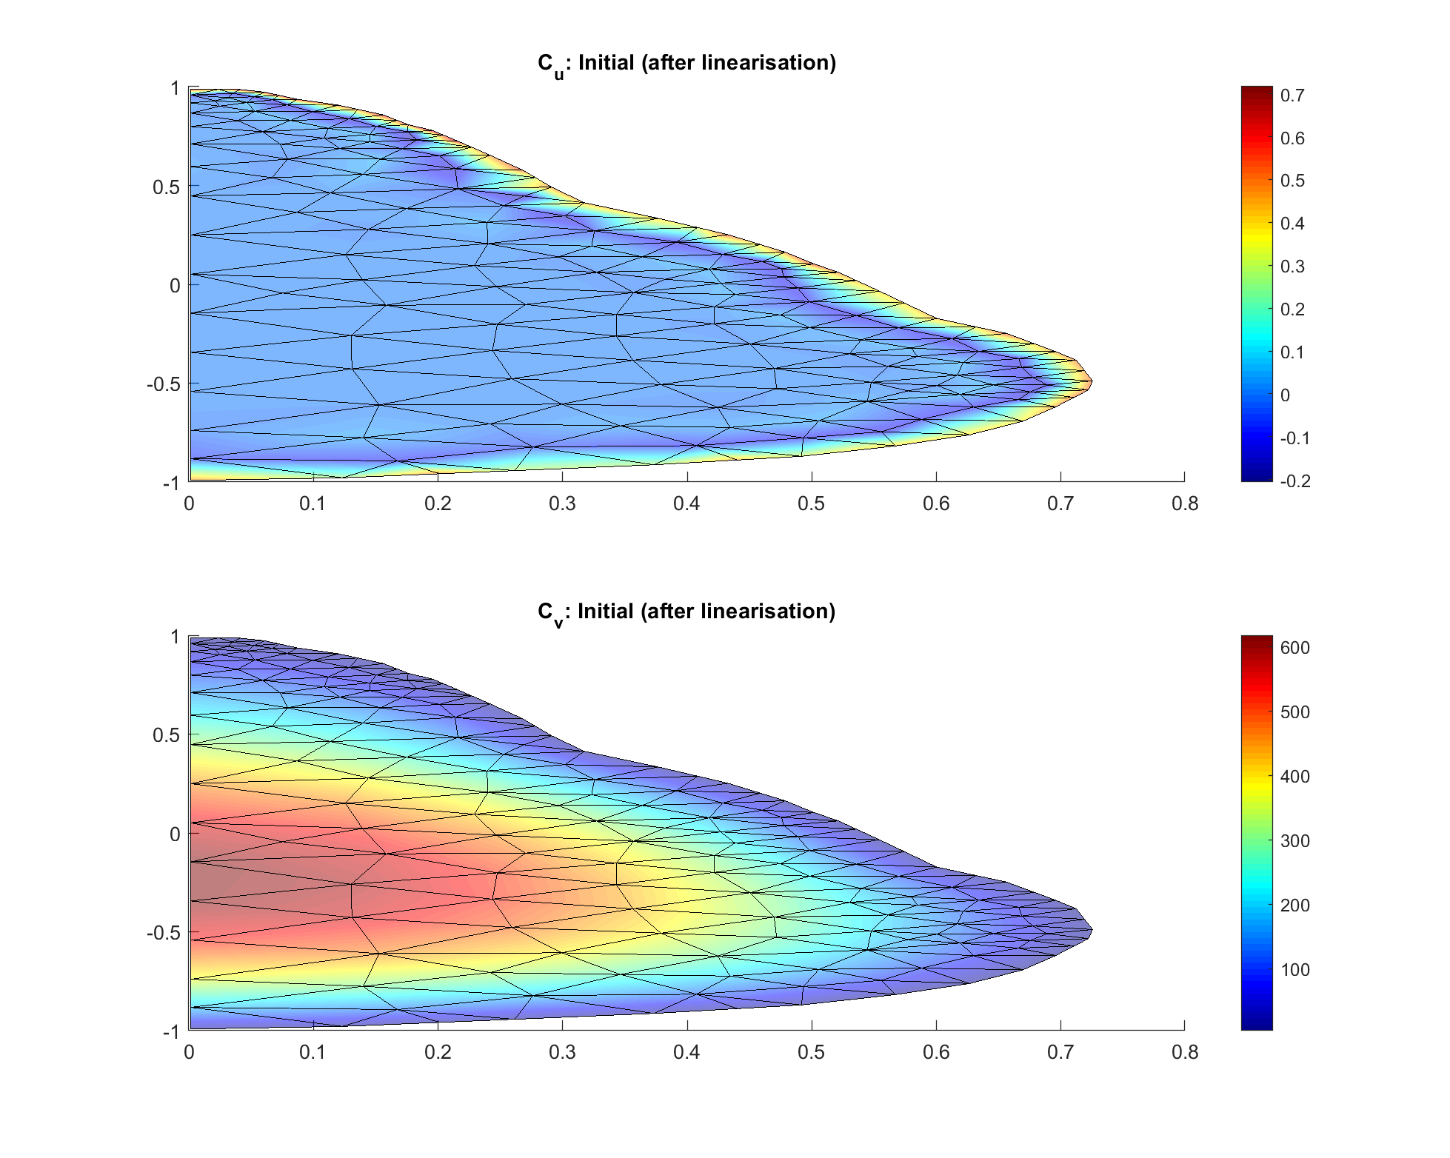
4. Results for initial values after linearisation
Using FORTRAN and MATLAB we get the same results.
Both concentrations show expected evolution pattern.
O2 concentration distribution is too heavily concentrated near the edges
Figure generated with data from FORTRAN

Slide 16


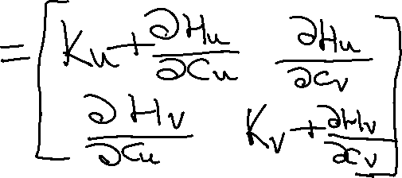







5. Solving Nonlinear System
We use the Newton-Raphson Iterative Algorithm

Slide 17
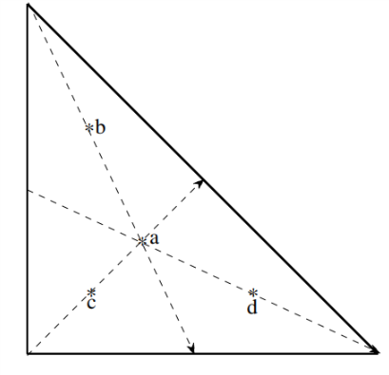

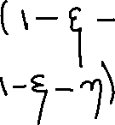


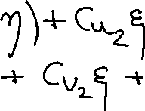









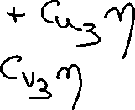









5. Solving Nonlinear System
Used Gaussian (degree 3 precision) quadrature formula to approximate integral
= known values in vertices from previous iteration

Slide 18
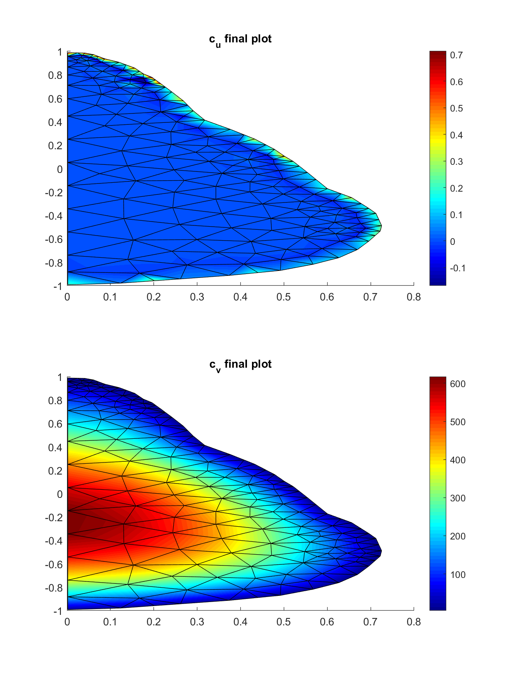
6. Demonstration of results of nonlinear problem
In FORTRAN: used MINPACK library to solve nonlinear system of equations (jacobian approximated by forward diffenrences)
In MATLAB: Calculated Jacobian analytically, result checked by calculating via finite differences function
The distribution of the CO2 concentration is as we would expect it.
The distribution of the O2 has not changed much from the initial values. Figure generated with data from MATLAB

Slide 19
Timing comparison: Fortran vs Matlab
Using a maximum of 100 iterations for both ways of solving the non-linear system, we got following timings for the same pear:
FORTRAN: 0.3948s (average)
MATLAB: 5.3906s (average)

Slide 20
Conclusion
Problems:
Not completly correct initial concentration (linearisation assumptions?)
Convergence to wrong solutions when solving non-linear system
Insights
More detailed understanding of Finite Element Method
Use of quadrature rules in practice
Structured MATLAB-programming
Structured FORTRAN-programming and working with library (MINPACK)
FORTRAN is much faster than MATLAB (also because of efficient solver)

