Slide 1
The design and assembly of a soldering station
Michiel Parthoens

Slide 2
Table of contents
-Pcb design
-Case design
-Assembly
-Problems and solutions
-Reflection

Slide 3
Pcb design
Step by step process
Parts search
Schematic
Pcb routing

Slide 4
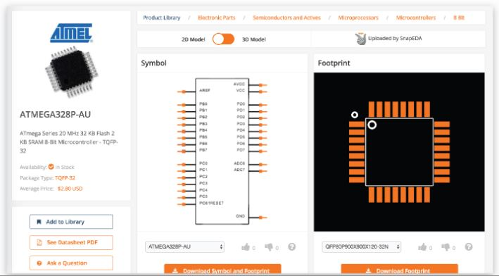
Part search
Symbols
Footprints
Price

Slide 5
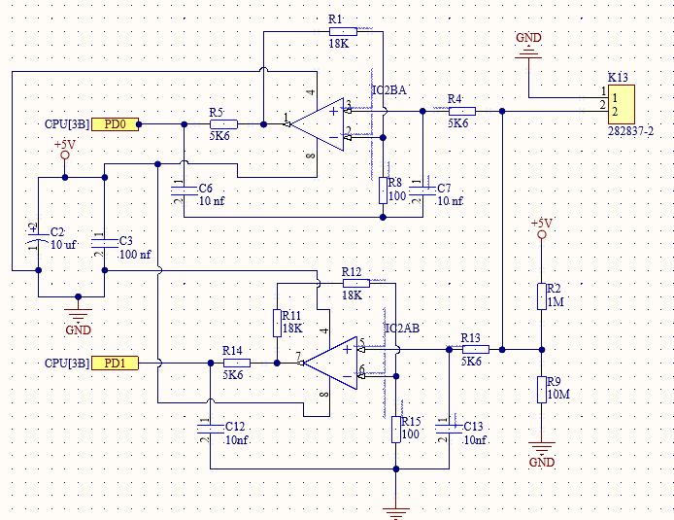
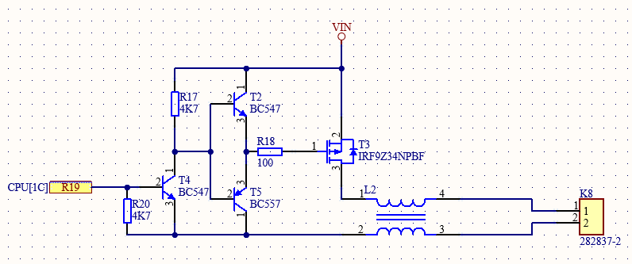
Schematic
Base of the pcb
Symbols
Different schematics

Slide 6
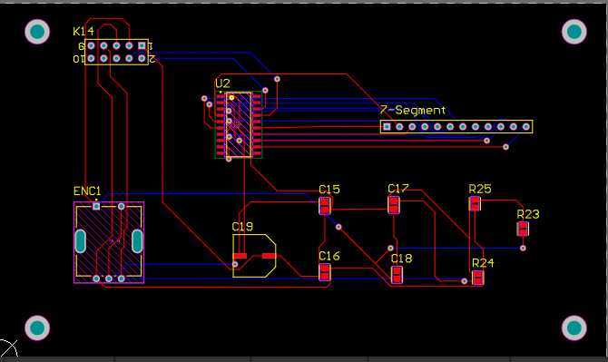
Pcb routing
Making the connections of the schematic
Rules
Track width
Autorouting
Interactive routing

Slide 7
Case design

Slide 8

Concept search
Steady base
Appealing to the eyes
Possible to manufacture

Slide 9
Sketching
Important for prototyping
Less time wasted
Fallback for drawing in inventor

Slide 10
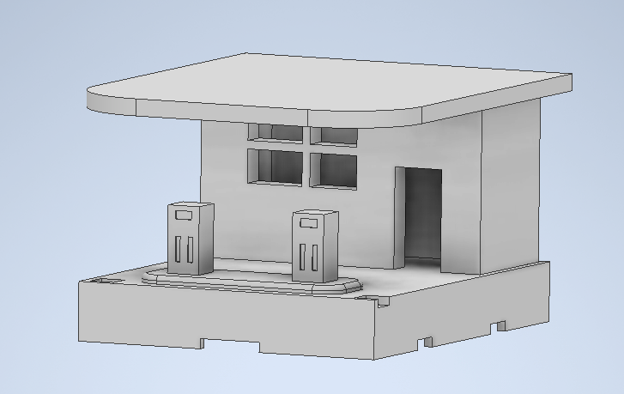
Drawing in inventor
Using sketch as base
Precise measurements
Taking clearings into account

Slide 11
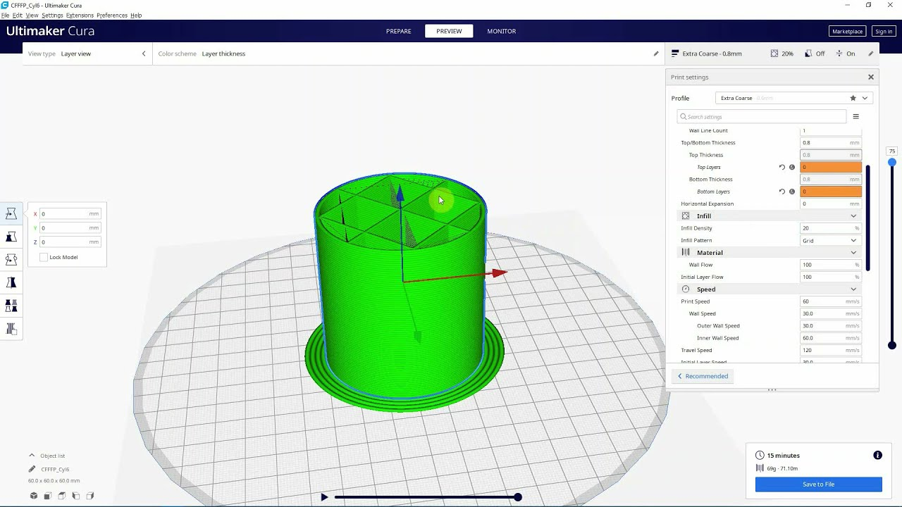
Cura slicer setup
Printer settings
Temperature settings
Speed
Support type

Slide 12
Assembly
SMD mounting
Soldering
3D-printing

Slide 13
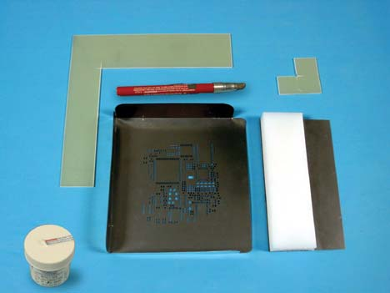
SMD mounting
Screening
Heating process
Checking connections
Improving bad connections

Slide 14
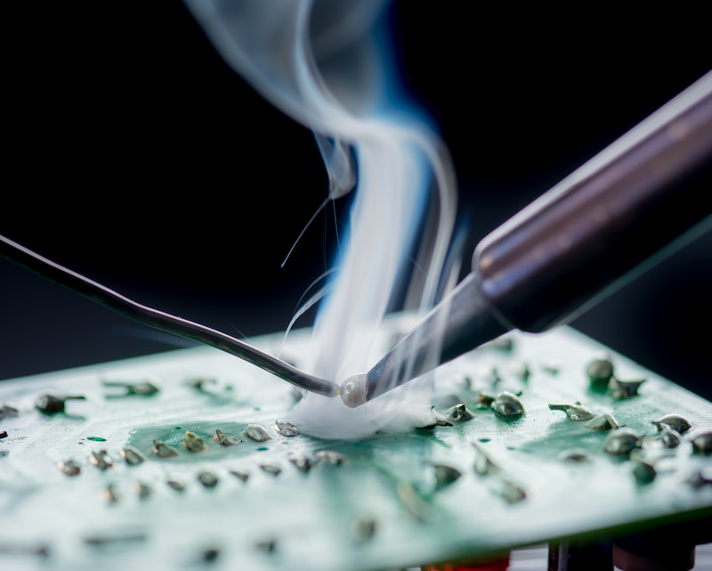
Soldering
Checking parts
Checking polarity

Slide 15
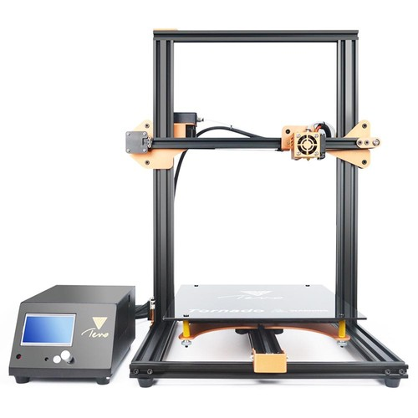
3D-printing
Prepping the printer
Removing and cleaning
Finishing the parts

Slide 16
Problems and solutions

Slide 17
Auto routing
Problems with auto routing
Interactive routing (by hand)
Larger pcb
Delay with manufacturer

Slide 18
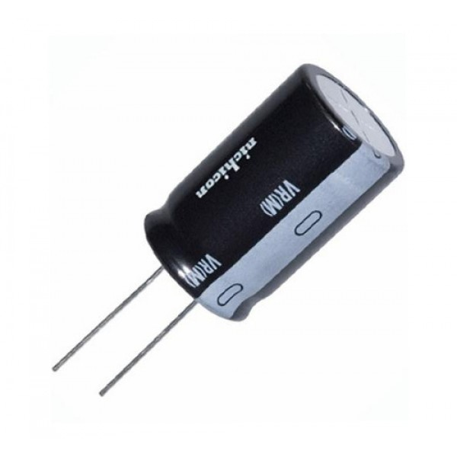
Components
Wrong footprint

Slide 19
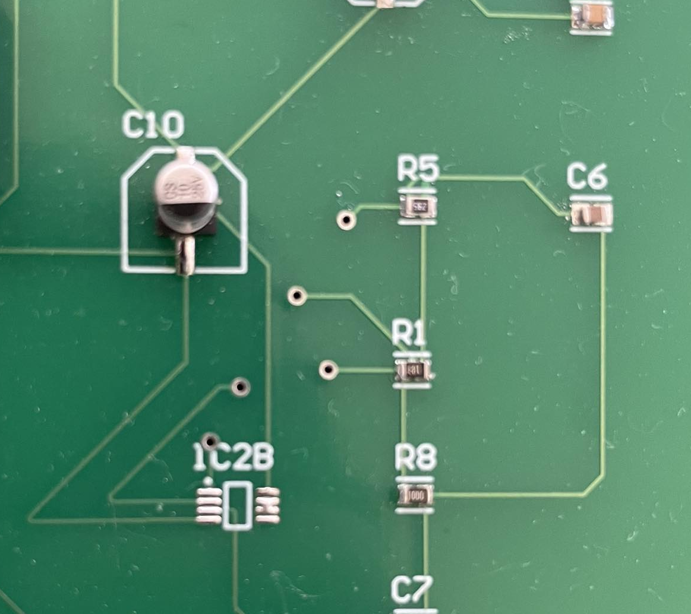
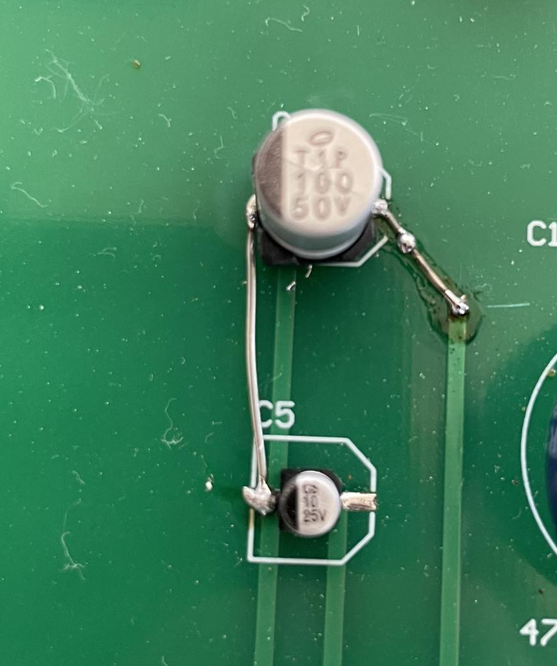
SMD connections

Slide 20
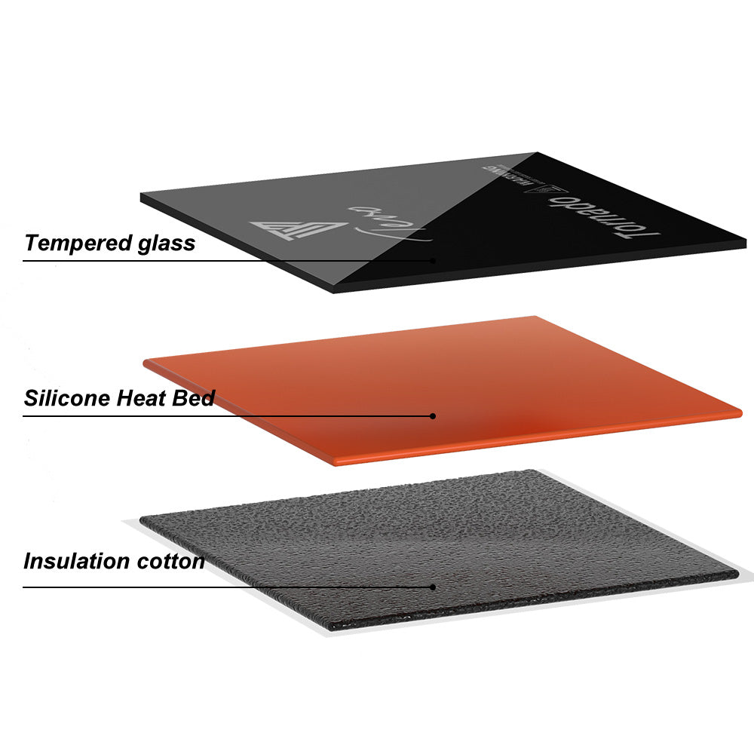
Designing and manufacturing the case
To big to print
Broken print bed

Slide 21
Reflection
Time management
More parts
Through hole components

Slide 22
Are there any questions?

