Slide 1
Statistical physics of learning

Slide 2
Motivation Statistical Physics of Learning
Physical systems consist of many particles. Together they form macroscopic properties: pressure, temperature, energy,…
Key observation: systems with many particles/elements behave highly deterministically.
ML models consist of many weights/parameters, which together result in the properties training and generalization loss.
Central aim: map the typical (in contrast to worst case) macroscopic behaviour of machine learning problems. Hence, typical learning behaviour of …
… generalization error
… order parameters (will be defined)

Slide 3
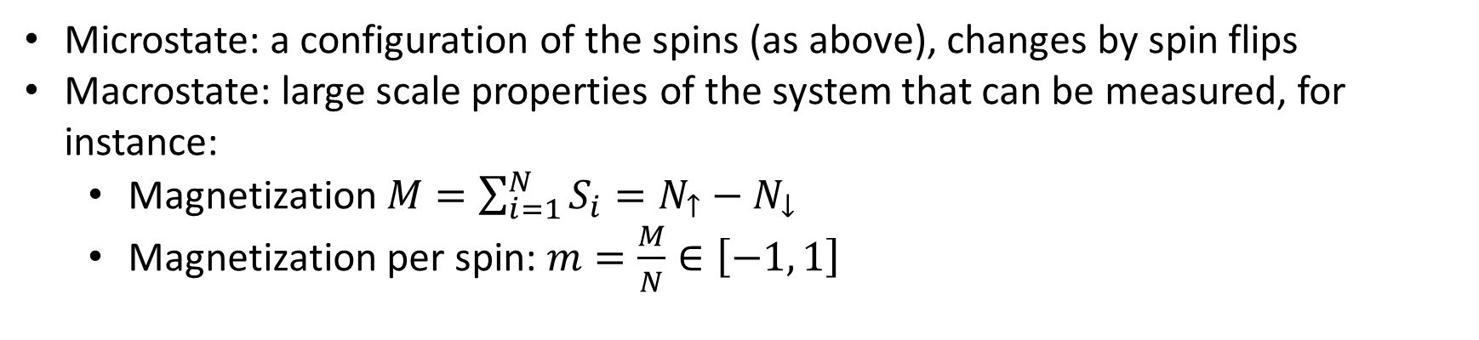
Spin model and thermodynamic limit
…
Ising model in 1D:
$N$ spins $S_{i}$ in up ($S_{i}=+1$) or down ($S_{i}=−1$) position
Microstate: a configuration of the spins (as above), changes by spin flips
Macrostate: large scale properties of the system that can be measured, for instance:
Magnetization $M=\sum_{i=1}^{N}{S_{i}=N_{↑}−N_{↓}}$
Magnetization per spin: $m=\frac{M}{N}∈\left[−1, 1\right]$

Slide 4
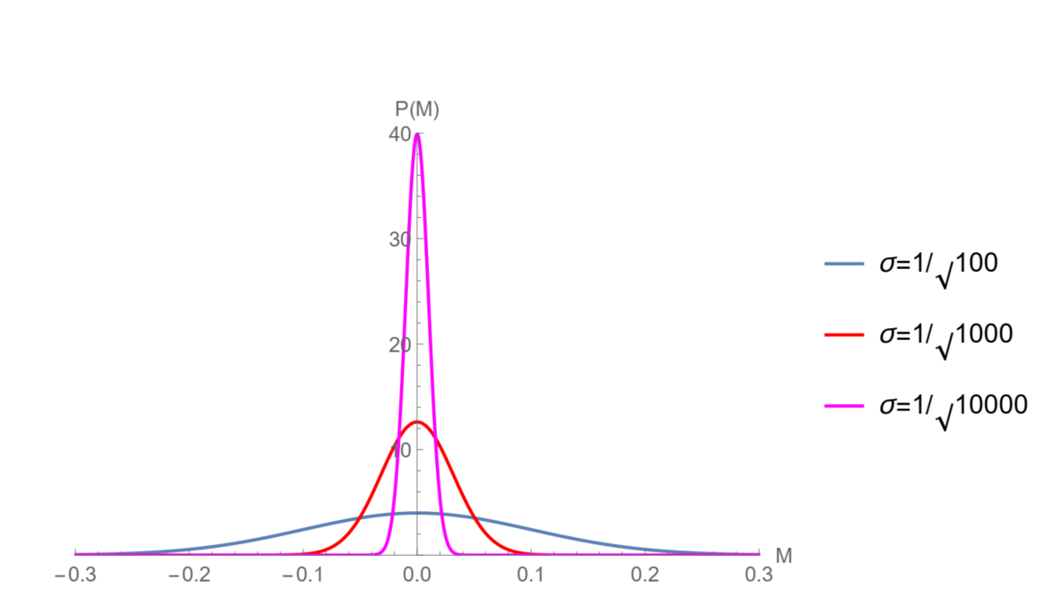
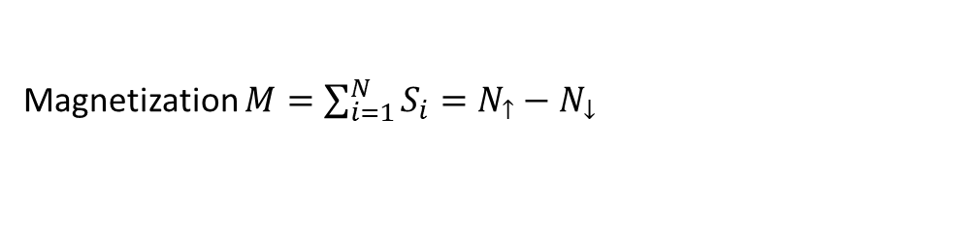
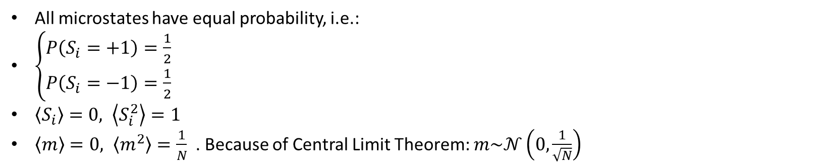

Magnetization $M=\sum_{i=1}^{N}{S_{i}=N_{↑}−N_{↓}}$
Magnetization per spin: $m=\frac{M}{N}∈\left[−1, 1\right]$
All microstates have equal probability, i.e.:
$\left\{\begin{aligned}P\left(S_{i}=+1\right)=\frac{1}{2} \\ P\left(S_{i}=−1\right)=\frac{1}{2}\end{aligned}\right.$
$\left\langle S_{i}\right\rangle =0, \left\langle S_{i}^{2}\right\rangle =1$
$\left\langle m\right\rangle =0, \left\langle m^{2}\right\rangle =\frac{1}{N}$. Because of Central Limit Theorem: $m\sim 𝒩\left(0,\frac{1}{\sqrt{N}}\right)$
Distribution of magnetization per spin for increasing number of spins
$$P(m)$$

Slide 5
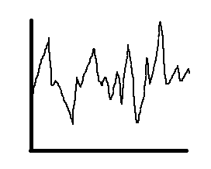
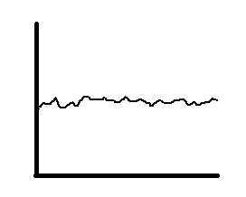
Second example: Pressure in a gas
Low number of particles
High number of particles
Pressure per particle
Pressure per particle
Time
Time

Slide 6

Some important papers
Hopfield network (Ising model of a neural network) ^{[1]}
Energy of a state: $E=−\frac{1}{2}\sum_{i,j}{w_{ij}s_{i}s_{j}−\sum_{i}{θ_{i}s_{i}}}$
Learning dynamics in two-layer neural networks ^{[2] [3]}
Currently these types of analyses are revisited in the deep learning era ^{[4]}
[1]: Hopfield, J. J. ‘Neural Networks and Physical Systems with Emergent Collective Computational Abilities’. Proceedings of the National Academy of Sciences 79, nr. 8 (1 april 1982): 2554-58.
[2]: Biehl, M., and H. Schwarze. ‘Learning by On-Line Gradient Descent’. Journal of Physics A: Mathematical and General 28, nr. 3 (februari 1995): 643-56.
[3]: Saad, David, and Sara A. Solla. ‘On-Line Learning in Soft Committee Machines’. Physical Review E 52, no. 4 (1 October 1995): 4225–43.
[4]: Zdeborová, L. ‘Understanding deep learning is also a job for physicists.’ Nat. Phys. 16, (2020), 602–604.

Slide 7
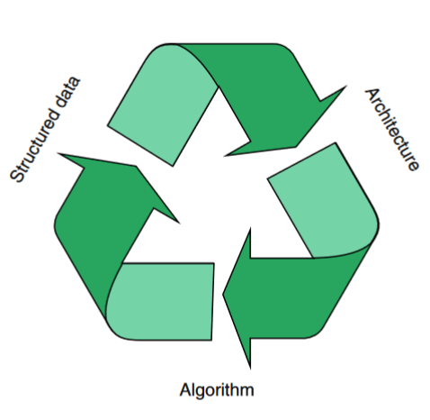
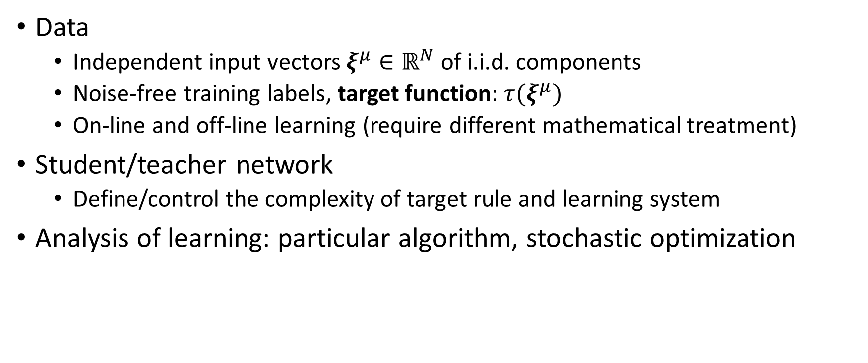
Typical results in model scenarios
Data
Independent input vectors $ξ^{μ}∈ℝ^{N}$ of i.i.d. components
Noise-free training labels, target function: $τ(ξ^{μ})$
On-line and off-line learning (require different mathematical treatment)
Student/teacher network
Define/control the complexity of target rule and learning system
Analysis of learning: particular algorithm, stochastic optimization

Slide 8
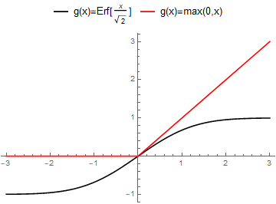
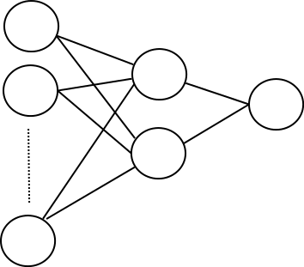
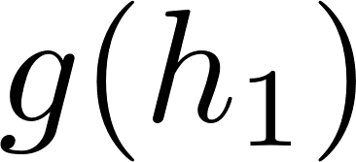
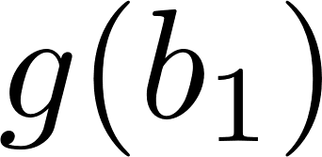


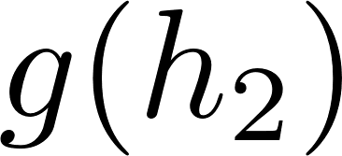
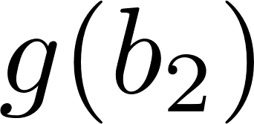

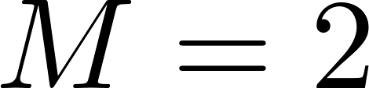


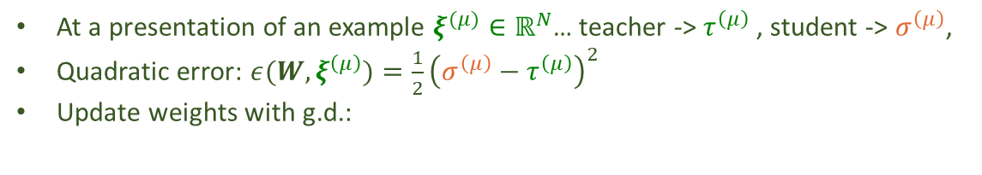




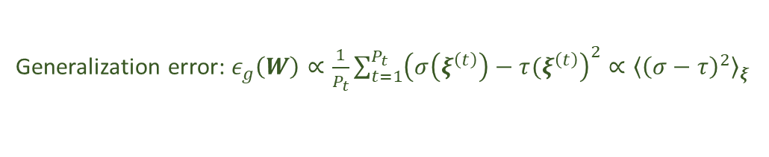



On-line learning modelling with student-teacher setup
Student hypothesis
Teacher rule
$$ξ_{1}^{(μ)}$$
$$ξ_{1}^{\left(μ\right)}$$
g(x)
?
$$ξ_{2}^{\left(μ\right)}$$
$$ξ_{2}^{\left(μ\right)}$$
?
$$σ^{\left(μ\right)}$$
?
$$τ^{\left(μ\right)}$$
?
$$σ : ℝ^{N}→ℝ$$
?
$$ξ_{N}^{\left(μ\right)}$$
$$ξ_{N}^{\left(μ\right)}$$
Consider a stream of examples: $ξ^{\left(1\right)},ξ^{\left(2\right)},ξ^{\left(3\right)}…$ from $ℝ^{N}$
At a presentation of an example $ξ^{(μ)}∈ℝ^{N}$… teacher -> $τ^{\left(μ\right)}$, student -> $σ^{\left(μ\right)}$,
Quadratic error: $ε(W,ξ^{\left(μ\right)})=\frac{1}{2}{\left(σ^{\left(μ\right)}−τ^{\left(μ\right)}\right)}^{2}$
Update weights with g.d.:
$w_{i}^{\left(μ+1\right)}=w_{i}^{\left(μ\right)}+\frac{η}{N}ρ_{i}^{\left(μ\right)}ξ^{(μ)}$, with $ρ_{i}^{\left(μ\right)}=\left(τ^{\left(μ\right)}−σ^{\left(μ\right)}\right)g^{′}(h_{i}^{\left(μ\right)})$
Given a test set $𝒟_{test}=\{ξ^{\left(1\right)},ξ^{\left(2\right)},…,ξ^{\left(P_{t}\right)}\}$ with examples not used for training:
Generalization error: $ε_{g}\left(W\right)∝\frac{1}{P_{t}}\sum_{t=1}^{P_{t}}{{\left(σ\left(ξ^{\left(t\right)}\right)−τ(ξ^{\left(t\right)}\right)}^{2}}∝{\left\langle {\left(σ−τ\right)}^{2}\right\rangle }_{ξ}$
Allows to model various types of practically relevant scenarios

Slide 9
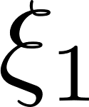
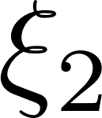
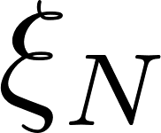
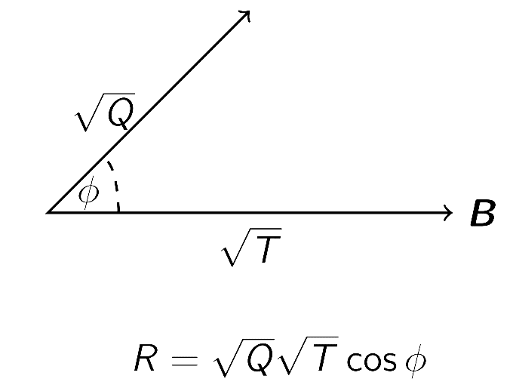

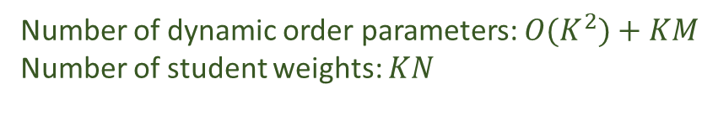

Order parameters: A high-level description
Student hypothesis
Teacher rule
?
?
?
?
?
Idea: $N$ can be quite large (MNIST: N=784), therefore keep track of and study a few order parameters:
$Q_{ik}=w_{i}⋅w_{k}$, $R_{im}=w_{i}⋅B_{m}$, $T_{nm}=B_{n}⋅B_{m}=δ_{nm}$
$$w$$
Dynamic
Constant in stationary situations
Number of dynamic order parameters: $O(K^{2})+KM$
Number of student weights: $KN$

Slide 10
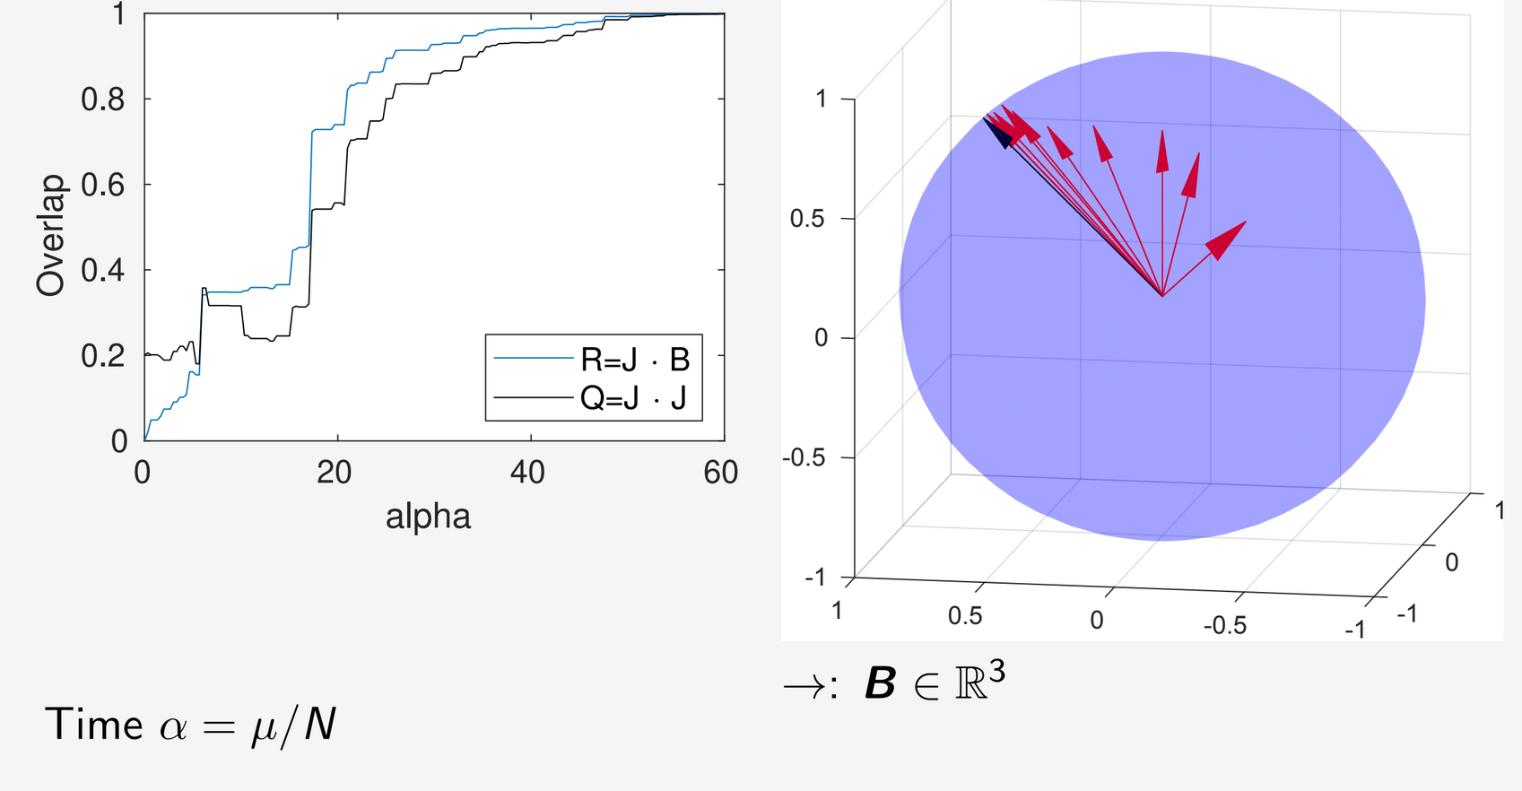

ReLU Perceptron learning: K=M=1 in N=3 dimensions
Order parameters during learning
: $w∈ℝ^{3}$

Slide 11
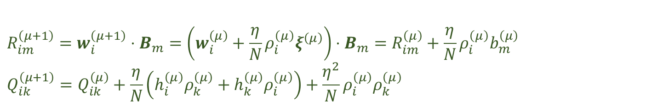

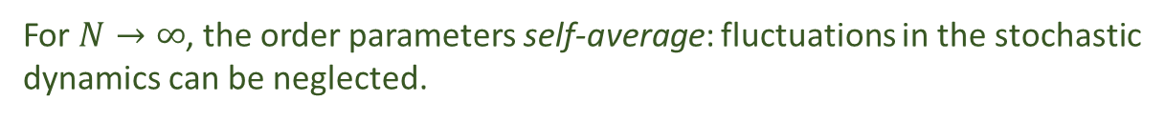
Learning of the Soft Committee Machine in high dimension
Recall order parameters: $Q_{ik}=w_{i}⋅w_{k}$, $R_{im}=w_{i}⋅B_{m}$, $T_{nm}=B_{n}⋅B_{m}=δ_{nm}$
Update weights: $w_{i}^{\left(μ+1\right)}=w_{i}^{\left(μ\right)}+\frac{η}{N}ρ_{i}^{\left(μ\right)}ξ^{\left(μ\right)}$, with $ρ_{i}^{\left(μ\right)}=\left(τ^{\left(μ\right)}−σ^{\left(μ\right)}\right)g^{′}(h_{i}^{\left(μ\right)})$
$$R_{im}^{\left(μ+1\right)}=w_{i}^{\left(μ+1\right)}⋅B_{m}=\left(w_{i}^{\left(μ\right)}+\frac{η}{N}ρ_{i}^{\left(μ\right)}ξ^{\left(μ\right)}\right)⋅B_{m}=R_{im}^{\left(μ\right)}+\frac{η}{N}ρ_{i}^{\left(μ\right)}b_{m}^{\left(μ\right)}$$
$$Q_{ik}^{\left(μ+1\right)}=Q_{ik}^{\left(μ\right)}+\frac{η}{N}\left(h_{i}^{\left(μ\right)}ρ_{k}^{\left(μ\right)}+h_{k}^{\left(μ\right)}ρ_{i}^{\left(μ\right)}\right)+\frac{η^{2}}{N}ρ_{i}^{\left(μ\right)}ρ_{k}^{\left(μ\right)}$$
For $N→∞$, the order parameters self-average: fluctuations in the stochastic
dynamics can be neglected.

Slide 12
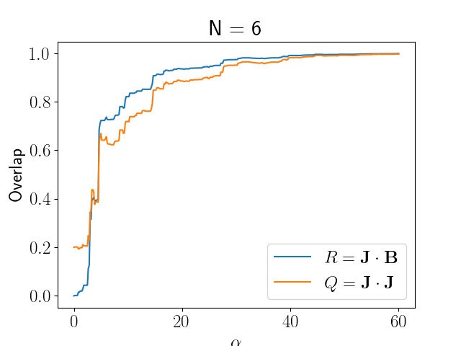
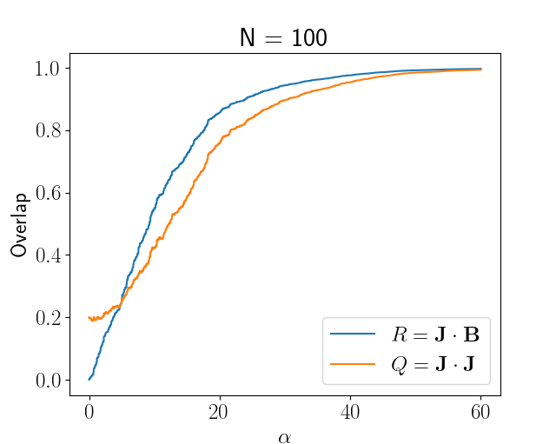
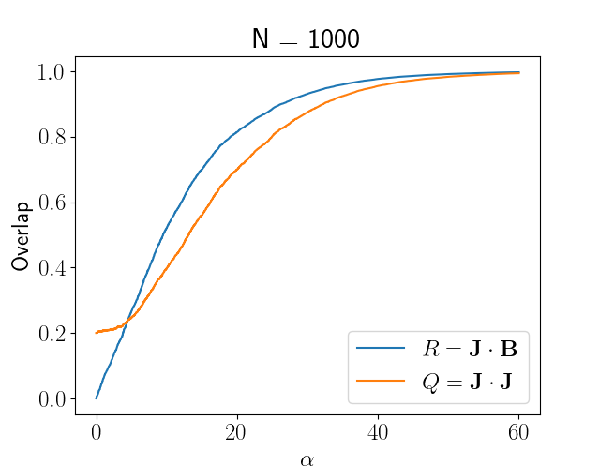
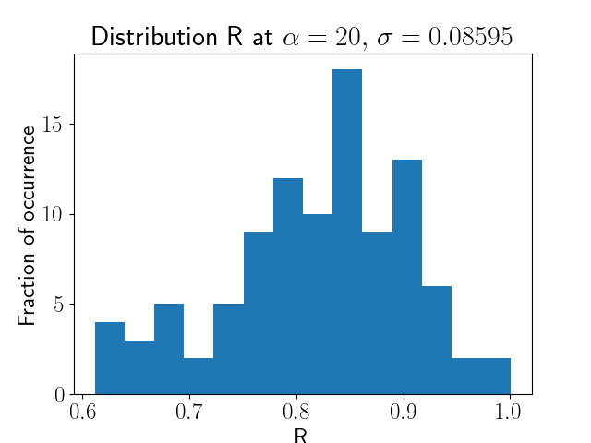
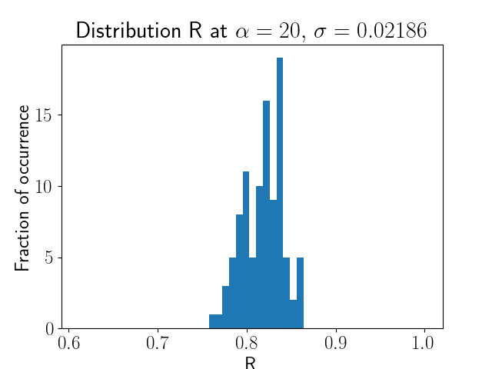
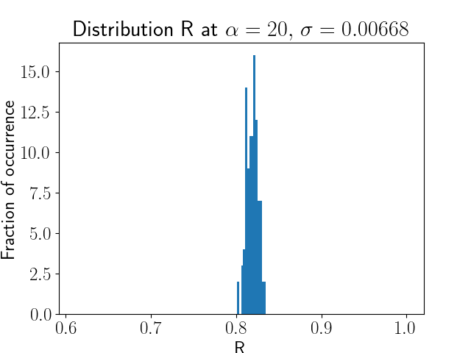
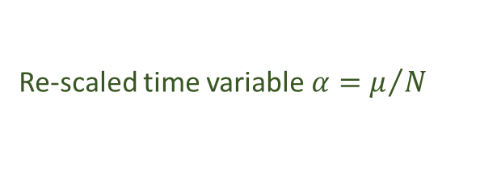



ReLU Perceptron learning for increasing input dimension N
Input distribution: $ξ \sim 𝒩\left(0, I\right)$
Re-scaled time variable $α=μ/N$
100 runs, record $α=20$ value of R:
Mathematical discussion of self-averaging property for on-line learning:
Reents, G. and Urbanczik, R.: 1998, Self-Averaging and On-Line Learning, Phys. Rev. Lett. 80, 5445–5448.
S. Goldt et al., Dynamics of stochastic gradient descent for two-layer neural networks in the teacher-student setup, NeurIPS 2019
$$σ\sim 1/\sqrt{N}$$

Slide 13
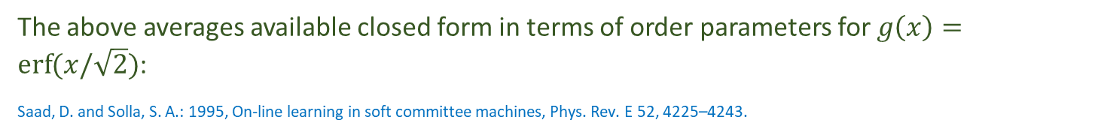
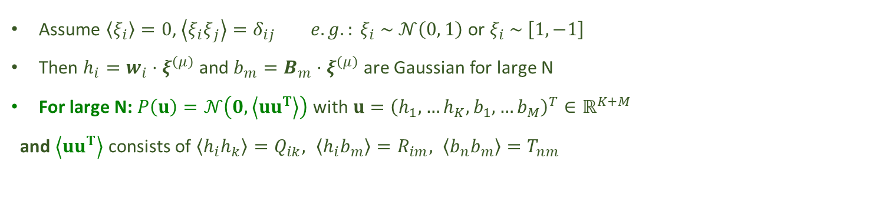
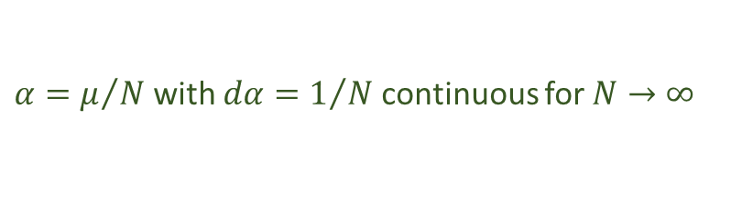
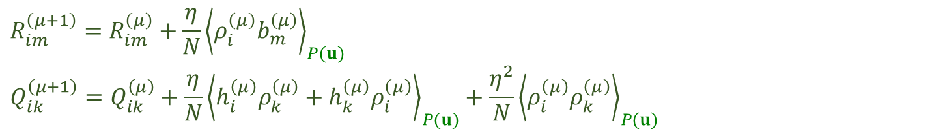
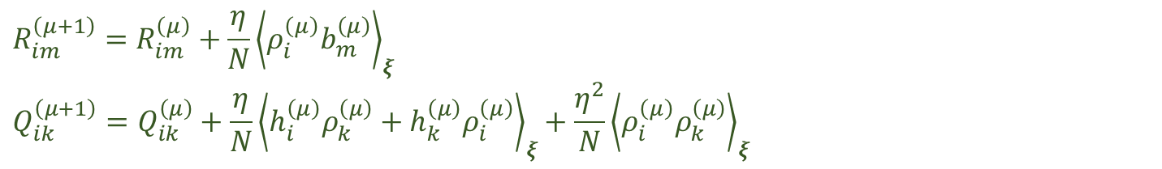
Averaged equations for the order parameters
$$R_{im}^{\left(μ+1\right)}=R_{im}^{\left(μ\right)}+\frac{η}{N}{\left\langle ρ_{i}^{\left(μ\right)}b_{m}^{\left(μ\right)}\right\rangle }_{ξ}$$
$$Q_{ik}^{\left(μ+1\right)}=Q_{ik}^{\left(μ\right)}+\frac{η}{N}{\left\langle h_{i}^{\left(μ\right)}ρ_{k}^{\left(μ\right)}+h_{k}^{\left(μ\right)}ρ_{i}^{\left(μ\right)}\right\rangle }_{ξ}+\frac{η^{2}}{N}{\left\langle ρ_{i}^{\left(μ\right)}ρ_{k}^{\left(μ\right)}\right\rangle }_{ξ}$$
$$R_{im}^{\left(μ+1\right)}=R_{im}^{\left(μ\right)}+\frac{η}{N}{\left\langle ρ_{i}^{\left(μ\right)}b_{m}^{\left(μ\right)}\right\rangle }_{P(u)}$$
$$Q_{ik}^{\left(μ+1\right)}=Q_{ik}^{\left(μ\right)}+\frac{η}{N}{\left\langle h_{i}^{\left(μ\right)}ρ_{k}^{\left(μ\right)}+h_{k}^{\left(μ\right)}ρ_{i}^{\left(μ\right)}\right\rangle }_{P(u)}+\frac{η^{2}}{N}{\left\langle ρ_{i}^{\left(μ\right)}ρ_{k}^{\left(μ\right)}\right\rangle }_{P(u)}$$
Assume $\left\langle ξ_{i}\right\rangle =0$, $\left\langle ξ_{i}ξ_{j}\right\rangle =δ_{ij} e.g.: ξ_{i} \sim 𝒩\left(0, 1\right)$ or $ξ_{i} \sim \left[1,−1\right]$
Then ${h_{i}=w}_{i}⋅ξ^{\left(μ\right)}$ and $b_{m}=B_{m}⋅ξ^{\left(μ\right)}$ are Gaussian for large N
For large N: $P\left(u\right)=𝒩\left(0,\left\langle uu^{T}\right\rangle \right)$ with $u={\left(h_{1},…h_{K},b_{1},…b_{M}\right)}^{T}∈ℝ^{K+M}$
and $\left\langle uu^{T}\right\rangle$ consists of $\left\langle h_{i}h_{k}\right\rangle =Q_{ik}, \left\langle h_{i}b_{m}\right\rangle =R_{im}, \left\langle b_{n}b_{m}\right\rangle =T_{nm}$
$α=μ/N$ with $dα=1/N$ continuous for $N→∞$
$\frac{dR_{im}}{dα}=η{\left\langle ρ_{i}b_{m}\right\rangle }_{P(u)}$, $\frac{dQ_{ik}}{dα}=η{\left\langle h_{i}^{\left(μ\right)}ρ_{k}^{\left(μ\right)}+h_{k}^{\left(μ\right)}ρ_{i}^{\left(μ\right)}\right\rangle }_{P(u)}+η^{2}{\left\langle ρ_{i}^{\left(μ\right)}ρ_{k}^{\left(μ\right)}\right\rangle }_{P(u)}$
The above averages available closed form in terms of order parameters for $g\left(x\right)=\operatorname{erf}{(x/\sqrt{2}})$:
Saad, D. and Solla, S. A.: 1995, On-line learning in soft committee machines, Phys. Rev. E 52, 4225–4243.

Slide 14

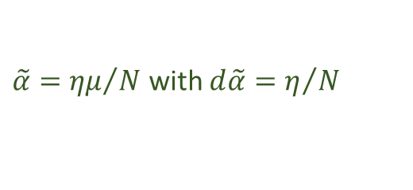



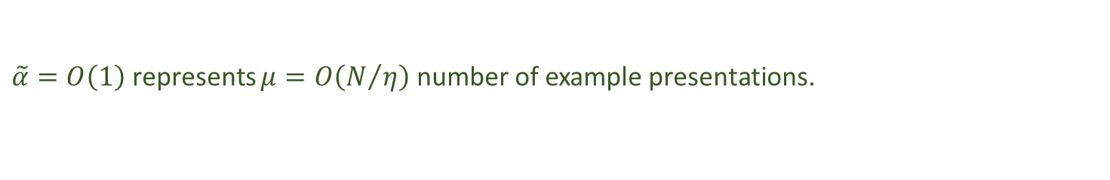

The limit of small learning rates
Exact $N→∞$ dynamics:
$\frac{dR_{im}}{dα}=η{\left\langle ρ_{i}b_{m}\right\rangle }_{P(u)}$, $\frac{dQ_{ik}}{dα}=η{\left\langle h_{i}ρ_{k}+h_{k}ρ_{i}\right\rangle }_{P(u)}+η^{2}{\left\langle ρ_{i}ρ_{k}\right\rangle }_{P(u)}$
$\frac{dR_{im}}{dα}=η{\left\langle ρ_{i}b_{m}\right\rangle }_{P(u)}$, $\frac{dQ_{ik}}{dα}=η{\left\langle h_{i}ρ_{k}+h_{k}ρ_{i}\right\rangle }_{P(u)}$
$\frac{dR_{im}}{d\tilde{α}}={\left\langle ρ_{i}b_{m}\right\rangle }_{P(u)}$, $\frac{dQ_{ik}}{d\tilde{α}}={\left\langle h_{i}ρ_{k}+h_{k}ρ_{i}\right\rangle }_{P(u)}$
For ($η→0$)
Closed form solution may not always be obtainable
$\tilde{α}={ημ}/N$ with $d\tilde{α}=η/N$
$\tilde{α}=O\left(1\right)$ represents $μ=O\left(N/η\right)$ number of example presentations.
Closed form equations for: $g\left(x\right)=\max\left(0,x\right)$:
Straat, M. and Biehl, M.: 2019, On-line learning dynamics of ReLU neural networks using statistical physics techniques,
in M. Verleysen (ed.), ESANN proceedings, pp. 517–522.

Slide 15
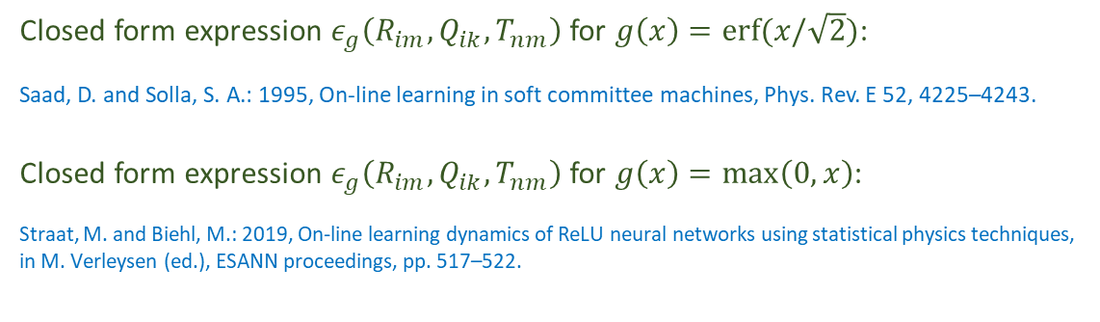
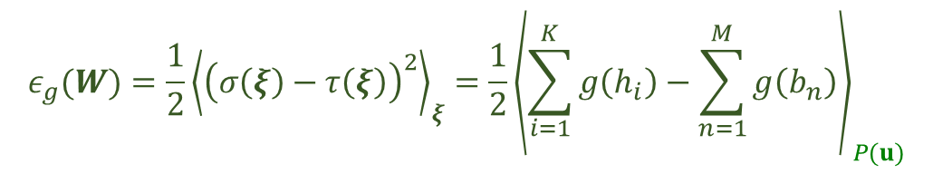


Generalization error
$$ε_{g}(W)=\frac{1}{2}{\left\langle {\left(σ\left(ξ\right)−τ\left(ξ\right)\right)}^{2}\right\rangle }_{ξ}=\frac{1}{2}{\left\langle \sum_{i=1}^{K}{g\left(h_{i}\right)−\sum_{n=1}^{M}{g\left(b_{n}\right)}}\right\rangle }_{P(u)}$$
Closed form expression $ε_{g}\left(R_{im},Q_{ik},T_{nm}\right)$ for $g\left(x\right)=\operatorname{erf}{(x/\sqrt{2}})$:
Saad, D. and Solla, S. A.: 1995, On-line learning in soft committee machines, Phys. Rev. E 52, 4225–4243.
Closed form expression $ε_{g}\left(R_{im},Q_{ik},T_{nm}\right)$ for $g\left(x\right)=\max\left(0,x\right)$:
Straat, M. and Biehl, M.: 2019, On-line learning dynamics of ReLU neural networks using statistical physics techniques,
in M. Verleysen (ed.), ESANN proceedings, pp. 517–522.
$α$ dependence of gen.err:
$$ε_{g}\left(R_{im}(α),Q_{ik}(α),T_{nm}\right)$$

Slide 16
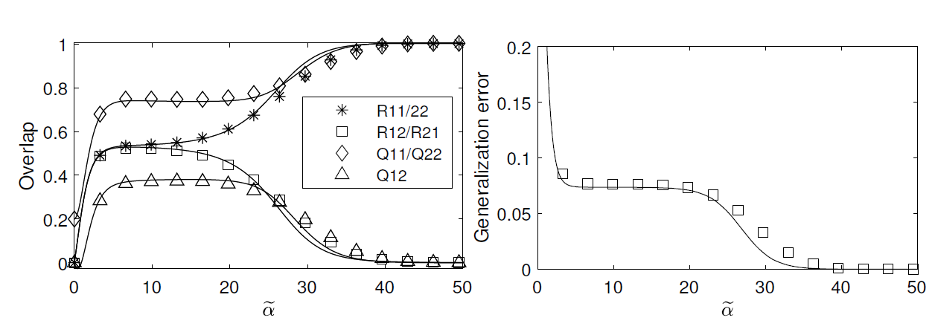
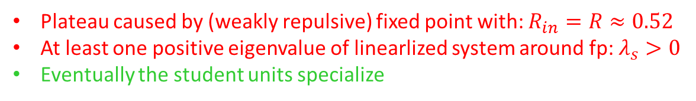
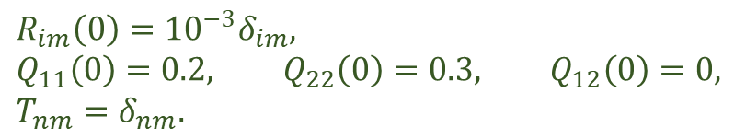
An example: student-teacher ReLU SCM (K=M=2)
$$R_{im}\left(0\right)={{10}^{−3}δ}_{im},$$
$$Q_{11}\left(0\right)=0.2, Q_{22}\left(0\right)=0.3, Q_{12}\left(0\right)=0,$$
$$T_{nm}=δ_{nm}.$$
Initial conditions:
Order parameters
Generalization error
Solid lines: Numerical integration of ODE
Symbols: simulation results for N=10000 and η=0.1
Plateau caused by (weakly repulsive) fixed point with: $R_{in}=R≈0.52$
At least one positive eigenvalue of linearlized system around fp: $λ_{s}>0$
Eventually the student units specialize

Slide 17
On-line learning: Results, Outlook and Challenges
Model framework for Concept Drift ^{[1][2]} (Also LVQ!)
ReLU vs. Sigmoidal
How realistic is it really? Realistic data distributions ^{[3]}
More hidden layers (difficult)
[1]: Straat, M., F. Abadi, Z. Kan, C. Göpfert, B. Hammer, and M. Biehl. ‘Supervised Learning in the Presence of Concept Drift: A Modelling Framework’. Neural Computing and Applications, 27 April 2021.
[2]: Straat, Michiel, Fthi Abadi, Christina Göpfert, Barbara Hammer, and Michael Biehl. ‘Statistical Mechanics of On-Line Learning Under Concept Drift’. Entropy 20, no. 10 (October 2018): 775.
[3]: Goldt, Sebastian, Marc Mézard, Florent Krzakala, and Lenka Zdeborová. ‘Modelling the Influence of Data Structure on Learning in Neural Networks: The Hidden Manifold Model’. Physical Review X 10, no. 4 (3 December 2020): 041044.

Slide 18
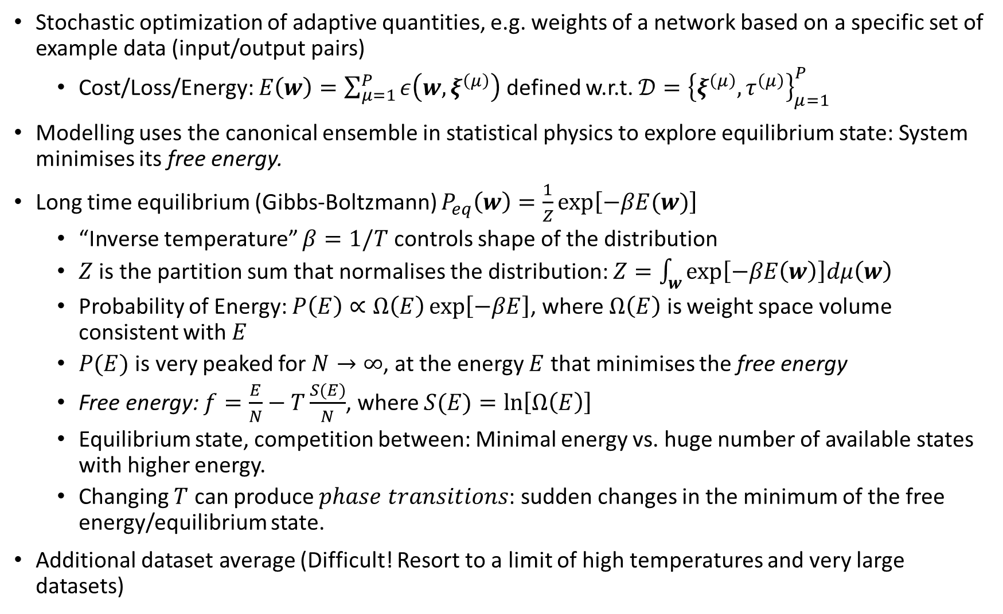
Off-line learning
Stochastic optimization of adaptive quantities, e.g. weights of a network based on a specific set of example data (input/output pairs)
Cost/Loss/Energy: $E\left(w\right)=\sum_{μ=1}^{P}{ε\left(w,ξ^{\left(μ\right)}\right)}$ defined w.r.t. ${𝒟=\left\{ξ^{\left(μ\right)},τ^{\left(μ\right)}\right\}}_{μ=1}^{P}$
Modelling uses the canonical ensemble in statistical physics to explore equilibrium state: System minimises its free energy.
Long time equilibrium (Gibbs-Boltzmann) $P_{eq}\left(w\right)=\frac{1}{Z}\exp\left[−βE(w)\right]$
“Inverse temperature” $β=1/T$ controls shape of the distribution
$Z$ is the partition sum that normalises the distribution: $Z=\int_{w}{\exp\left[−βE\left(w\right)\right]dμ\left(w\right)}$
Probability of Energy: $P\left(E\right)∝Ω\left(E\right)\exp\left[−βE\right]$, where $Ω\left(E\right)$ is weight space volume consistent with $E$
$P(E)$ is very peaked for $N→∞$, at the energy $E$ that minimises the free energy
Free energy: $f=\frac{E}{N}−T\frac{S(E)}{N}$, where $S(E)=\ln\left[Ω\left(E\right)\right]$
Equilibrium state, competition between: Minimal energy vs. huge number of available states with higher energy.
Changing $T$ can produce $phase transitions$: sudden changes in the minimum of the free energy/equilibrium state.
Additional dataset average (Difficult! Resort to a limit of high temperatures and very large datasets)

Slide 19
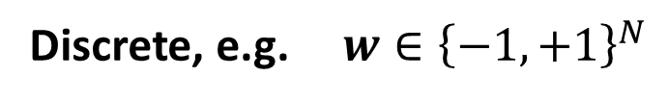
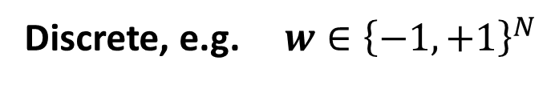






Stochastic optimization
Objective/cost/loss function $H(w)$ with many degrees of freedom
Discrete, e.g. $w∈{\left\{−1,+1\right\}}^{N}$
Continuous, e.g. $w∈ℝ^{N}$
Discrete, e.g. $w∈{\left\{−1,+1\right\}}^{N}$
Continuous, e.g. $w∈ℝ^{N}$
Metropolis algorithm:
Suggest a (small) change
$w→\tilde{w} e.g. a single spin flip$
$w_{j}→{\tilde{w}}_{j}=−w_{j}$ for a random $j$
Acceptance of change
Always if $ΔH<0$
With probability $\exp{[−βΔH]}$ if $ΔH≥0$
Langevin dynamics:
Continuous temporal change, “noisy gradient descent”:
$$\frac{∂w}{∂t}=−∇_{w}H\left(w\right)+f(t)$$
with delta-correlated white noise
$$\left\langle f_{i}\left(t\right)f_{j}(s)\right\rangle =\frac{2}{β}δ_{ij}δ(t−s)$$
Temperature $T=1/β$
controls acceptance rate for “uphill” moves
…. Controls noise level, i.e. random deviation from gradient

Slide 20


student teacher scenario: “soft committees”
adaptive student
N inputs
(K) hidden units (M)
teacher
? ? ? ? ? ? ?
here: learnable rules, reliable data (outputs provided by teacher)
perfectly matching complexity K=M
consider two prototypical activation functions:
sigmoidal / ReLU in student and teacher
Site symmetry assumptions to limit the number of variables:
$R_{ij}=\left\{\begin{aligned}R, i=j \\ &S, i≠j\end{aligned}\right.$, $Q_{ij}=\left\{\begin{aligned}1, i=j \\ &C, i≠j\end{aligned}\right.$

Slide 21

typical learning curves by minimization of free energy
given: $K, g(x)$,
solve:
Closed form expression for the Erf, ReLU and GELU
model-independent closed form expression
determine (global and local) minima of
obtain learning curves
order parameters, generalization error (typical, average)
as a function of the (scaled) training set size

Slide 22


sigmoidal (K>2)
permutation symmetry of h.u.
initial R=S phase
K=5
first order transition, local min.
R>S competes with R=S
R>S becomes global minimum
facilitates perfect learning
additional transition:
“anti-specialization” S>R
(overlooked in 1998!)
discontinuous jump in ε _{g}
coexistence of poor and good
generalization
weak / no effect of additional
anti-specialization on gen. error

Slide 23
discontinuous transition (schematic)
βf
βf
βf
βf
R>S
R<S
R=S
R=S
R=S
R>S
R>S

Slide 24


ReLU (K>2)
permutation symmetry of h.u.
initial R=S phase
K=10
continuous phase transtion
global minimum: R>S
local minimum: R<S
continuous kink(s) in ε _{g}
competing minima of
poor* vs. good generalization
^{* pretty good}

Slide 25


ReLU (large K)
permutation symmetry of h.u.
initial R=S phase
continuous phase transtion
at
degenerate minima: R>S, R<S
specialized and
anti-specialized branch
both achieve perfect
generalization, asymptotically !
Elisa Oostwal, Michiel Straat, and Michael Biehl. ‘Hidden Unit Specialization in Layered Neural Networks: ReLU vs. Sigmoidal Activation’. Physica A: Statistical Mechanics and Its Applications 564 (15 February 2021): 125517.

Slide 26
Phase transition type
Which property of the activation function determines the type of phase transition?
Division in the two classes
Continuous: RELU, Abs
Discontinuous: sigmoidal (tanh, erf, logistic), PLU
Possible hypothesis: convexity of the activation function
In practice: Swish and GELU have shown superior performance.

Slide 27


Stat. Phys. Analysis of GELU
Frederieke Richert, Michiel Straat, Elisa Oostwal and Michael Biehl. ‘Layered Neural Networks with GELU Activation, a Statistical Mechanics Analysis’. Accepted at ESANN 2023

Slide 28


Results for different hidden layer size $K$

Slide 29


Results for different scaling $γ$

Slide 30
Books
Engel, Andreas, and Christian P. L. Van den Broeck. Statistical Mechanics of Learning. New York, NY, USA: Cambridge University Press, 2001.
Saitta, L., A. Giordana, and A. Cornuéjols. Phase Transitions in Machine Learning. Cambridge University Press, 2011.
Krauth, Werner. Statistical Mechanics: Algorithms and Computations. Oxford Master Series in Physics Statistical, Computational, and Theoretical Physics 13. Oxford: Oxford Univ. Press, 2006.

Slide 31
Conclusion
Interesting analysis of typical learning behaviour, exact averaged results. Increased understanding can inspire new algorithm design.
Complementary to other theories and studies.
Requires further simplifying assumptions to model realistic situations, e.g. in case of deep neural networks
Future work: Adding more realism to improve modelling. Realistic data distributions.

