Slide 1

Vanguard

Slide 2



More complains, less logons?

Slide 3
Table of contents
01
02
03
04
05
06
Exploring Data
Cleaning & Wrangling
KPI Metrics
Hypothesis & Results
Experiment Evaluation
Recommendations

Slide 4
01
Exploring Data
Client Profiles Table / Digital Footprints Tables / Experiment Roster / Step Definition
Start Open UI
Step 1 Searching for Investment Opportunities
Step 2 Choosing Product
Step 3 Choosing Investment Amount
Confirm Making Investment

Slide 5
02
Cleaning & Wrangling

Slide 6
Null Value Processing
Gender Column Cleanup
Age and Tenure Discrepancy Fix
Age Grouping
20 years or younger: Teen
20-60 years: Adult
Above 60 years: Senior
Overview of Data Tables
Data Analysis
Identified Similar Structures
Data Concatenation
Final Clients DataFrame
Data Merge

Slide 7

Is the data of the Experiment enough to be reliably used to assess an added value for Vanguard, or is it a
GAMBLE?

Slide 8
03
KPI Metrics
Completion Rate
Time spent on each step
Error rates per step

Slide 9
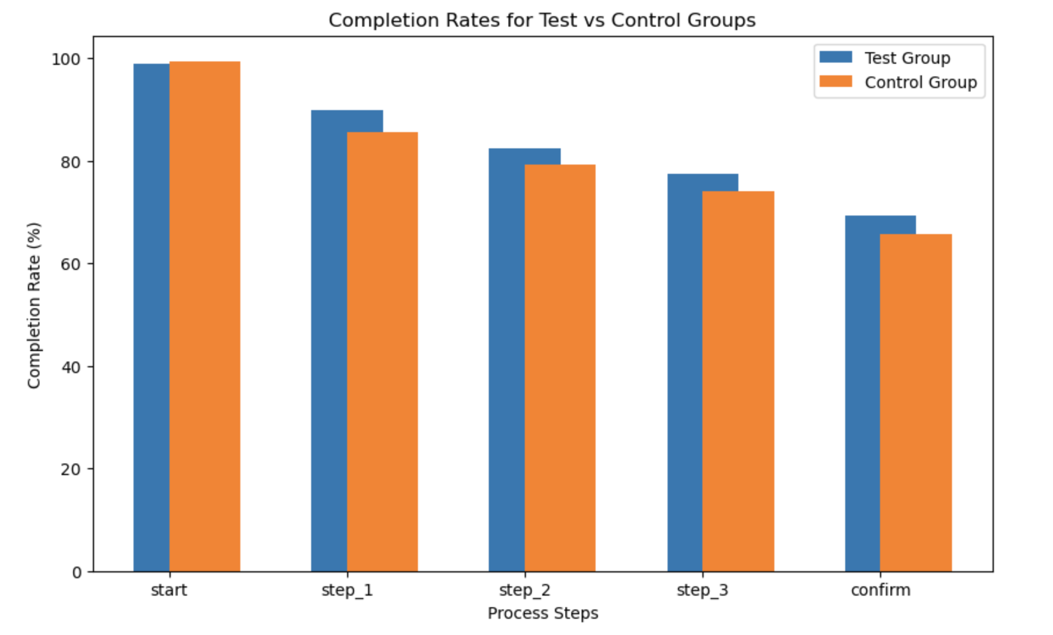
Proportions per step
Total Test User | Total Control User
18687 | 15434
Client ID -
user had to reach ‘confirm’ at least once
Confirm Threshold below 5%

Slide 10
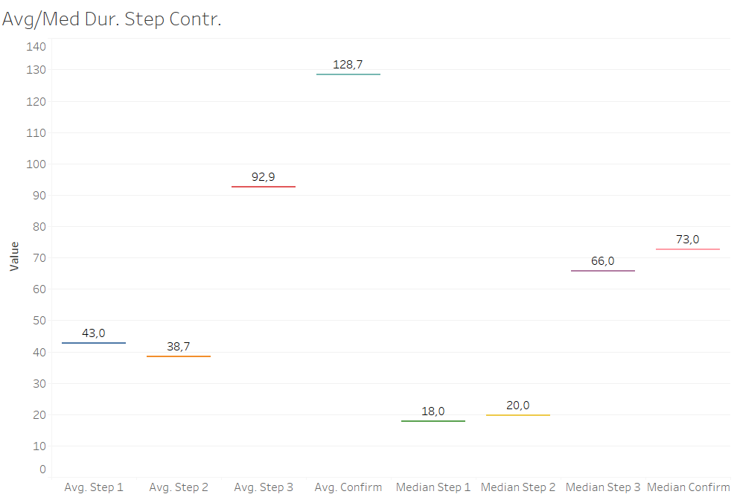
Step Duration Average Median
Control

Slide 11
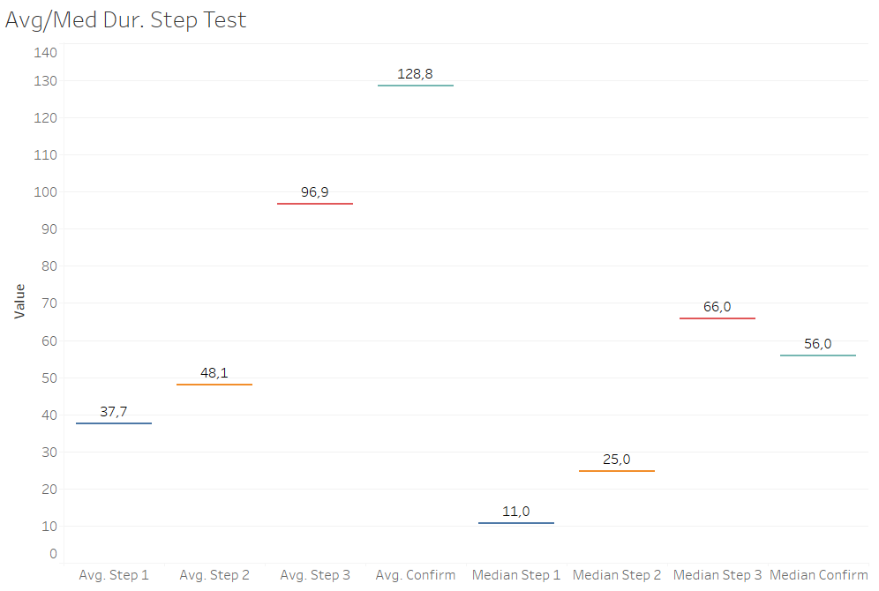
Step Duration Average Median
Test

Slide 12
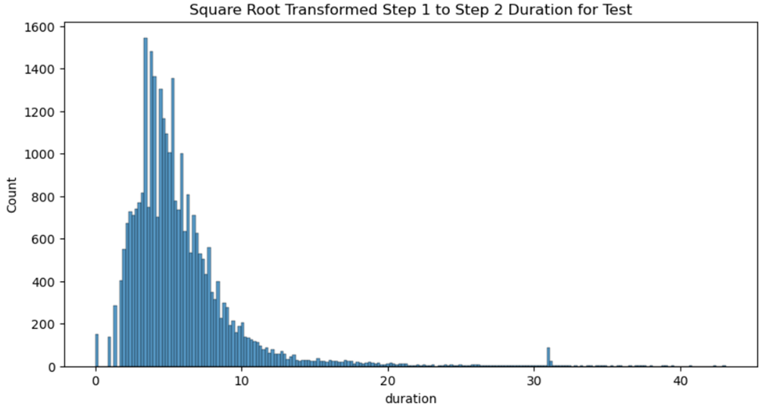
Step Time Distribution

Slide 13
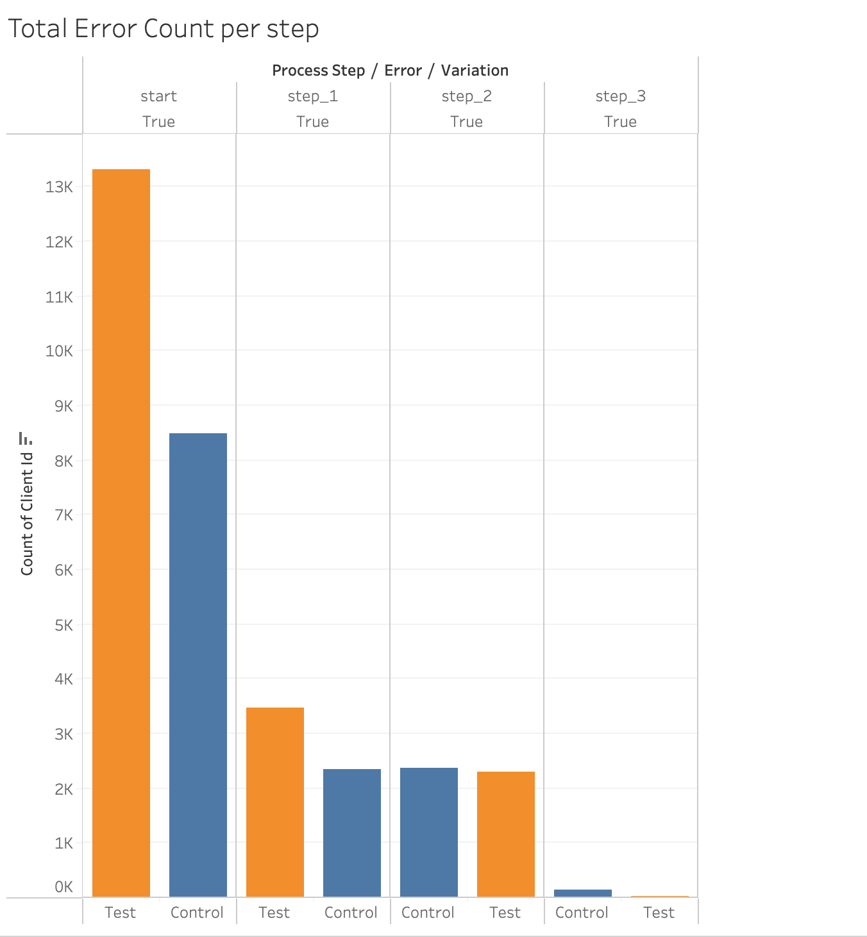
Error Rates
 | Control | Test
Total | 19088 | 13335
Rate | 10,73% | 9.3%
Error = step backward, interruption or repeating step

Slide 14
04
Hypothesis

Slide 15
Hypothesis - Proportions
Null Hypothesis (H₀): There is no difference in the completion rates between the Test and Control groups.
Alternative Hypothesis (H₁): There is a difference in the completion rates between the Test and Control groups.
 | p-value | t-statistic | H0 reject
ttest two-sided | 6.822182086187193e-19 | 8.881266522192275 | yes
greater | 3.4110910430935966e-19 | 8.881266522192275 | yes

Slide 16
Hypothesis - Step Duration
H0: Test Step Duration == Control Step Duration
H1: Test Step Duration != Control Step Duration
Step | ttest two-sided | H0 reject (below 5%)
Start to step 1 | 9.44E-12 | yes
Step 1 to step 2 | 1.61E-38 | yes
Step 2 to step 3 | 0.0003813 | yes
Step 3 to confirm | 0.9632919 | no

Slide 17
Hypothesis - Step Duration
H0: Test Step Duration <= Control Step Duration
H1: Test Step Duration > Control Step Duration
Step | ttest greater | H0 reject (below 5%)
Start to step 1 | 0.000000000004721 | yes
Step 1 to step 2 | 1.00 | no
Step 2 to step 3 | 0.999809367 | no
Step 3 to confirm | 0.518354072 | no

Slide 18
Hypothesis - Gender - Control and Test
Null Hypothesis (H₀): There is no difference in engagement between genders with the old process.
Alternative Hypothesis (H₁): There is a difference in engagement between genders with the old process.
Null Hypothesis (H₀): There is no difference in engagement between genders with the new process.
Alternative Hypothesis (H₁): There is a difference in engagement between genders with the new process.
 | p-value | t-statistic | H0 reject
ttest two-sided control | 0.0013847093462349372 | -3.198458818170921 | yes
ttest two-sided test | 4.72375894269815e-09 | -5.8597 | yes

Slide 19
Key Results
KPI | Test | Control
Completion Rate | 69,29% | 65,59%
Time spent on each step | Step 2 and 3 quicker | Step 1 quicker
Error rate | 9,3% | 10,73%
Total User | 18687 | 15434
Start Open UI
Step 1 Searching for Investment Opportunities
Step 2 Choosing Product
Step 3 Choosing Investment Amount
Confirm Making Investment

Slide 20
05
Experiment Evaluation
Experiment structure, client distribution and duration
Notes:
Was the experiment well-structured? Were clients randomly and equally divided between the old and new designs? Were there any biases?

Slide 21
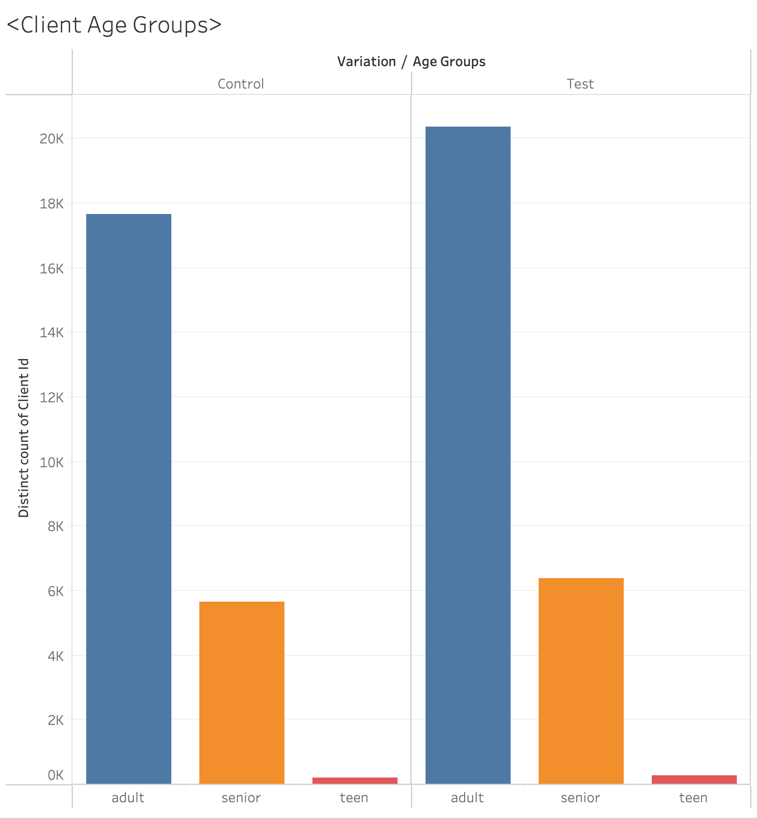
Experiment Evaluation

Slide 22
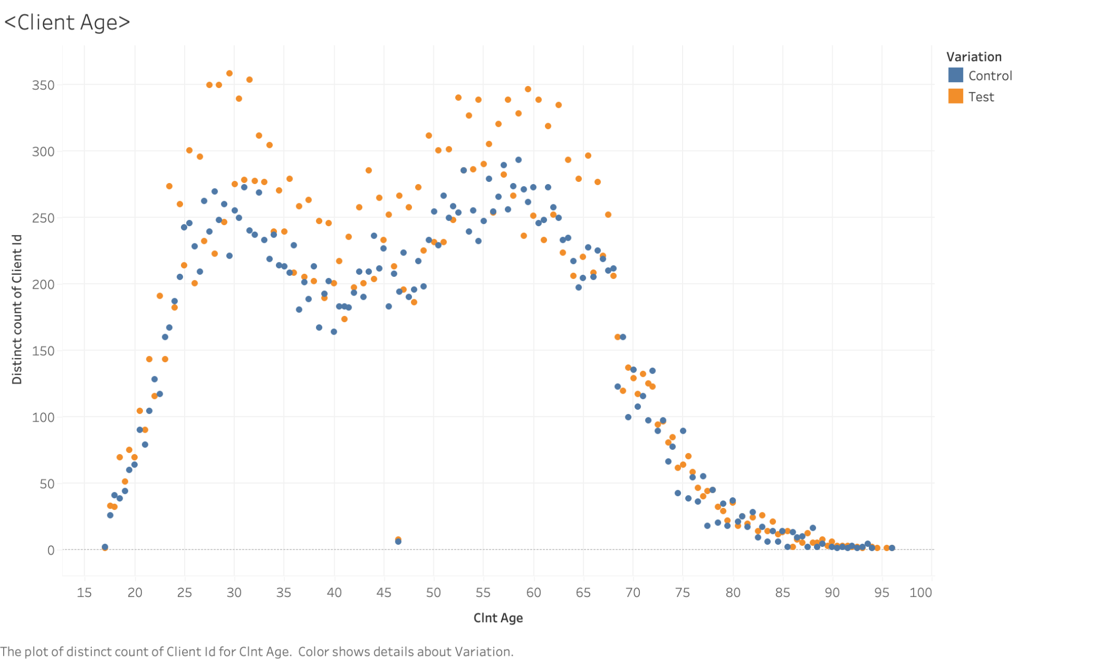
Experiment Evaluation

Slide 23
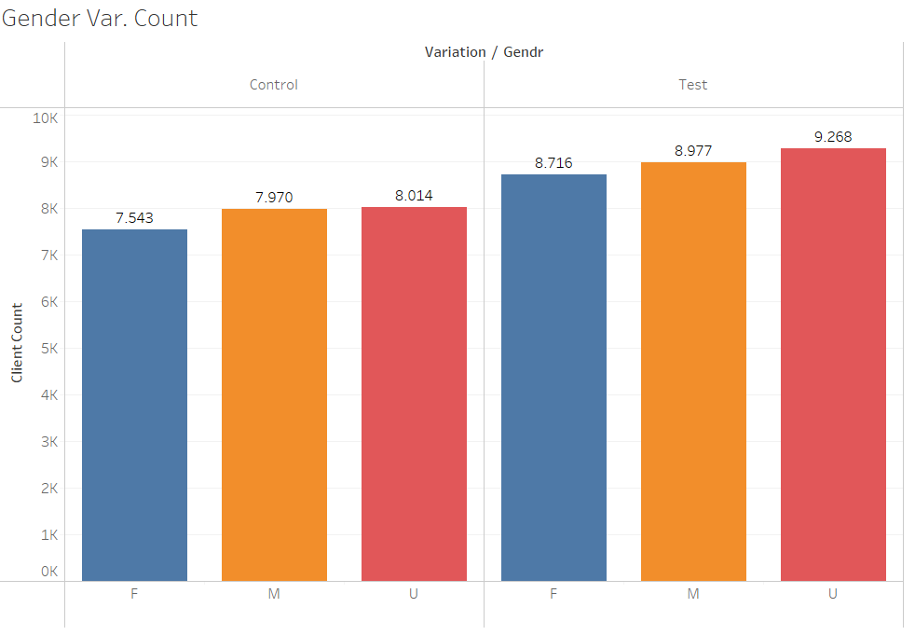
Experiment Evaluation

Slide 24
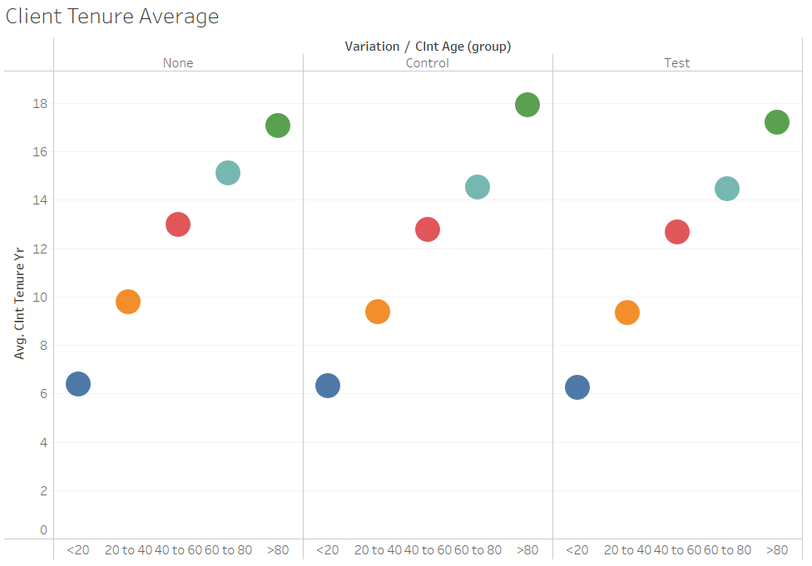
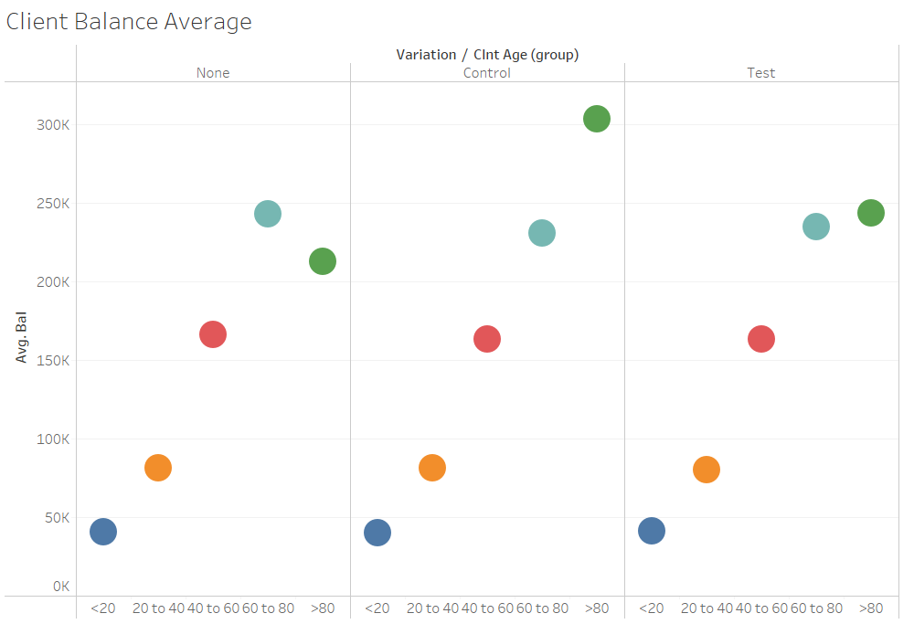
Experiment Evaluation

Slide 25
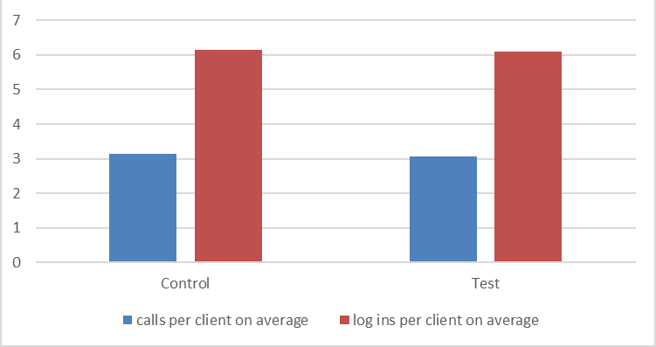
Calls and Logons - 6 months

Slide 26
04
Recommendations
Notes:
Was the experiment well-structured? Were clients randomly and equally divided between the old and new designs? Were there any biases?

Slide 27
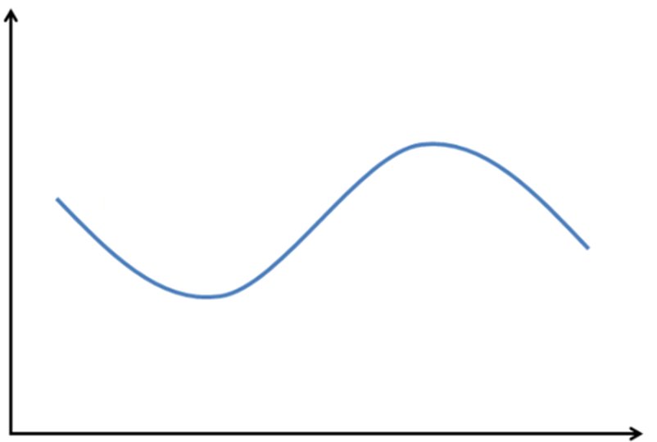
Notes:
longer time period / investigating outliers

Slide 28
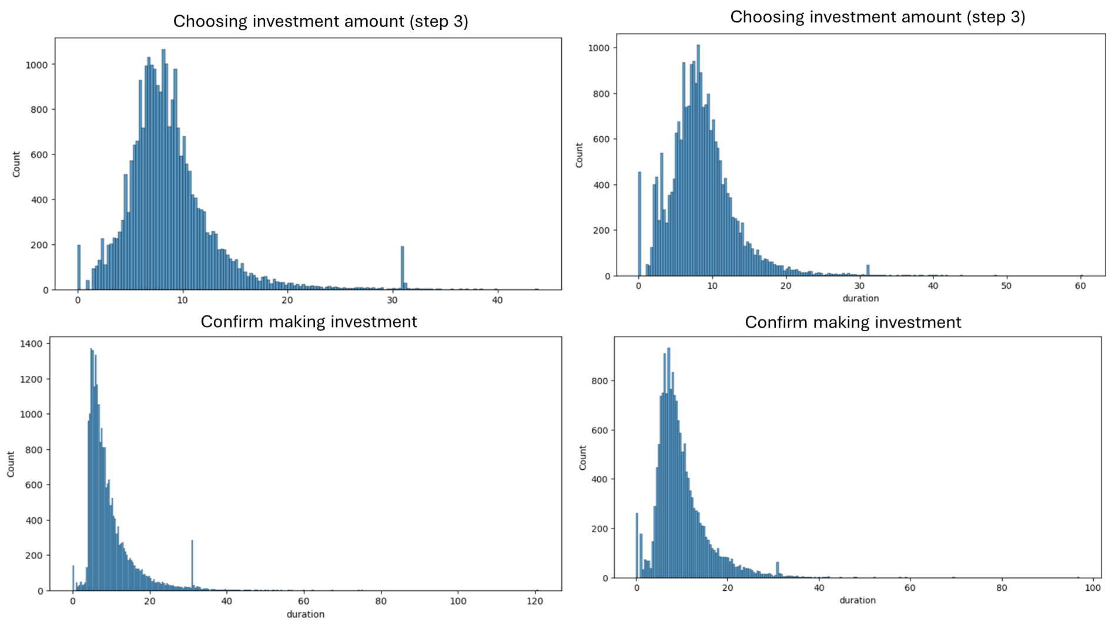
Test
Control

Slide 29
Challenges
sorting values for calculations (client_id: Every client’s unique ID, visitor_id: A unique ID for each client-device combination, visit_id: A unique ID for each web visit/session, date_time: Timestamp web activity)
formatted p-value to 4f - mistook for close to 1 and 0
dataframes werent optimized for tableau
lists give different p-value than array

Slide 30
Thanks!
Do you have any questions?

Slide 31
Hypothesis - Average age and Tenure
H0: test_average_age == control_average_age
H1: test_average_age != control_average_age
Test Variable | ttest two-sided | H0 reject (below 5%)
Age | 0.01568808321554057 | yes
H0: test_average_tenure == control_average_age
H1: test_average_age != control_average_age
Test Variable | ttest two-sided | H0 reject (below 5%)
Tenure | 0.03210338822227781 | yes

Slide 32
Hypothesis - Step Duration
H0: Test Step Duration >= Control Step Duration
H1: Test Step Duration < Control Step Duration
Step | ttest less | H0 reject (below 5%)
Start to step 1 | 0.999999999 | no
Step 1 to step 2 | 8.06E-39 | yes
Step 2 to step 3 | 0.000190633 | yes
Step 3 to confirm | 0.481645928 | no

