Slide 1
RUST
Michał Pałkowski

Slide 2
TABLE OF CONTENTS
01
03
02
04
Beginning
Basic code
Where it is
used
End

Slide 3
01
OVERVIEW

Slide 4
Beginning
Rust is statically-typed language designed for performance and safety
It is one of the most popular language
Rust is based in c++, because of the syntax
It was created in 2006 by Graydon Hoare

Slide 5
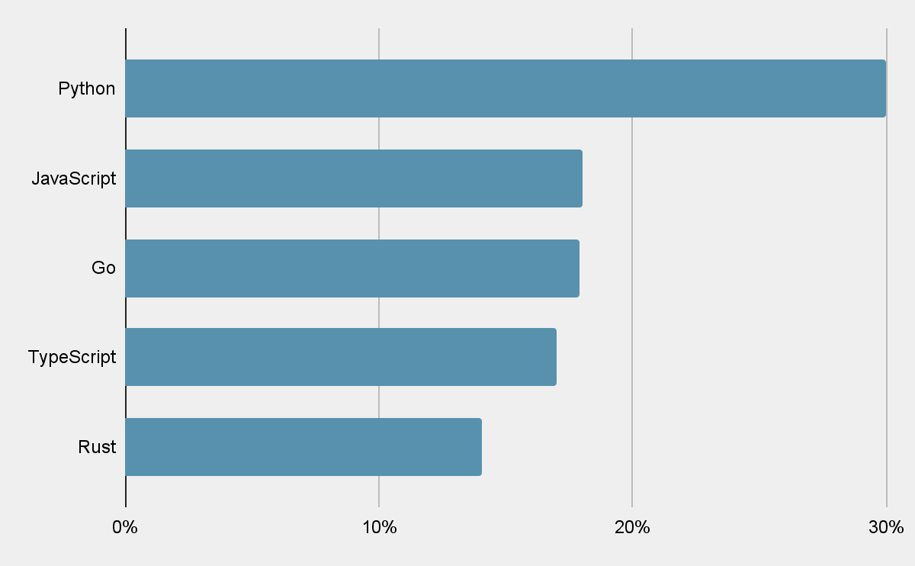
Most liked programming language
Data from 2021

Slide 6
$160,000
2,200,000
Rust medium salary
Active rust developers

Slide 7
02
Where it is used

Slide 8
49%
38%
CLI TOOLS
System Programming
Web development
Game development

Slide 9
03
Basic code

Slide 10
Code
fn main(){
println!(“Hello world”);
}
Terminal:
Hello world

Slide 11

Fun facts
Rust is used in linux kernel
It doesn’t have garbage collector
Rust has a mascot - crab

Slide 12
Thanks for watching!

