Slide 1
The Four Gates
ארבעה שערים
Michoel Reach

Slide 2
Contents
History and overview
ארבעה שערים
The Four Gates app

Slide 3
History of the “ארבעה שערים” - 1
See my presentation on “This Year’s Calendar”.
The Rambam says calculation of the fixed calendar began around the time of Abaye and Rava.
The basic steps of calculating the calendar: (a) Is the year is פשוטה (regular) or מעוברת (leap)? – 19 year cycle. (b) When is the molad for this year’s Rosh Hashana? - counting months from the beginning of time, and (c) Use that to decide on the actual calendar for the year.
Details are in “This Year’s Calendar”. Here I assume that the reader is familiar with the 19 year cycle, and with how to calculate the molad.

Slide 4
History of the “ארבעה שערים” - 2
The date of Rosh Hashana is always on or after the day where the molad falls. But -
מולד זקן – if the molad is after 18 hours of the day (=noon), Rosh Hashana is moved forward to the next day.
לא אד"ו ראש – Rosh Hashana is never allowed to be on Sunday, Wednesday, or Friday. If that happens, it is moved to the next day. Both of these can happen, or just one of them.
For example, if the molad is (ג, יט, כ) = (3 days, 19 h, 20 chalakim), Rosh Hashana would move from Tuesday to Wednesday because 19h > 18h, מולד זקן.
But Rosh Hashana cannot fall on Wednesday (לא אד"ו ראש), so it would move to Thursday.

Slide 5
History of the “ארבעה שערים” – 3a
Aside from those two “דחיות”, additional adjustments to Rosh Hashana are made in various ways. Let’s start with the original system.
שו"ח כה"ז חד"ו - the original system described in the writings of the Gaonim.
Chazal set allowable lengths of the year, from one Rosh Hashana to the next. There are three types of years: שלימה, כסידרן, חסרה. Short, medium, long.
For a regular פשוטה year, the allowable lengths are 353, 354, 355 days. Leaving off the 50 weeks (=350 days), that’s a shift of 3, 4, or 5 days in the week from one Rosh Hashana to the next.
For a leap מעוברת year – an extra month! - the allowable lengths are 383, 384, and 385 days. Leaving off 54 weeks (=378 days), that’s a shift of 5, 6, 7 days in the week from one Rosh Hashana to the next.

Slide 6
Allowable length of year - summary
 | שלימה | כסידרה | חסירה
פשוטה | 5 day shift (355 days) | 4 day shift (354 days) | 3 day shift (353 days)
מעוברת | 7 day shift (385 days) | 6 day shift (384 days) | 5 day shift (383 days)

Slide 7
History of the “ארבעה שערים” – 3b
שו"ח כה"ז חד"ו, cont.
Somewhat confusingly, the Gaonim counted the shifts inclusively, including both the beginning and the ending day.
So the shift of 3, 4, or 5 days for a regular year, they called 4, 5, 6 days: ד, ה, ו, for short, medium, and long years.
The shift of 5, 6, 7 days in the week for a leap year, they called 6, 7, 8 days: ו, ז, ח.
ש is a long year, שלימה. כ is a medium year, כסידרן. And ח is a short year, חסרה.
To summarize: שו"ח כה"ז חד"ו, a mnemonic for remembering the allowable year lengths.

Slide 8
History of the “ארבעה שערים” - 4
So here was the original שו"ח כה"ז חד"ו system:
Find the molad of Tishrei for four years: last year, this year, next year, the year after.
Adjust each of them forward, if needed, using מולד זקן and לא אד"ו ראש.
Check the resulting lengths of last year, this year, and next year.
Use the rule שו"ח כה"ז חד"ו to find what is allowed. If any year is too long, move the day of Rosh Hashana at its beginning one day later to adjust. If that violates לא אד"ו ראש, move it again.
If any year is too short, move the day of Rosh Hashana at its end one day later to adjust, same idea.

Slide 9
History of the “ארבעה שערים” – 4b
More on theשו"ח כה"ז חד"ו system:
You might think that adjustments like that could have a knock-on effect, messing up the length of the next year over. That turns out never to happen; you never need to do it more than once.
Even if we are only interested in the beginning and end of this year, for this year’s calendar, we still need to work out the molad Tishrei of all these four years. That’s because the length of next year could pull the Rosh Hashana at the end of this year forward, and the length of last year could push the Rosh Hashana at the beginning of this year forward.

Slide 10
History of the “ארבעה שערים” - 5
The Gaonim saw that these adjustments are rare, actually only happen in two cases:
ג"ט ר"ד: In a regular year (פשוטה), if the molad is on Tuesday after 9 hrs and 204 chalakim (ג' ט' ר"ד), next year’s Rosh Hashana ends up moving two days forward and the year is too long. This year’s Rosh Hashana needs to move forward from Tuesday to Wednesday to compensate, and then to Thursday because of לא אד"ו ראש.
בט"ו תקפ"ט: In a leap year (מעוברת), if the molad is on Monday after 15 hrs and 589 chalakim (ב' ט"ו תקפ"ט), last year’s Rosh Hashana ends up moving two days forward and the year is too short. This year’s Rosh Hashana needs to move forward from Monday to Tuesday to compensate.

Slide 11
History of the “ארבעה שערים” - 6
We now have the “ד' דחיות” given in most discussions of the calendar:
מולד זקן
לא אד"ו ראש
ג"ט ר"ד for regular years
בט"ו תקפ"ט for leap years
This is the system as it is usually presented.
For the ד' דחיות we only need to calculate the molad of this year’s Tishrei, and of next year’s. We use these four rules on each of them to see where their Rosh Hashanos end up.

Slide 12
Contents
History and overview
ארבעה שערים
The Four Gates app

Slide 13
ארבעה שערים
The Gaonim also described a way to mechanize the entire process: the ארבעה שערים, the “Four Gates”.
You only need this year’s molad Tishrei, and
from the 19 year cycle: Of last year, this year, and next year, which are regular (פ for פשוטה) and leap years (מ for מעוברת)? For instance, פמ"פ means this is a leap year in the middle between two regular years.
The ארבעה שערים now tells you the proper calendar.
This is the ultimate simplification of the process of determining the calendar. All the dechiyos are taken into account automatically.

Slide 14
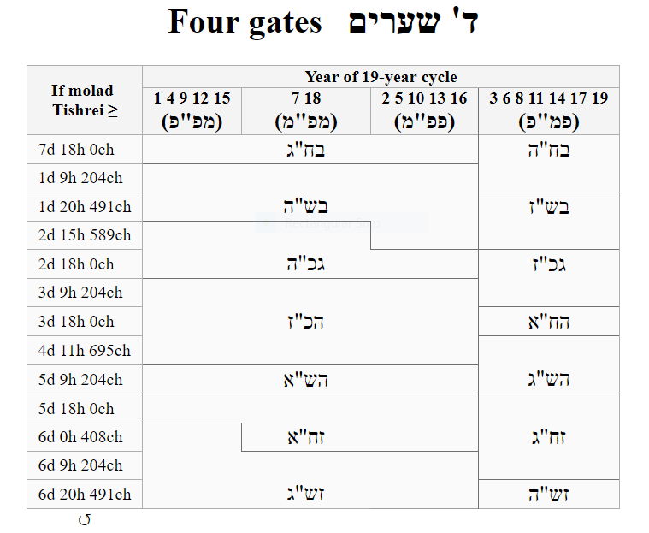
(6d 11h 882ch)

Slide 15
History of the “ארבעה שערים” – 7b
In the Tur (OH 428) this is just presented as a list of cases:
שנה שעיבור לפניה ולא לאחריה והיא שנת אד"ט י"ב ט"ו, וכלל שלה אטר"ד ב"ש בט"ו תקפ"ט ג"כ גטר"ד ה"כ הטר"ד ה"ש הי"ח ז"ח ות"ח ז"ש זי"ח ב"ח. וזה פירושו מולד של ר"ה שנולד באטר"ד וממנו עד בט"ו ותקפ"ט יהיה ר"ה ביום ב' והשנה שלימה והנולד בבט"ו תקפ"ט וממנו עד גטר"ד יהיה ר"ה ביום ג' והשנה כסדרן והנולד בגטר"ד וממנו עד הטר"ד יהיה ר"ה ביום ה' והשנה כסדרן והנולד בהטר"ד וממנו עד הי"ח יהיה ר"ה ביום ה' והשנה שלימה והנולד בהי"ח וממנו עד ות"ח יהיה ר"ה ביום ז' והשנה חסירה והנולד בות"ח וממנו עד זי"ח יהיה ר"ה ביום ז' והשנה שלימה והנולד בזי"ח וממנו עד אטר"ד יהיה ר"ה ביום ב' והשנה חסירה
ובשנה שעיבור לאחריה ולא לפניה והיא שנת ב' ה' י"ג י"ו כלל שלה אטר"ד ב"ש בי"ח ג"כ גטר"ד ה"כ הטר"ד ה"ש הי"ח ז"ח וטר"ד ז"ש זי"ח ב"ח. והפי' כמו שכתבתי בכלל הראשון מתחלת הסי' עד סי' שלאחריו סי' השנה כמו שכתוב אצלו
ובשנה שעיבור לפניה ולאחריה והוא שנת זי"ח כלל שלה אטר"ד ב"ש בט"ו תקפ"ט ג"כ גטר"ד ה"כ הטר"ד ה"ש הי"ח ז"ח וטר"ד ז"ש זי"ח ב"ח
ובשנה מעוברת שהיא שנת גוח יא יד יז יט כלל שלה א"כ תצ"א ב"ש בי"ח ג"כ גי"ח ה"ח די"א תרצ"ה ה"ש הי"ח ז"ח ו"ך תצ"א ז"ש זי"ח ב"ח. עכ"ל

Slide 16
ארבעה שערים - 1
That list is obviously pretty obscure.
But the idea is that as you gradually move the molad of Tishrei, from 0h on Shabbos through to 23h on Friday, each of the molads for Tishrei of the other three years (last year, next year, the year after) move in synch. They are linked together, distanced by the lengths of last year, this year, next year, respectively.
Those year lengths depend on whether each of those years is פשוטה or מעוברת, 12 lunar months or 13. Once you’ve chosen this year in the 19-year cycle, all that is determined, and all the molads will move together.

Slide 17
ארבעה שערים - 2
As all these molads move in synch, at certain points (listed by the Tur) one of them crosses a transition point – 18h in the day for the rule of מולד זקן.
At that point its Rosh Hashana shifts by a day (maybe two because of לא אד"ו ראש).
As we’ve seen, that can affect the neighboring years as well, pulling them forward to make the year in between longer or shorter.
To understand the list, you need to go through them one by one and work out which molad is hitting the transition and what happens as a result.

Slide 18
ארבעה שערים - 3
It would be natural to assume that the Four in “Four Gates” refers to the four types of years on the 19-year cycle as shown above: פמ"פ, פפ"מ, מפ"מ, and מפ"פ.
From the writings of the Gaonim, that turns out not to be true. They describe the system as four days of Rosh Hashana: The range of molads that lead to Monday as Rosh Hashana is one gate, another gate is that range that leads to Tuesday, etc.
Since there are four possible days from Rosh Hashana according to לא אד"ו ראש, there are four gates.
(See for instance the description in Sefer Hamoadim, ascribed to R’ Saadia Gaon.)

Slide 19
Contents
History and overview
ארבעה שערים
The Four Gates app

Slide 20
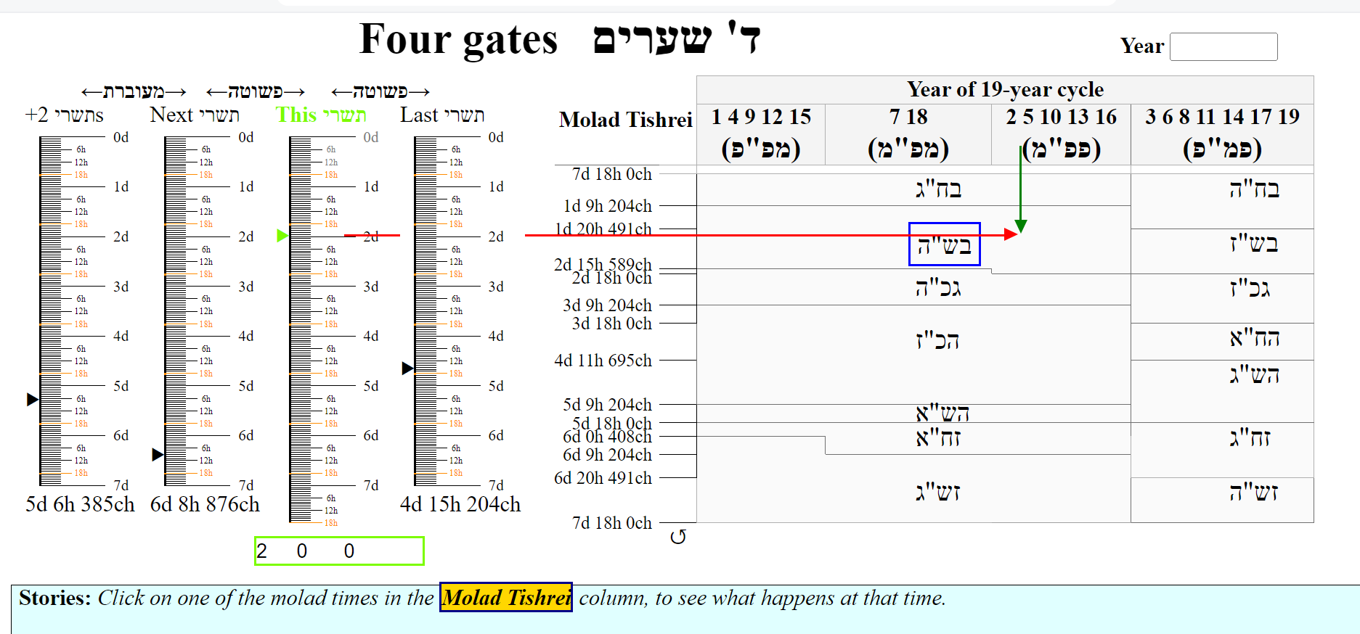
The Four Gates app - 1
To help in understanding this, I made an app to illustrate the Four Gates. It is a self-contained web page.

Slide 21
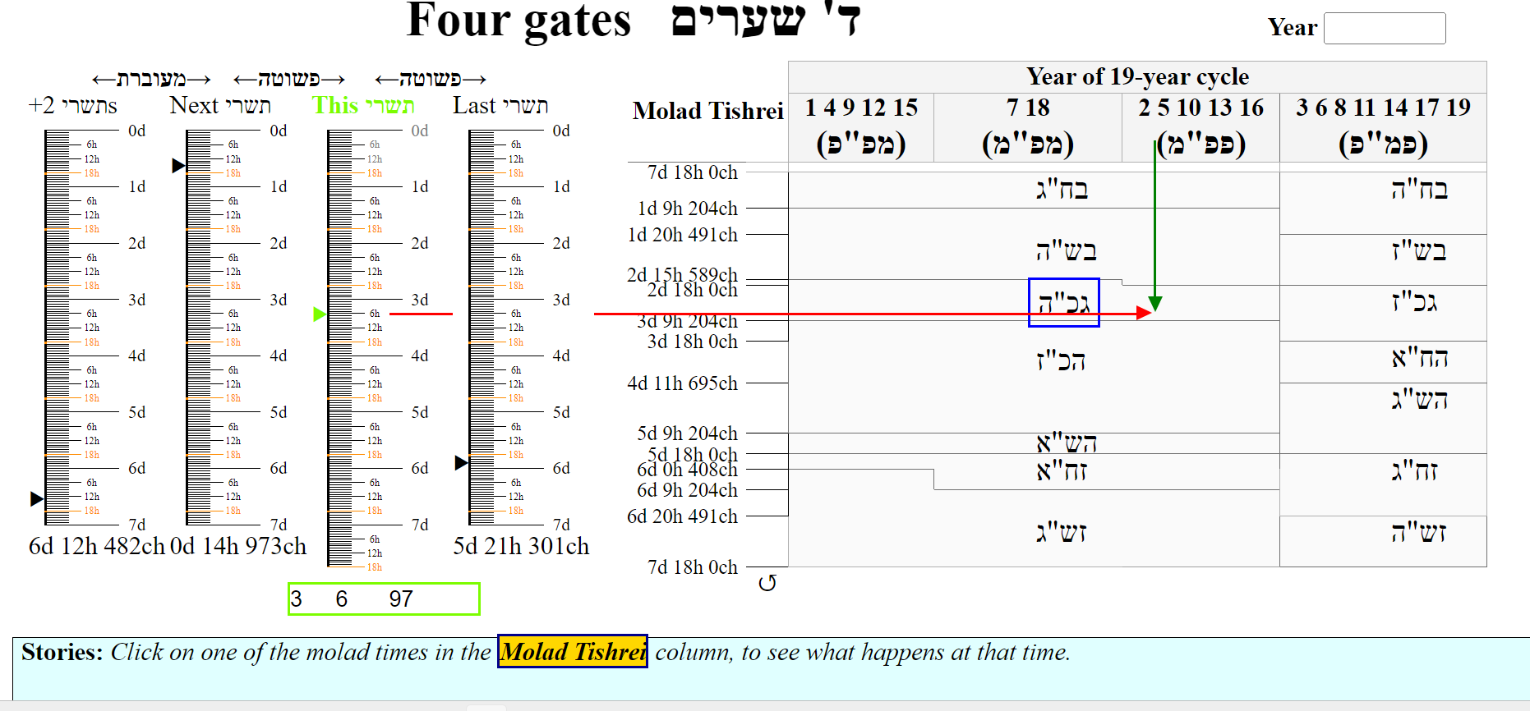
The Four Gates app - 2
You can pull on this year’s molad Tishrei – the green triangle in the third column from the left – to change the molad. The other three molad pointers keep track.

Slide 22
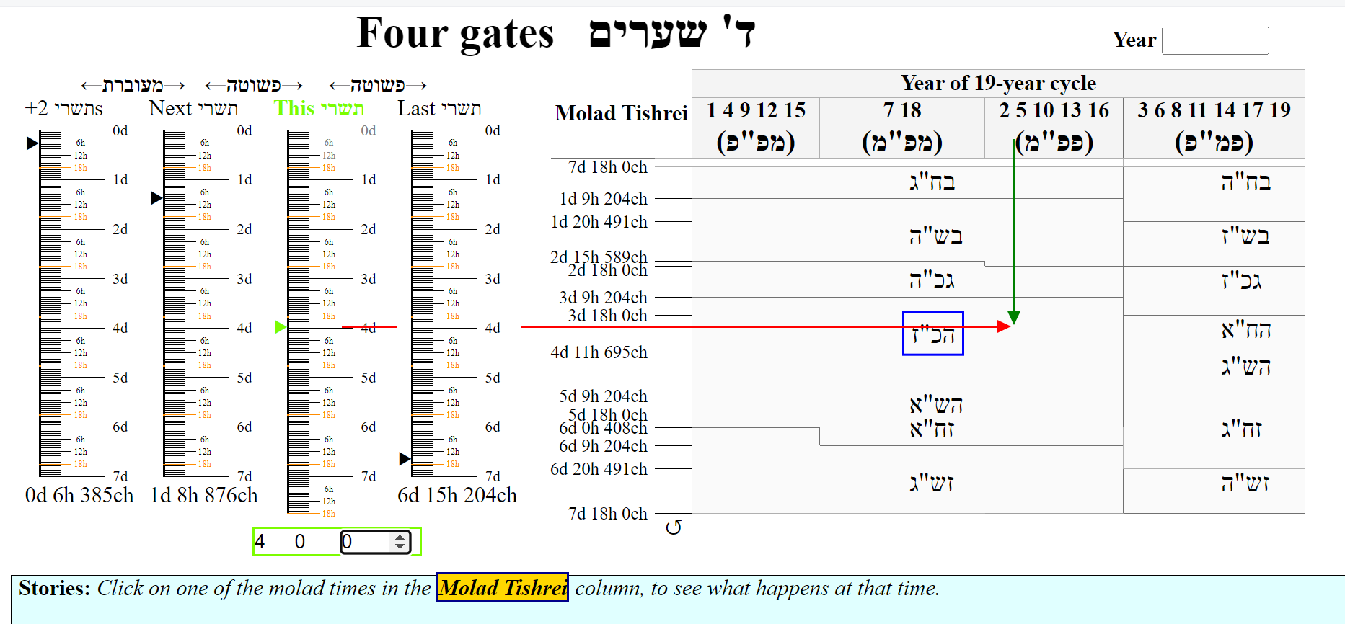
The Four Gates app - 3
You can also set the molad by hand in the green rectangle box on the bottom left. Again the other molads shift to match the new value.

Slide 23
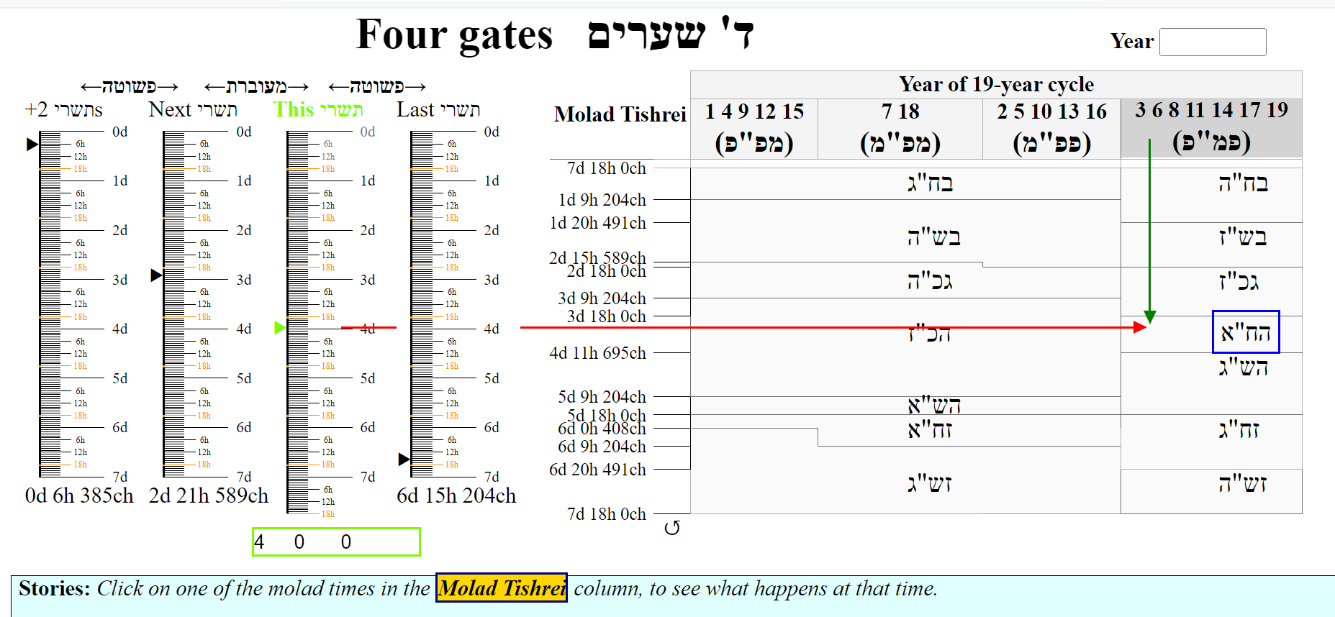
The Four Gates app - 4
Click on a grey year-type headers on the right – (פמ"פ) here – and the molad pointers on the left-hand-side adjust, because the lengths of the years changed.

Slide 24
The Four Gates app - 5
The red and green arrows always point from this year’s molad (red), and this year’s year type (green), to the actual calendar for that year. Here it is הח"א.

Slide 25
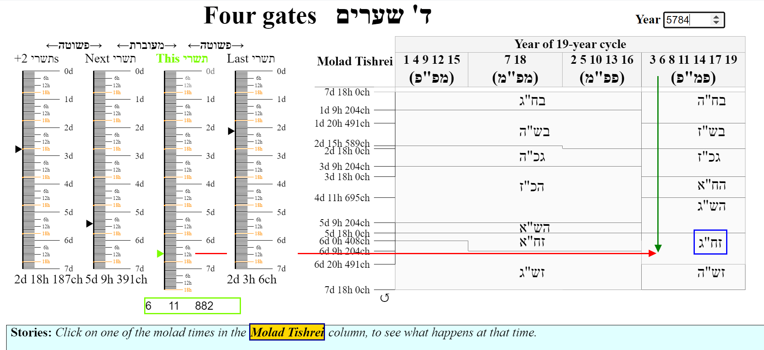
The Four Gates app - 6
If you enter the year in the box on the upper right, it will set the molad to the molad Tishrei for that year - and give the correct calendar. This year:

Slide 26
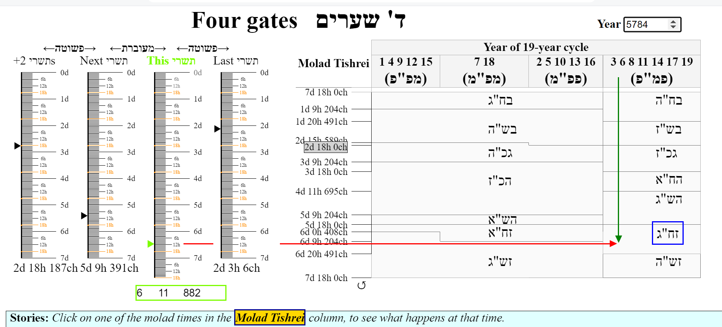
The Four Gates app – 7a
Okay, let’s look at those transitions from the Tur! These are the molad times in the column titled “Molad Tishrei”. Hover over one of them for its story.

Slide 27
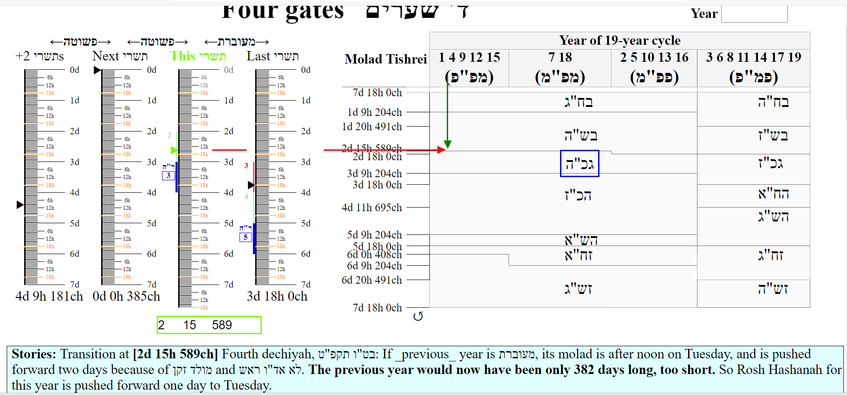
The Four Gates app – 7b
If you click on one of them, (a) a full explanation appears in the Stories section:

Slide 28
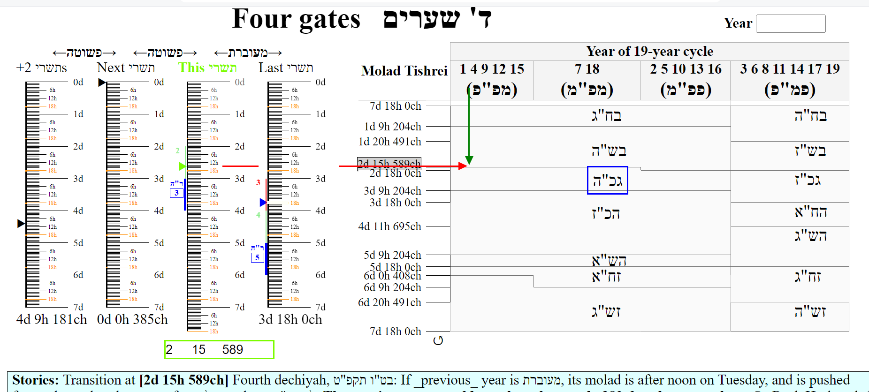
The Four Gates app – 7c
Also, (b) the molad is set on the left. You can see all the changes that happened in the relevant years: initial Rosh Hashana, and where it ended up (blue bar(s)).

Slide 29
The Four Gates app – 7d
You will see the molad Tishrei that triggered the rest, as it passed an 18h mark (מולד זקן). In this case (2d 15h 589ch), it was last year’s molad (fourth column).

Slide 30
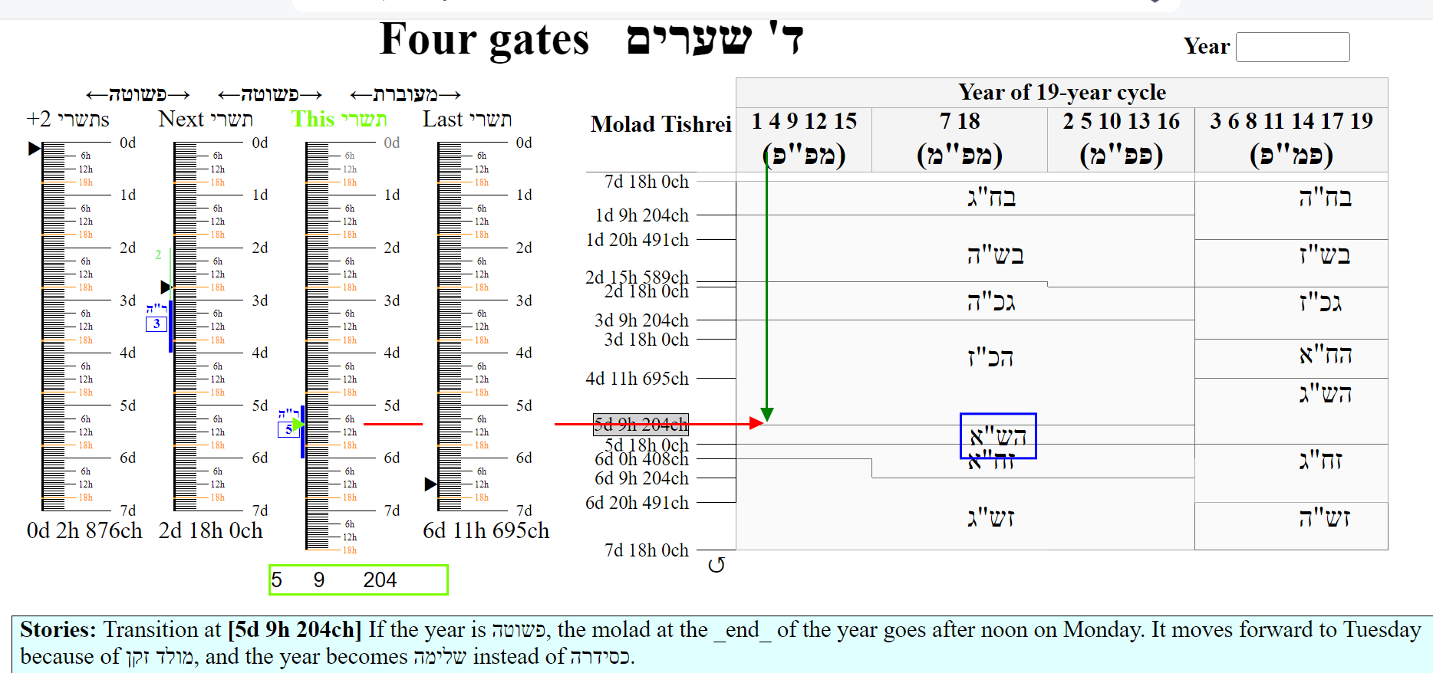
The Four Gates app – 7e
In this way, you can see how each of the Tur’s transitions works.

Slide 31
References
Tur, Orach Chaim, 428. The chart there is the basis of the Keviyus web page.
Tiferes Yisrael, Sh’vilei d’rakia (at end of Seder Moed)
Rabbi Nathan Bushwick, Understanding the Jewish Calendar, Moznayim, 1989.
This presentation and the Four Gates app are available on https://github.com/MichoelR/Keviyus/tree/master/FourGates and
https://drive.google.com/drive/folders/1a1V1rV5Pg-ZidLweWUIJk_-8f5r7Dgwm

