Slide 1
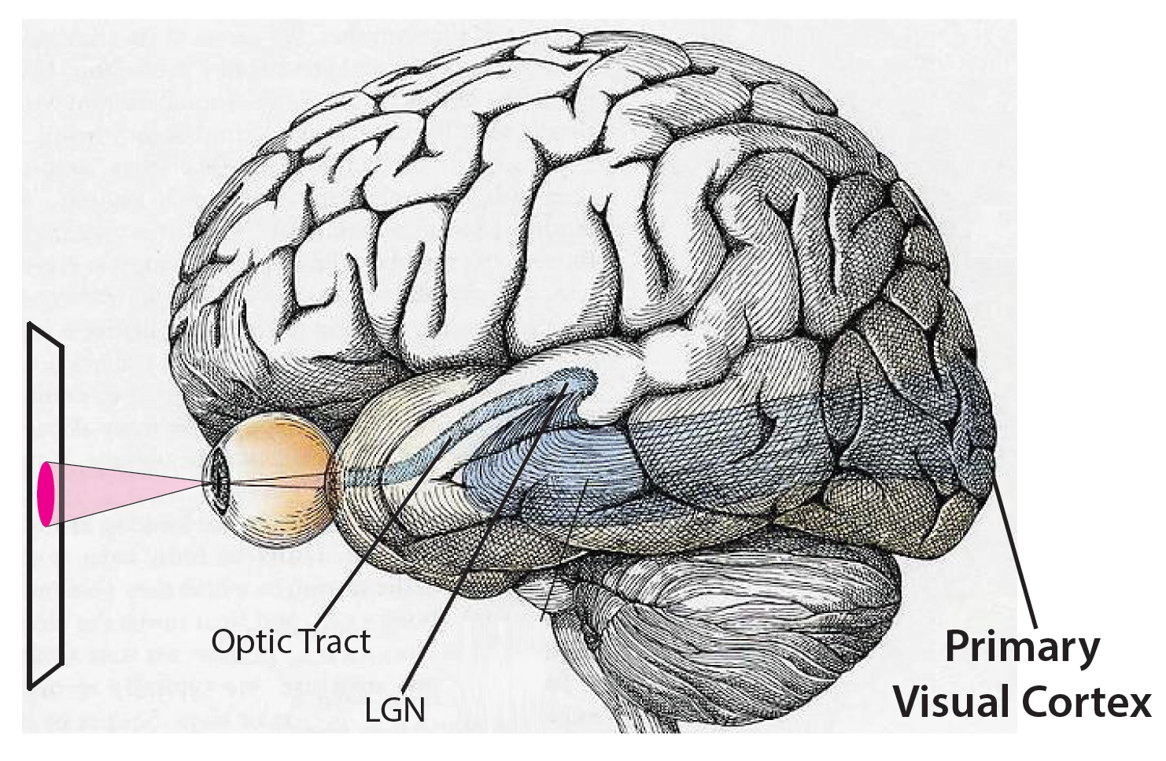
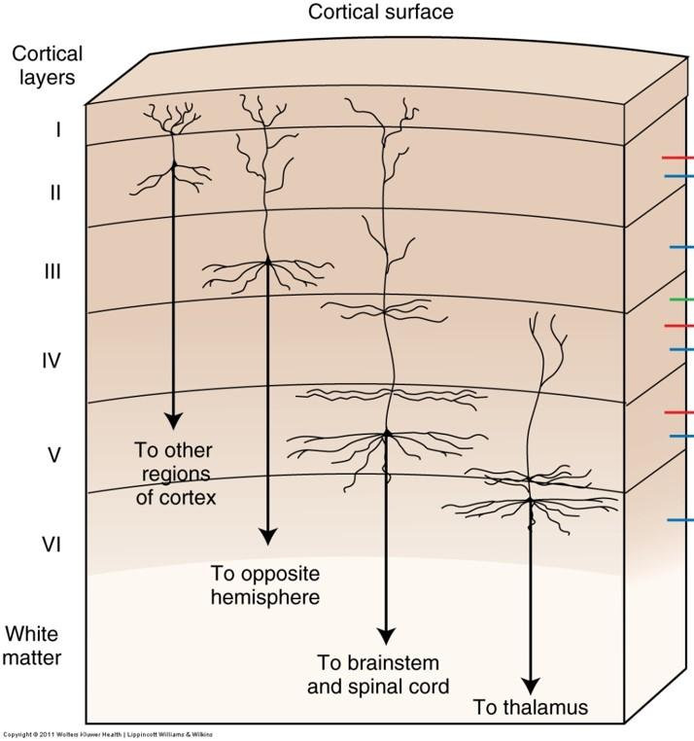
Hierarchical Temporal Memory (HTM) Model
Sensation
Perception
(feature recognition)
Predictions
Recognition, Detection,
Anticipation…

Slide 2
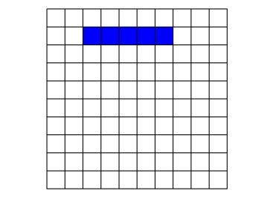
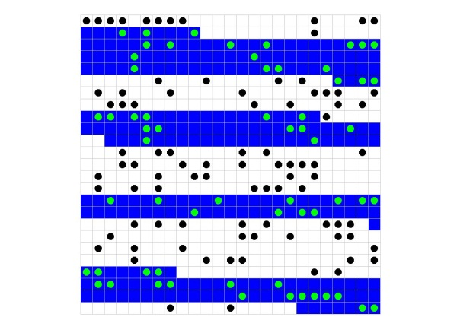
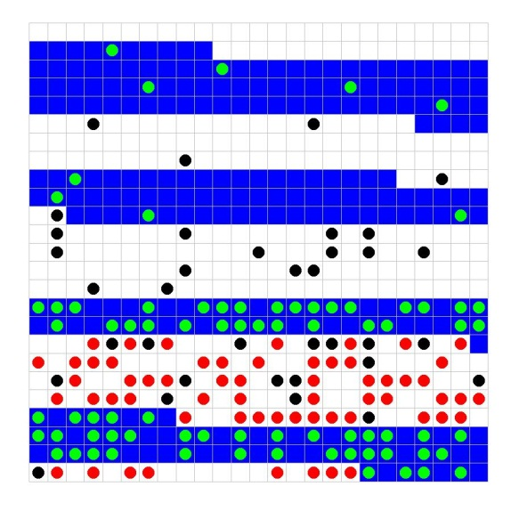
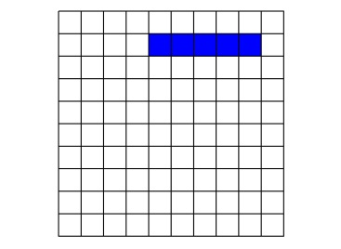
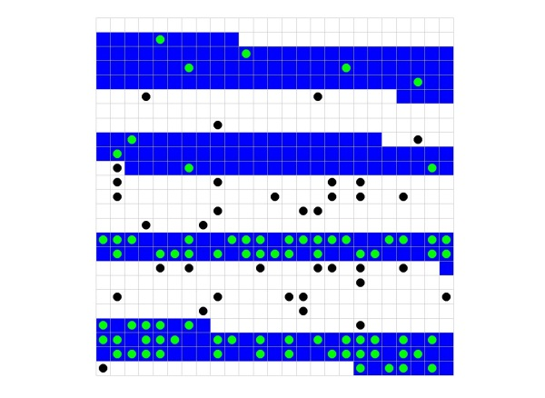
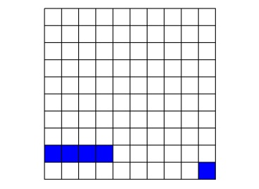
Hierarchical Temporal Memory (HTM) Model
Sensation
Perception
(feature recognition)
Predictions
Recognition, Detection,
Anticipation…
Semantic Encoding
Structure Recognition
Predictions
(Pattern) Detection
85°
Start
87°
End
12°

Slide 3
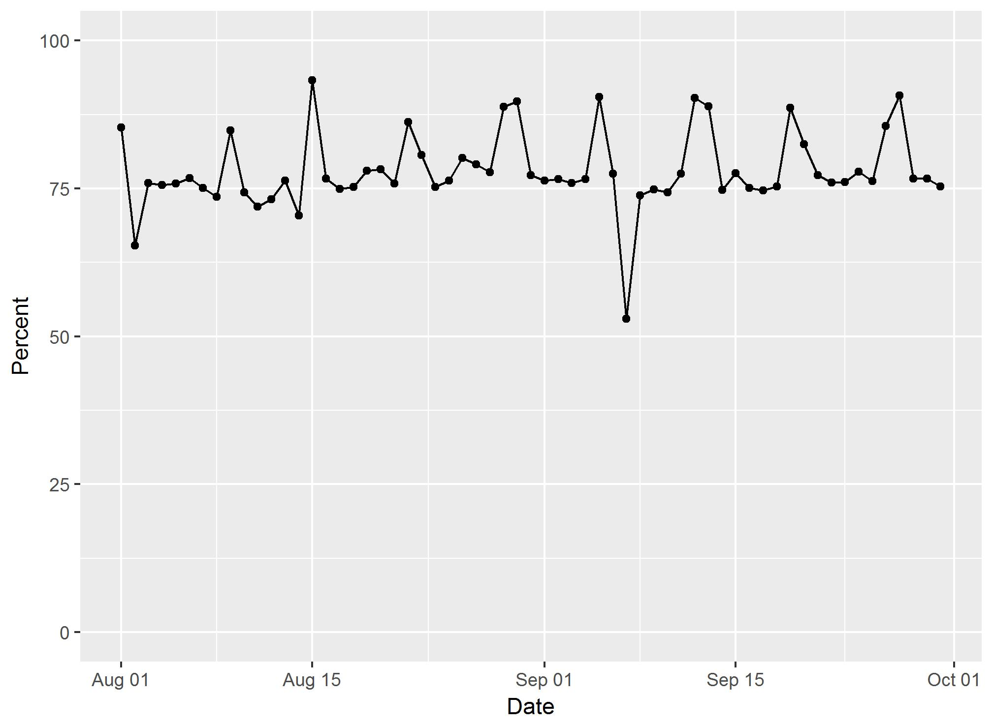
Time Series Prediction
What percentage of our clinic patients will show up for their appointments next Monday?

Slide 4
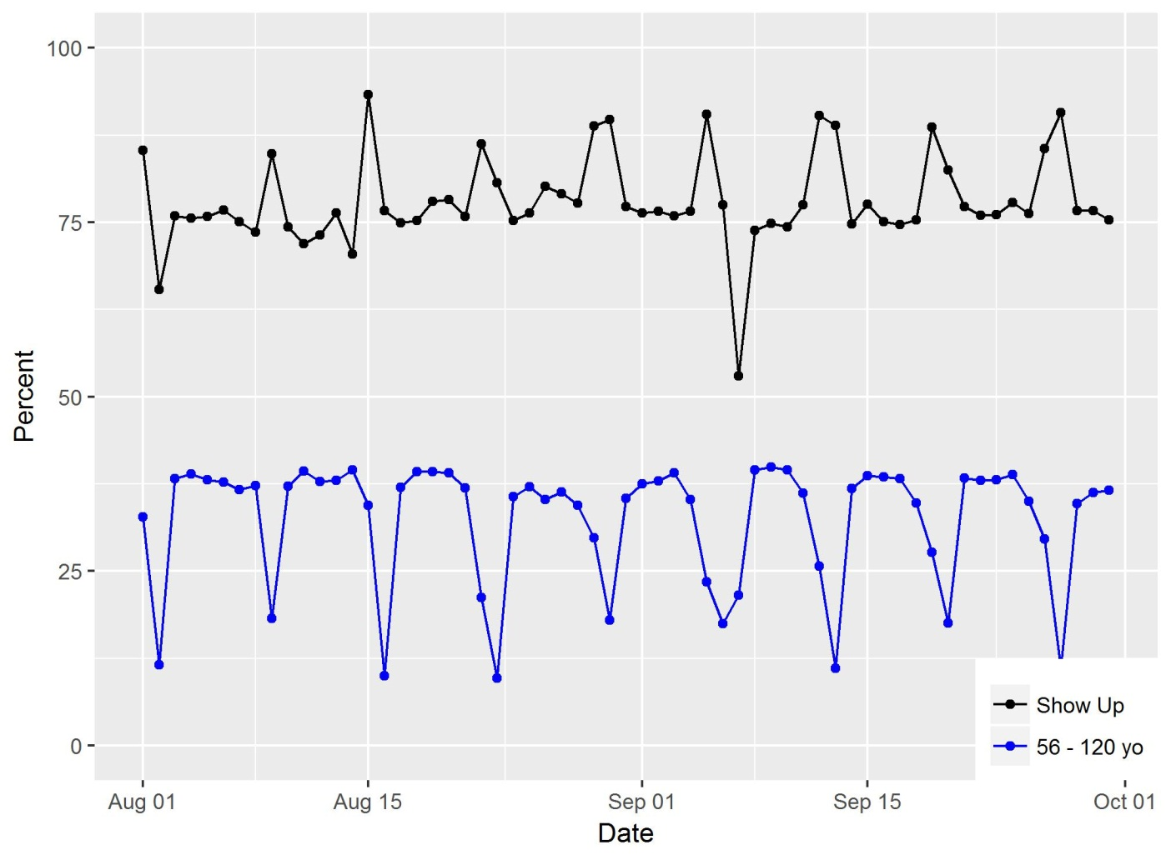
Possible Contributing Factors
Department
Appointment Type
Facility
Age
Gender
Marital Status
Time since made

