Slide 1
PLASMODIUM & TRYPANOSOMA
BLOOD PROTOZOANS

Slide 2
Introduction to Plasmodium
Plasmodium is a parasitic protozoan
It infects human red blood cells
Causes malaria
Transmitted by the female Anopheles mosquito
Malaria is a major public health problem in tropical region

Slide 3
Classification of Plasmodium
Kingdom: Protista
Phylum: Apicomplexa
Class: Aconoidasida
Order: Haemosporida
Genus: Plasmodium
Apicomplexa are parasites characterized by an apical complex used for cell invasion

Slide 4
Species of Plasmodium Infecting Humans
Plasmodium falciparum
  Most severe and fatal
Plasmodium vivax
  Causes relapsing malaria
Plasmodium malariae
  Causes chronic infection
Plasmodium ovale
  Mild malaria with relapses
Plasmodium knowlesi
  Zoonotic (from monkeys)

Slide 5
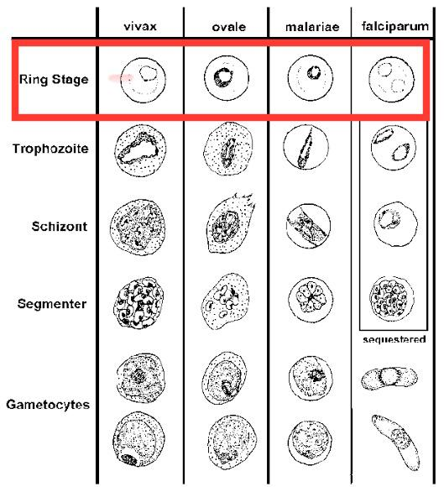
Ring Stage (Early Trophozoite – in RBC)
Species | Distinctive Features
P. falciparum | Very delicate, thin rings; often multiple rings in one RBC; appliqué (accolé) forms seen at RBC margin
P. vivax | Thick, large ring; single ring per RBC; RBC enlarged
P. malariae | Compact, thick ring; usually single; RBC normal size
P. ovale | Compact ring; RBC slightly enlarged and oval-shaped
P. knowlesi | Similar to P. falciparum early rings but usually single

Slide 6
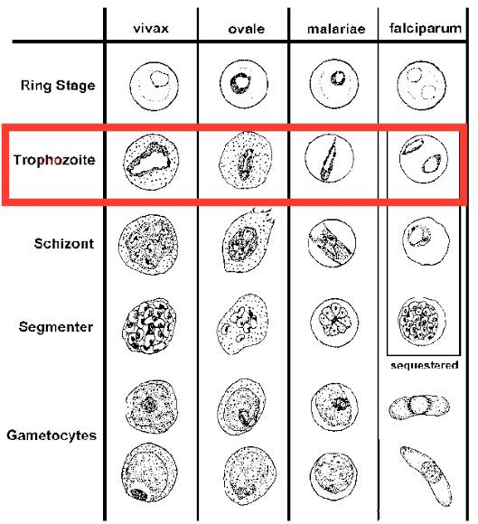
Trophozoite Stage
Species | Distinctive Features
P. falciparum | Mature trophozoites rarely seen in peripheral blood
P. vivax | Amoeboid (irregular shape); Schüffner’s dots present
P. malariae | Characteristic band-shaped trophozoite across RBC
P. ovale | Compact trophozoite; Schüffner’s dots present
P. knowlesi | Band forms similar to P. malariae

Slide 7
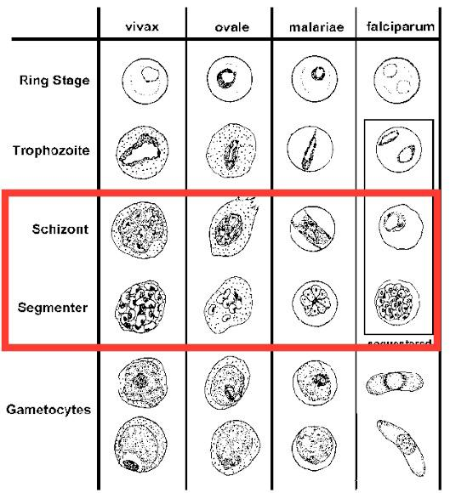
Schizont Stage
Species | Distinctive Features
P. falciparum | Schizonts rarely seen; many merozoites (up to 24)
P. vivax | Large schizont; 12–24 merozoites; RBC enlarged
P. malariae | Rosette or daisy pattern; 6–12 merozoites
P. ovale | 8–12 merozoites; RBC oval and enlarged
P. knowlesi | 8–10 merozoites

Slide 8
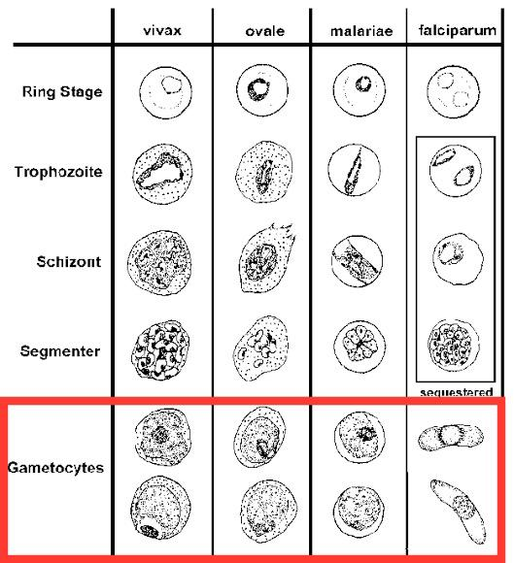
Gametocyte Stage
Species | Distinctive Features
P. falciparum | Crescent or banana-shaped (diagnostic feature)
P. vivax | Large, round or oval; fills enlarged RBC
P. malariae | Round, compact; RBC normal size
P. ovale | Round/oval; RBC oval with fringed edges
P. knowlesi | Round; resembles P. malariae

Slide 9
Red Blood Cell (RBC) Changes
Species | RBC Changes
P. falciparum | RBC size normal; multiple infections common
P. vivax | RBC enlarged; Schüffner’s dots
P. malariae | RBC normal size
P. ovale | RBC enlarged, oval, fringed edges
P. knowlesi | RBC normal size

Slide 10
Geographical Distribution
Common in:
Sub-Saharan Africa
South and Southeast Asia
Central and South America
P. falciparum is dominant in Africa
P. vivax common outside Africa

Slide 11
Host and Vector
Definitive host: Female Anopheles mosquito
(sexual reproduction occurs here)
Intermediate host: Human
(asexual reproduction occurs here)

Slide 12
Morphology of Plasmodium
Exists in different developmental stages
No fixed shape
Found inside:
  Liver cells
  Red blood cells
Contains:
  Nucleus
  Cytoplasm
Apical complex for host cell invasion

Slide 13
Life Cycle of Plasmodium
Life cycle involves two hosts
Two main phases:
Asexual phase in humans
Sexual phase in mosquito

Slide 14
Life Cycle – Human Liver Stage
• Mosquito injects sporozoites during a bite
Sporozoites enter bloodstream
Travel to the liver
Invade hepatocytes
Multiply by schizogony
Form merozoites

Slide 15
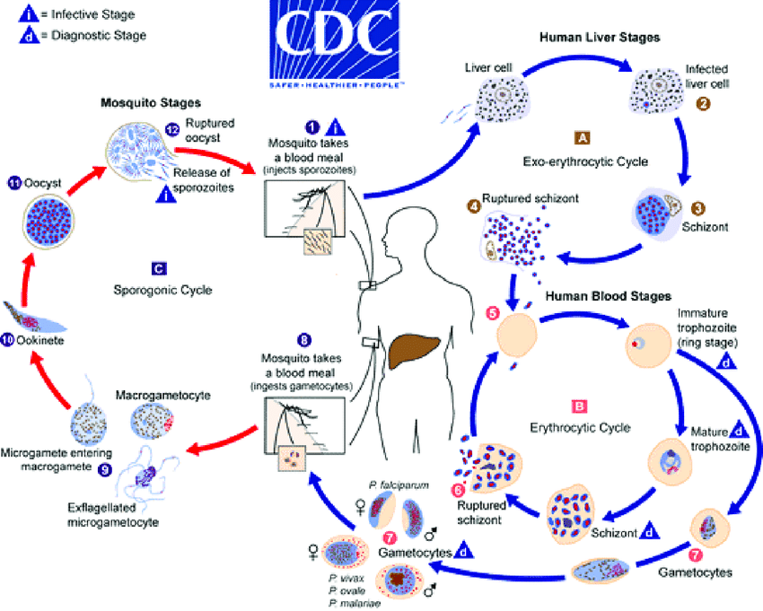
Red Blood Cell Stage
Merozoites enter red blood cells
Develop through stages:
  Ring stage
  Trophozoite
  Schizont
RBC ruptures releasing merozoites
Causes fever and chills

Slide 16
Life Cycle – Sexual Stage in Humans
Some merozoites develop into:
Male gametocytes
Female gametocytes
These circulate in the blood
Picked up by mosquito during blood meal

Slide 17
Life Cycle – Mosquito Stage
Gametocytes mature in mosquito gut
Fertilization occurs → zygote
Develops into ookinete
Forms oocyst
Produces sporozoites
Sporozoites migrate to salivary glands

Slide 18
Pathogenesis of Malaria
Destruction of red blood cells
Release of toxic substances (haemozoine)
Causes:
  Fever
  Anemia
  Splenomegaly
P. falciparum causes:
  Cerebral malaria
  Organ failure
  Death

Slide 19
Clinical Signs and Symptoms
Fever Chills and sweating
Headache
Muscle and joint pain
Nausea and vomiting
Severe cases:
  Coma
  Severe anemia
  Death

Slide 20
Diagnosis of Malaria
Microscopy (Gold standard):
  Thick blood smear
  Thin blood smear
Rapid Diagnostic Tests (RDTs)
PCR (research and confirmation)

Slide 21
Treatment of Malaria
Depends on species and severity
Common drugs:
  Artemisinin-based Combination Therapy (ACT)
  Chloroquine (limited use)
  Quinine
Early treatment prevents complications

Slide 22
Prevention and Control
Insecticide-treated mosquito nets
Indoor residual spraying
Elimination of breeding sites
Chemoprophylaxis
Health education

Slide 23
TRYPANOSOMA
TISSUE AND BLOOD PROTOZOANS

Slide 24
Introduction to Trypanosoma
Trypanosoma is a unicellular, flagellated protozoan parasite
Belongs to the Kinetoplastida
Parasite of blood and tissues
Transmitted by insect vectors
Causes trypanosomiasis, a potentially fatal disease
Diseases: African Tripanosomiasis & American Tripanosomiasis

Slide 25
Classification of Trypanosoma
Kingdom: Protista
Phylum: Sarcomastigophora
Class: Zoomastigophorea
Order: Kinetoplastida
Genus: Trypanosoma

Slide 26
Medically Important Species
African Trypanosomes
Trypanosoma brucei gambiense
→ West & Central Africa (chronic)
Trypanosoma brucei rhodesiense
→ East & Southern Africa (acute)
American Trypanosome
Trypanosoma cruzi
→ Causes Chagas disease

Slide 27
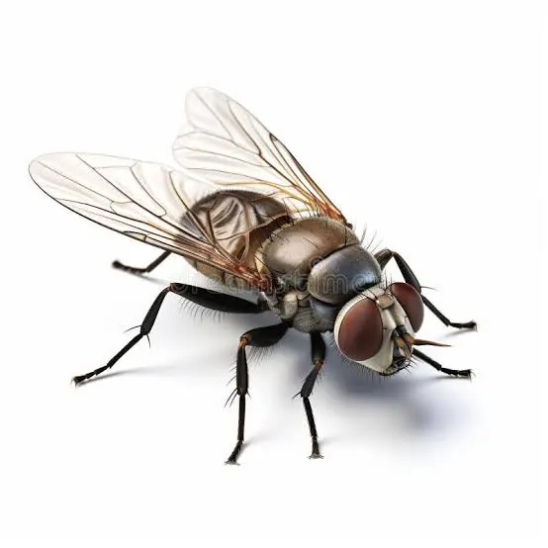
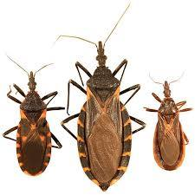
Host and Vector
Species | Vector | Disease | Image
T. brucei | Tsetse fly (Glossina) | African sleeping sickness
T. cruzi | Reduviid bug (kissing bug) | Chagas disease

Slide 28
Morphology of Trypanosoma
Elongated, spindle-shaped organism
Has:
  Single nucleus
  Flagellum
  Undulating membrane
  Kinetoplast (mitochondrial DNA)
Moves with corkscrew motion

Slide 29
Developmental Forms
Form | Key Feature | Location
Trypomastigote | Long, flagellated | Blood
Epimastigote | Short undulating membrane | Vector gut
Amastigote | Round, no flagellum | Tissues (T. cruzi only)

Slide 30
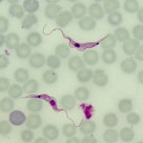
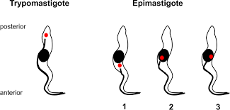
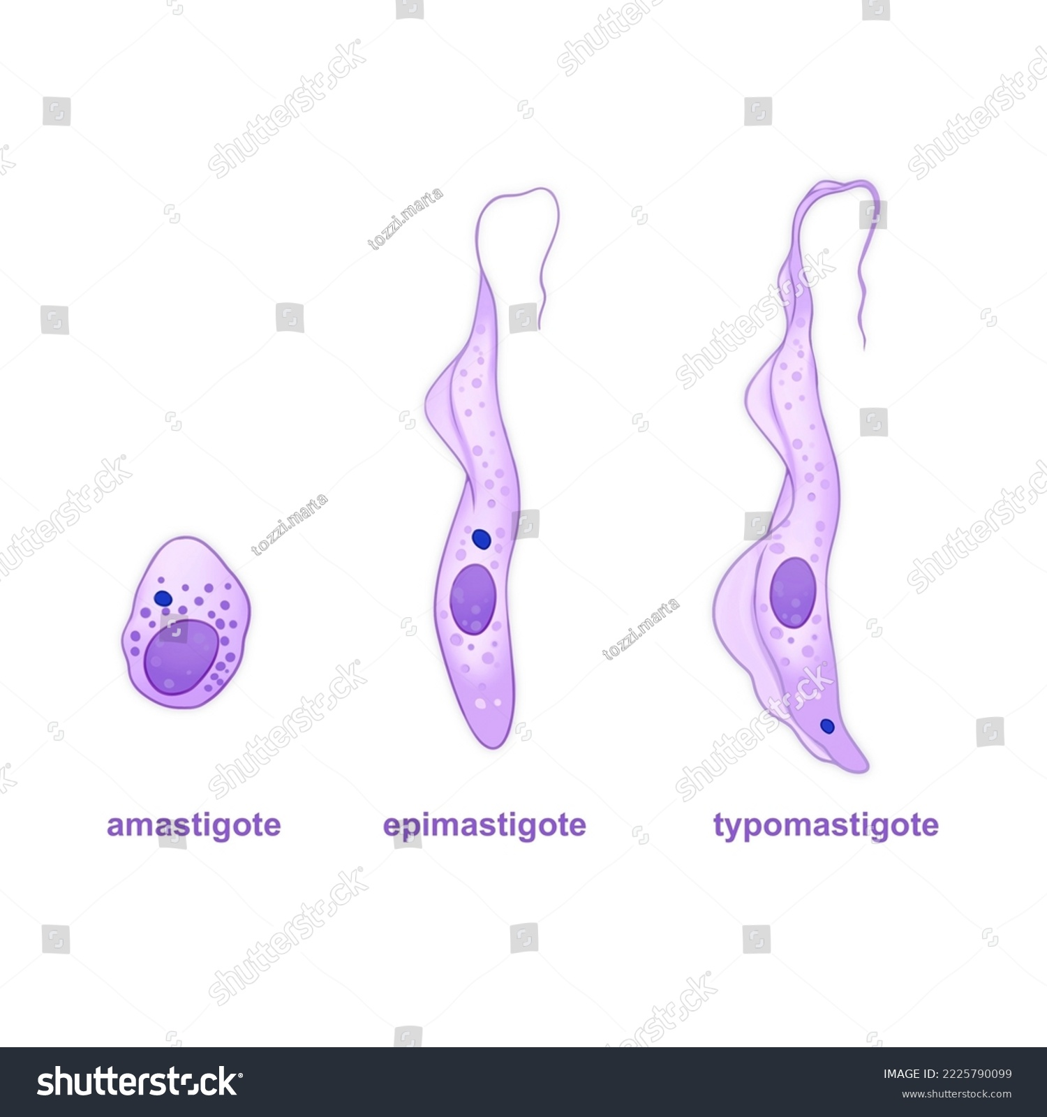
FORMS OF TRYPANOSOMA
FORM | IMAGE
Trypomastigotes
Epimastigote
Amastigote

Slide 31
Life Cycle of Trypanosoma brucei
Requires two hosts
Human – asexual multiplication
Tsetse fly – developmental stages

Slide 32
Life Cycle – Human Stage (T. brucei)
Tsetse fly injects trypomastigotes
Parasites multiply in:
  Blood
  Lymph
  Cerebrospinal fluid
No intracellular stage

Slide 33
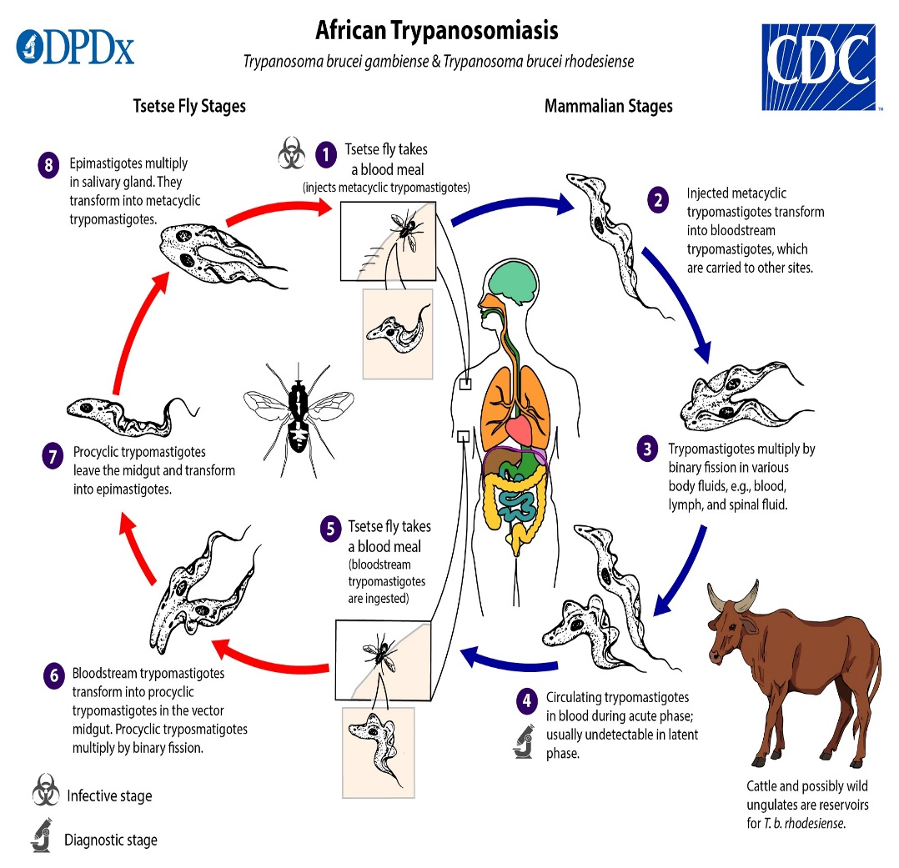
Life Cycle – Vector Stage (T. brucei)
Fly ingests trypomastigotes
Convert to epimastigotes in midgut
Multiply and migrate to salivary glands
Develop into infective trypomastigotes

Slide 34
Life Cycle of Trypanosoma cruzi
Bug defecates during blood meal
Parasites enter through bite wound
Convert to amastigotes inside tissues
Multiply and re-enter bloodstream as trypomastigotes

Slide 35
Pathogenesis
Parasite multiplies in blood
Causes:
  Anemia (Immune-mediated hemolysis)
  Immunosuppression
CNS invasion causes neurological symptoms
Antigenic variation allows immune evasion

Slide 36
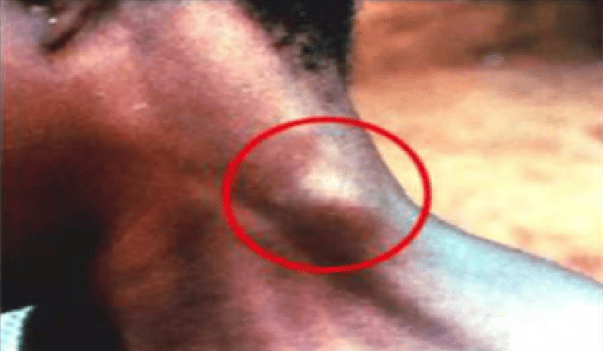
Clinical Features – African Trypanosomiasis
Early Stage
Fever
Headache
Joint pain
Lymphadenopathy (Winterbottom’s sign)
Late Stage
Sleep disturbances
Confusion
Coma
Death if untreated

Slide 37
Clinical Features – Chagas Disease
Acute Phase
Fever
Romaña’s sign (eye swelling)
Chronic Phase
Cardiomyopathy
Megaesophagus
Megacolon

Slide 38
Diagnosis
Microscopy of blood smear
Lymph node aspirate
CSF examination (late stage)
Serology (Chagas disease)
PCR (advanced labs)

Slide 39
TREATMENT
Disease | Drug
African trypanosomiasis | Pentamidine, Suramin
CNS involvement | Melarsoprol
Chagas disease | Benznidazole

Slide 40
Prevention and Control
Vector control
Protective clothing
Insecticides
Screening blood donors
Early diagnosis and treatment

Slide 41
Antigenic Variation
Parasite changes surface glycoproteins
Escapes immune system
Causes relapsing fever
Major challenge in vaccine development

Slide 42
TRICHOMONAS VAGINALIS
TISSUE PROTOZOA

Slide 43
Introduction
Trichomonas vaginalis is a flagellated protozoan parasite
Causes trichomoniasis, a common sexually transmitted infection (STI)
Infects the urogenital tract
Exists only as a trophozoite (no cyst stage)

Slide 44
Classification
Kingdom: Protista
Phylum: Sarcomastigophora
Class: Zoomastigophorea
Order: Trichomonadida
Genus: Trichomonas
Species: T. vaginalis

Slide 45
Habitat
Females:
  Vagina
  Cervix
Males:
  Urethra
  Prostate gland
Survives best in slightly acidic to neutral pH

Slide 46
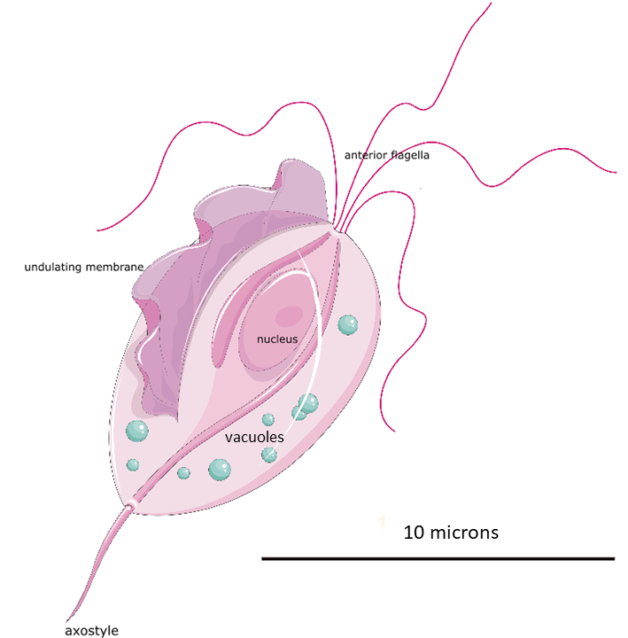
Morphology
Pear-shaped organism
Size: 10–20 µm
Features:
  4 anterior flagella
  1 recurrent flagellum
  Undulating membrane (short)
  Axostyle projecting posteriorly
Rapid, jerky motility.

Slide 47
Developmental Form
Only trophozoite stage
No cyst stage → cannot survive long outside host
Transmission requires direct contact

Slide 48
Mode of Transmission
Sexual intercourse (most common)
Rarely via:
  Contaminated towels
  Shared underwear
High risk with:
  Multiple sexual partners
  Poor genital hygiene

Slide 49
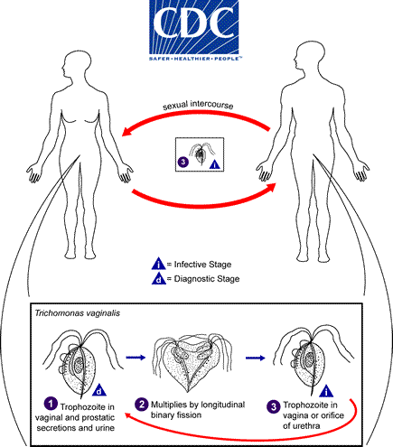
Life Cycle
Simple and direct
Steps:
  Trophozoites transmitted during intercourse
  Attach to epithelial cells
  Multiply by binary fission
  Remain in urogenital tract
No intermediate host

Slide 50
Pathogenesis
Parasite attaches to vaginal epithelium
Causes:
  Cell damage
  Inflammation
  Increased vaginal pH
Produces enzymes that destroy epithelial cells

Slide 51
Clinical Features in Females
Often symptomatic
Common signs:
  Frothy, greenish-yellow vaginal discharge
  Offensive odor
  Vaginal itching
  Dysuria
  Dyspareunia
Strawberry cervix (punctate hemorrhages)

Slide 52
Clinical Features in Males
Often asymptomatic
May present with:
  Urethral discharge
  Burning sensation during urination
  Prostatitis (rare)

Slide 53
Complications
Increased risk of:
  HIV transmission
  Pelvic inflammatory disease
Pregnancy complications:
  Preterm birth
  Low birth weight

Slide 54
Diagnosis
Wet mount microscopy (motile trophozoites)
Vaginal swab examination
Culture (more sensitive)
Rapid antigen tests
PCR (most sensitive)

Slide 55
Treatment
Metronidazole (drug of choice)
Tinidazole (alternative)
Treat both partners
Avoid alcohol during treatment

Slide 56
Prevention and Control
Safe sexual practices
Use of condoms
Early diagnosis and treatment
Treat sexual partners
Public health education

Slide 57
TOXOPLASMA GONDII
TISSUE PROTOZOA

Slide 58
Introduction
Toxoplasma gondii is an obligate intracellular protozoan parasite
Widely distributed worldwide
Infects humans and many warm-blooded animals
Usually asymptomatic but severe in immunocompromised individuals and fetuses

Slide 59
Classification
Kingdom: Protista
Phylum: Apicomplexa
Class: Conoidasida
Order: Eucoccidiorida
Genus: Toxoplasma
Species: T. gondii

Slide 60
Hosts
Definitive host: Cat (family Felidae)
Intermediate hosts:
  Humans
  Birds
  Mammals (sheep, goats, pigs, rodents)
Sexual reproduction occurs only in cats

Slide 61
Infective Forms
Tachyzoite – rapidly multiplying form (acute infection)
Bradyzoite – slow-growing form in tissue cysts (chronic infection)
Oocyst – passed in cat feces

Slide 62
Morphology
Crescent-shaped organism
Size: ~5–7 µm
Has:
  Apical complex (for cell invasion)
  Single nucleus
Similar appearance to Plasmodium stages but found in tissues

Slide 63
Modes of Transmission
Ingestion of:
  Oocysts from cat feces (soil, vegetables, water)
  Tissue cysts in undercooked meat
Transplacental (mother → fetus)
Blood transfusion / organ transplant (rare)

Slide 64
Life Cycle
Two phases:
  Sexual cycle in cats
  Asexual cycle in intermediate hosts
Humans acquire infection accidentally

Slide 65
Life Cycle – Cat (Definitive Host)
Cat ingests tissue cysts
Sexual reproduction occurs in intestinal epithelium
Produces oocysts
Oocysts shed in feces
Become infective after sporulation

Slide 66
Life Cycle – Human (Intermediate Host)
Ingest oocysts or tissue cysts
Parasite becomes tachyzoites
Spread via bloodstream
Convert to bradyzoites in tissues:
  Brain
  Eye
  Muscle

Slide 67
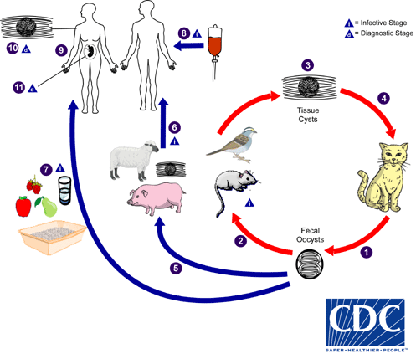
Life Cycle

Slide 68
Pathogenesis
Tachyzoites destroy host cells
Tissue inflammation and necrosis
Bradyzoites persist lifelong in cysts
Reactivation occurs when immunity is low

Slide 69
Clinical Features in Immunocompetent Adults
Usually asymptomatic
Mild flu-like illness
Lymphadenopathy
Low-grade fever
Myalgia

Slide 70
Congenital Toxoplasmosis
Occurs when mother is infected during pregnancy
Classic Triad:
  Hydrocephalus
  Intracranial calcifications
  Chorioretinitis
Severity depends on gestational age at infection

Slide 71
Toxoplasmosis in Immunocompromised Patients
Common in HIV/AIDS
Causes:
  Encephalitis
  Seizures
  Confusion
  Coma
Reactivation of latent infection

Slide 72
Diagnosis
Serology (IgG, IgM antibodies)
PCR (CSF, amniotic fluid)
Imaging:
  CT/MRI brain (ring-enhancing lesions)
Tissue biopsy (rare)

Slide 73
Treatment
Pyrimethamine + Sulfadiazine + Folinic acid
Spiramycin (pregnancy)
Treatment depends on:
  Severity
  Immune status
  Pregnancy

Slide 74
Prevention and Control
Properly cook meat
Wash fruits and vegetables
Avoid contact with cat feces
Pregnant women:
  Avoid litter boxes
  Wear gloves while gardening

Slide 75


