Slide 1
HyperDimensional computing for protein language modeling
Master’s thesis Michael Fatjanov

Slide 2


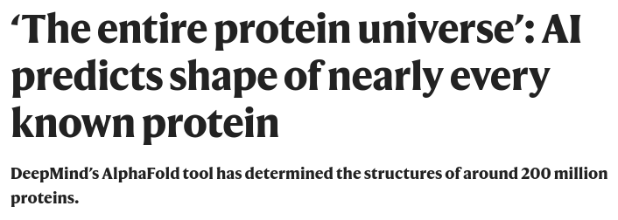
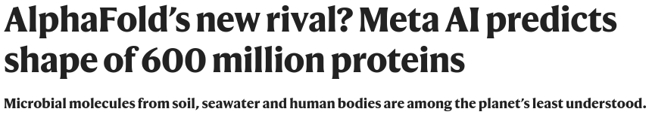
Protein language modeling
State-of-the-art:
AlphaFold 2
ESM-2

Slide 3
Protein language modeling
Based on research in NLP (GPT, BERT...)
Artificial neural networks (transformer-based)
Impressive accuracy on many tasks:
Structure prediction
Evolutionary modeling
}
Finding functional and semantic relationships

Slide 4
Drawbacks of neural network language models
Very data-hungry:
65 million sequences for ESM-2
Very computationally heavy:
Biggest ESM-2 model has 15 billion parameters
Estimated time to train GPT-3 = 34 days on 1024 NVIDIA A100 GPUs
Not biologically realistic

Slide 5
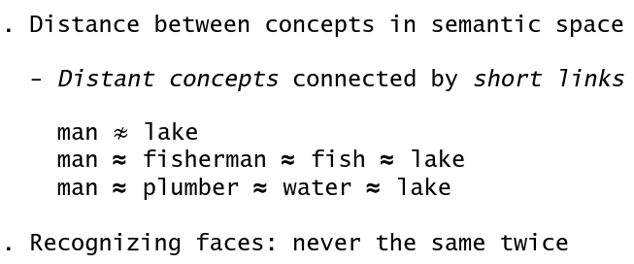
Motivation Hyperdimensional computing
Properties of the brain:
Robust
Can learn wide semantic relationships
Very efficient (~20 Watt)
High-dimensional:
Billions of interconnected neurons and synapes for highly parallelized activities

Slide 6
Operations on Hyperdimensional vectors
Anything can be stored as a random binary/bipolar hyperdimensional vector (usually 10000-D)
Bundling: results in a similar vector
A + B = C element-wise addition
Binding: results in a dissimilar vector
A + B = C element-wise XOR
Permutation: results in a permuted vector
Π(A) Usually a circular shift to encode position
Similarity measure
Hamming distance for binary vectors
Cosine similarity for bipolar vectors

Slide 7
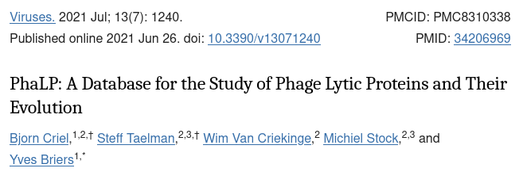
PHALP
Database containing phage lytic proteins
As of now >17000 entries
Serves as inspiration for further research in protein engineering (enzybiotics)

Slide 8
Type classification
Simulate classification experiment in paper
Virion-associated lysins (VALs) vs. endolysins
Classify manually annotated proteins based on their sequence (~5000)
SeqVec embeddings Random forest classifier
10-fold cross-validation
F1-score = 0.98433
v2019_10

Slide 9
Type classification
Random HDV per AA
ESM embedding extended to HDV per AA
1. Encode AA to HDV
Bag-of-words 3-mer HDV embeddings
Convolutional 3-mer HDV embeddings
2. Encode sequence to HDV
Purely HDC
classifier
Default XGBoost classifier
3. Classify HDVs

Slide 10
Type classification
v2021_04
10-fold cross validation
F1-score | BoW Random | BoW ESM | Convolutional Random | Convolutional ESM
HDC Classfier | 0.1458 | 0.1468 | 0.1461 | 0.1464
XGBoost Classifier (default) | 0.9667 | 0.9754 | 0.9661 | 0.9860

Slide 11
What’s next
Assess amino acid and sequence embedding methods
Embed amino acids in UniRef database and assess PCA
Could we implement an unsupervised learning method based on HDC?
Similarity search benchmark against BLAST?
Could we develop a generative method based on HDC?
Use HDVs as inputs for binarized neural networks?

