Slide 1
Network Measurement Data Imputation
Lois Omotara and Mickey Shamah
Graduate Mentor: Fengchen Gong
Faculty Mentors: Professor Apostolaki and Professor Gupta
Research Mentors: Bikash Poudel and Mohammad Mahdi Bidmeshki
Notes:
give a takeaway message from each graph in each title
Takeaway message should be one sentence each

Slide 2
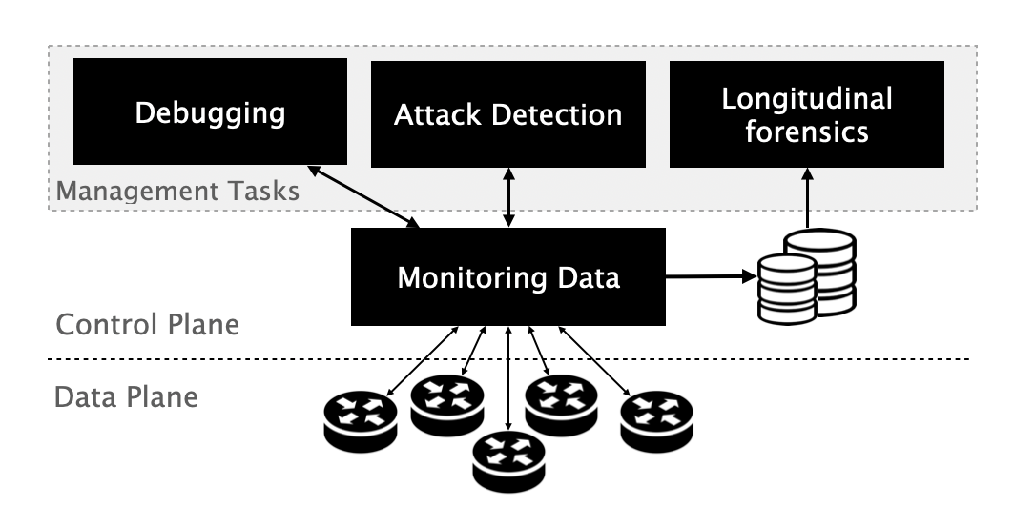
The Need for Imputing Data in Network Analysis
Fine grained data is necessary for debugging and safeguarding tasks
Problem: Network monitoring data are coarse-grained, sampled, and sometimes unreliable
Solution: use a telemetry imputation layer that refines the coarse-grained data fed to management tasks
Figure taken from presentation from Prof. Apostolaki
Notes:
Although there are many statistical methods to impute missing data, in this work we leveraged transformer model to impute missing one way delay (OWD)

Slide 3
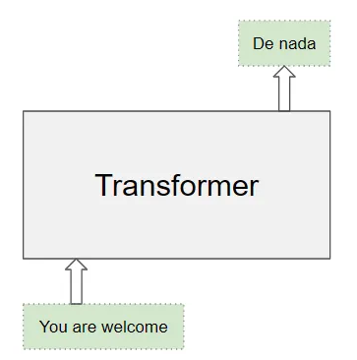
Can You Use Transformer Model for Data Imputation?
A Transformer is a sequence to sequence ML model used to learn correlations over a long series
Transformers are more suitable choice for data imputation compared to other ML models
Has the ability to handle long correlated sequences
Can process all the elements in a sequence in parallel
Can take into account multiple features
https://towardsdatascience.com/transformers-explained-visually-part-1-overview-of-functionality-95a6dd460452
Notes:
Other Models]:
Machine Learning (ML) can successfully handle complex and nonlinear relationships between multiple variables
Autoregressive Integrated Moving Average (ARIMA)
Stationary time series
Long Short-Term Memory (LSTM) Networks
Long-term dependencies
Gated Recurrent Unit (GRU) Networks:
Temporal dependencies in network latency data
Gaussian Processes (GPs)
Few parameters to make predictions
Transformers

Slide 4
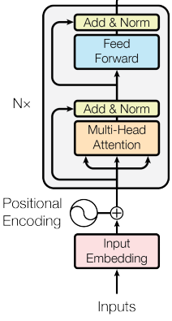
How Does a Transformer-Encoder Work?
Multi-Head Attention Sublayer
Uses a self-attention mechanism that captures relationship and dependency of one element to all others elements in an input sequence
In multi-head, self-attention operation is performed multiple times in parallel, each head with its own learned set of parameters
Feed Forward Sub-Layer
Learn higher-level features
Allow model to learn hierarchical representations and capture different levels of abstractions in the input data
Attention Is All You Need https://arxiv.org/pdf/1706.03762.pdf
Notes:
Uses a self-attention mechanism that captures relationship and dependency of one element to all others elements in an input sequence like relation of a word with other words in a sentence

Slide 5
Phase 1: Training on a Smaller Dataset
Goals:
Check the correlation in one way delay (OWD) across different network paths
Prepare coarse grained data for experiment
Establish a ground truth
Modify the transformer model to fit our data
Notes:
[]Add goals for each phase

Slide 6
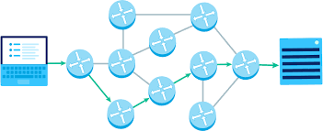
Correlation in Network Latency Measurements
As multiple paths converge at an Autonomous System (AS), the network traffic and network measurements such as one way delay (OWD) are correlated
Network paths share some links therefore they are often affected by similar conditions such as network congestion
https://www.khanacademy.org/computing/computers-and-internet/xcae6f4a7ff015e7d:the-internet/xcae6f4a7ff015e7d:routing-with-redundancy/a/redundancy-fault-tolerance
Notes:
Definition of one way delay
As multiple paths converge at an Autonomous System (AS), the network traffic and network measurements such as queue lengths and latency, are correlated.Paths share some links so they are often affected by similar conditions such as network congestion
Queue Lengths: When packets arrive at an AS they are placed into a queue to be processed. If multiple paths converge at a single point, they will share this queue, so the queue length would be affected by the combined traffic of all these paths.
Latency: This is the delay between when a packet is sent and when it is received. It is affected by factors like distance the packet has to travel, and network congestion. When a network is congested, latency between multiple converging paths could be correlated

Slide 7
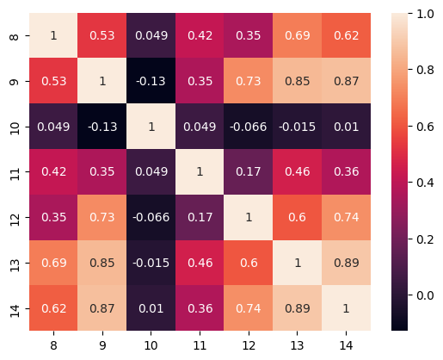
Correlation Matrix for Single Source to Multiple Destinations
Destination
Destination
Notes:
Used the pearson correlation metric

Slide 8
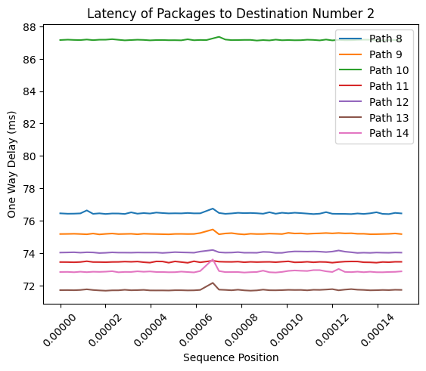
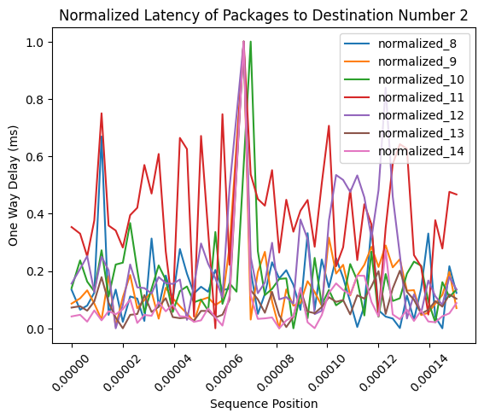
Training Data Preparation - Data Normalization
Normalization

Slide 9
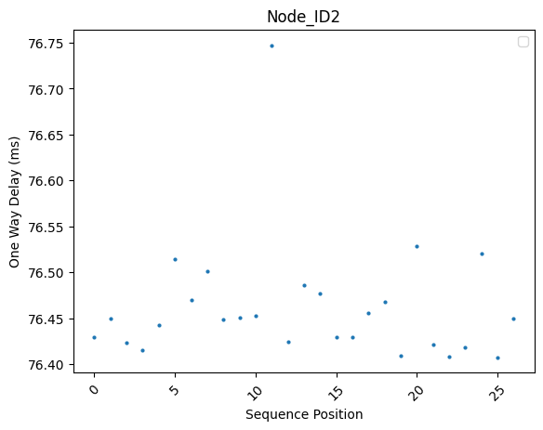
Training Data Preparation - Sampling Fine Grain Data to Generate Coarse Grained Data
Normalized Latency of Packages to Destination Number 2
Normalized Latency Across Path 8 to Destination Number 2
Sampling
By 1/2
Notes:
- add another arrow from normalized to coarse-grained

Slide 10
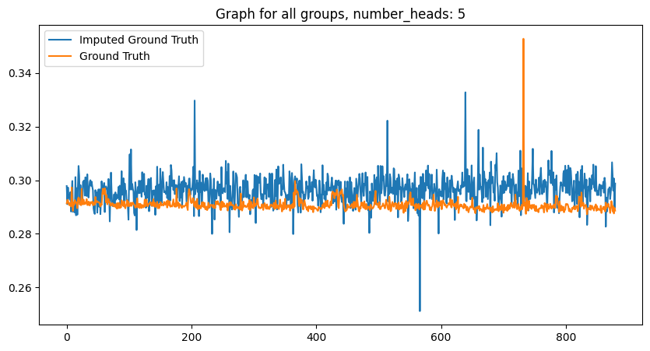
Transformer Encoder Learning the Missing Data
Normalized Latency Across Path 8 to Destination Number 2
Transformer Encoder
One Way Delay(ms)
Sequence position
Notes:
-38000 smaller data set

Slide 11
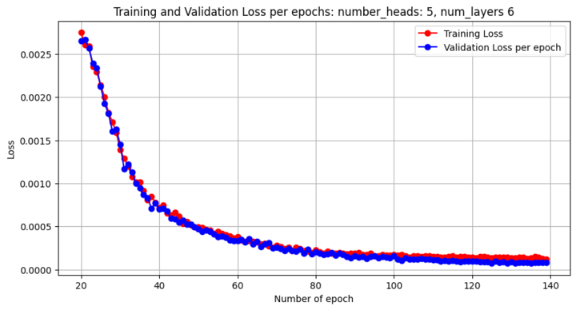
Training and Validation Loss for Transformer Encoder on Smaller Dataset
Model learning rate vs number of epochs (MSE)
Notes:
Loss function: metric of success, ‘HOW the transformer learns’
Epoch: one training session for a result (one batch), number of epochs is determined by how long it takes for the loss to converge at a single value
Training loss: loss of transformer during the training process, the model is still actively changing at this point
Validation loss: Loss of transformer AFTER training process, the model is not actively changing at this point

Slide 12
Phase 2: Training on a Larger Dataset
Goals:
Train the transformer with full dataset without adjusting the hyperparameters
Hyperparameter Tuning
Loss Function Tuning
Notes:
Goals for phase 1 and 2

Slide 13
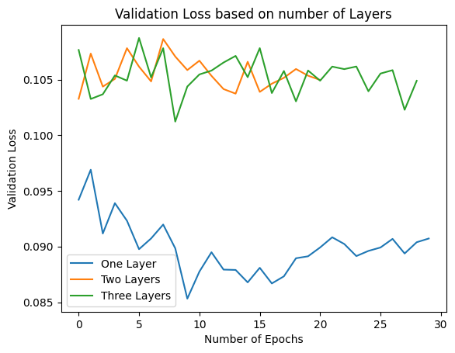
Tuning the Number of Layers
Notes:
Layers = amount of encoders working simultaneously
Explain why one layer is better = talk about overfitting less weights

Slide 14
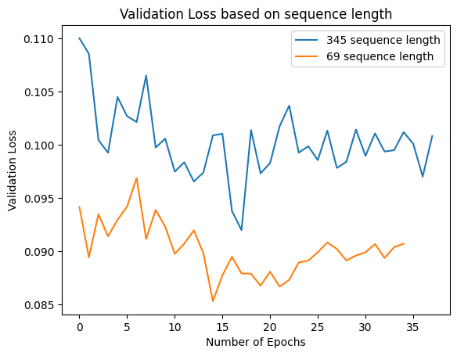
Tuning the Sequence Length
Notes:
Length of input
Smaller sequence length = more focus put on the peaks in the data

Slide 15
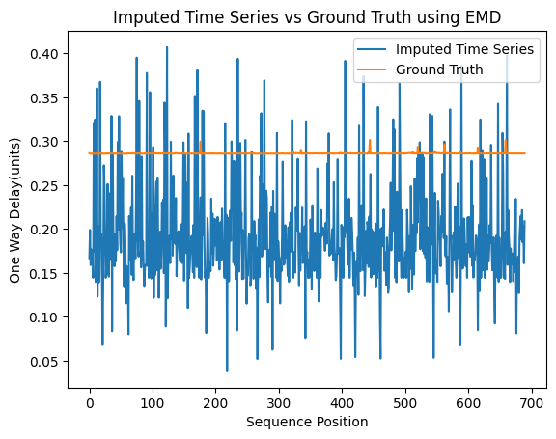
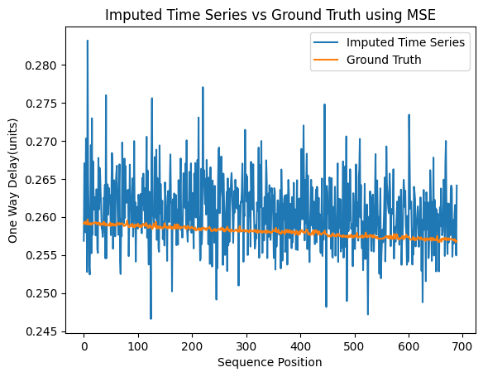
Tuning Loss Function: Earth Mover's Distance(EMD) vs Mean Squared Error(MSE)
Notes:
Loss function: Model’s success metric, asses performance of model, ‘how it learns’
Mean Squared Error (MSE) penalizes large errors more than small one.
Earth Mover's Distance provides a way to consider the overall shape and dynamics of the data series.

Slide 16
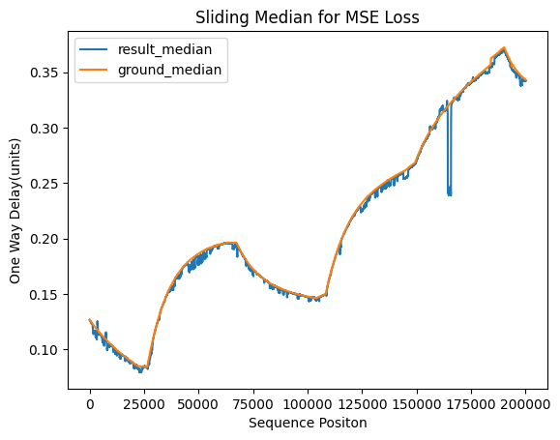
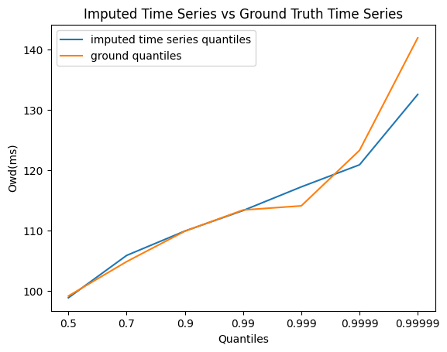
How Well Transformer Encoder Impute the OWD?
Notes:
Why we chose median of window: needed a metric that would cut through the noise of the imputed time series

Slide 17
Challenges
Cloudlab/jupyter: Experiment expirations, working between cloudlab and VS-code
Overfitting during Training: Model can overfit training data which makes it less useful when imputing other data
Right Loss Function: Model’s learning is directly related to how its penalized, tuning the loss function incorrectly can have massive consequences like a constant value being imputed. Therefore, finding a correct way to control this was a huge challenge

Slide 18
Future Directions
Time Series Data Imputation:
Noise Tolerance: Future work should focus on creating models that can effectively deal with and filter out high levels of noise
Scalability: Future work should focus on developing efficient algorithms that can handle large-scale coarse-grained time series data
Our Project:
Decoder: A decoder can be implemented to further refine results
Impute multiple time series simultaneously
Multiple sources
Using stricter penalization methods on model

Slide 19
Thank you!
Any Questions?

