Slide 1
Predicting the Severity of Car Accidents
Yihe Li

Slide 2
A useable model for predicting severity is useful for governance
Usually we can only determine the severity of a car accident after careful investigation, including collecting the fataility rate, the detailed identity of the people, and determine the damaging status of the car.
The severity value is of great useness to government, which can use it to present suggestions and policies in order to reduce accident fatailities.

Slide 3
Data acquisition & Preprocessing
Using the shared data that contains all of the car accident in Seattle city that happened in the 2004-2020 time period.
The data contains severity level and people/vehicle count of each accident.
The severity code, people count and vehicle count are combined to describe the severity of the accident
Carefully choose 10 metrics (weather, light, etc.) that is both easy to collect and related to the severity deeply.

Slide 4
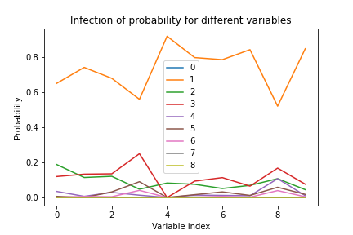
Severity Value
The severity of most accident is 1, as most accident involve many peoples (not necessarily injuried).

Slide 5
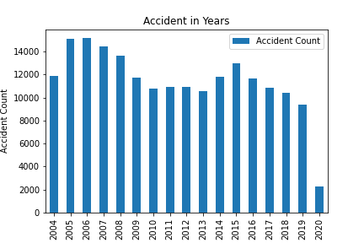
Result display
The accident had been reducing in the continuous progress of the government (2020 is partial data). This model will help to futher reductions, which is an important research topic of the government of any big cities.

Slide 6
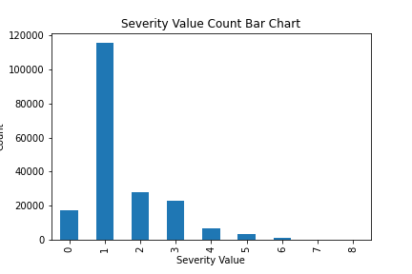
Result display
The weather (indexed 4) is the most influencial feature to the final severity, so we suggest to improve signs and policies like speed-reducing bumps to be placed in fog/snow areas.

Slide 7
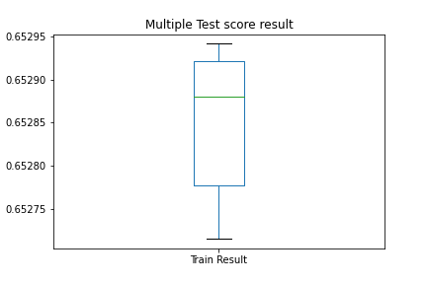
Model evaluation
The parameter of models:
Stable R^2 score of around 65.29% in ten runs.
Cross-validation score of 65.35%.
High accuracy (due to multi-value result).

Slide 8
Conclusion
The Seattle government had made noticable progress in reducing the accident number and fatalities rate in recent years.
Aspects that most affect the severity of an accident is weather and speeding.
Combined, speed-reducing bumps, speed limit cameras should be deployed more in weather-affected (fog, snow, etc.) areas.

