Slide 1
P3423R1:
Extending User-Generated Diagnostic Messages
Yihe Li
EWG Kona (2025-11)

Slide 2
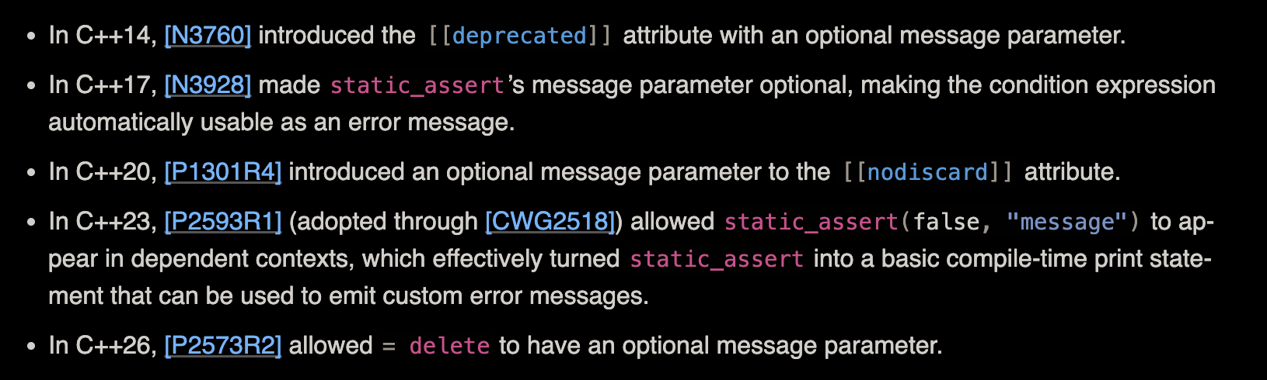
Refresher: What Is Proposed?
This proposal thus tries to introduce a user-provided string parameter for the other three things that currently accept a string literal.
Namely: [[nodiscard(message)]], [[deprecated(message)]], = delete(message)

Slide 3
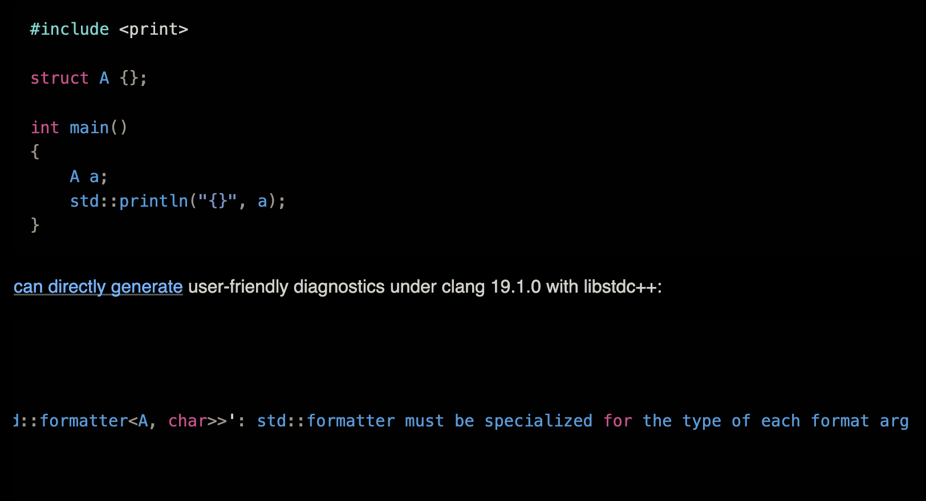
Refresher: Motivation
Better error message

Slide 4
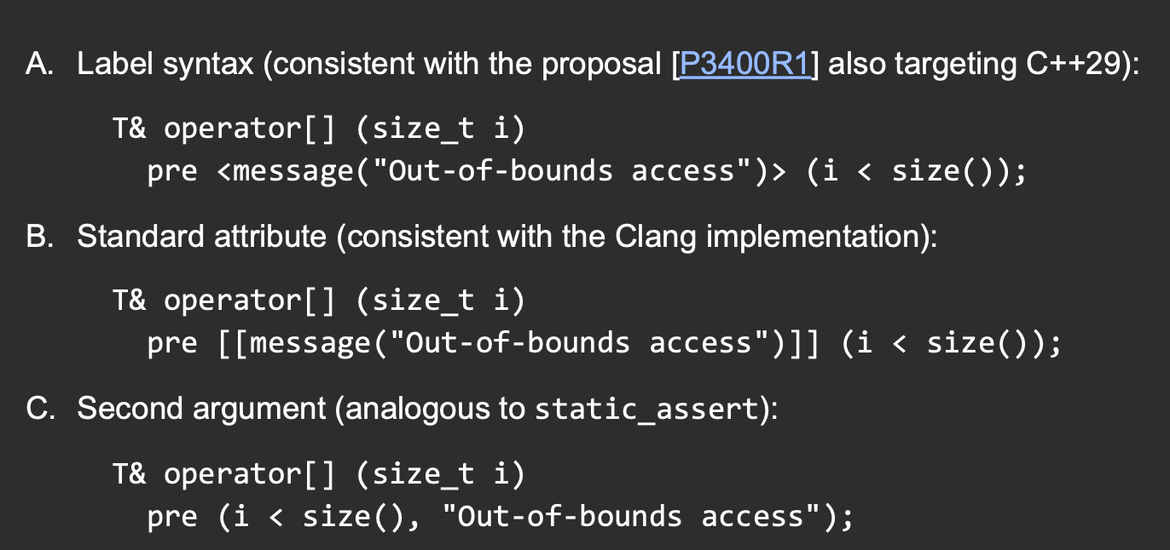
New Information: More Motivation
Contracts is trying to adopt the same thing! (P3099R0)

Slide 5
Questions from Sofia: SFINAE Interaction?
SFINAE behave as the same as in noexcept() or normal contexts
Basically: First overload resolution, then instantiation.
Bottom line: Attribute does not affect overload resolution at all

Slide 6
Questions from Sofia: Circular Dep?
Yes, this is valid ([dcl.attr.deprecated]/3), and redeclaration with different argument is also allowed.
However, which argument is displayed in the error message is unspecified.
Here we have a solution: fun<T>() is not a constant expression before it is defined, so hard error.

Slide 7
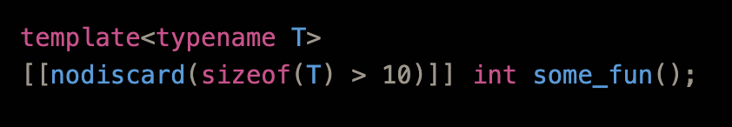
Questions from Sofia: Disambiguation?
What if attributes later take a condition?
Can be (condition, message) <- no conflict here
Can also be disambiguated by string-like vs bool <- Someone says this is insufficient… “string literals” are convertible to bool already
The author really thinks that using string literals that way most likely is an error, so one non-breaking approach is to prefer ”reason” on string-like & string literal, and try boolean only if doesn’t work

Slide 8
Thanks for Listening!

