Slide 1
P3351: views::scan
SG9 Review, Wrocław (2024-11)
Author: Yihe Li

Slide 2
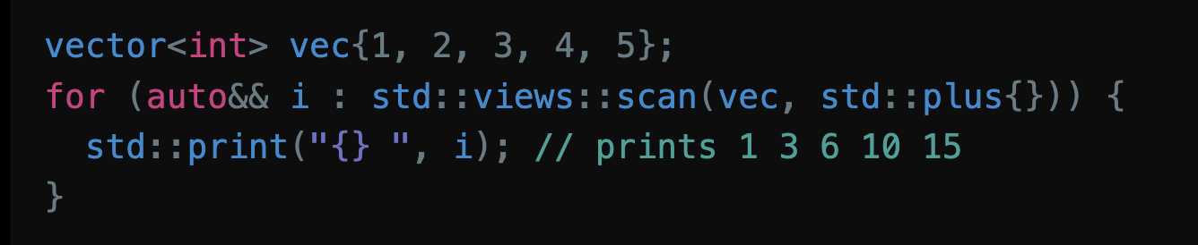
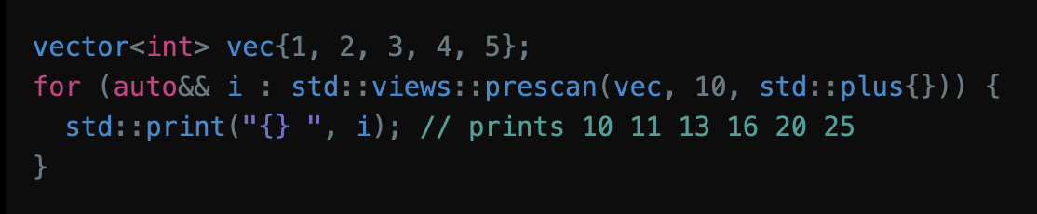
What is proposed?
views::scan family: Lazy version of std::inclusive_scan
views::scan
views::prescan
Also an alias: views::partial_sum
Tier 1 item in P2760R1

Slide 3
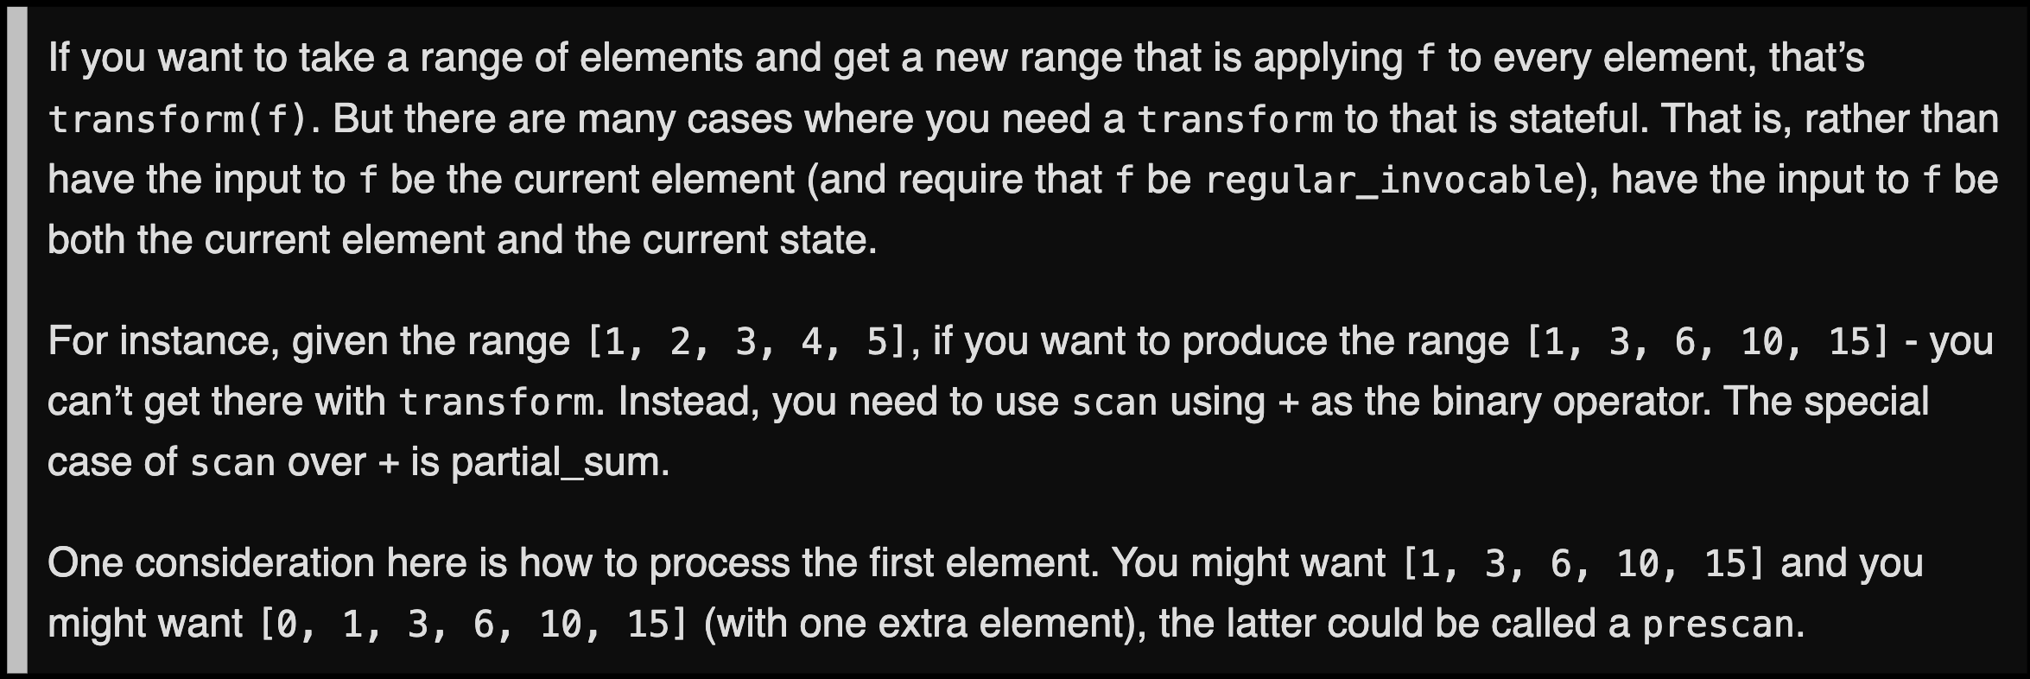
Motivation
Also present in range-v3: called views::partial_sum here
However, that name strongly suggests +, so the more generic name scan is chosen

Slide 4
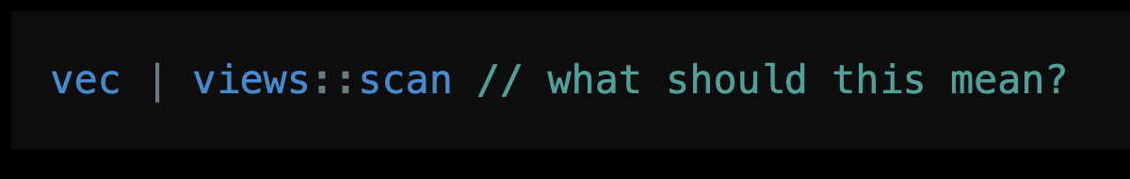
Why Three Adaptors?
Why choose three names instead of just views::scan?
Similar to ranges::fold vs std::accumulate

Slide 5
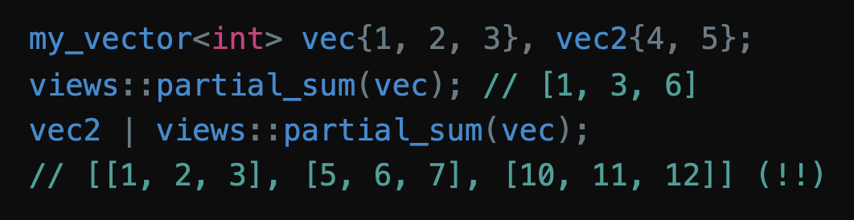
Why Two Adaptors?
Why do we need views::prescan?
Consider a my_vector<T> which overloads + to be boardcasting ([1, 2, 3] + 3 = [4, 5, 6])
Same problem as views::join_with

Slide 6
Options
1. Bail out: Don’t support prescan/Anything satisfies range that comes in the first argument will be treated as input
2. Reorder and bail out: Reorder to scan(rng, func, init)
Have precedence: std::inclusive_scan does this
3. Choose different name (scan vs prescan)
More naming discussion later

Slide 7
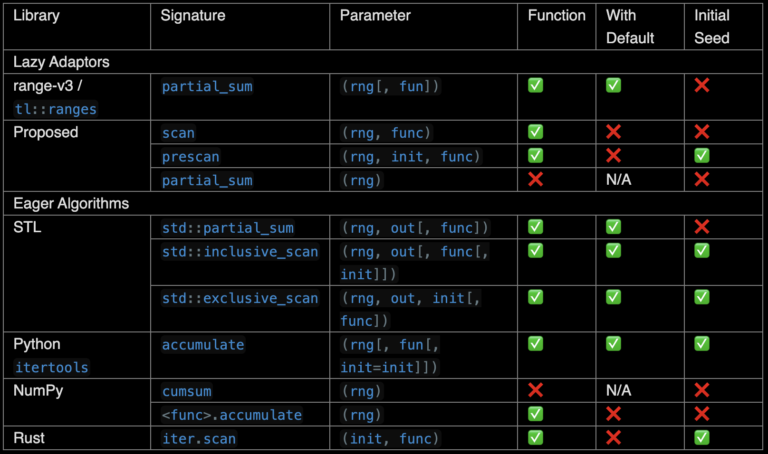
Prior Art
range-v3: views::partial_sum
tl::ranges: views::partial_sum
Algorithm version:
STL: std::[in, ex]clusive_scan (C++17), std::partial_sum (C++98)
Python: itertools.accumulate
NumPy: cumsum / ufunc.accumulate
Rust: iter.scan

Slide 8
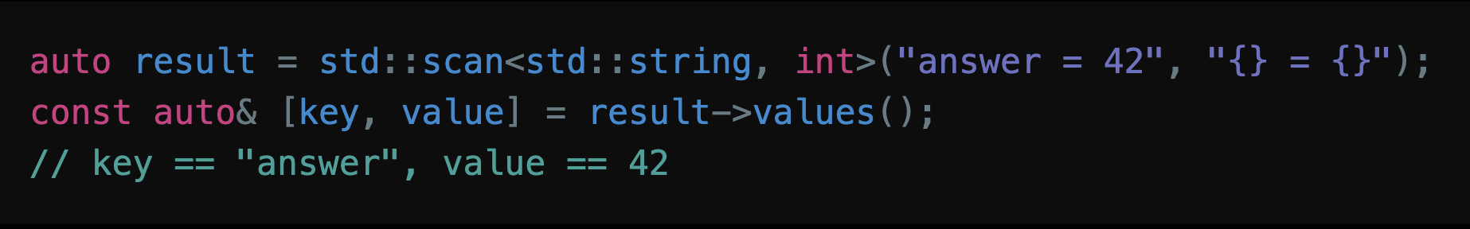
Naming Conflicts
New Info since R1
“scan” has another meaning: read user input
scanf family
P1729R5 std::scan
No real conflicts (in different namespace)
Alternative names are brainstormed in case SG9/LEWG want separation

Slide 9
Alternative Naming Options
For scan:
partial_fold: Suggested by P2214R2, makes connection clear
However, scan = fold_left_first, prescan = fold_left
accumulate, views::fold, …: The output is range instead of value
For partial_sum:
prefix_sum: Good, but inconsistent with STL
views::cumsum: Probably need to spell cumulative_sum (cache1)

Slide 10
Alternative Naming Options (cont’d)
scan | prescan | partial_sum
inclusive_scan | exclusive_scan | partial_sum
scan_first | scan | partial_sum[_first]
scan | scan_init | partial_sum[_init]
Notice that the analogy with [in, ex]clusive_scan does not work:
std::[in, ex]clusive_scan requires associative BinaryOp
exclusive_scan ignores the last element; inclusive_sum discards the init

Slide 11
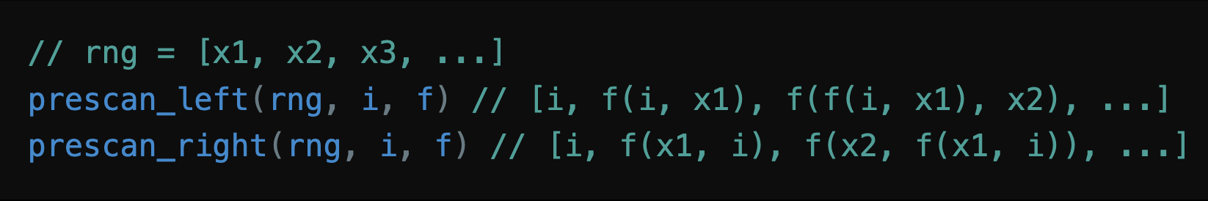
Left or Right Fold?
scan_right = scan_left + reverse the order of arguments

Slide 12
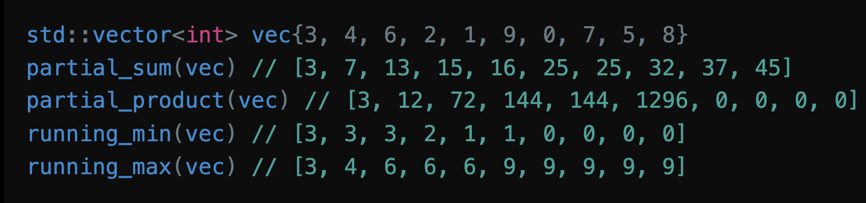
More Aliases
Apply std::plus{}, std::multiplies{}, ranges::min, ranges::max (after P3136R0)
Not proposed for now; the author is happy to add if SG9/LEWG requests

Slide 13
Range Properties
Always the fun part

Slide 14
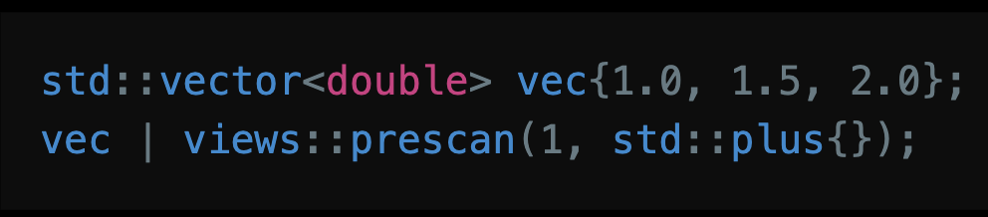
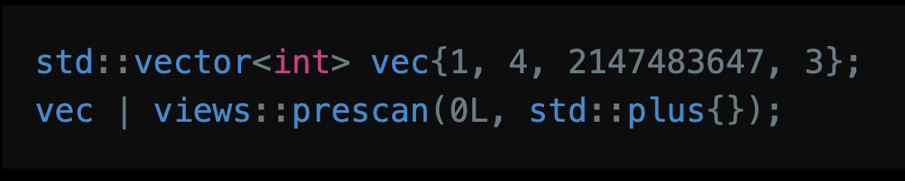
Reference and Value Type
std::accumulate pitfall: [1, 2, 3, 5]
One possible choice: use the input range’s element type
Chosen by range-v3

Slide 15
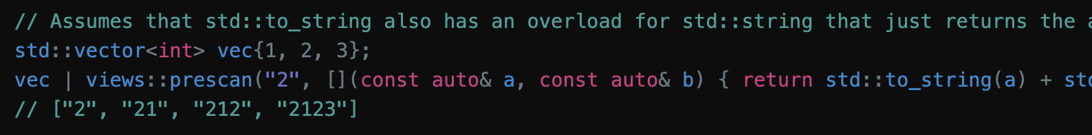
Reference and Value Type (cont’d)
decay_t<invoke_result_t<F&, T, ranges::range_reference_t<Rng>>>
Basically, result of func(init, *begin(rng))
Chosen by ranges::fold_left family

Slide 16
Transversal Category
At most forward
Cannot be bidirectional due to storing the current sum

Slide 17
Common
Never
Consistent with range-v3; iterator need to store current sum, so end() is not available in O(1)

Slide 18
Borrowed
Never for now
P3117R0 may make views::transform conditionally borrowed; the same can apply to views::scan

Slide 19
Other Properties
Sized iff the input range is sized
For prescan, size = underlying size + 1
Const-iterable iff the input range is const-iterable

Slide 20
Freestanding & Feature-Test Macro
Freestanding: Yes; I assumed that views::concat & views::enumerate not being freestanding is an oversight
Feature-Test Macro: __cpp_lib_ranges_scan for all 3

Slide 21
Questions for SG9
Naming
Author’s preference:
If using different names, scan & prescan
If using the same name, scan or partial_fold or inclusive_scan
invocable or regular_invocable?
range-v3 used invocable, views::transform used regular_
operator- needed?

