Slide 1
P3351: views::scan
SG9 Review, Hagenberg (2025-02)
Author: Yihe Li

Slide 2
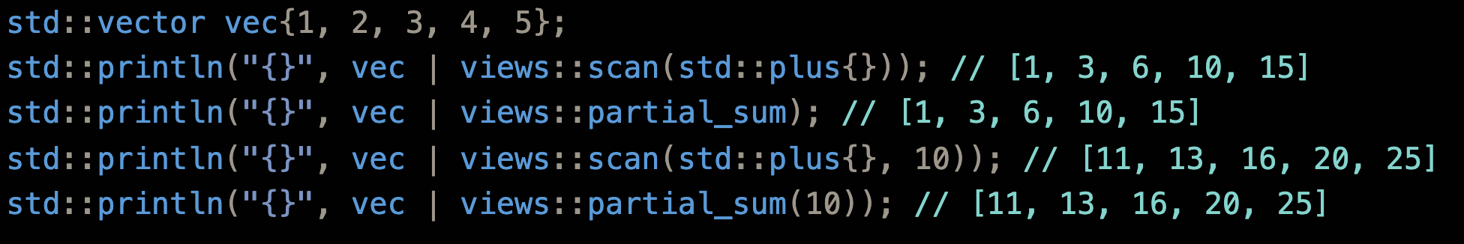
What Is Being Proposed?
views::scan family: Lazy version of std::inclusive_scan
views::scan
Also an alias: views::partial_sum
Tier 1 item in P2760R1

Slide 3
A Tale of Three Scans
Original |  | 1 | 2 | 3 | 4 | 5
Inclusive |  | 1 | 3 | 6 | 10 | 15
Inclusive Seed=10 |  | 11 | 13 | 16 | 20 | 25
Exclusive Seed=10 | 10 | 11 | 13 | 16 | 20
prescan Seed=10 | 10 | 11 | 13 | 16 | 20 | 25

Slide 4
Significant Changes: R1 -> R2
Removed prescan
Reorder scan’s parameter such that it is now consistent with std::inclusive_scan (rng, func, init)
Make init optional for both scan and partial_sum

Slide 5
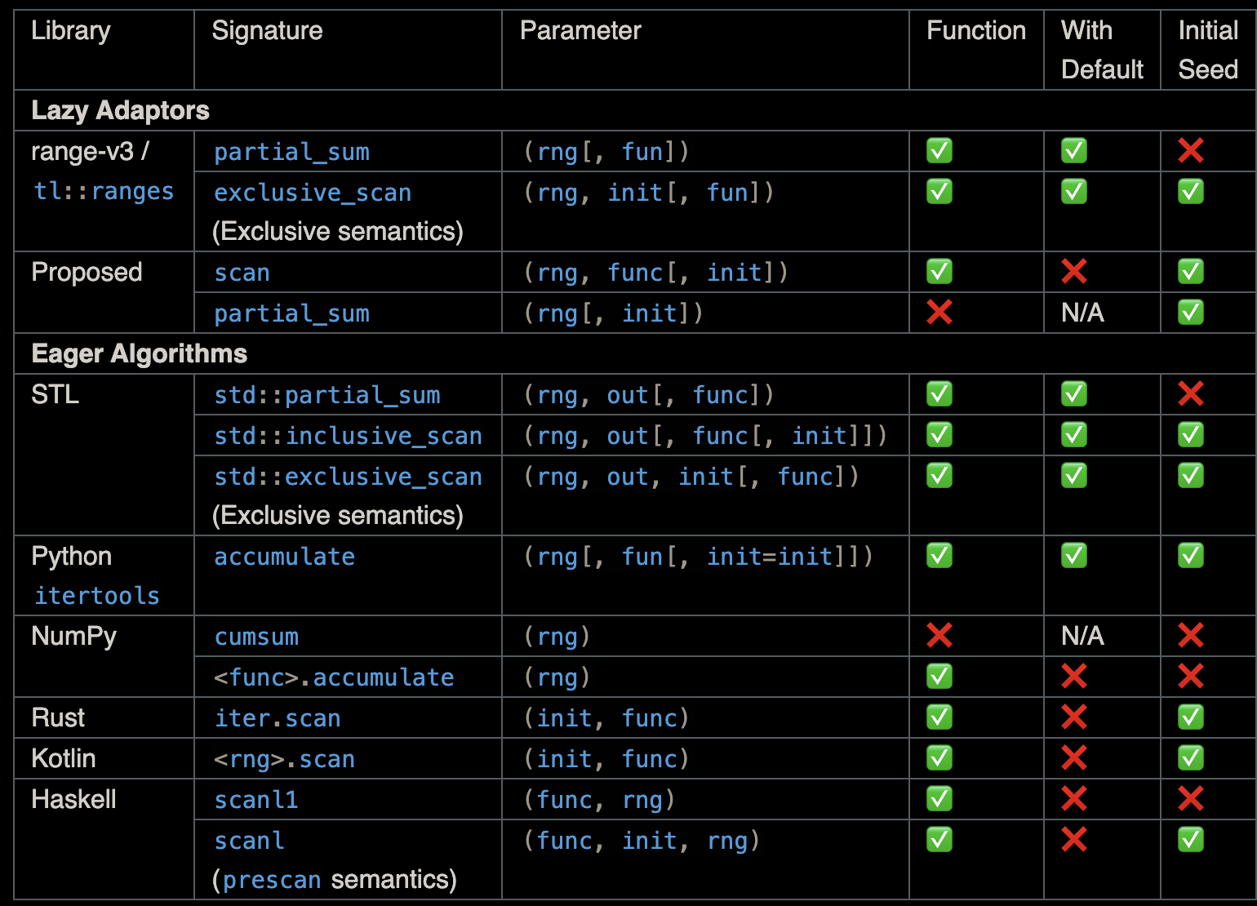
Prior Art
range-v3: views::partial_sum
tl::ranges: views::partial_sum
Algorithm version:
STL: std::[in, ex]clusive_scan (C++17), std::partial_sum (C++98)
Python: itertools.accumulate
NumPy: cumsum / ufunc.accumulate
Rust: iter.scan

Slide 6
Function Parameter Defaults
std::inclusive_scan defaults its functor to +, why not follow?
vec | views::scan // <- not obvious what this means
vec | views::partial_sum // <- much better
Most other languages do not default (see last slide)
Can be convinced otherwise though if we want full parity

Slide 7
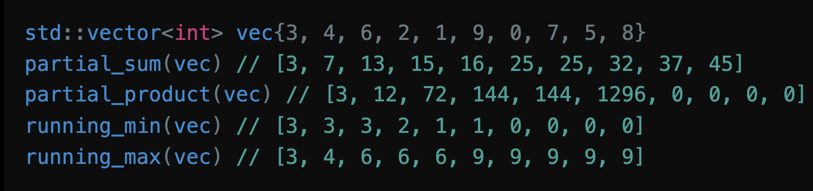
More Aliases
Apply std::plus{}, std::multiplies{}, ranges::min, ranges::max (okay after P3136R1 adopted in Wroclaw)
Not proposed for now; the author is happy to add if SG9/LEWG requests

Slide 8
Range Properties
Always the fun part

Slide 9
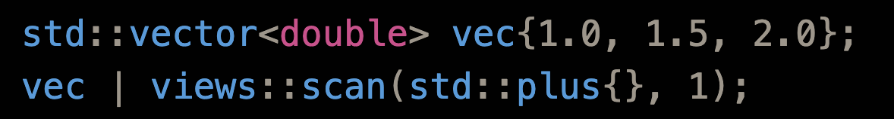
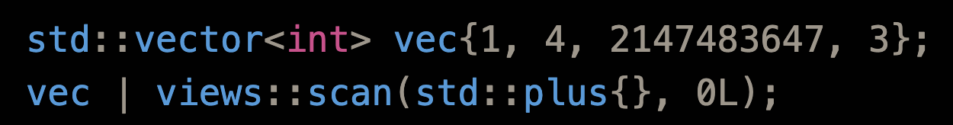
Reference and Value Type
std::accumulate pitfall: [2, 3, 5]
One possible choice: use the input range’s element type
Chosen by range-v3

Slide 10
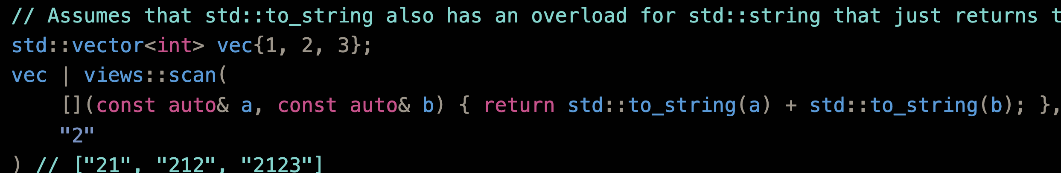
Reference and Value Type (cont’d)
decay_t<invoke_result_t<F&, T, ranges::range_reference_t<Rng>>>
Basically, result of func(init, *begin(rng))
Chosen by ranges::fold_left family

Slide 11
Transversal Category
At most forward
Cannot be bidirectional due to storing the current sum

Slide 12
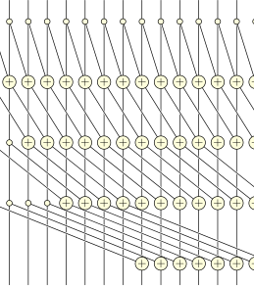
Parallelism
Concern raised about the ability to parallelize the execution of scan_view
Scan itself can be parallelized; hence the pSTL versions of std::{in, ex}clusive_scan

Slide 13
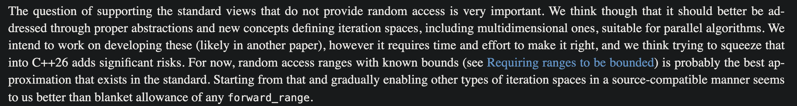
Parallelism (cont’d)
However, parallelism = random access in the STL
Although C++17 pSTL requires only forward iterators, in practice libc++ & libstdc++ downgrade to serial without random access
Most backends (OpenMP, oneTBB, ...) requires random access
Not a new problem: views::filter (which is at most bidirectional) already cannot be parallelized
P3179 will only support random access for now
P3179R5 has this to say:

Slide 14
Common
Never
Consistent with range-v3; iterator need to store current sum, so end() is not available in O(1)

Slide 15
Borrowed
Never for now
P3117R1 may make views::transform conditionally borrowed; the same can apply to views::scan

Slide 16
Other Properties
Sized iff the input range is sized (same size)
Const-iterable iff the input range is const-iterable

Slide 17
Questions for SG9
Function Parameter Default?
Convenience Aliases?

