Slide 1
P3423R1: Extending User-Generated Diagnostic Messages
Yihe Li
EWG Sofia (2025-06)

Slide 2
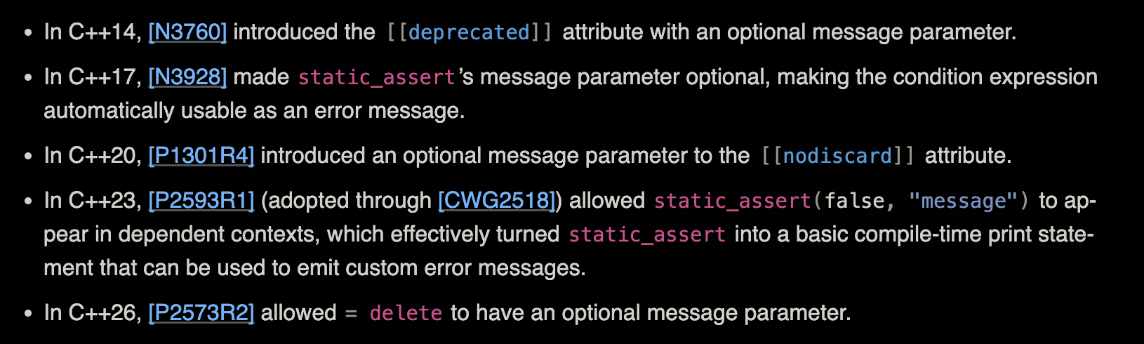
What Is Proposed?
This proposal thus tries to introduce a user-provided string parameter for the other three things that currently accept a string literal.
Namely: [[nodiscard(message)]], [[deprecated(message)]], = delete(message)

Slide 3
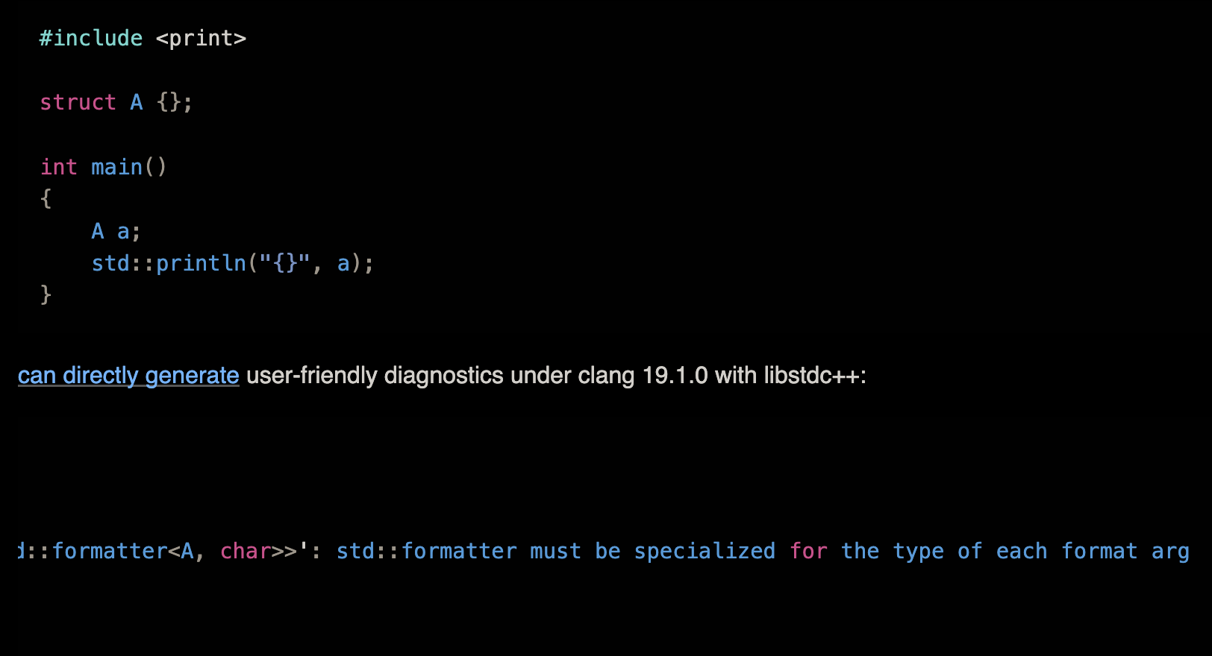
Motivation
Better error message

Slide 4
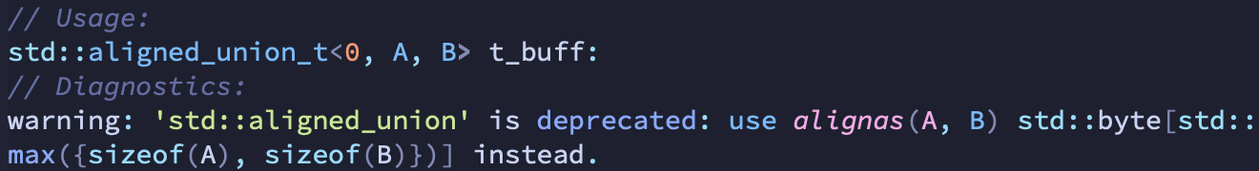
Examples in the Standard Library
make_unique<T[N]>() => = delete(“make_unique<T[N]>(...) is not supported; perhaps you mean make_unique<T[]>(N) instead?”) with T and N substituted
std::rel_ops => [[deprecated(“operator!= will be automatically generated for class T”)]] with T substituted
std::aligned_storage => [[deprecated]] with the following

Slide 5
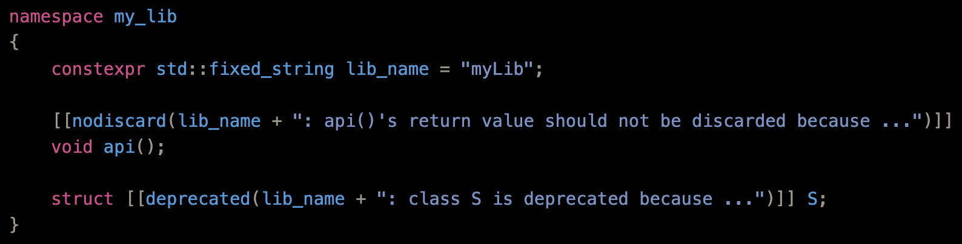
Examples in Third-Party Libraries

Slide 6
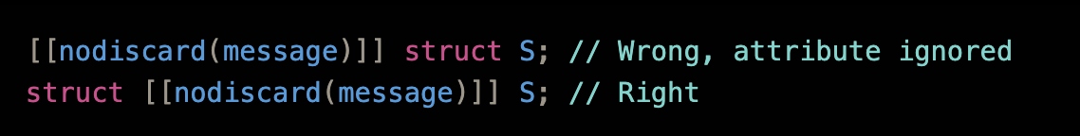
Design
Mostly follows P2741 (static_assert message)
Accepted parameter: constant string-like values
String-like = .size() returning size_t && .data() returning const char*
No change to attribute placement

Slide 7
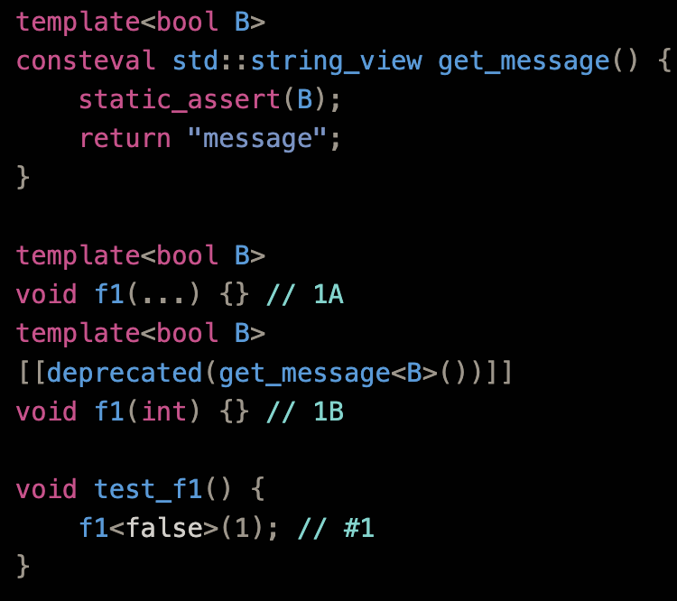
Immediate Context Issue
What should this mean? Should attributes affect SFINAE?
Currently unspecified as no attributes with expression argument can appear here
Proposed: same semantics as noexcept(…), pre(…), post(…); attributes are not in the immediate context (left is hard error)
Follows from parsing logic: parsing/instantiating declaration needs to be done on first encountering the attribute/= delete, and also string-like check happens here.
Then, only when the overload resolution selects this candidate, the instantiation of the definition is done. Any substitution error is a hard error here.

Slide 8
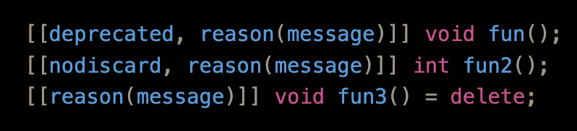
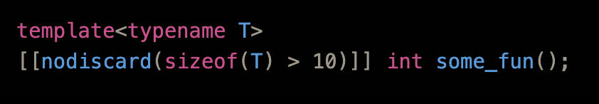
Alternatives Considered
Hard to specify two attribute
The attribute already have arguments
What if attributes later take a condition?
Can be (condition, message)
Can also be disambiguated by string-like vs bool

Slide 9
Reflection
P3385 already have provisos for attribute arguments: ill-formed if not string literal
Maybe constant strings pose less of an implementation challenge than runtime arguments (like [[assume]]); can always relax later if that is the case.

Slide 10
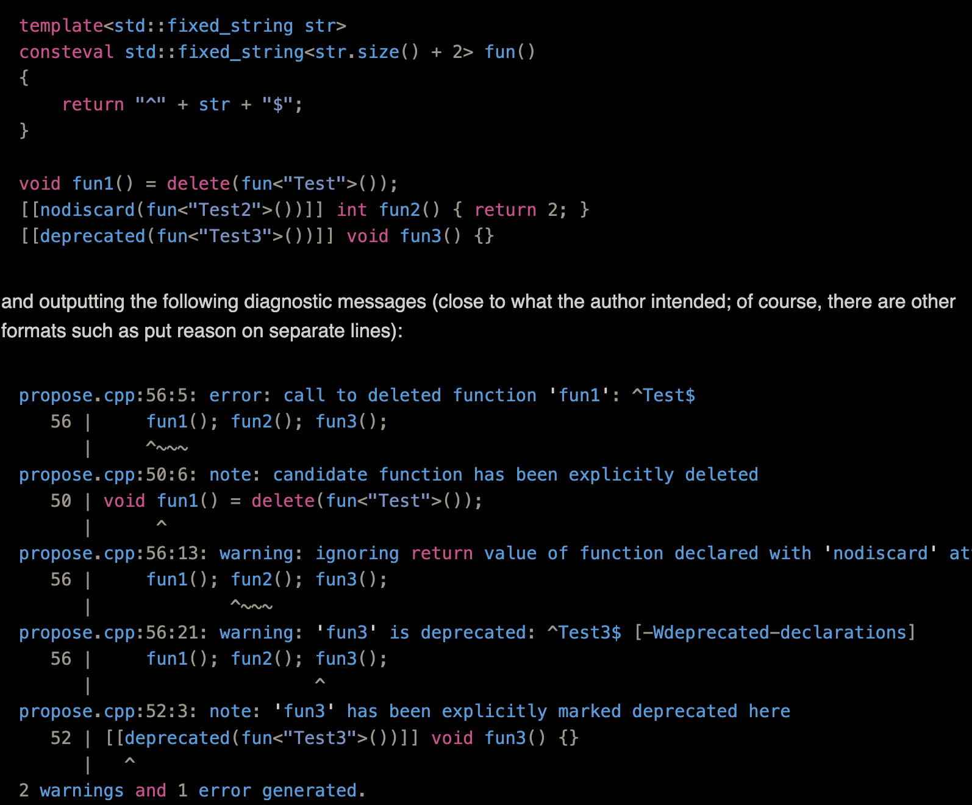
Implementation
Have a preliminary Clang fork; not completed (no test, etc.) but no difficulties are expected.

Slide 11
Thanks for Listening!

