Slide 1
P2549R0: std::unexpected<E> should have error() as member accessor
Yihe Li (@Mick235711)
Audience: LEWG

Slide 2
1. Motivation 2. Design 3. Implementation & Existing Practice 4. Initial Wording

Slide 3

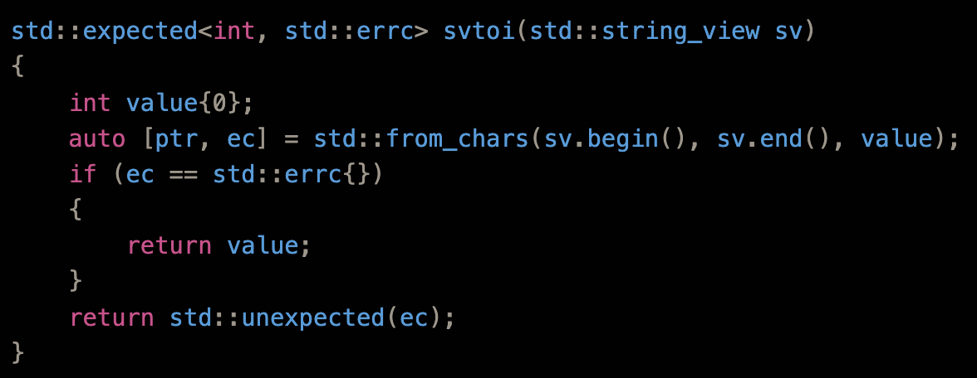
Motivation - Background
P0323R12 (std::expected)
Class template expected<T, E> is a vocabulary type which contains an expected value of type T, or an error E.
expected<T, E> models a discriminated union of types T and unexpected<E>.
Adopted for C++23 at Feb 2022 plenary.

Slide 4
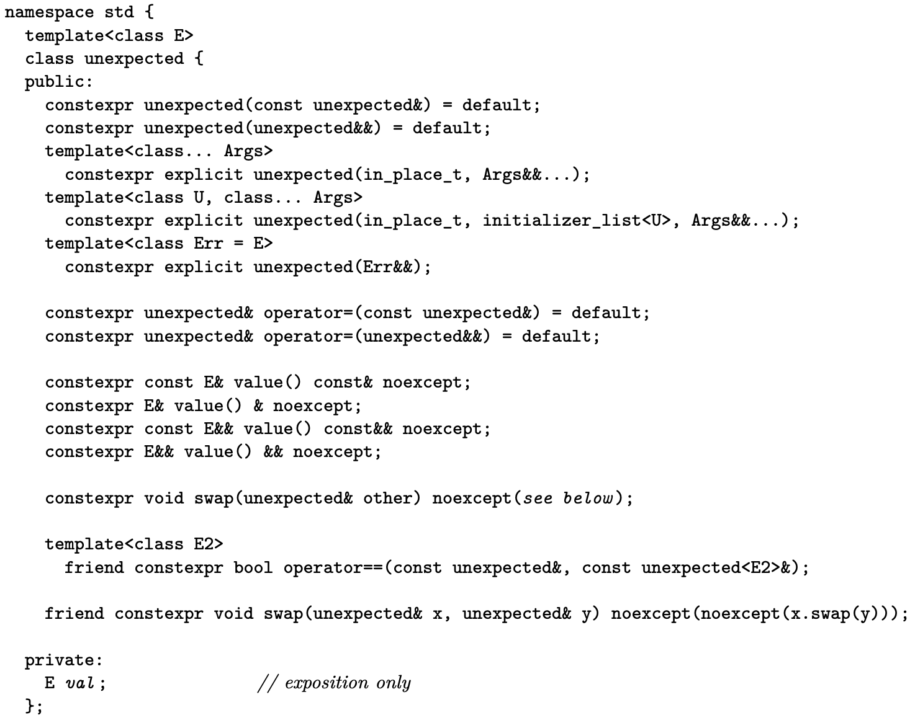
Motivation - Status Quo
std::unexpected<E> - a simple wrapper for E (error type)
Also is implicitly convertible to std::expected<T, E> (“trampoline class”)
Member accessor: value()

Slide 5
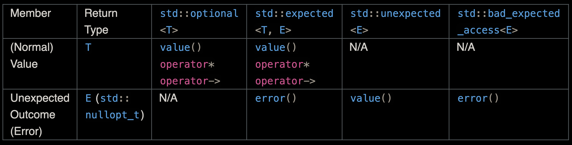
Motivation - Why Changing?
Status Quo is inconsistent with other types in the expected hierarchy (std::expected<T, E> and std::bad_expected_access<E>)
Consistency among library vocabulary types is important and makes user interaction intuitive
expected<T, E> is specifically designed based on optional<T> (expand the fixed nullopt_t to E).
Comparison on the member access method of two types:

Slide 6
Motivation - Why Changing?
Benefits by changing to error():
Consistency: Within expected, and also reduce inconsistency with other value()-providing types that have different preconditions.
Generic: Same name means more generic code is allowed. For example, generic code can do e.error() on any (potentially) error-wrapping types to retrieve the error (includes expected and further error-handling types like std::status_code [P1028R3] and std::error [P0709R4]).
Safety & Inituitive: Other value() type often have different preconditions, for example throwing when the type does not hold a normal value, or (worse) have narrow contract and UB on abnormal call.

Slide 7
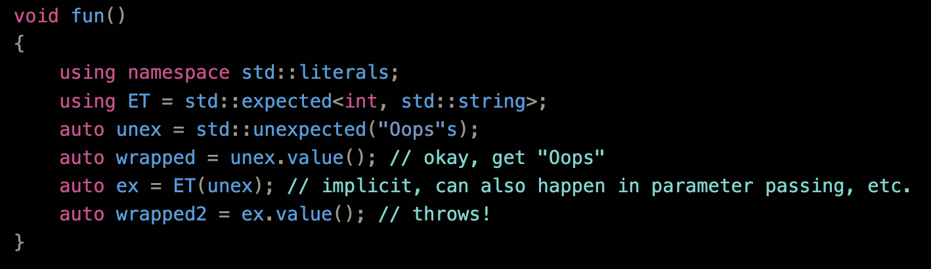
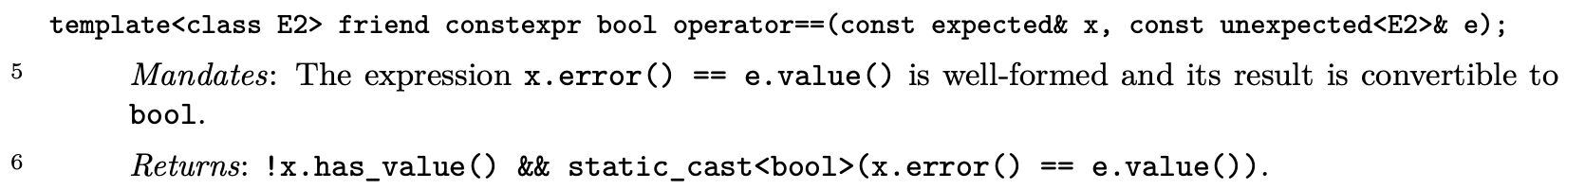
Motivation - Code Smell of Status Quo
Different contracts of value()
Wording ([expected.object.eq])

Slide 8
1. Motivation 2. Design 3. Implementation & Existing Practice 4. Initial Wording

Slide 9
Design - Already Inconsistent?
Use of value() across the library is already inconsistent?
Most use of value() member function across the standard library adhere to the tradition, aka return the normal "value" that the type is holding.
std::chrono::leap_second::value() -> +1s/-1s as value of the type
std::error_code/std::error_condition value() --- Seemingly precedent of value() returning error type? Not really.
Not really the "error value" or "unexpected outcome”
Furthermore, value() is not really the whole "error" contained in these types, value() plus category() is. Value() itself should not be taken as the "error representation".

Slide 10
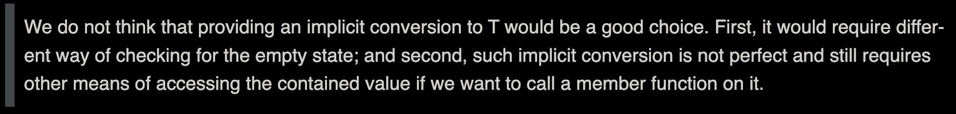
Design - Alternatives Considered
Conversion operator? Make std::unexpected<E> (implicit/explicit) convertible to E? (Besides, just a wrapper)
Precedent: std::reference_wrapper<T> (implicitly convertible to T&)
Not a particularly good idea - even implicit conversions are not perfect (and harmful)
Rejected for optional<T> (N3672)

Slide 11
Design - Alternatives Considered
No member accessor?
Interesting choice
Have precedent: Rust Result, https://github.com/viboes/std-make (one of referenced implementation of P0323R12)
Besides, the intended usage is just return std::unexpected(some_error);, provide a member accessor does not seem to help this use case at all.
Seems providing an accessor will not do harm... And maybe have some use case that I’m not aware of
Not proposed but will not against if LEWG favor this.

Slide 12
Design - Target Vehicle
C++23
Aware of design freeze deadline (already passed)...
Want to classify as “improvement/fix” (P0592R4 bucket 2) of current std::expected type hierarchy.
Huge breaking change after C++23.

Slide 13
1. Motivation 2. Design 3. Implementation & Existing Practice 4. Initial Wording

Slide 14
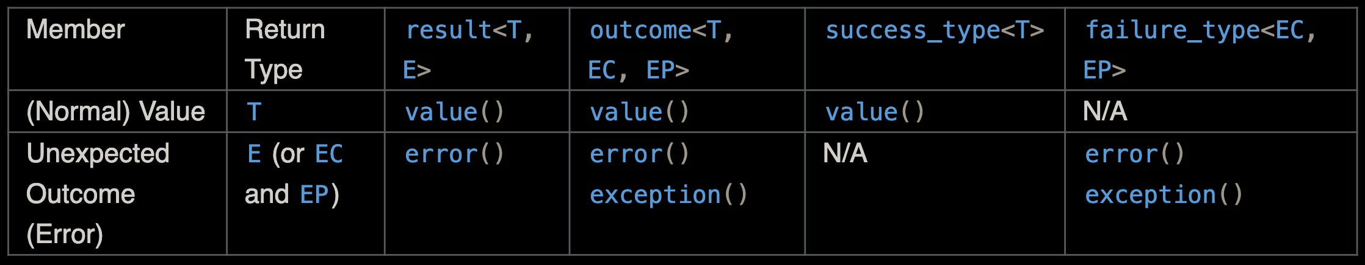
Outcome v2
Outcome (standalone) or Boost.Outcome
A set of tools for reporting and handling function failures in contexts where directly using C++ exception handling is unsuitable.
Created as a negative response to original std::expected.
Current design of P0323R12 is influenced greatly by Outcome.
The library provided result<T, E, Policy> and outcome<T, EC, EP, Policy> types that represents value/error duo type, with the difference in interface and outcome can hold both EC and EP (error code and exception (pointer)).

Slide 15
Boost.LEAF
Lightweight Error Augmentation Framework (LEAF), a lightweight error handling library for C++11. (Negative response to Outcome)
In error forwarding (common case), only trivial success-or-failure discriminant is transported. Actual error objects are communicated directly to the error handling scope, skipping the intermediate check-only frames altogether.
The main type for LEAF is leaf::result<T>, expected with E eliminated from signature. Unexpected results are produced by leaf::new_error(some_error), returns leaf::error_id object that can be converted to an unexpected leaf::result<T>.
There is also a leaf::error_info that is used as the generic error type receiver for functions such as leaf::try_catch.

Slide 16
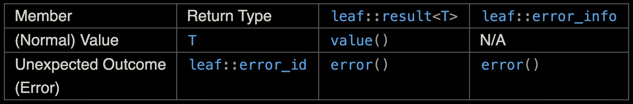
Boost.LEAF
Notice: leaf::error_id is the final error (unexpected outcome) type, its value() is like that of std::error_code, which does not return an "unexpected outcome", but instead return an error ID for the alternative description of leaf::error_id, which actually fits into my reasoning of returning "value”.

Slide 17
1. Motivation 2. Design 3. Implementation & Existing Practice 4. Initial Wording

Slide 18
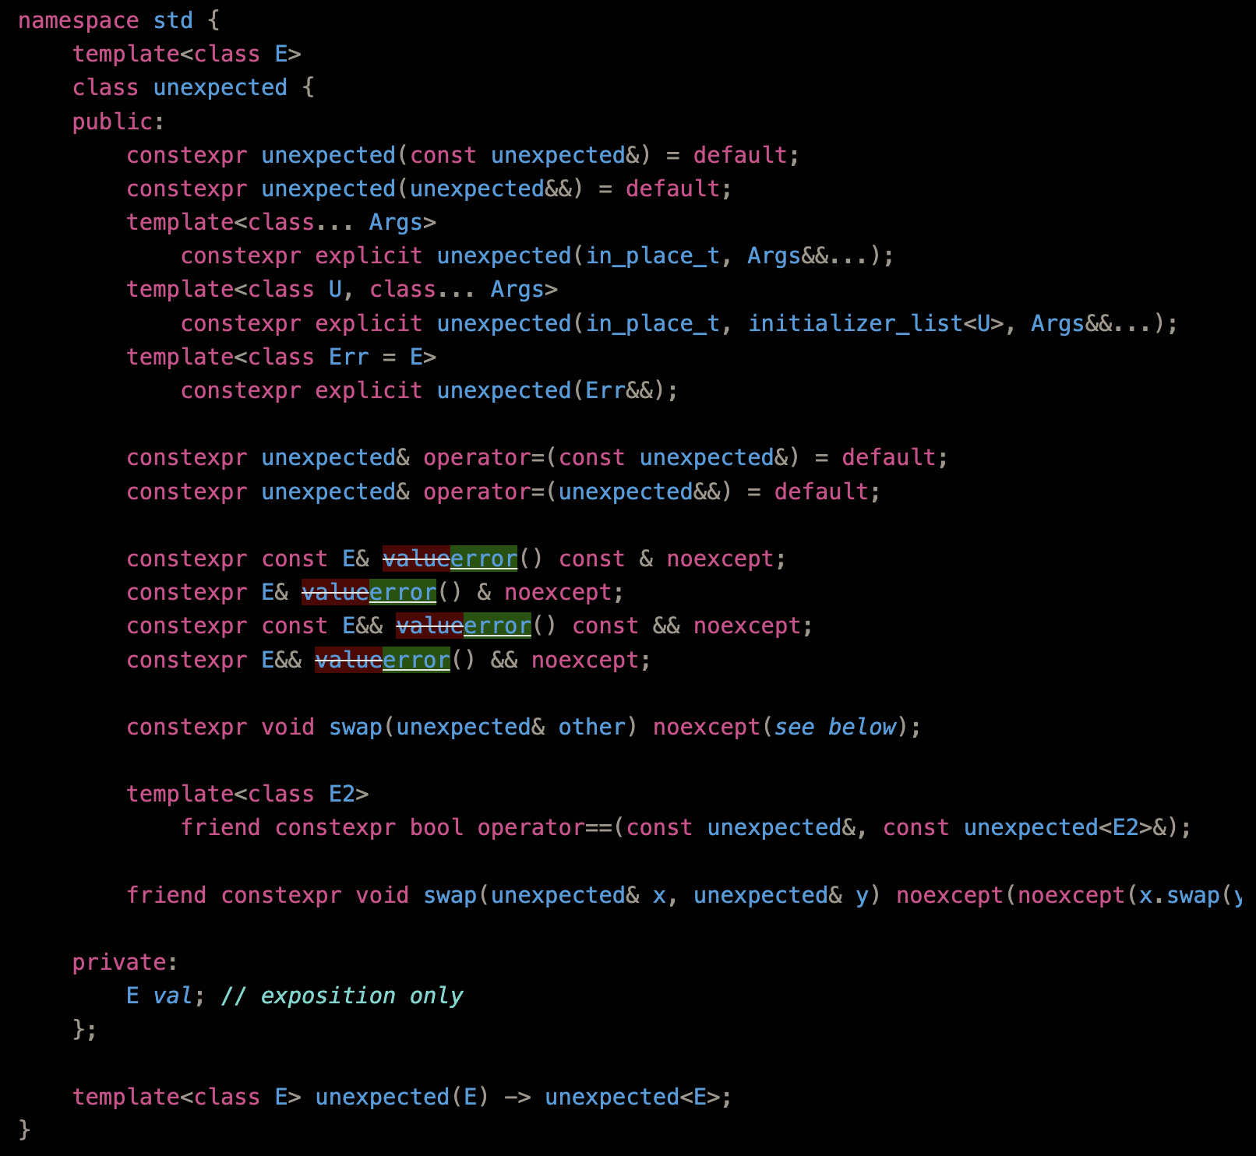
Initial Wording
Change every mention of std::unexpected<E>::value() to error()
Feature test macro?
I don’t think need one. But if LEWG feels there is a need, I suggest bumping __cpp_lib_expected.

Slide 19
Thanks for Listening!

