Slide 1
P3351: views::scan
LEWG Review, 2026-08-11
Author: Yihe Li

Slide 2
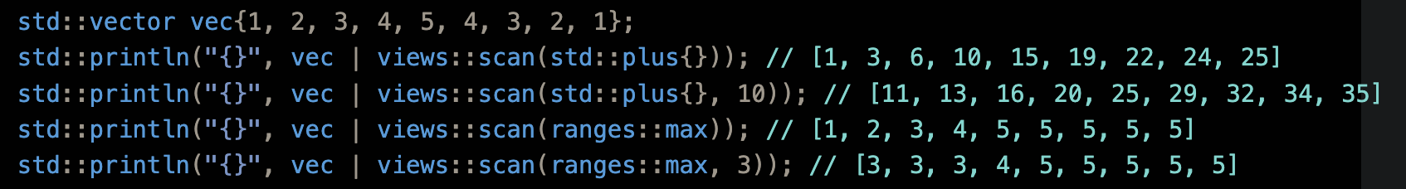
What Is Being Proposed?
views::scan family: Lazy version of std::inclusive_scan
Tier 1 item in P2760R1

Slide 3
A Tale of Three Scans
Original |  | 1 | 2 | 3 | 4 | 5
Inclusive |  | 1 | 3 | 6 | 10 | 15
Inclusive Seed=10 |  | 11 | 13 | 16 | 20 | 25
Exclusive Seed=10 | 10 | 11 | 13 | 16 | 20
prescan Seed=10 | 10 | 11 | 13 | 16 | 20 | 25
Originally, this proposal have prescan in addition to scan
Now we only purpose views::scan (inclusive semantics, optional seed)

Slide 4
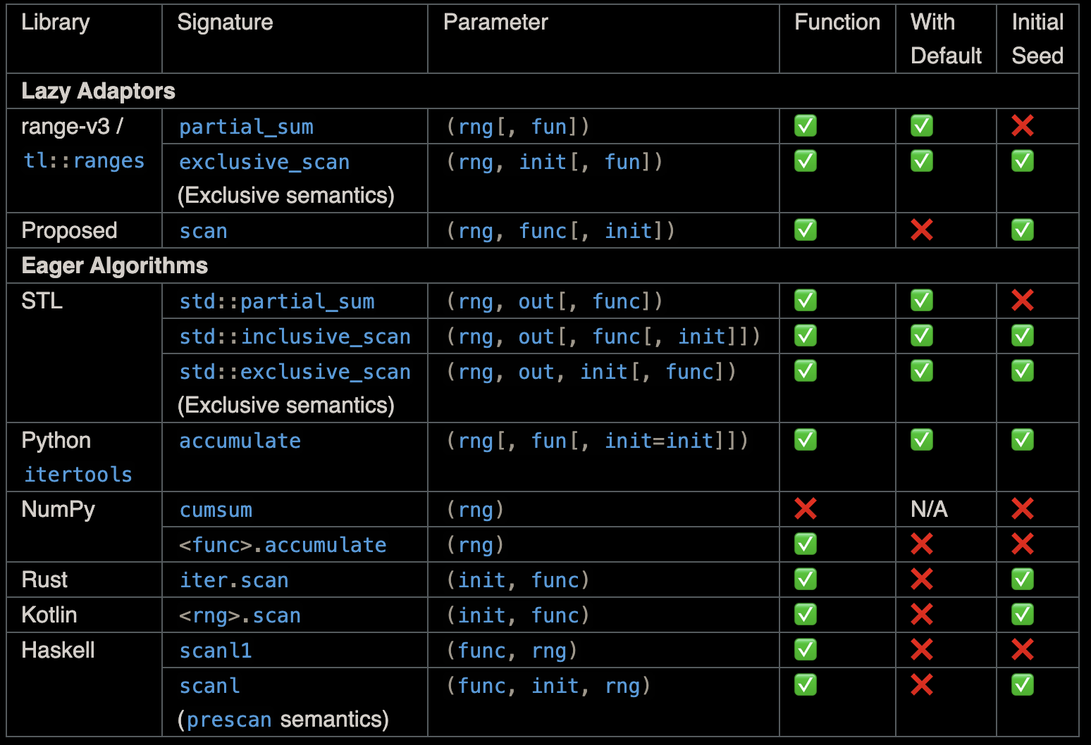
Prior Art
range-v3: views::partial_sum
tl::ranges: views::partial_sum
Algorithm version:
  STL: std::[in, ex]clusive_scan (C++17), std::partial_sum (C++98)
  Python: itertools.accumulate
  NumPy: cumsum / ufunc.accumulate
  Rust: iter.scan

Slide 5
Function Parameter Defaults
std::inclusive_scan defaults its functor to +, why not follow?
  vec | views::scan // <- not obvious what this means
  vec | views::partial_sum // <- much better
  Most other languages do not default (see last slide)
SG9 in Hagenberg: no default on functor

Slide 6
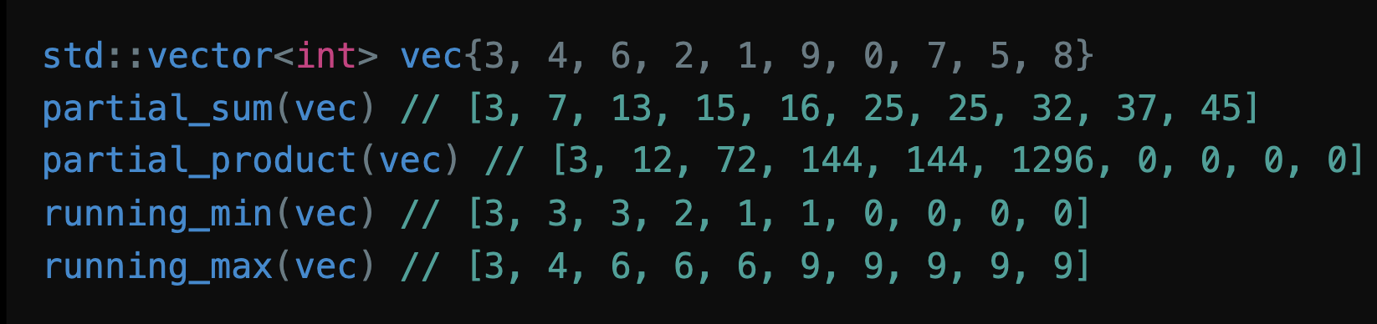
More Aliases
Apply std::plus{}, std::multiplies{}, ranges::min, ranges::max (okay after P3136R1 adopted in Wrocław)
Originally views::partial_sum was purposed
SG9 in Hagenberg: remove all convenient alias

Slide 7
Naming
The author prefer views::scan, however...
Some people stated that it is unclear whether inclusive or exclusive
Another proposal on std::scan (P1729) does unrelated things
  Already existing conflict in the STL: scanf vs inclusive_scan
  Not really conflicting (std:: vs views::)
Maybe we want to be consistent with STL algorithm and do views::inclusive_scan or partial_sum? (Or partial_fold suggested by P2214)

Slide 8
Range Properties
Always the fun part

Slide 9
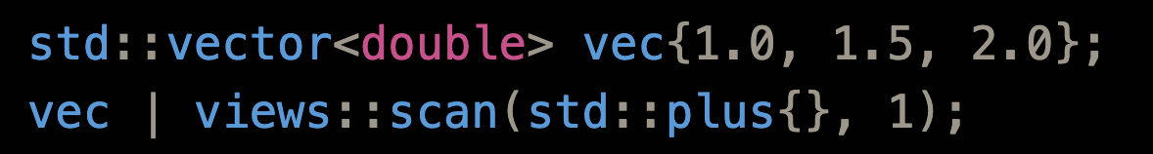
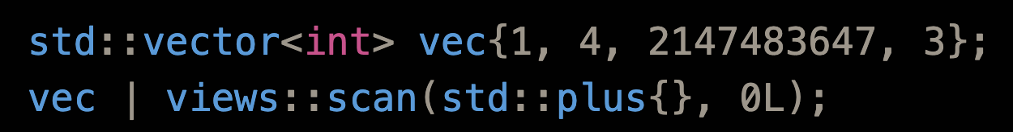
Reference and Value Type
std::accumulate pitfall: [2, 3, 5]
One possible choice: use the input range’s element type
  Chosen by range-v3

Slide 10
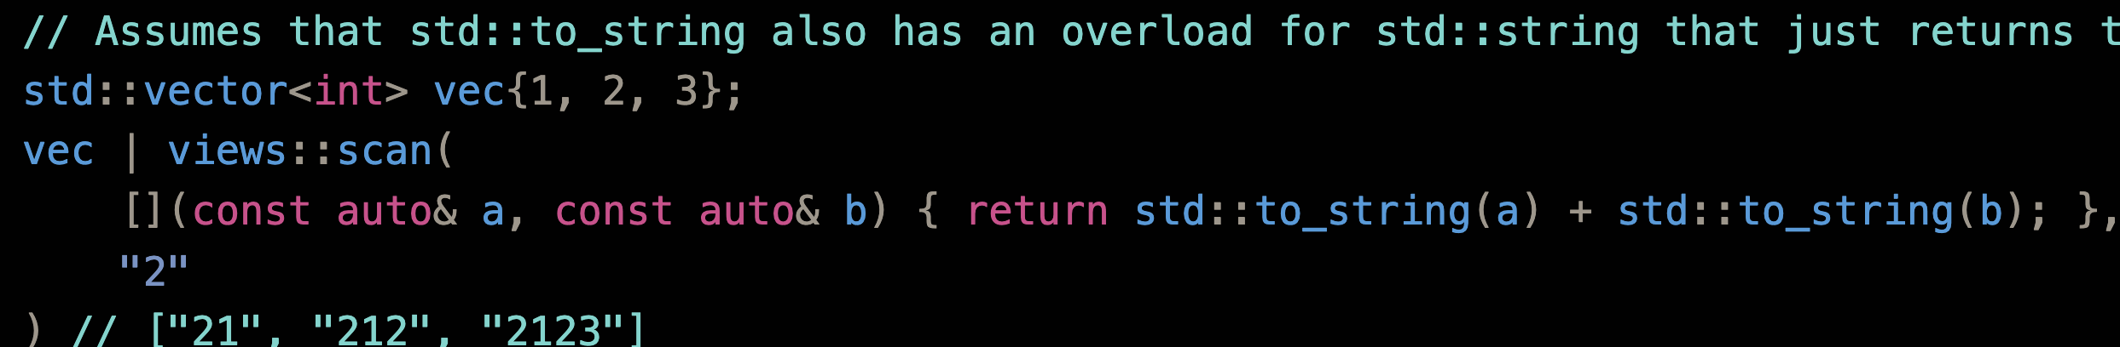
Reference and Value Type (cont’d)
decay_t<invoke_result_t<F&, T, ranges::range_reference_t<Rng>>>
Basically, result of func(init, *begin(rng))
Chosen by ranges::fold_left family

Slide 11
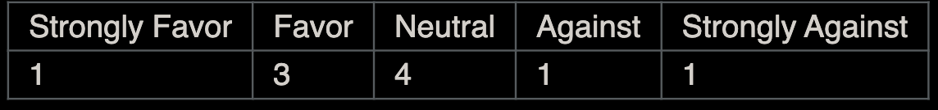
Transversal Category
Input only since R3
Cannot be bidirectional due to storing the current sum
Cannot be forward due to stashing iterator requirements
  Choose your potion: copy in operator* or input only
SG9 in Hagenberg: Make scan_view input only

Slide 12
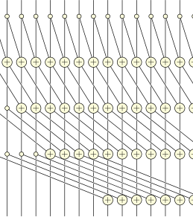
Parallelism
Concern raised about the ability to parallelize the execution of scan_view
Scan itself can be parallelized; hence the pSTL versions of std::{in, ex}clusive_scan

Slide 13
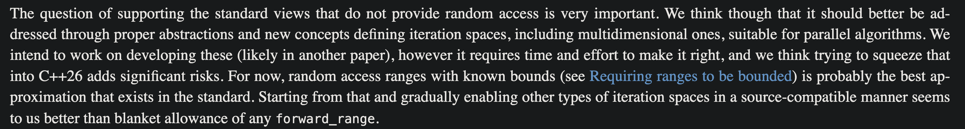
Parallelism (cont’d)
However, parallelism = random access in the STL
Although C++17 pSTL requires only forward iterators, in practice libc++ & libstdc++ downgrade to serial without random access
Most backends (OpenMP, oneTBB, ...) requires random access
Not a new problem: views::filter (which is at most bidirectional) already cannot be parallelized
C++26 parallel ranges algorithms only support random access range
P3179 has this to say:

Slide 14
Common
Never
Consistent with range-v3; iterator need to store current sum, so end() is not available in O(1)

Slide 15
Borrowed
P3117R1 (design approved by LEWG) may make views::transform conditionally borrowed; the same can apply to views::scan
Therefore, this proposal also makes scan_view borrowed if input range is borrowed and functor is “small”
Approved by SG9 in Hagenberg

Slide 16
Other Properties
Sized iff the input range is sized (same size)
Const-iterable iff the input range is const-iterable
In freestanding
FTM: __cpp_lib_ranges_scan

Slide 17
Implementation Experience
In Beman Project, basically word-for-word from wording
No significant obstacles

Slide 18
Questions for LEWG
Naming?
regular_invocable (All views currently) or invocable (range-v3 views::partial_sum / C++23 ranges::fold_left)?

