Slide 1
Advanced Algorithm and Parallel Programming
Student Michele Gennaioli 899062
Prof. Fabrizio Ferrandi
Prof. Marco Lattuana

Slide 2
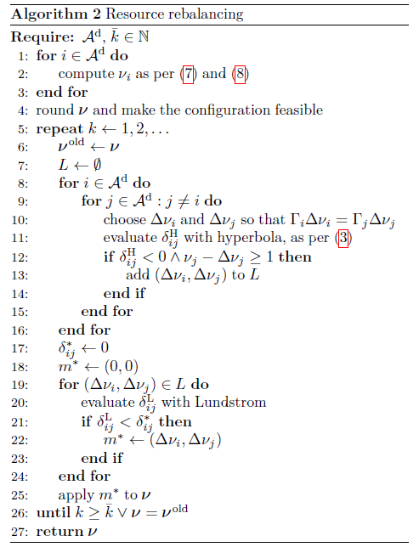
Description
For this project I have to implement some parallelization techniques for the algorithm presented in the picture and a «simulator» to replace Lundstom (that is used at line 20) .
I use Visual Studio 2017 and OpenMP to write my code.
I use C++ as programming language.

Slide 3
Component
My project is composed of some classes that are divided in mainClasses (circle) and simulatorClasses(square):
DeltaVM
VM
ComputeProduct
Project
Simulator
VMSimulator

Slide 4
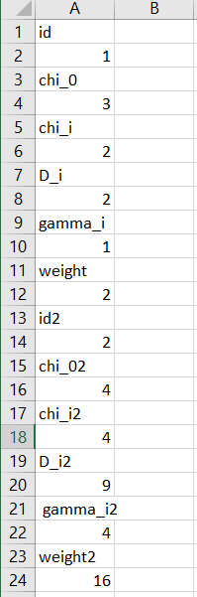
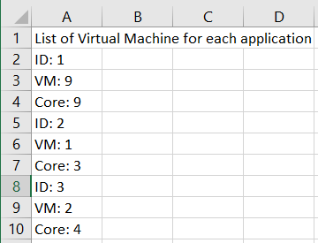
Project.cpp
This Project has several functions, it obtains its input from a file named «application.csv» and returns its output into a file named «result.csv».
The Functions are:
calculateVM(ComputeProduct,float,float)
checkBestSolution(DeltaVM)
checkFeasibility()
computeDenominator(vector<Application>)
computeSearch()
createElementForL(VM,VM)
createFile()
createFinalResult()
defineVectorVM
modifyVectorVM()
readApplicationFile()
readFileFromSimulator()
weightedTardiness(vm,vm,int,int)
Input Output

Slide 5
Implementation of the loop from line 8 to 15

Slide 6
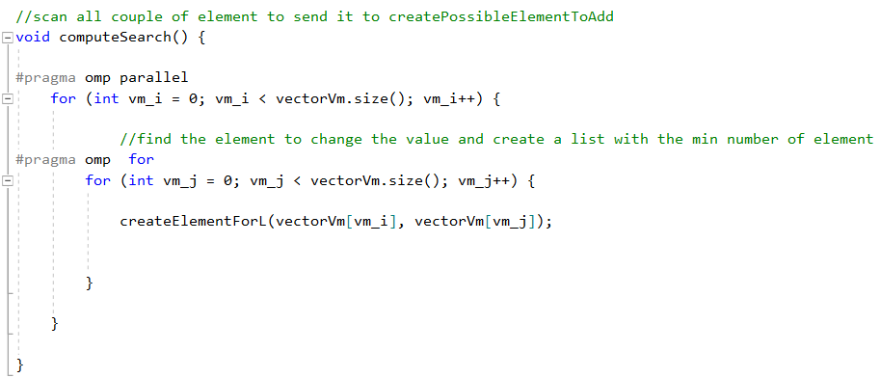
computeSearch()
computeSearch() uses a nested for loop to find couple to send the createElementForL(VM,VM), the internal for loop is using to divide it between several threads to decrease computation time.

Slide 7
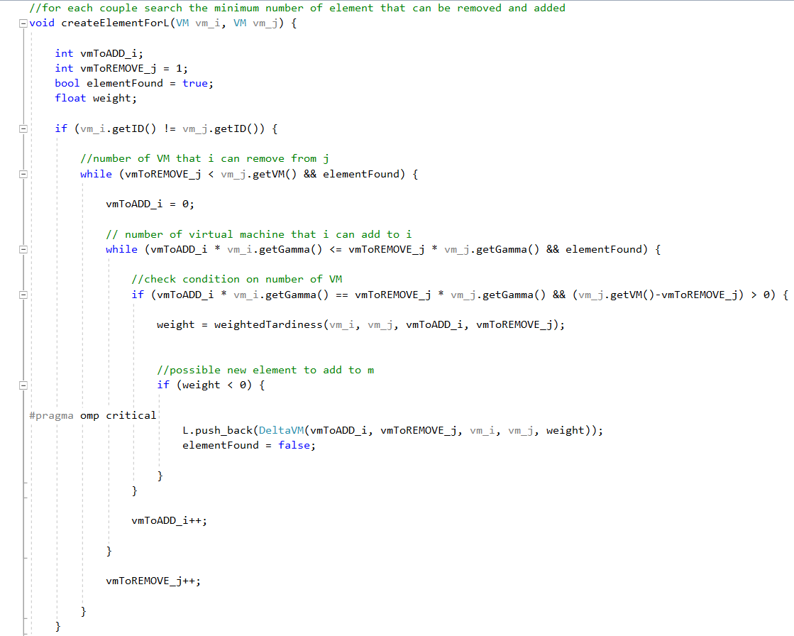
creteElementForL(VM,VM)
createElementForL(VM,VM) uses 2 while loops instead of for loop, because the search has to stop when it finds the element that can be added to the vector<DeltaVM> L.
L is a shared resource, so when several threads are trying to use it they need to access it one at a time; to do this the internal while loop use
that imposes an individual access to that instruction.

Slide 8

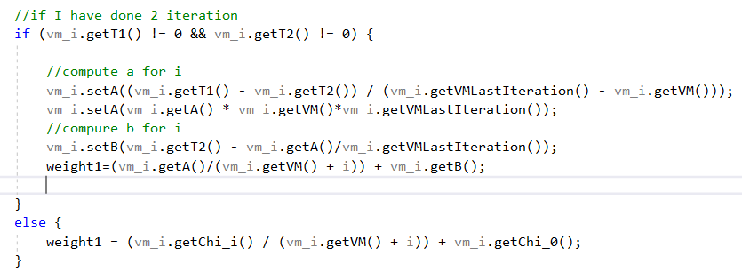
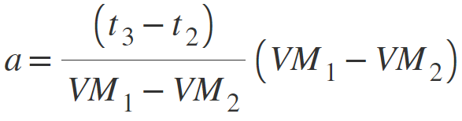
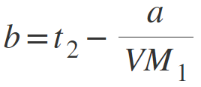

weightTardiness(VM,VM,int,int)
weightTardiness function implements line 11 of the algorithm, that employs this equation:
To compute t the function has to compute a first and then b (it has to interpolate them from the previous equation); in the first 2 iteration the function doesn’t have the value of the last two iteration to interpolate a and b, so i have to use Chi_i and Chi_O.

Slide 9
Implementation of loop from line 19 to 24

Slide 10
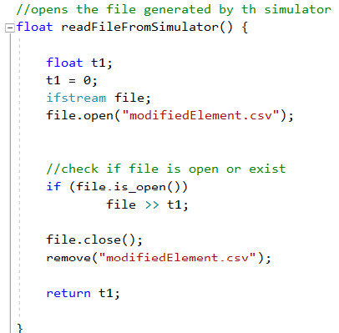
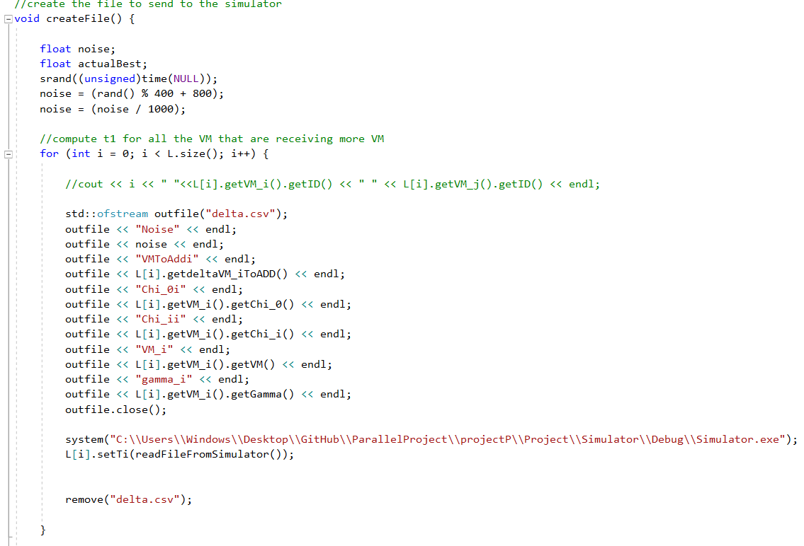
createFile()
This function is used to create the file that has to be read by the Simulator. It is divided in 3 not nested loop, the first 2 loops are used to write each element into a file named «delta.csv» and for each iteration they create and destory the file, as the simulator accepts only one object at the time. In each iteration it uses readFileFromSimulator() to set the result of the simulator in vector L.

Slide 11
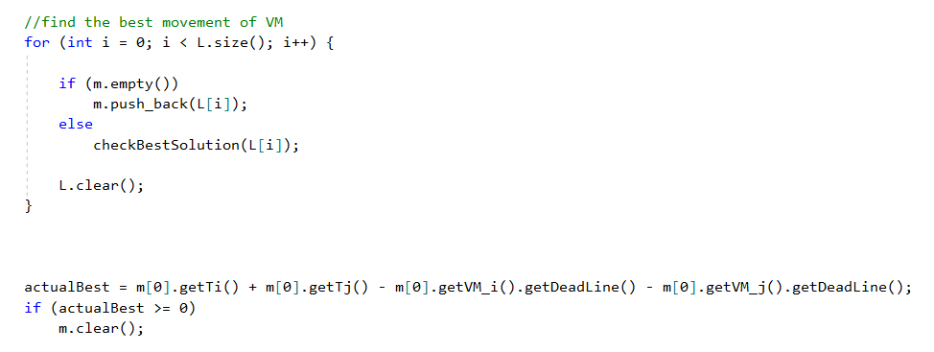
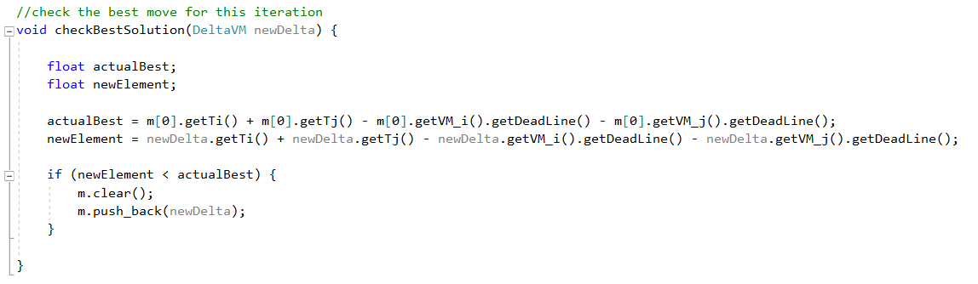
createFile()
The third loop is used to find the best move at that moment and it saves it in vector m that will update line 25. In each iteration it uses checkBestSolution(DeltaVM) to obtain the best move to apply.
Third loop
checkBestSolution

Slide 12
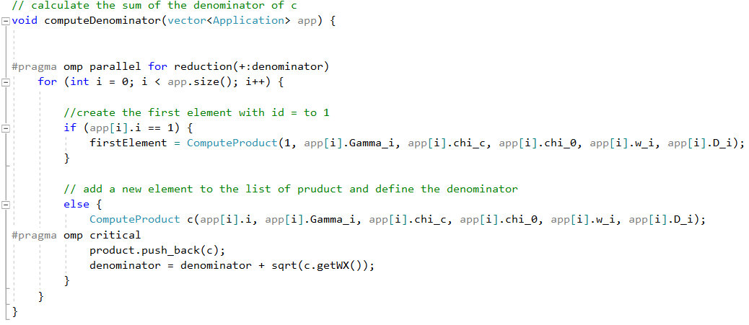
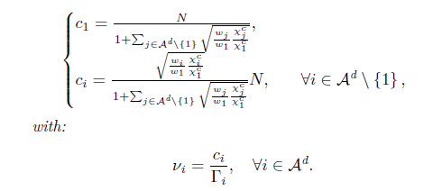
computeDenominator(Application)
This function uses
to compute the summation of the denominator of c

Slide 13
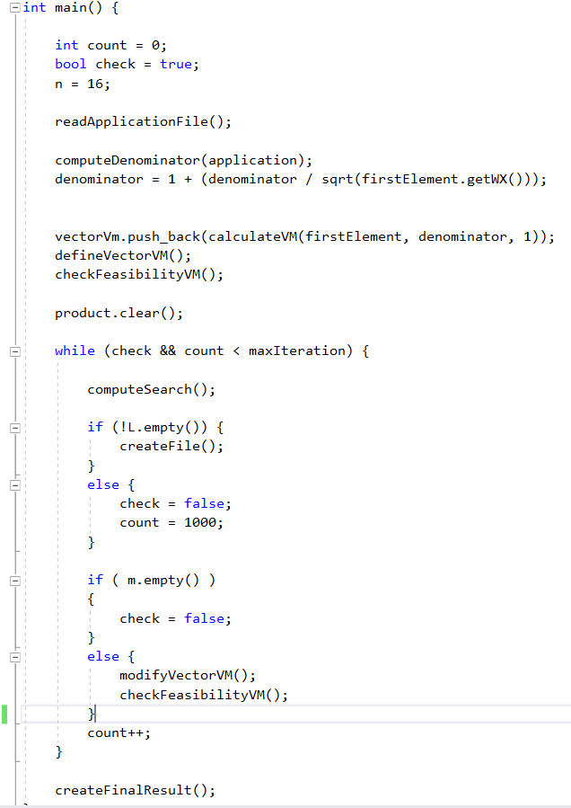

Main()
n represents the number of available cores.
The instuctions before the while loop are defining a vector and checking that the used resources are less than the available ones.
In the while loop in each iteration it checks if the vector L or m are empty; if so it means that there aren’t changes from the previous iteration and the algorithm shouldn’t search for a better solution.

Slide 14
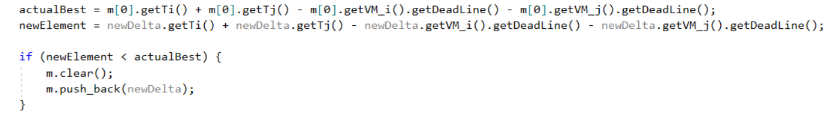
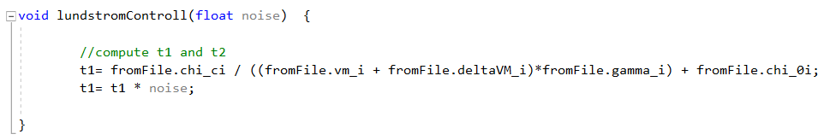
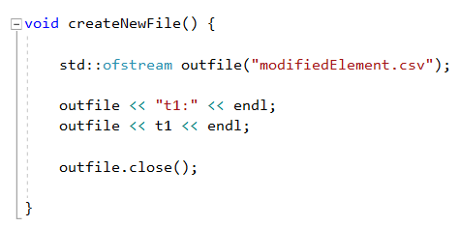
Simulator
The simulator is called by createFile() using the following function( I have to insert the path where the executable is located) :
It is used to compute t used by weightTardiness to interpolate a and b and to find the best move .
It is divided in 3 parts: main() (in which the Simulator reads the value from a file), lundstromControll(float) (in which it computes t) and createNewFile() (in which it creates the returned file to use).

Slide 15
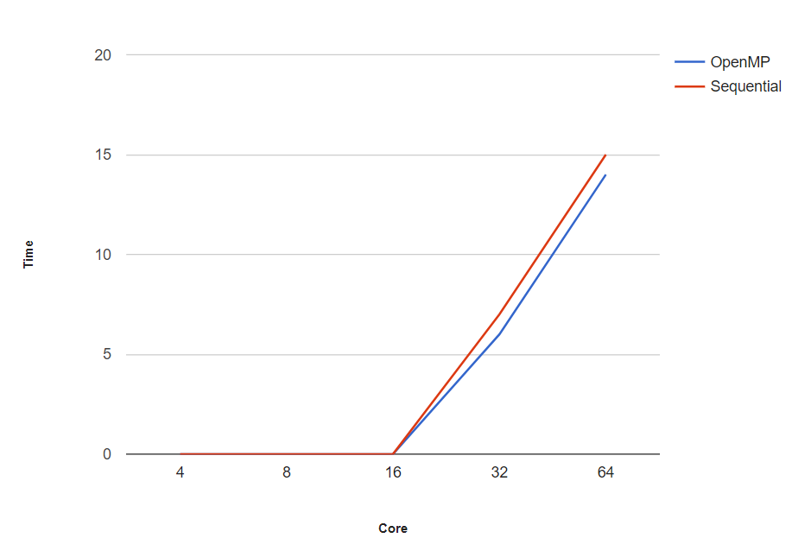
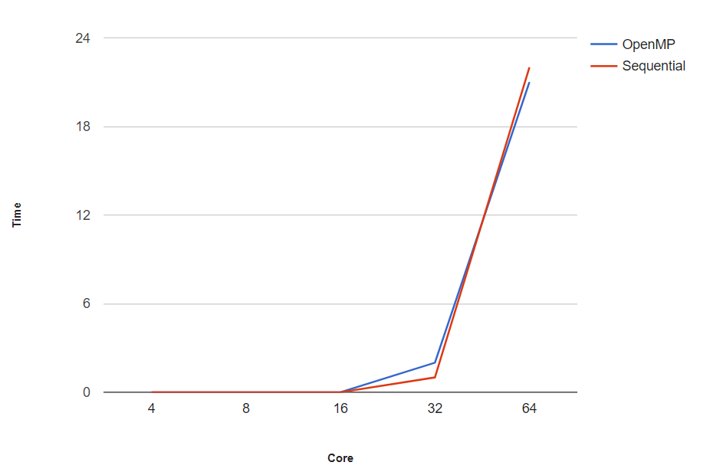
Computation time
The computation time of my application is computed using 4 different sets to see how it behaves with respect to the sequential algorithm.
The first 2 sets have a constant number of input and a variable number of cores:
8 applications 15 applications

Slide 16
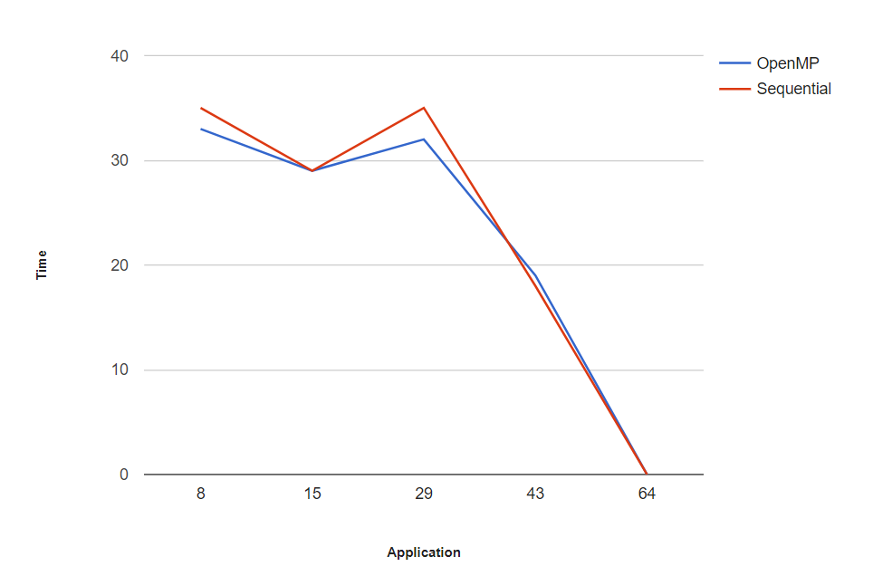
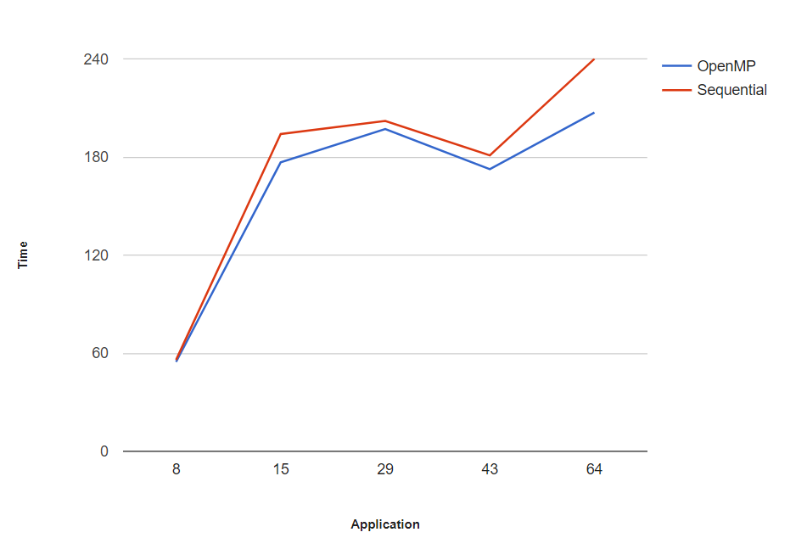
The others 2 sets have a constant number of cores and a variable number of applications:
100 cores 300 cores

