Slide 1
Advanced Algorithm and APrallel Programming
Student Michele Gennaioli 899062
Prof. Fabrizio Ferrandi
Prof. Marco Lattuana

Slide 2
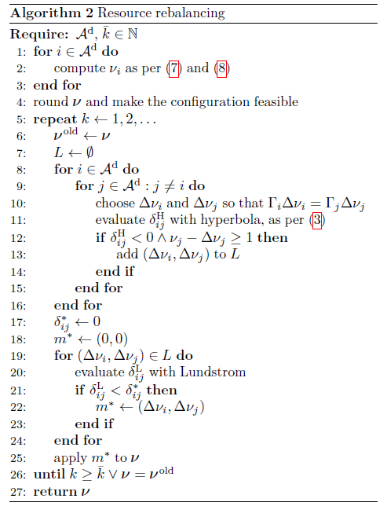
Description
For this project I have to implement some parallelization techniques for the algorithm presented in the picture and a «simulator» to replace Lundstom (that is used at line 20) .
I use Visual Studio 2017 and OpenMP to write my code.
I use C++ as programming language.

Slide 3
Component
My project is composed of some classes that are divided in mainClasses (circle) and simulatorClasses(square):
DeltaVM
VM
ComputeProduct
Project
Simulator
VMSimulator

Slide 4
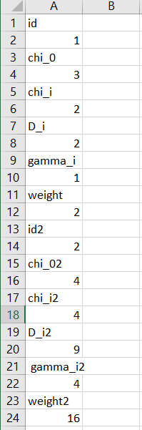
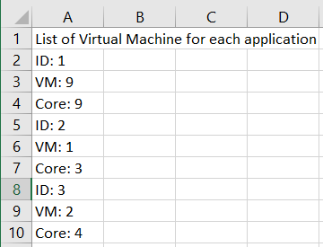
Project.cpp
This Project has several function, it obtain its input from a file named «application.csv» and returns its output into a file named «result.csv».
The Funcions are:
calculateVM(ComputeProduct,float,float)
checkBestSolution(DeltaVM)
checkFeasibility()
computeDenominator(vector<Application>)
computeSearch()
createElementForL(VM,VM)
createFile()
createFinalResult()
defineVectorVM
modifyVectorVM()
readApplicationFile()
readFileFromSimulator()
weightedTardiness(vm,vm,int,int)
Input Output

Slide 5
Implementation of the loop from line 8 to 15

Slide 6
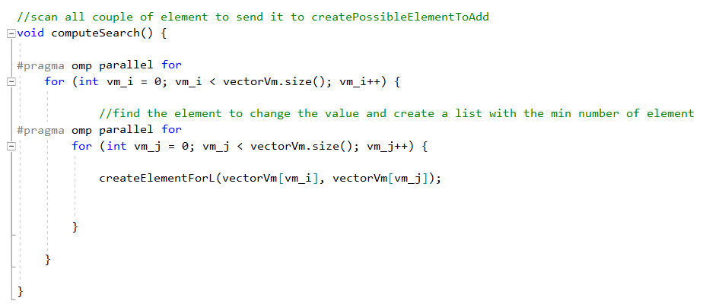
computeSearch()
computeSearch() use a nested for loop to find couple to send the createElementForL(VM,VM), the 2 for loop are using to divide them between several threads to decrease the computation time.

Slide 7
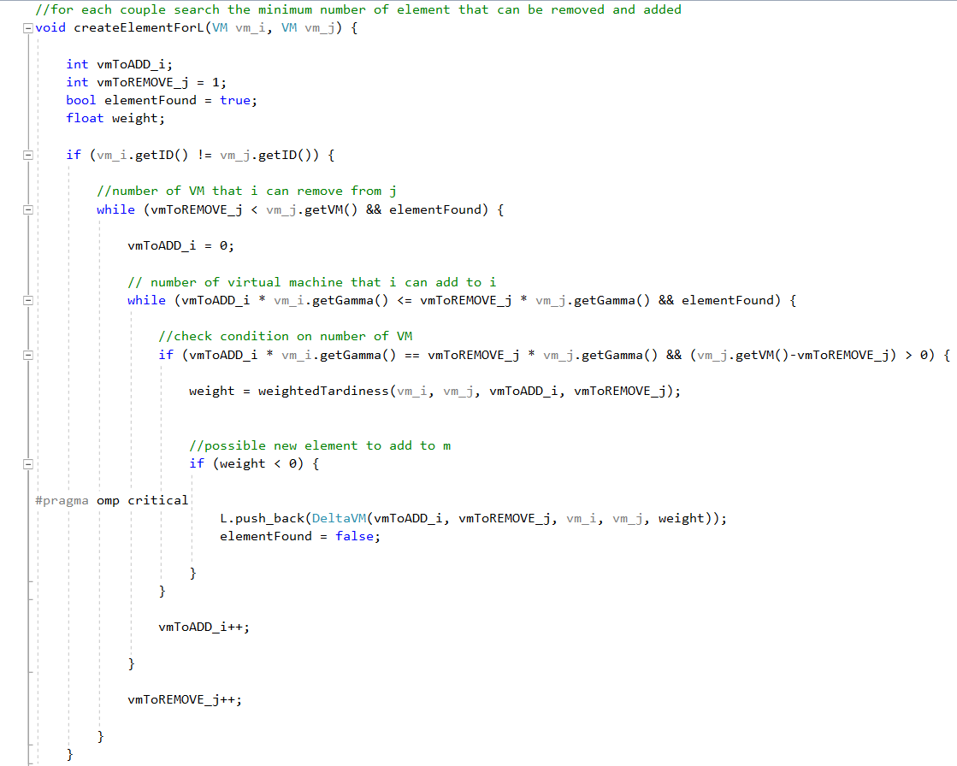
creteElementForL(VM,VM)
createElementForL(VM,VM) use 2 while loop instead the for loop, because the search has to stop when it find the element that can be added to the vector<DeltaVM> L.
L is a shared resource, so when the several thread are tring to use it they need to use it one at a time, to do this the internal while loop use
that imposes a individual access to that instruction.

Slide 8

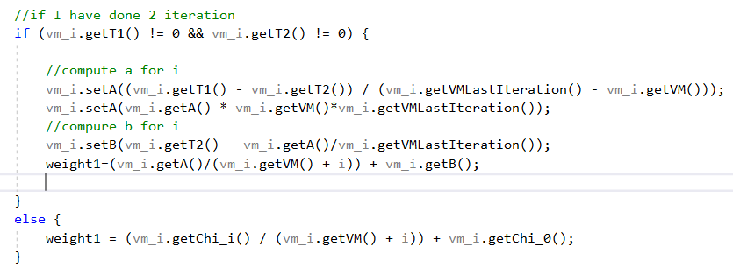
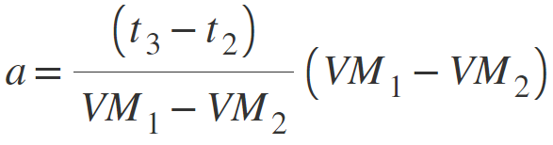
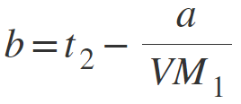

weightTardiness(VM,VM,int,int)
The weightTardiness function implements line 11 of the algorithm, that exploit this equation:
To compute t the function has to compute first a and b (the function has to interpolate them from the previous equation), in the first 2 iteration when the function doesn’t have the value of the last two iteration to interpolate a and b i have to use Chi_i and Chi_O.

Slide 9
Implementation of loop from line 19 to 24

Slide 10
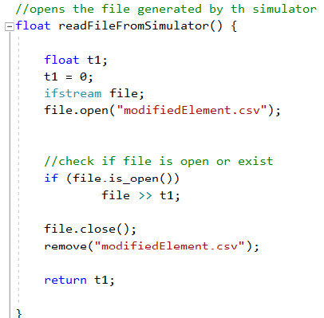
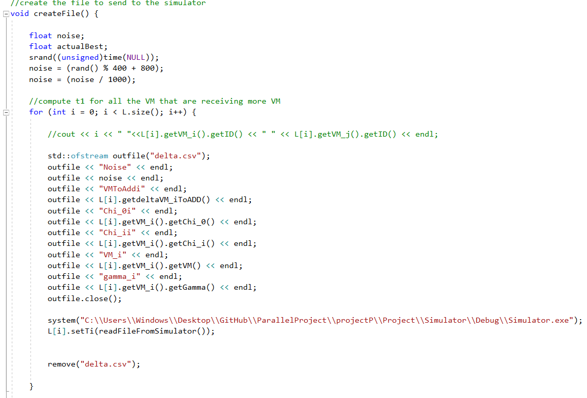
createFile()
This function is used to create the file that has to be read by the Simulator, it is divided in 3 not nested loop, the first 2 loops are used to write each element into a file named «delta.csv» and at each iteration they create and destory the file, because the simulator accept only one object at the time. At each iteration it use the readFileFromSimulator() to set the result of the simulator in the vector L.

Slide 11
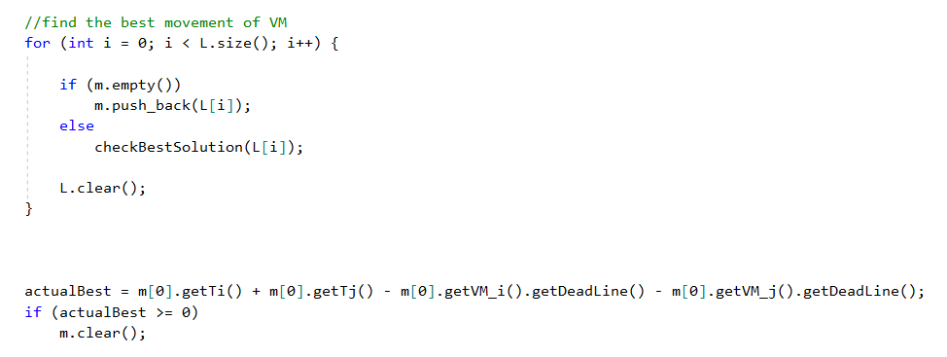
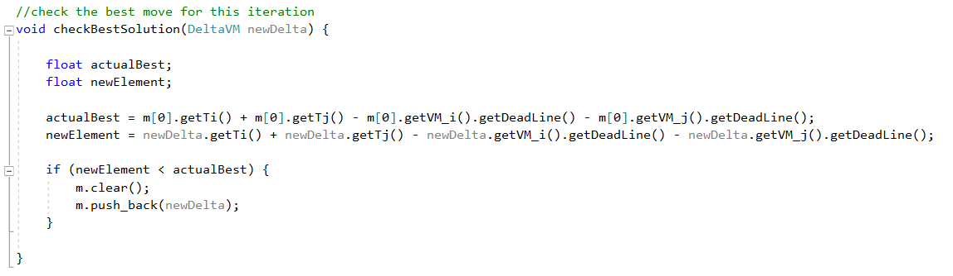
createFile()
The third loop is used to find the best move at that moment, it save the best move in the vector m that will do the update of line 25. At each iteration it use the checkBestSolution(DeltaVM) function, to obtain the best move to apply
Third loop
checkBestSolution

Slide 12
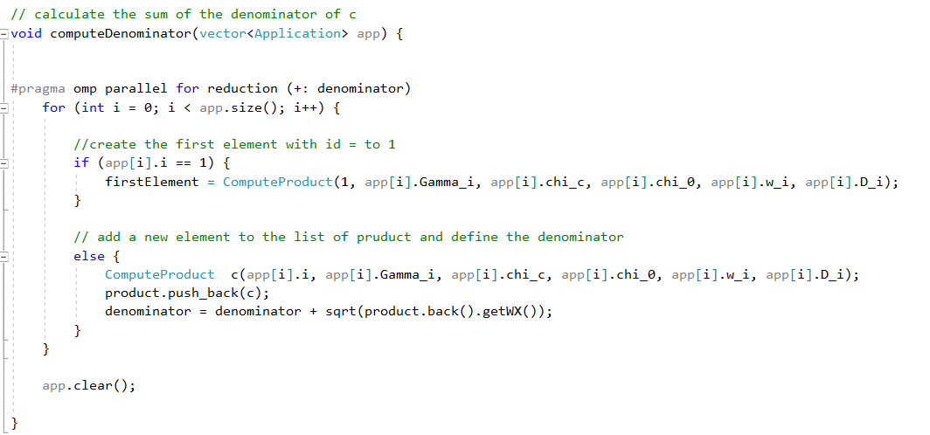
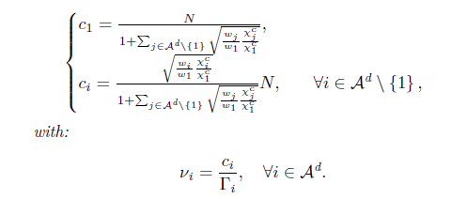
computeDenominator(Application)
This function use
To compute to sun of the denominator of c

Slide 13
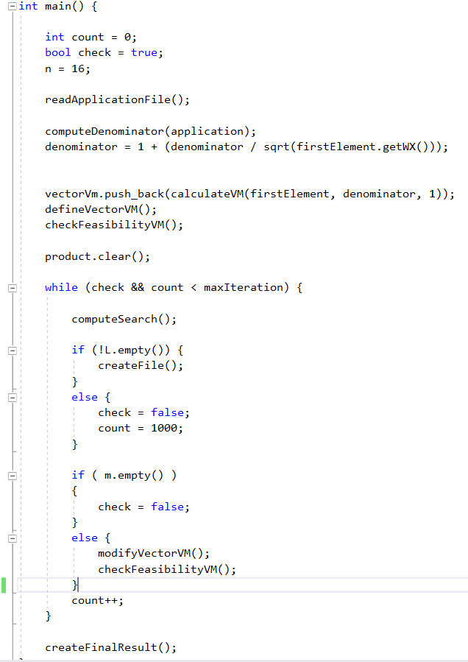

Main()
n represents the number of available core,
The next instuctions until the while loop are defining a vector and are making a check to control if the used resource aren’t greater than the available ones.
In the while loop at each iteration it check if the vector L or m are empty because if one of them is empty this means that there aren’t changes from the previous iteration, so the algorithm shouldn’t search for a better solution.

Slide 14
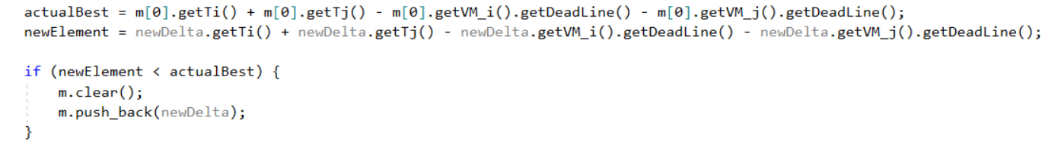
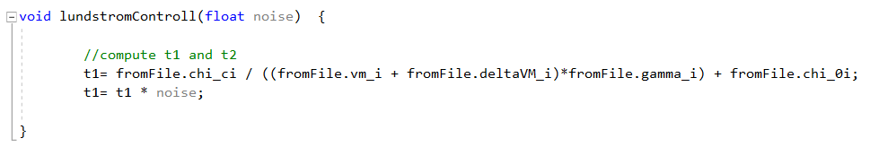
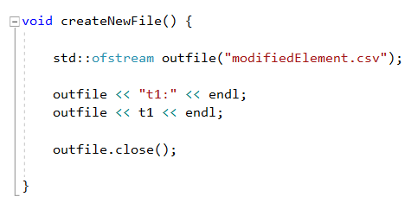
Simulator
The simulator is called by the function createFile() using the following function( I have to insert the path where the executable is located) :
The simultator is used to compute the t used by weightTardiness function to interpolate a and b and to find the best move .
It is divided in 3 parts: main() (in which the Simulator read the value from a file), lundstromControll(float) (in which the Simulator compute t) and createNewFile() (in which the Simulator create the returned file to use).

