Slide 1
Agora server integrated on a docker container
Student Michele Gennaioli 899062
Prof. Cristina Silvano
Prof. Davide Gadioli

Slide 2
Description
For this project I had to create a dockerfile that could launch the Agora server.
Agora server is a component of mARGOt.
mARGOt is a framework that provides to an application the ability to dinamically adapt in order to face changes in the execution environment or in the application requirements.
The Dockerfile that I used is based on the Ubuntu:16.04 image.

Slide 3
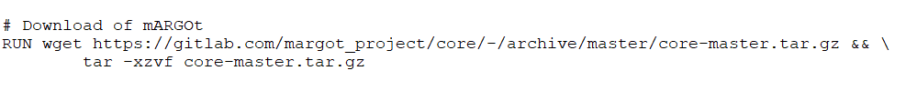
Executable of Agora
To create the executable file of Agora I need to Download and install mARGOt and the dependencies of Agora .
Before the installation of mARGOt I need to download and install all the dependencies (presented on the next slide), then to build the mARGOT framework I need to use CMake and enable Agora

Slide 4
Agora dependencies
The C/C++ MQTT client implementation
A MQTT broker (to enable the connection of the client, I choose Mosquitto)
The C/C++ Cassandra driver
Rscript Package (Hmisc , crs )
Python driver for Cassandra

Slide 5
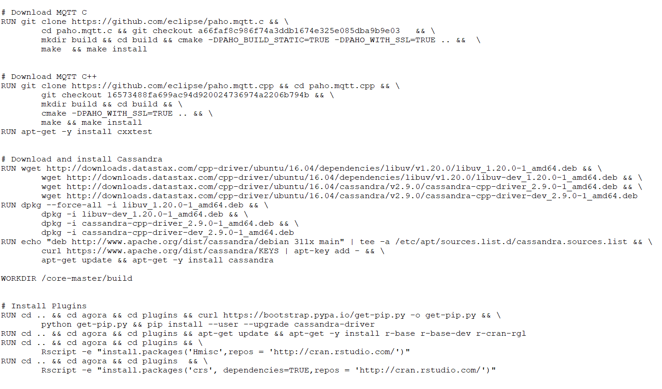

Slide 6
Download docker with Agora
There are two ways to download and start agora.
Download directly the docker image
Download the Dockerfile from the github repository

Slide 7
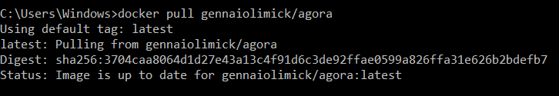
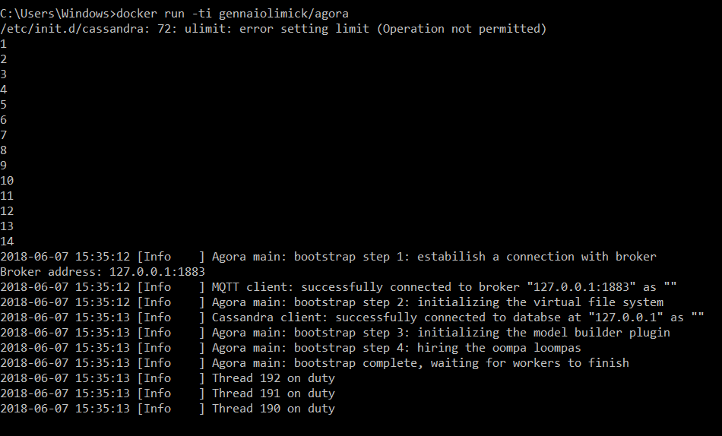
FIRST METHOD
I have to do 2 step:
docker pull gennaiolimick/agora
docker run –ti gennaiolimick/agora
The agora server starts to run immediatly

Slide 8

SECOND METHOD
I have to dowload the dockerfile from the github repository (https://github.com/Mick95/agoraProject), using the command line I have to go to the folder in which the Dockerfile is and then I need to write the following command:
docker build .
This command will create the docker container that contains the agora server.
Then I need to copy the string after «Succesfully build»
And then I have to execute the following command:
docker run –ti pasteTheCopyedString
The instruction to start agora are written in the next slide.

Slide 9
To Execute Agora
To execute agora I need to do 4 steps:
Execute Cassandra as service
Execute Mosquitto as service
Wait for Cassandra to start running (for this I have created a python script that check if cassandra is running)
Launch Agora and define its Workspace and Plugin Folder

Slide 10
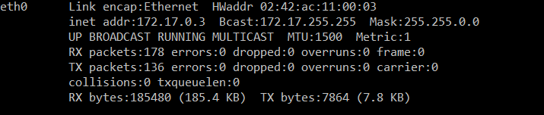
Testing
To test the application I have created a second Dockerfile in which I used a tutorial app to test if the agora server would have accepted the connection. This Dockerfile can be found in https://github.com/Mick95/agoraProject with the name DockerfileTutorial. In this Dockerfile I have to define the ip address in which the docker running agora is stored.
If there aren’t running containers the ip address of the docker running agora is
172.17.0.2, otherwise, before executing agora and after running the Dockerfile with the second method, I have to use this 2 commands:
Apt-get –y install net-tools
Ifconfig –a
The ip address is located in inet address of eth0

