Slide 1

Weather’s Impact on Crime Rates
Team:

Slide 2
Can changes in weather affect Crime? Can changes in weather affect certain types of crime? Can changes a barometric pressure affect crime rates?
- Question(s) to be answered

Slide 3
Why Crime and Weather?
Are changing weather patterns affecting the crime rates? The United Nations Office on Drugs and Crime define a “Climate-related event” as “an umbrella term for adverse events that may be attributed directly or indirectly to changes in the climate”.
Weather plays a role in our daily lives, it shapes our choices and behaviors affecting when, where and how we choose to carry out our daily activities. Studies into the impact of weather on crime have been going on for decades but what about here and now? Forbes recently published an article “A Different Heatwave Warning: Online Hate—Like Violent Crime—Soars With High Temperatures”.
We are taking a look at Toronto Crime rates from 2014 to 2018 to see if changes in weather affected crime rates.
Outcome: Can we predict higher precedence of crime based on weather forecasts? Can Police Services use weather to predict higher staffing levels, increased surveillance in high crime areas based on the weather forecast? If our climate is experiencing changes will these changes affect the long term police services needs and budget?
Source: https://www.unodc.org/documents/human-trafficking/GLO-ACTII/UNODC_Climate-TIP-SOM_Policy_Paper.pdf
Source: https://www.forbes.com/sites/brianbushard/2022/09/07/a-different-heatwave-warning-online-hate-like-violent-crime-soars-with-high-temperatures-study-suggests/?sh=53cf4e515e2f

Slide 4
Database
Segment 1: Create a mock-up of the Database
Type: PosgresSQL
ERD: <link>
PostgreSQL_DB: <link>
Data Scope:
Crime CSV files: Assault, Auto Theft, Bicycle Theft, Break & Enter, Homicides, Robbery, Shooting & Firearm Discharges, Theft from a Motor Vehicle, Theft Over, Traffic Collisions
Each file contains location (Long / Lat), date, time, day of the week and Neighborhood info
Weather CSV files: Weather stats for Toronto hourly, ?? Daylight
Contains Pressure, Wind, Relative Humidity, Temperature, Visibility, Cloud Cover, and min/max temp in the previous hour

Slide 5
How the database is used
Raw crime data based on the Greater Toronto Area is used.
Tables are created based on types of crime e.g.: Assault, Theft from Auto, Burglery
Tables all included year, day, hour and a unique id
Weather data
Tables are created for weather by year, day, hour

Slide 6
List of Technologies
Database: PostgreSQL
Data Engineering: Python, Pandas, ??
Analysis: Random Forest, Deep Neural Network
Visualization: Tableau
Presentation: JavaScript using GitHub Pages, PowerPoint

Slide 7
Raw Data
Size
(location,year)
Python
Clean
Train

Slide 8
Raw Data
Raw Data

Slide 9
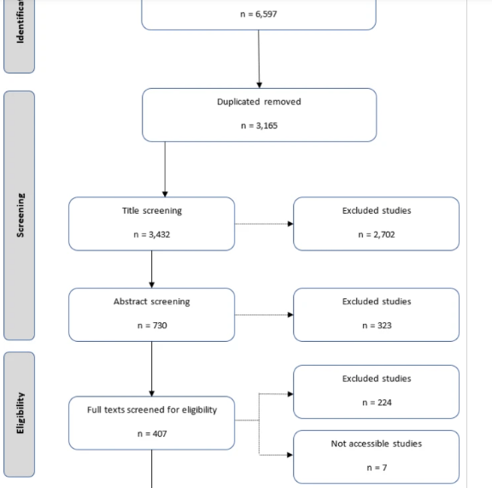

Slide 10
Raw data files
Fit to Scope
Neural Model –
1 Layer
? Merge into 1 file
? Keep separate files by crime type?
Neural Model –
Optimizer
Base data files
?? Is this before or after db??
Clean:
Null –
Neural Model –
Deep Learning
Add to DB
Import - Notebook
Neural Model –
Deep Learning
Cleaning method
Notebook

Slide 11
Interesting Links:
https://www.dtn.com/how-does-the-temperature-affect-crime-rates/

