Slide 1
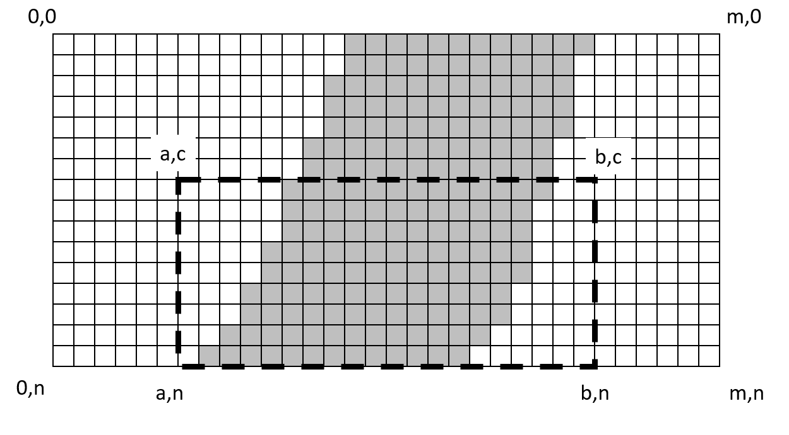
Image Representation
(R,G,B,A)

Slide 2
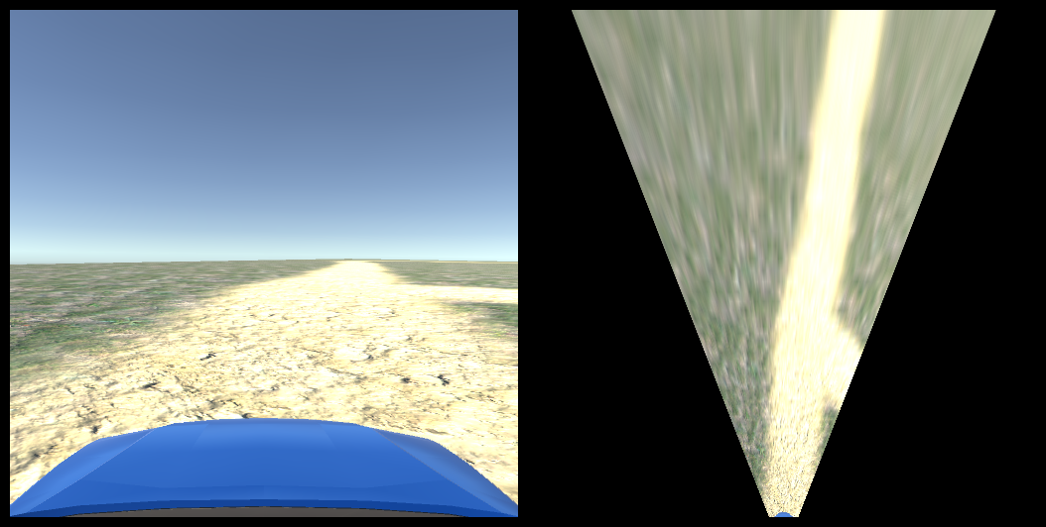
Inverse Perspective Transformation

Slide 3
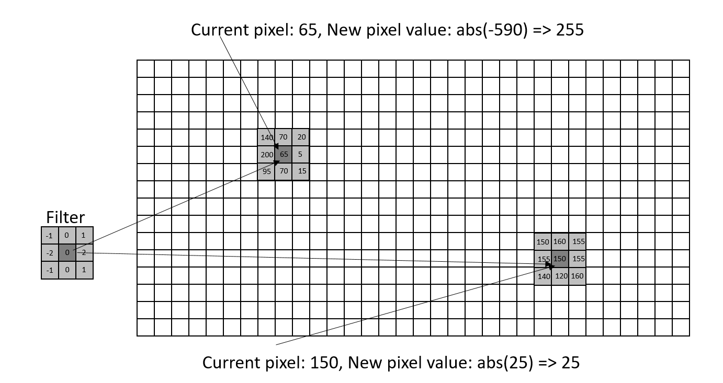
Image Filtering
Kernels
Identity
Low/High pass
Edge
Sharpen
Convolution
Edge cases

Slide 4
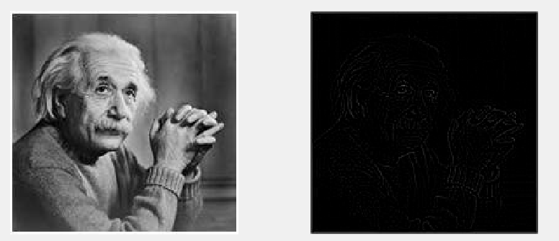
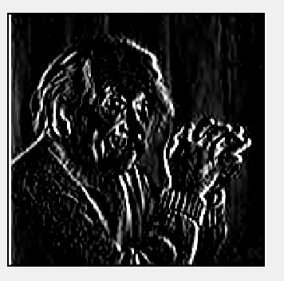


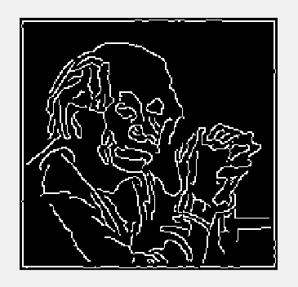
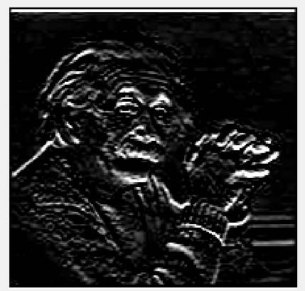

Edge Detection
Identity
High pass filter
Sobel vertical
Sobel horizontal
Canny

Slide 5
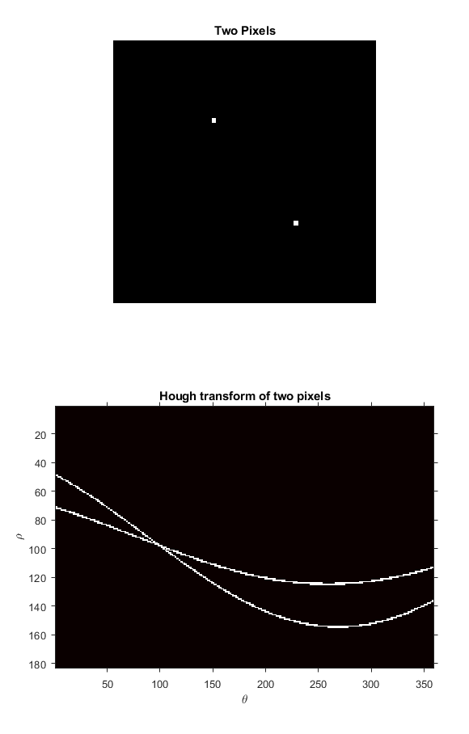
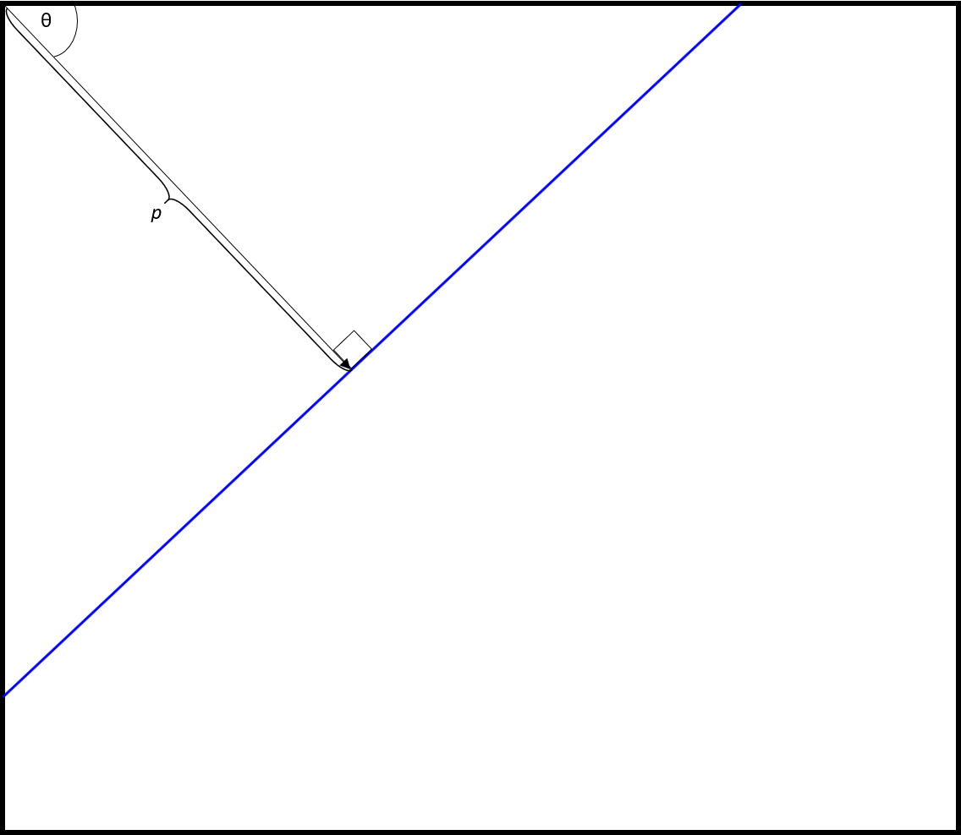
Hough transform and Hough lines

Slide 6
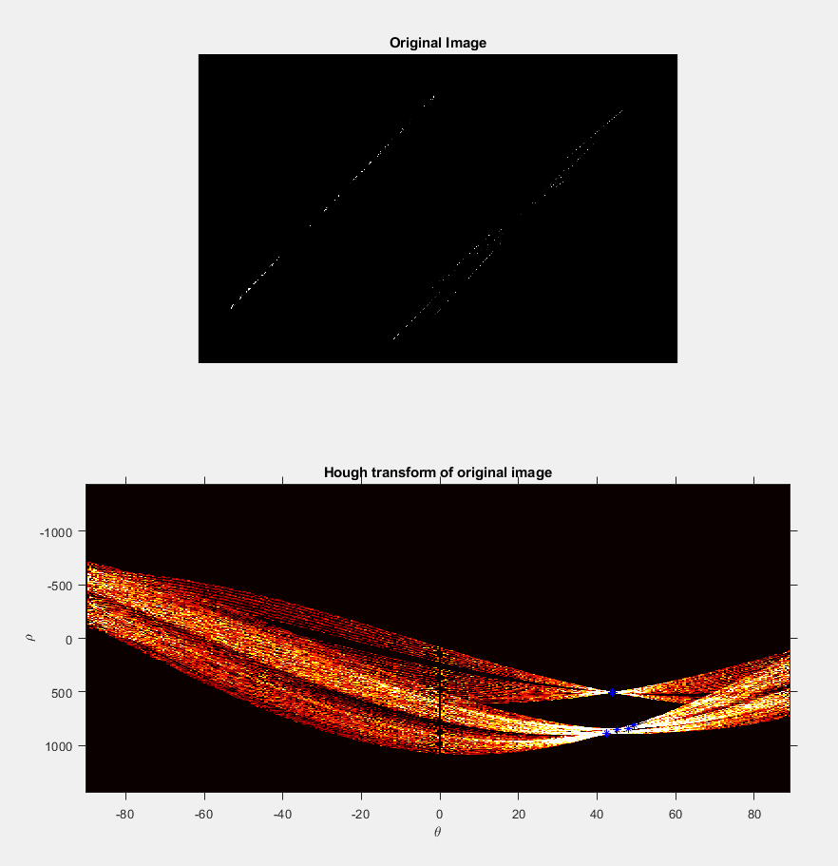
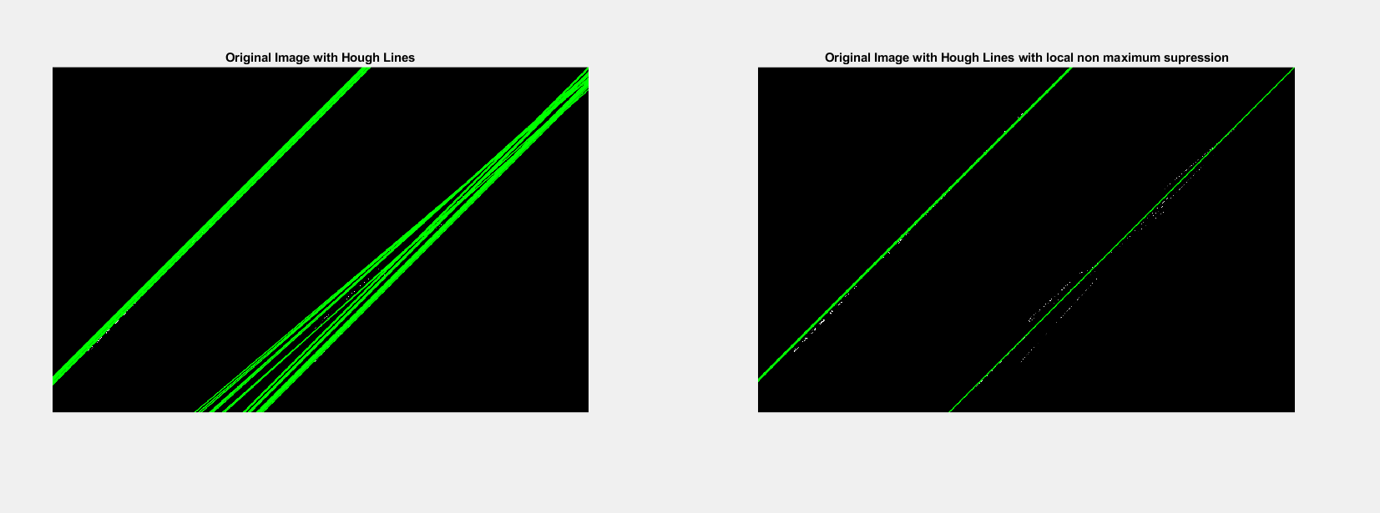
Hough transform and Hough lines

Slide 7
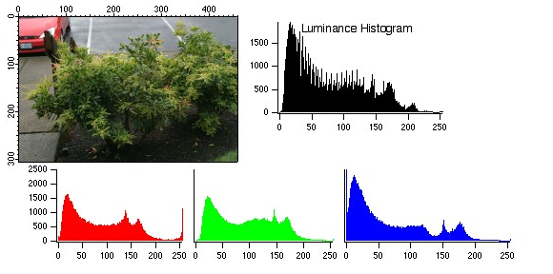
Histogram based Road Detection
From: https://www.wavemetrics.com/products/igorpro/imageprocessing/imagetransforms/histmodification

Slide 8
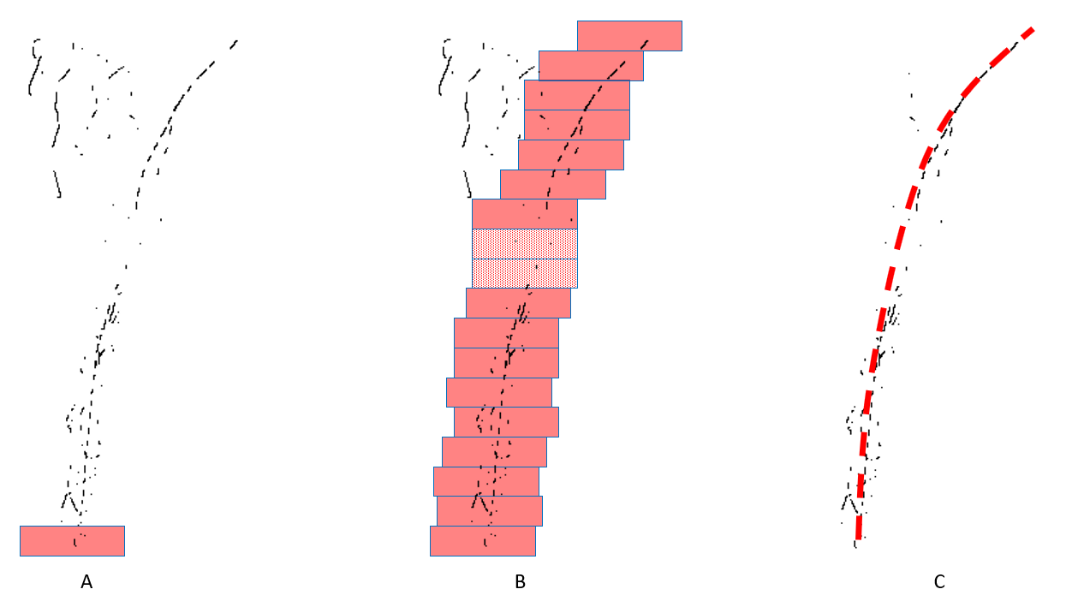
Curved lane edge detection
Appendix C

Slide 9
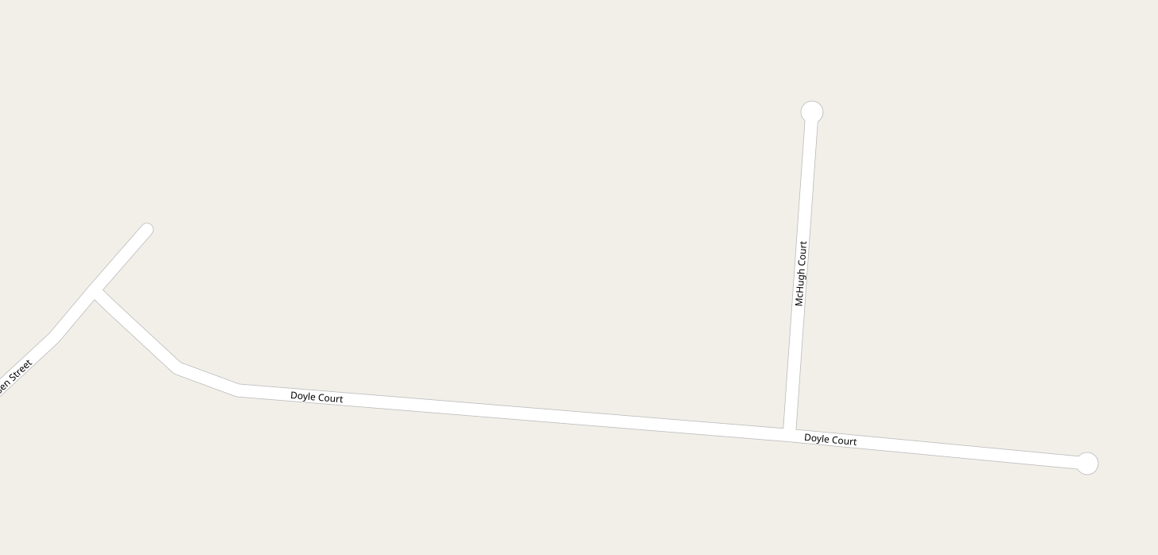
Mapping data (OSM, Google maps)

Slide 10
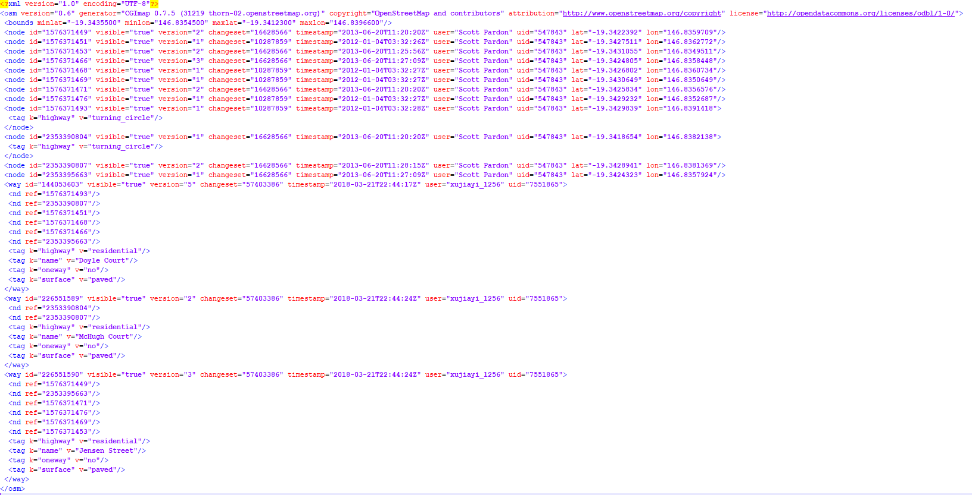
Mapping data (OSM, Google maps)

Slide 11
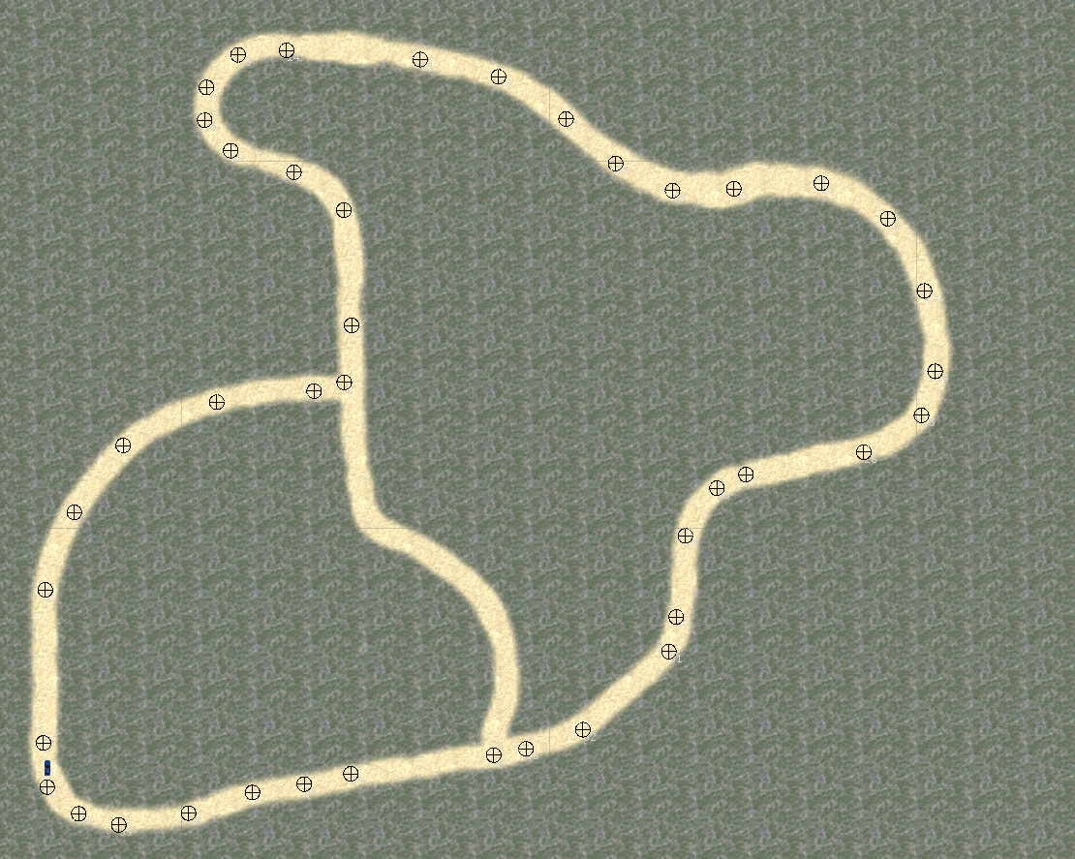
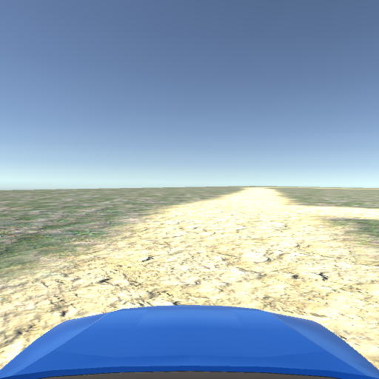
Simulation

