Slide 1
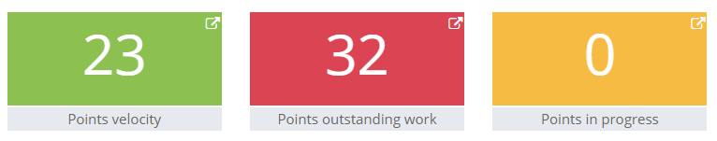
Sprint 1
30 May – 05 Jun

Slide 2

Key points
Waypoint based AI implemented
GPS and Vehicle camera implemented
Interprocess Communication (IPC) with Python process implemented
Time dilation with IPC implemented
Output video developed (Based on vehicle camera sensor data from AI driving, inverse perspective mapping applied)

Slide 3
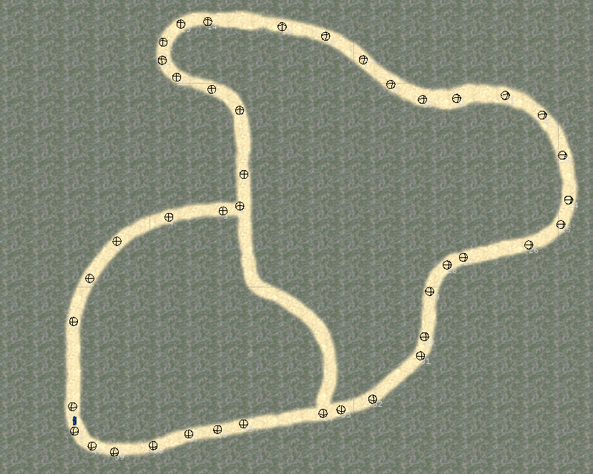
Simulation road nodes

Slide 4
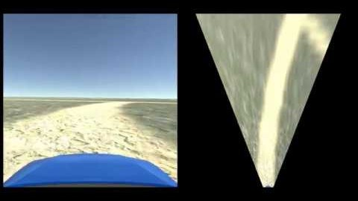
IPC demo : Simulation camera data IPM transformed in Python

Slide 5
Performance metrics
Velocity
How many story points completed in a sprint. Used for estimating future work
Cumulative Flow Diagram
Is WIP building up over time?
Backlog tracking
Work rates
Cycle time
How long individual tasks take to complete vs day completed

Slide 6
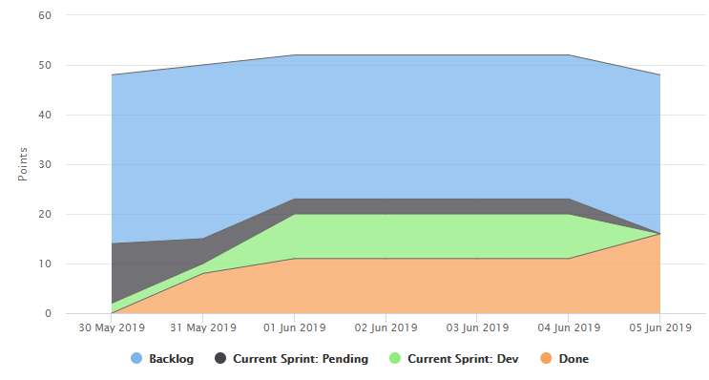
Cumulative Flow Diagram

Slide 7
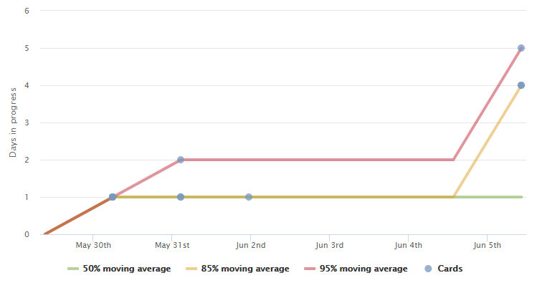
Cycle time

