Slide 1
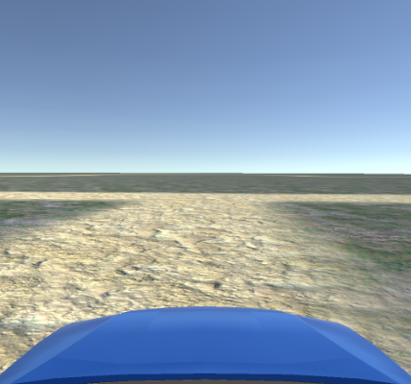
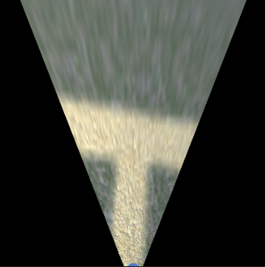

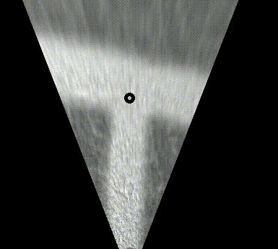
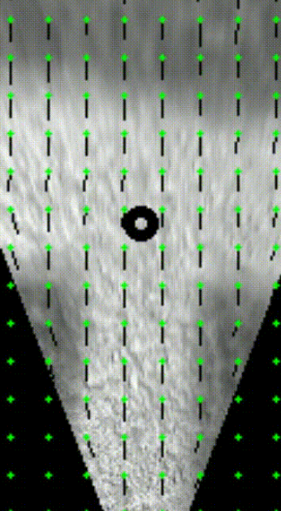
DRIVING LINE BEZIER CURVE
Mapping data
INTERSECTION MODEL MASK GENERATION
INVERSE PERSPECTIVE MAPPING
HISTOGRAM BACKPROJECTION
MASK MATCHING
OPTICAL FLOW
Camera
perspective
feed
Birds eye view
Detected road surface
Detected intersection
Tracked intersection

Slide 2
t
Exit node
Feature node
Exit node
Feature node
p1
B(t)
p0
t
t
Approach node
Approach node

Slide 3
Feature nodes
Piecewise mask legs
Feature mask combined with IPM mask
Resulting feature mask

Slide 4
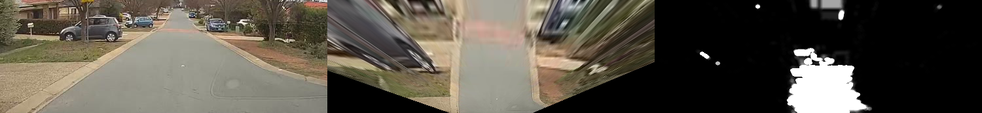
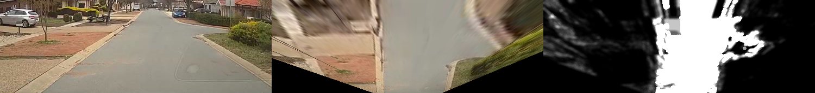
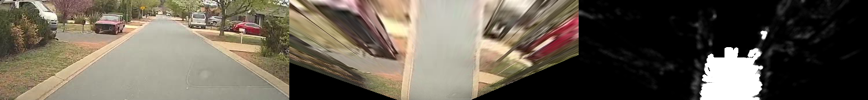
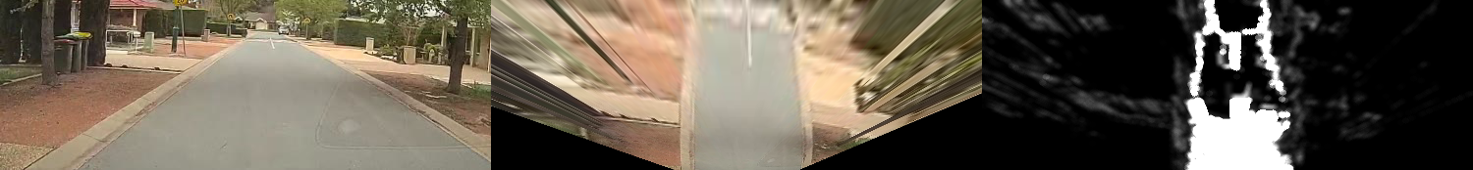
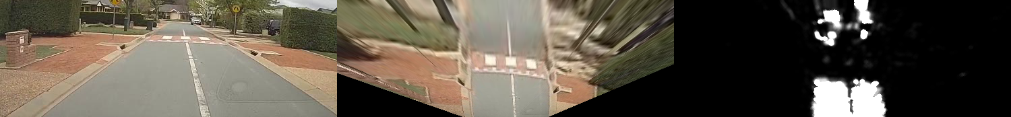

Slide 5
