Slide 1
Overview
(Sim, Python, IPC, output etc)

Slide 2
Comparable Work
Tesla
MIT

Slide 3
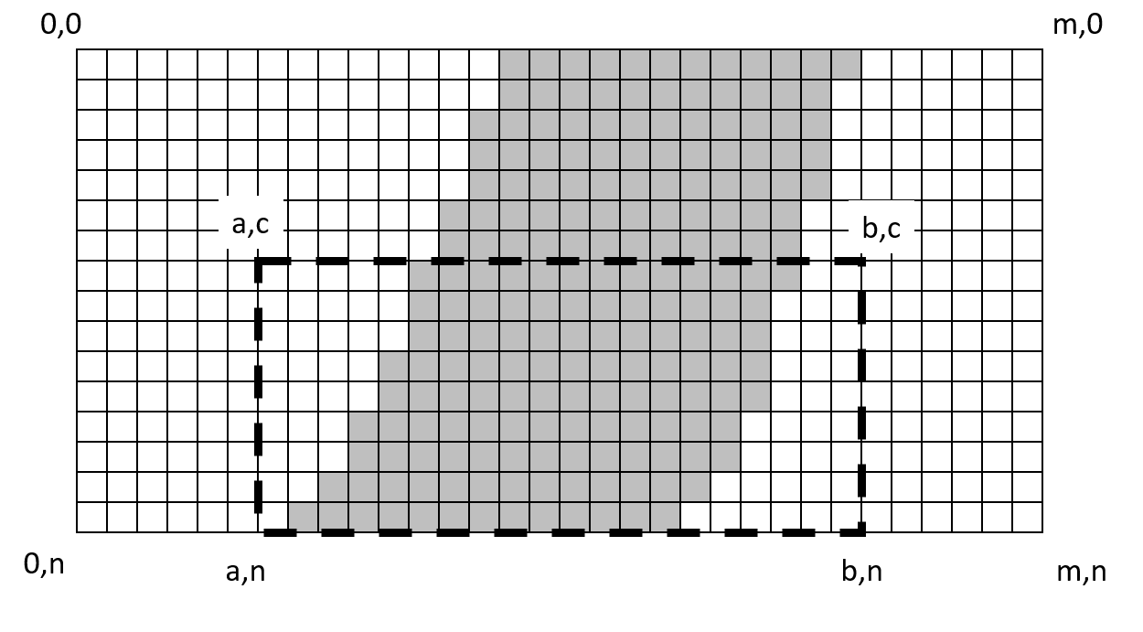
Image Representation
Pixels, colour representation

Slide 4
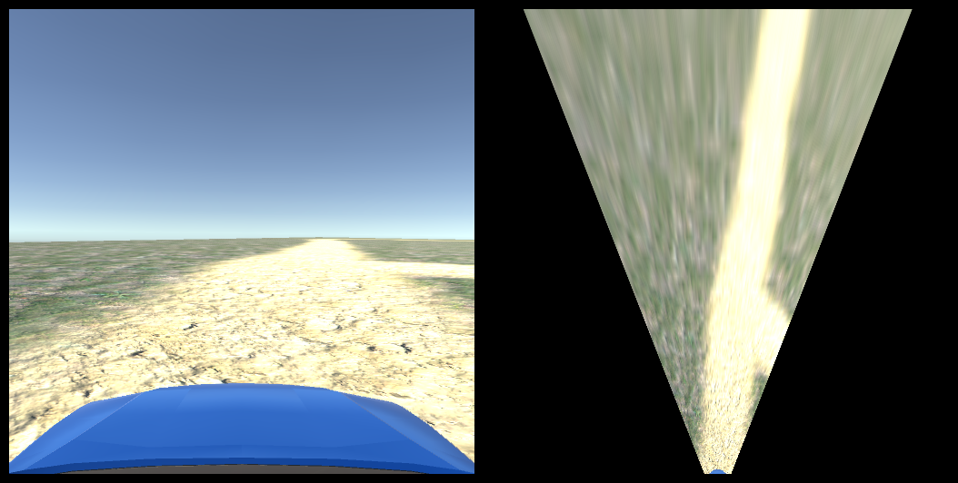
Inverse Perspective Transformation
https://www.youtube.com/watch?v=ny3sXMR-QEU

Slide 5
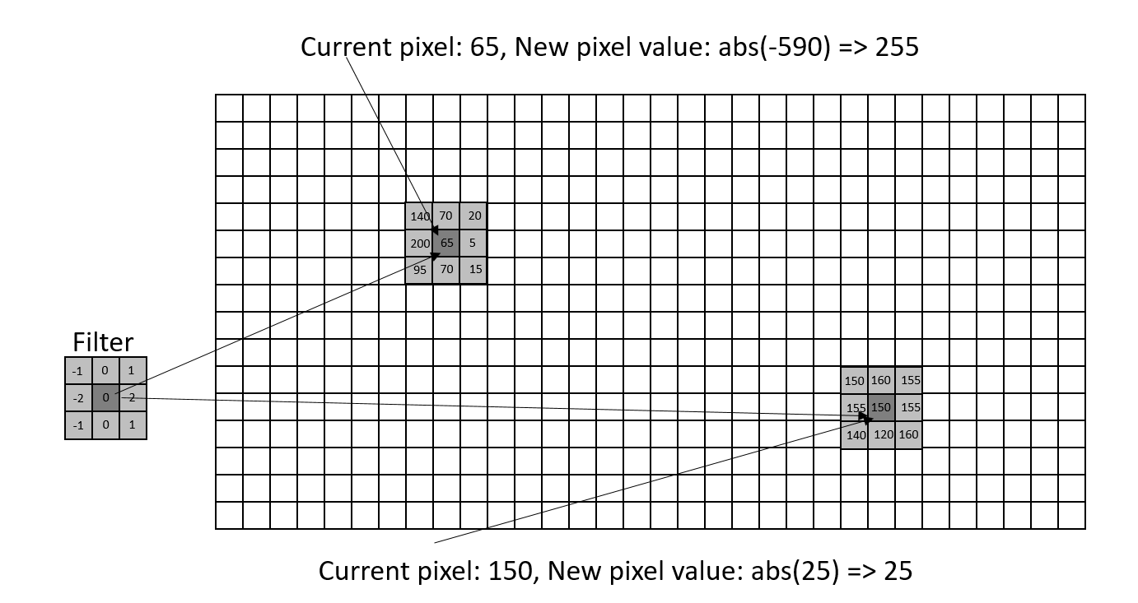
Image Filtering
Kernels
Identity
Low/High pass
Edge
Sharpen
Convolution
Edge cases

Slide 6
Edge Detection
High pass filter, Sobel, Canny
Driving with Canny
https://www.youtube.com/watch?v=EQSl_cPVMBk

Slide 7
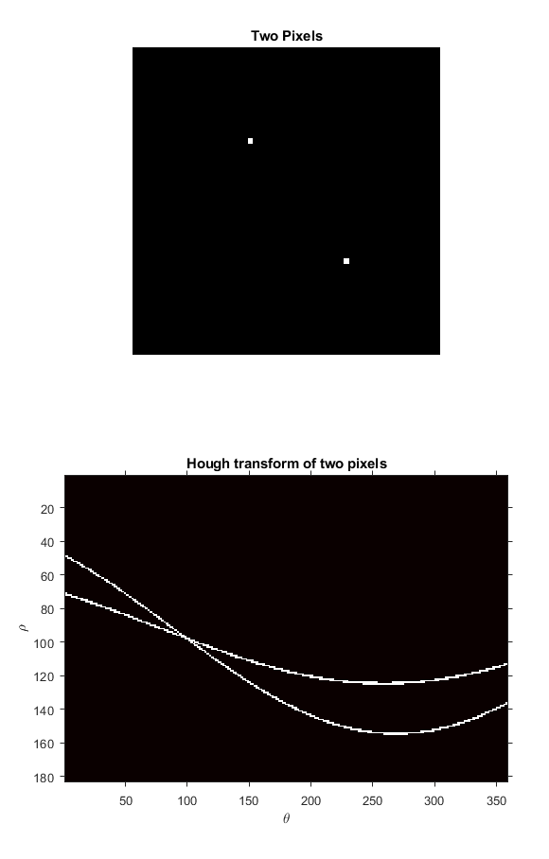
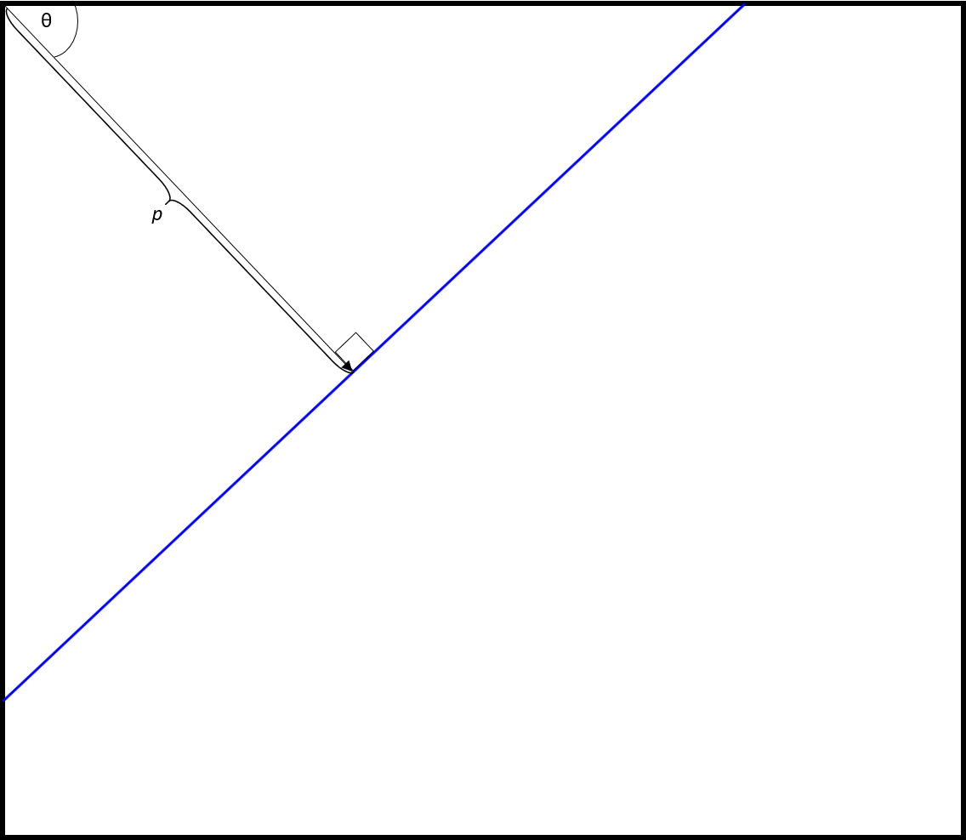
Hough transform and Hough lines

Slide 8
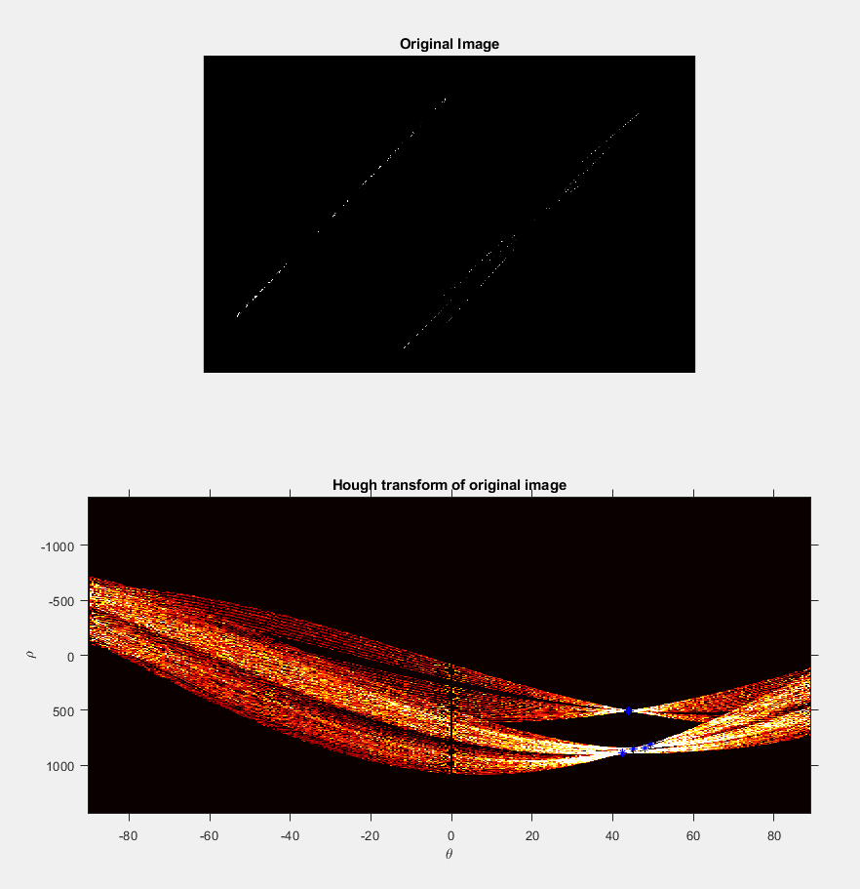
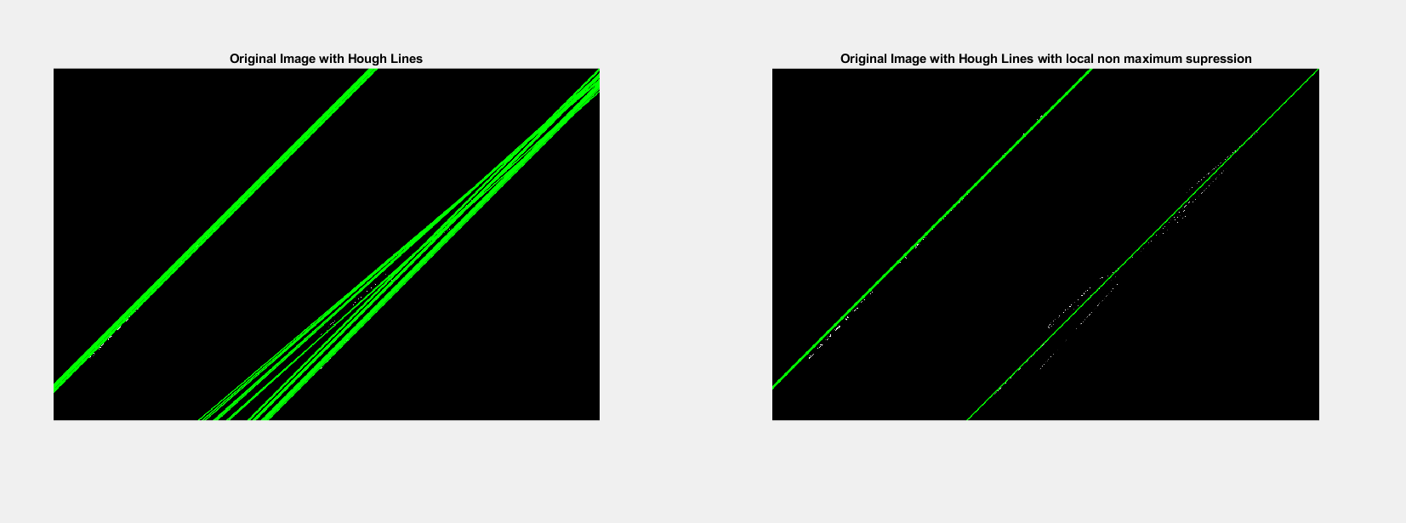
Hough transform and Hough lines

Slide 9
Hough based Road Detection
Initial
https://www.youtube.com/watch?v=puBFjQstAj4
Averaged
https://www.youtube.com/watch?v=oc6sZblH1bw

Slide 10
Histogram based Road Detection
Image Histogram
Demo
https://www.youtube.com/watch?v=vO35EfVdNkM
Probability
https://www.youtube.com/watch?v=BfRE_dGd14c

Slide 11
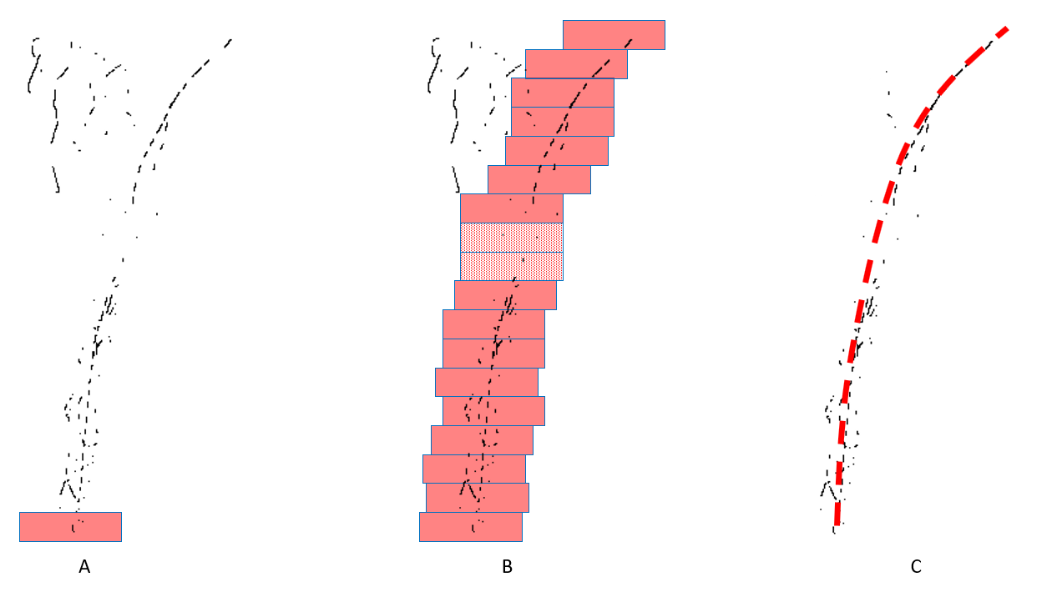
Curved lane edge detection
Appendix C

Slide 12
Intersection model matching

Slide 13
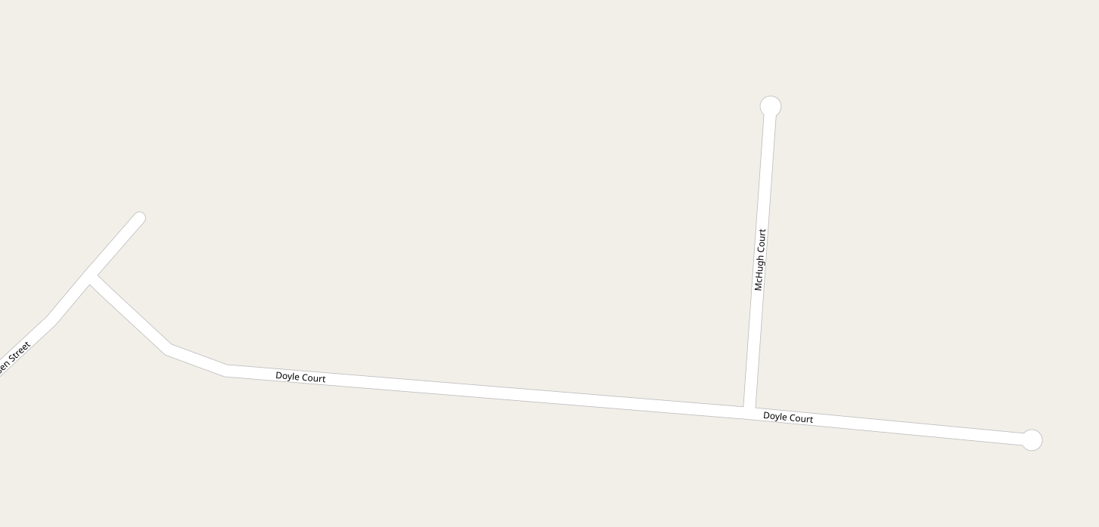
Mapping data (OSM, Google maps)

Slide 14
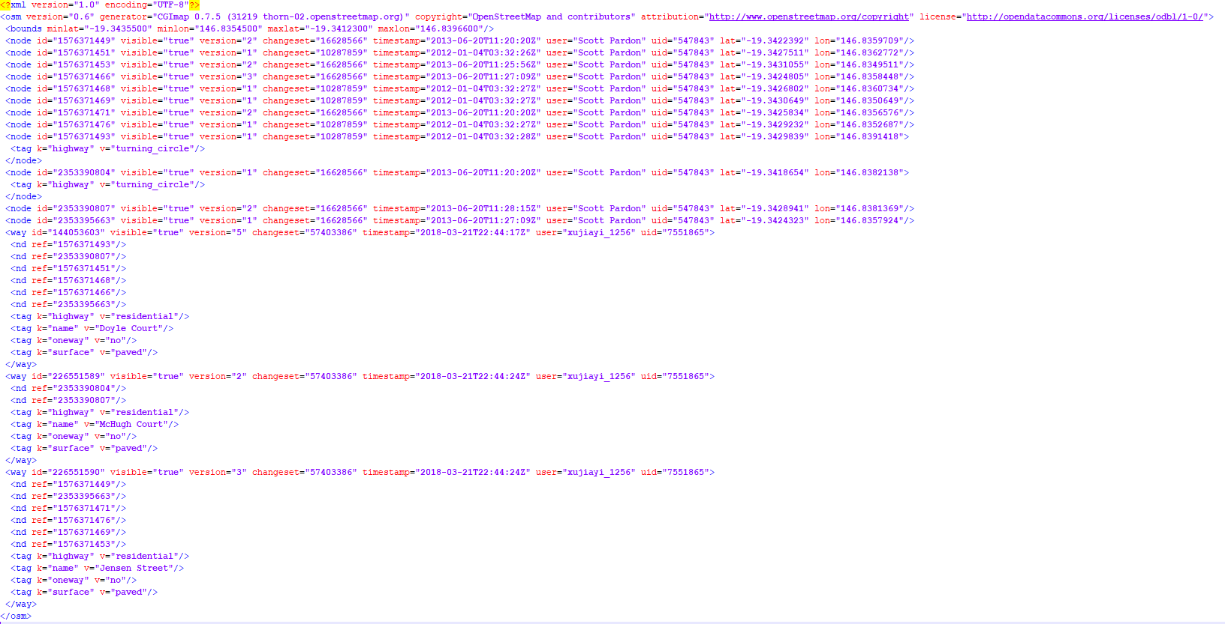
Mapping data (OSM, Google maps)

Slide 15
**** SIMULATION STUFF ***

Slide 16
Vehicle Controller

Slide 17
Sensor Definition
Is this needed?

Slide 18
GPS/Waypoint system

Slide 19
Vehicle AI

Slide 20
Agile process
Overview
Current sprint dashboard

Slide 21
Image Filtering
ZeroMQ
Time dilation and Sim `tick’

