Slide 1
Part 1
Megan Lynn Wilson

Slide 2
Locate a directory you would have used when installing the programs in in Module 1.
Program | Directory Path
Google Chrome | C:\Program Files (x86)\Google\Chrome\Application
Slack | C:\Users\Megan\AppData\Local\Microsoft\WindowsApps\slack
Git Bash (Windows only) | C:\ProgramData\Microsoft\Windows\Start Menu\Programs\Git
Python (Version 3) | C:\Users\Megan\Anaconda3\Python
VirtualBox | C:\Program Files\Oracle\VirtualBox\virtualbox
Ubuntu Linux (WSL) | C:\Users\Megan\AppData\Local\Microsoft\WindowsApps\Ubuntu
Kali Linux (WSL) | C:\Users\Megan\AppData\Local\Microsoft\WindowsApps\kali
GitKraken | C:\Users\Megan\AppData\Local\gitkraken
Wireshark | C:\Program Files\Wireshark
Grammarly | C:\Users\Megan\AppData\Roaming\Microsoft\Windows\Start Menu\Programs\Grammarly
Oh-my-zsh! | \\wsl$\kali-linux\home\kali\.oh-my-zsh
.zshrc

Slide 3
Created Accounts
Website | Account
LinkedIn | https://www.linkedin.com/in/megan-wilson-20414b41/
GitHub | https://github.com/classic89/
GitLab | https://gitlab.com/classic89
Google | Retrorock8821@gmail.com
ISACA | https://www.isaca.org/pages/default.aspx
(ISC)^2^ | https://www.isc2.org/Dashboard/Profile

Slide 4
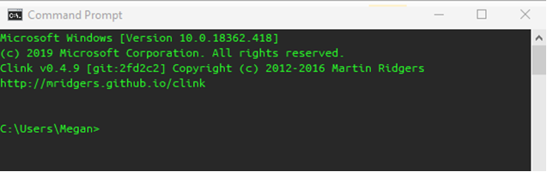
CLI

Slide 5
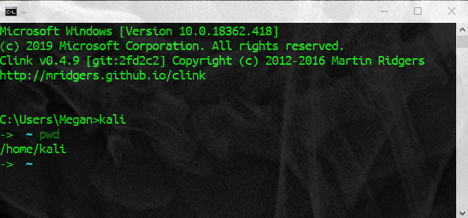
CLI

Slide 6
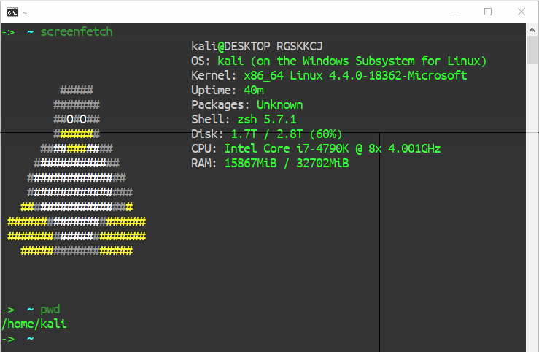
CLI

Slide 7
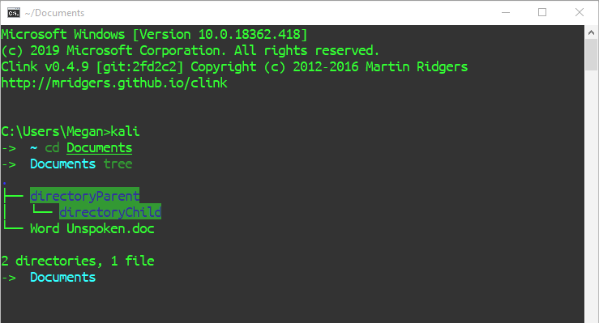
Locate a Directory within a directory

Slide 8
Locate .doc

Slide 9
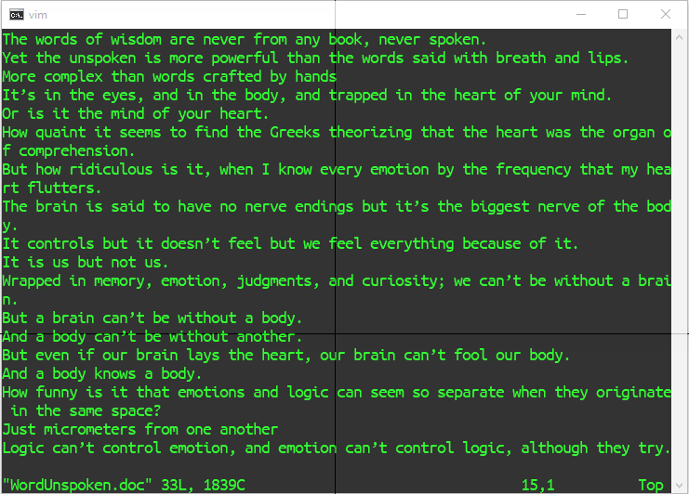
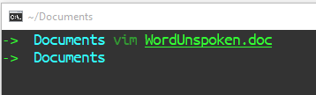
Open .doc in the terminal

Slide 10
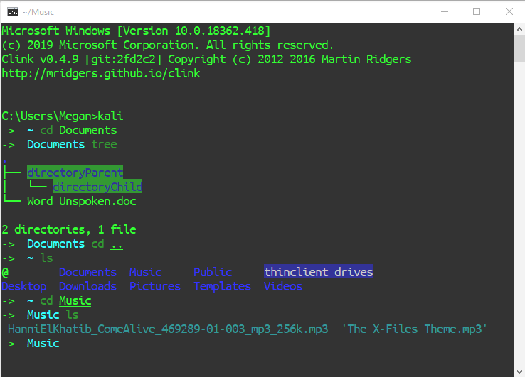
Locate .mp3

Slide 11
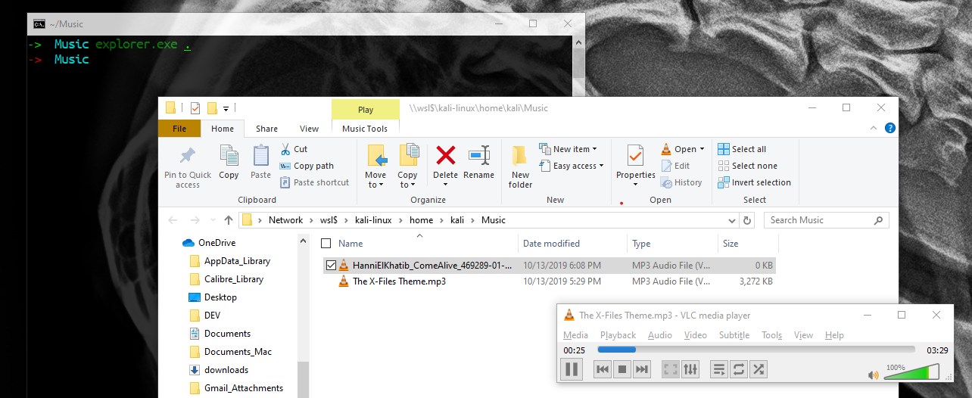
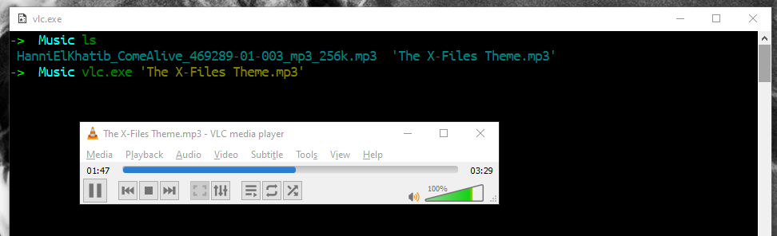
Open .mp3 using terminal
OR

Slide 12
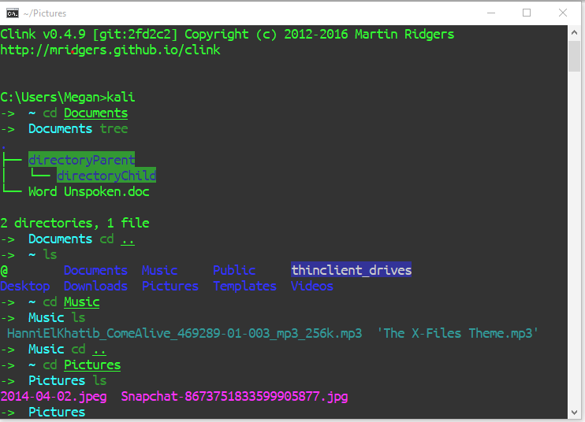
Locate .jpeg

Slide 13
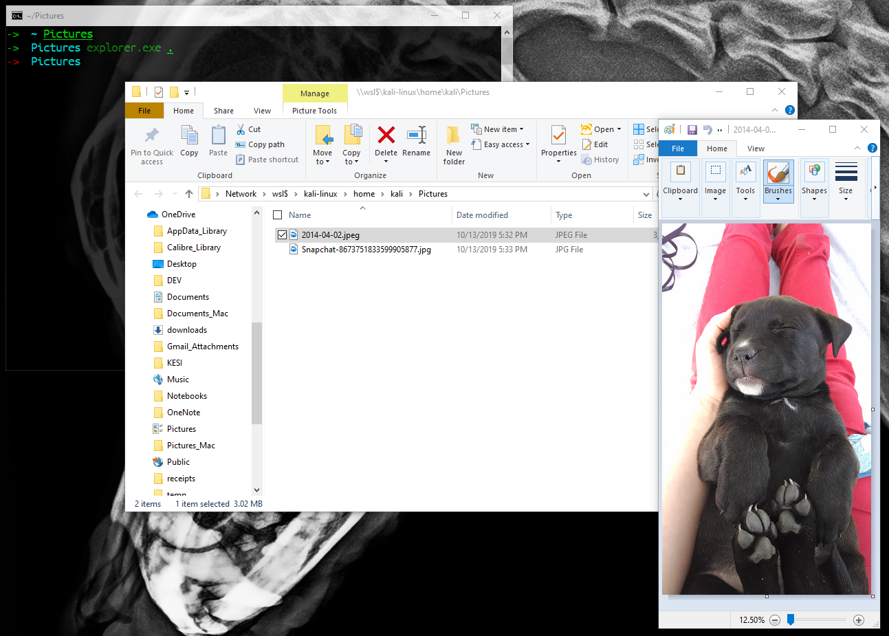
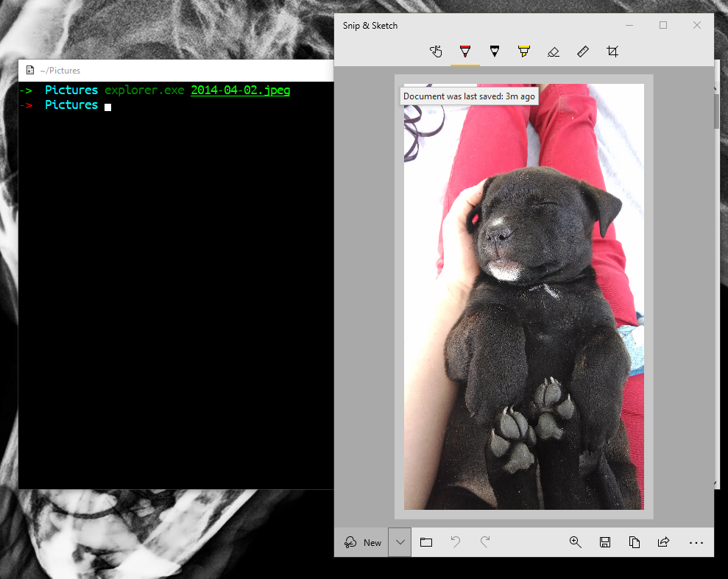
Open .jpeg using terminal
OR

