Slide 1
Part 2
Megan Wilson

Slide 2
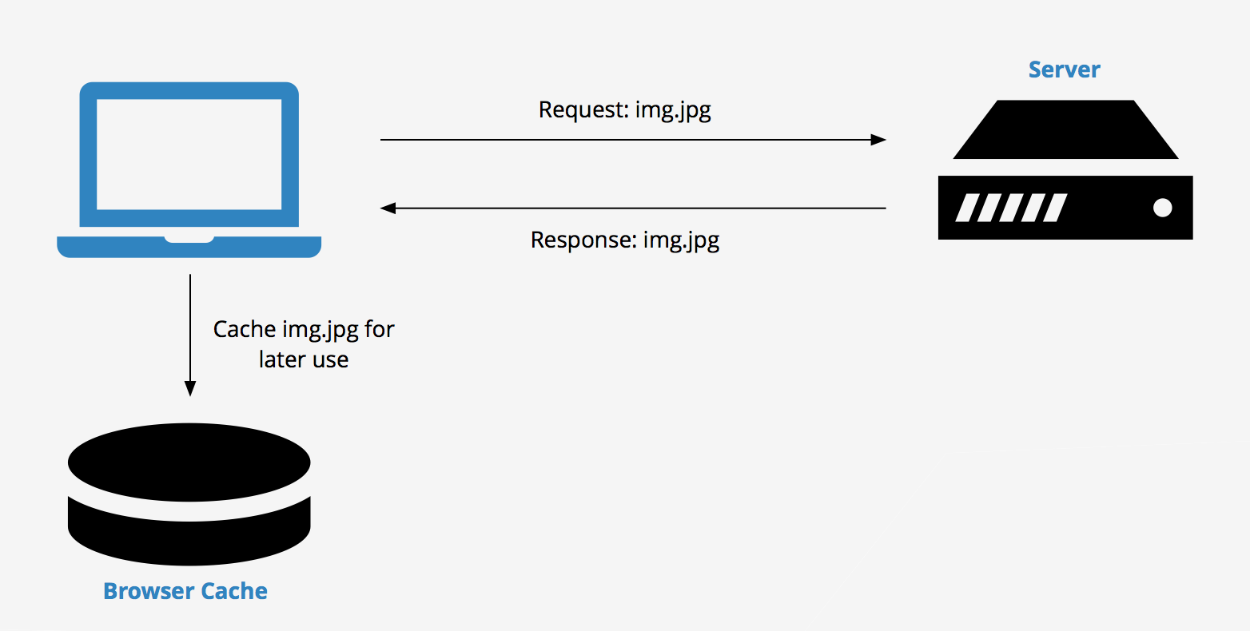
Cache
Definition
What is this concept / tool?
The cache is used to temporarily store values for faster performance in future access of the application

Slide 3
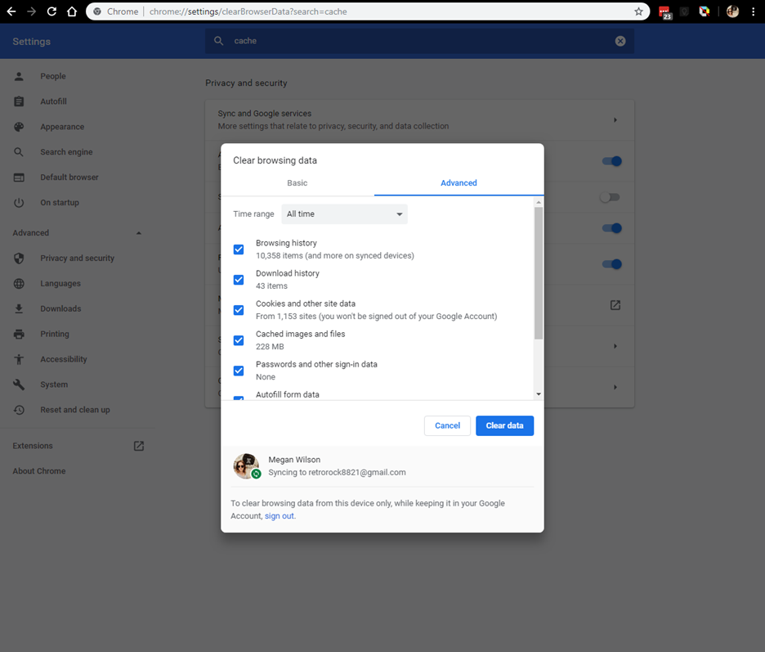
Clearing CACHE
→ Settings → Privacy and Security → Clear Browsing Data

Slide 4
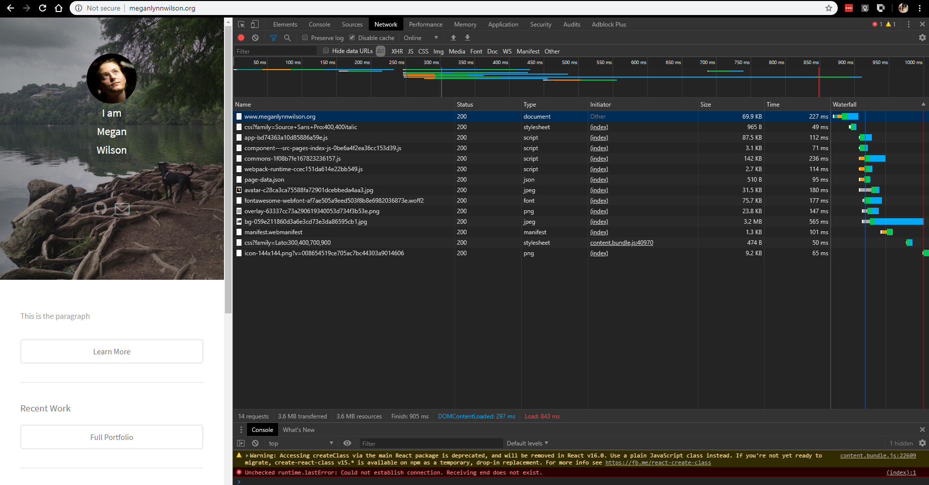


The Browser Requests the Data from the Server for faster load

Slide 5
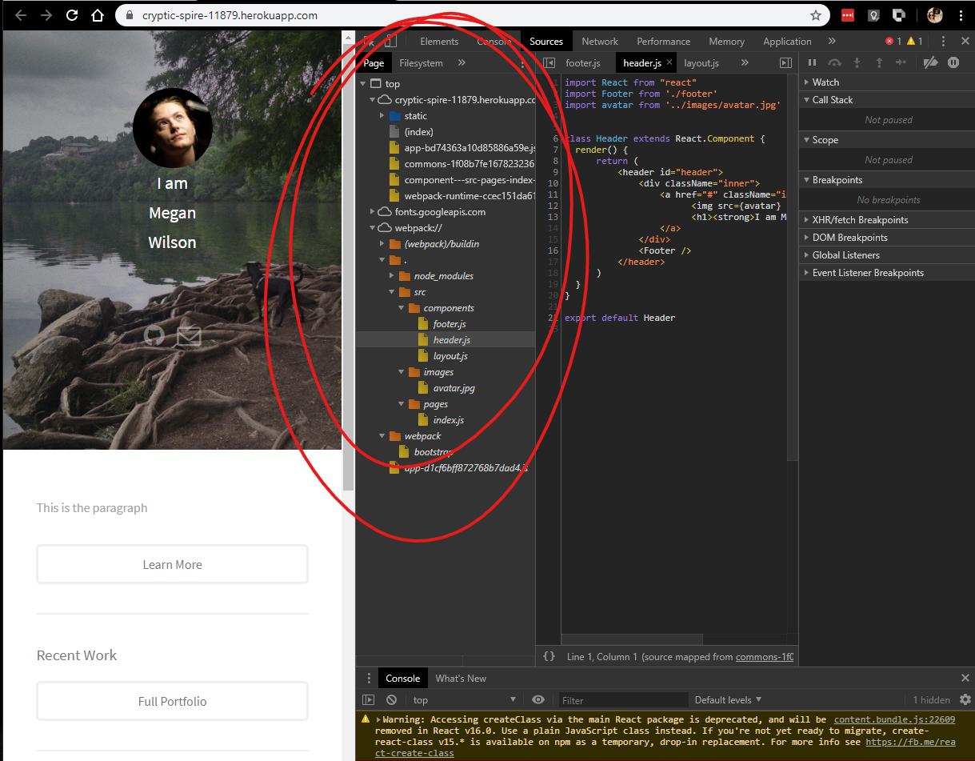
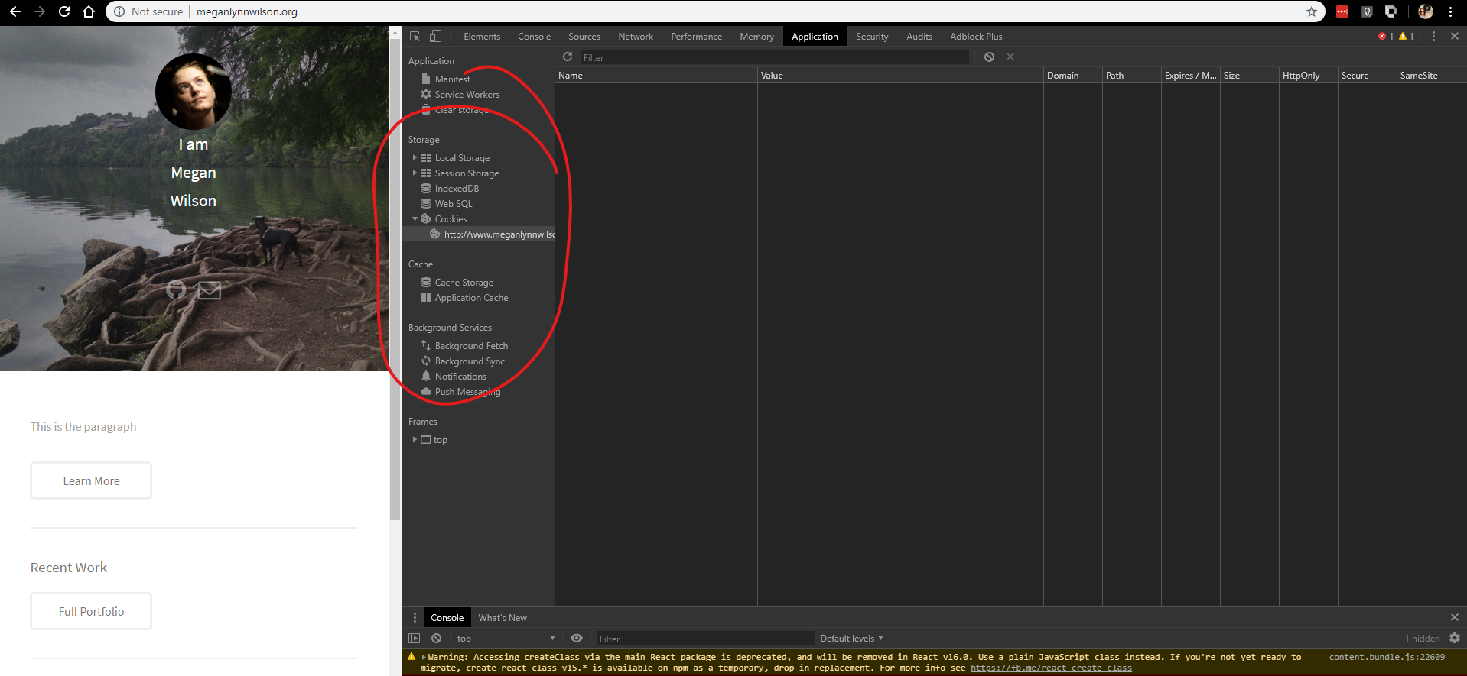
What is Being Loaded In the cache?

Slide 6
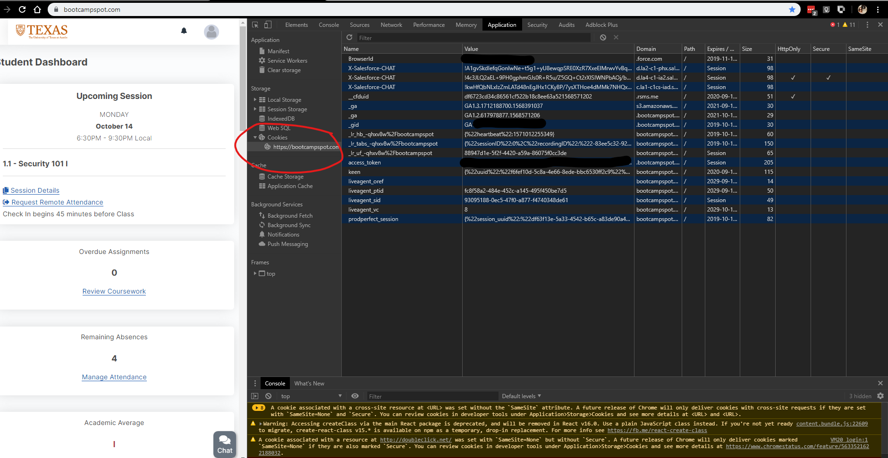
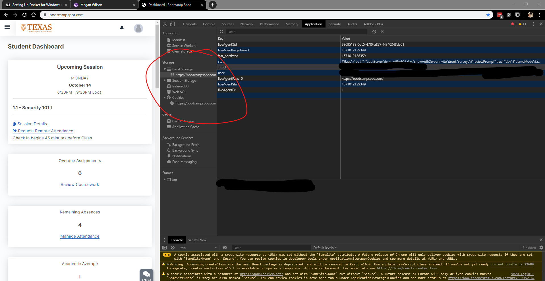
What is being Loaded:

Slide 7
Why is the CAche relevant to broader cybersecurity and privacy issues?
Caching can leave you vulnerable because sensitive information like user_id, password for a site could have been saved in the cache, and if the browser is left unattended to another user on the PC the next user could gain access to your information stored in the cache.

Slide 8
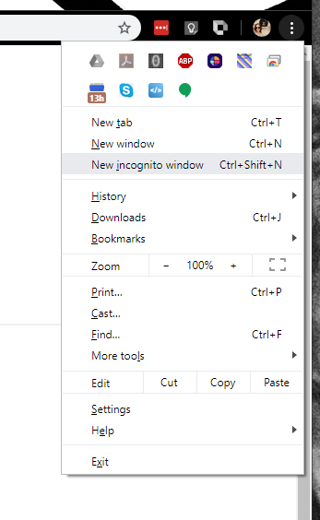
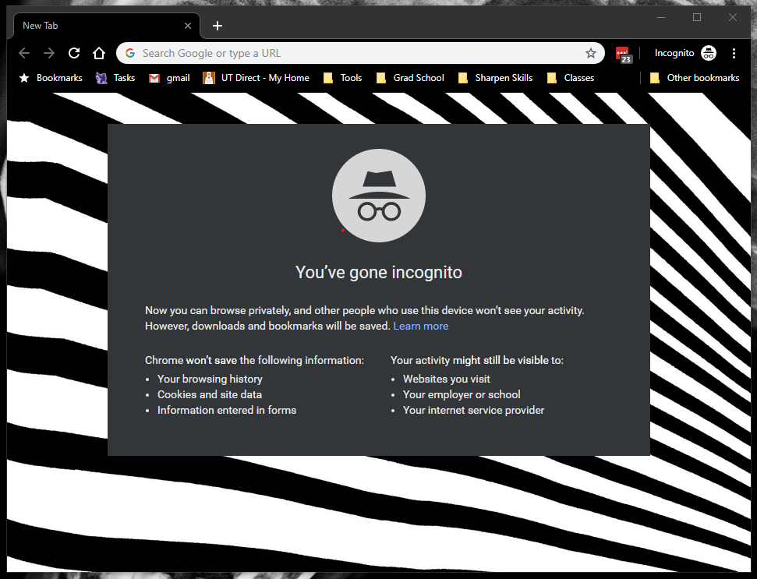
Incognito Window
How to find it:
What it is:

Slide 9
Incognito Mode
What is this concept / tool?
Why is it relevant to broader cybersecurity and privacy issues?
The Incognito mode is a browser setting that prevents certain information from being stored in the cache
Not everything is erased after use such as downloads and bookmarks and any addon cache, and the garbage collection is not run afterwards so theoretically you could get still the information from the memory

Slide 10
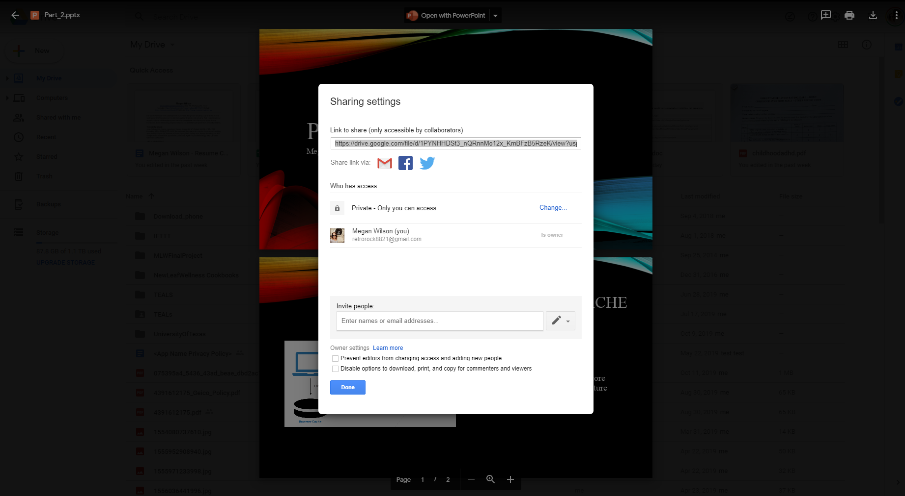
Access Controls (Google Drive)

Slide 11
Access Controls (Google Drive)
“As an administrator, you can restrict access to files in a shared drive. You can also set the default access for new shared drives. You can apply these restrictions in a specific organizational unit or to your entire organization.
You can also prevent shared drive members with Manager access from modifying settings. In the shared drive, you can restrict:
Non-members from accessing files
People outside your organization from accessing files
Commenters and viewers from downloading, copying, and printing files ”
-- https://support.google.com/a/answer/7662202?hl=en

Slide 12
Access Controls (Google Drive)
What is the concept/Tool?
Why is it relevant to broader cybersecurity and privacy issues?
Shared drive files belong to the team instead of an individual. Even if members leave, the files stay in place so your team can keep sharing information and work anywhere, from any device.
don't install Backup & Sync or Drive File Stream on a shared or public computer. Anyone who uses the computer could access your files.
You can share them with one person or a few people using a link or with everyone by making them public

