Slide 1

Projet 5 : Count on me
Mickaël Horn OpenClassrooms

Slide 2

Sommaire
Présentation du projet
Architecture de l’application
Arborescence
ViewController
Count.swift
Tests unitaires
Démonstration sur l’application
Allons voir le code !
Conclusion

Slide 3
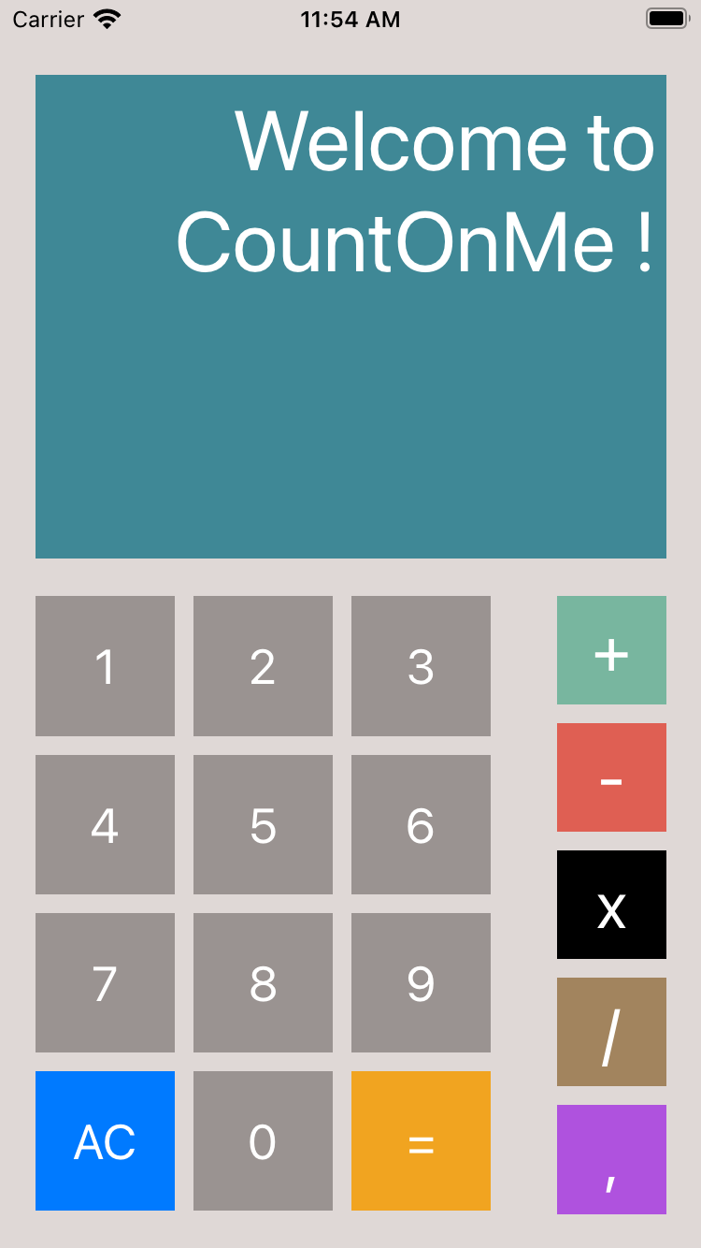
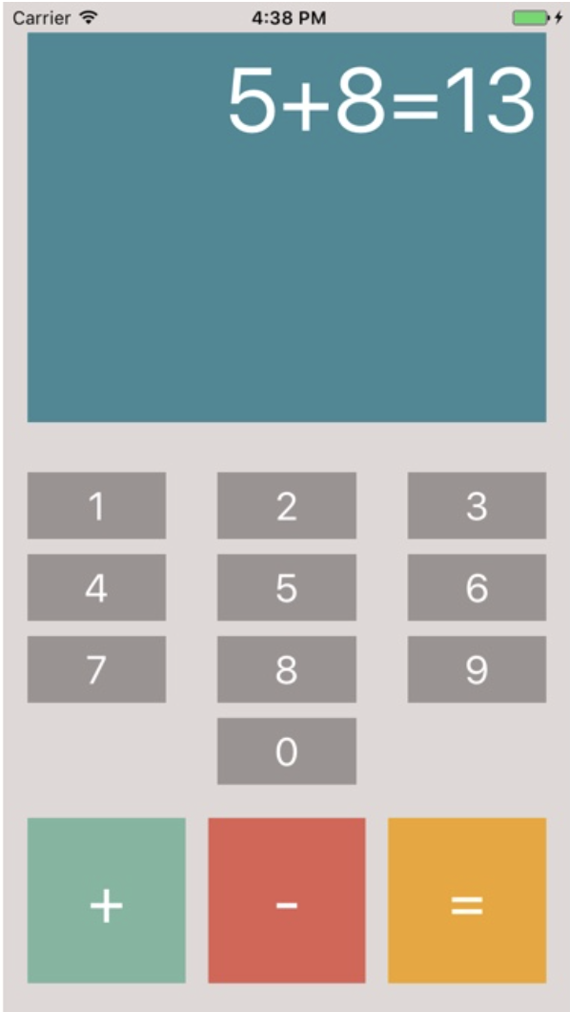
Présentation du projet
Ajout de nouvelles fonctionnalités
Multiplication
Division
Virgule
AC (Nettoyage)
Adaptation du design

Slide 4

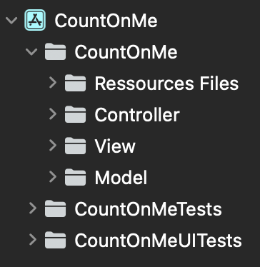
Architecture de l’application
Arborescence

Slide 5
Architecture de l’application
ViewController
Variables / Outlets
@IBActions
Fonctions
@IBOutlet weak var textView: UITextView!
@IBOutlet var numberButtons: [UIButton]!
@IBOutlet var operandButtons: [UIButton]!
var continueOperation = false
var count = Count()
var expressionHaveResult: Bool
func clearText(_ sender: UIButton)
func tappedNumberButton(_ sender: UIButton)
func tappedOperandButton(_ sender: UIButton)
func tappedEqualButton(_ sender: UIButton)
func tappedCommaButton(_ sender: UIButton)
private func isTheOperationPossible(button: UIButton)
private func removeWelcomeMessage()
private func didUserFinished()
private func incorrectExpressionError()
private func notEnoughElementsError()
private func unknownOperandError()
private func operandAlreadySetError()
private func dividedBy0Error()
private func doubleCommaError()

Slide 6
Architecture de l’application
Count.swift
Variables
Fonctions
var number = ’’’’
var elements: [String]
var expressionIsCorrect: Bool
var expressionHaveEnoughElement: Bool
var exepressionAlreadyHaveComma: Bool
func calculateOperation() -> [String]?
func addNumber(numberToAdd: String)
func addOperand(operand: String)
func addComma()
private func findPriority(operation: [String]) -> Int
private func isInteger(number: Double) -> Any

Slide 7
Architecture de l’application
Tests unitaires
func testGivenPlusAndMultiplication_WhenCalculateOperation_ThenMultiplicationCalculatedFirst()
func testGivenPlusAndDivisionOperand_WhenCalculateOperation_ThenDivisionCalculatedFirst()
func testGivenTwoPriorityPlusTwoNonPriorityOperand_WhenCalculateOperation_ThenCalculateInOrder()
func testGivenCorrectExpression_WhenTestIfExpressionIsCorrect_ThenExpressionIsCorrect()
func testGivenIncorrectExpression_WhenTestIfExpressionIsCorrect_ThenExpressionIsIncorrect()
func testGivenCanAddAnOperator_WhenAddTheOperator_ThenOperatorIsAdded()
func testGivenCantAddAnOperator_WhenAddTheOperator_ThenOperatorIsNotAdded()
func testGivenExpressionWithEnoughElements_WhenTestIfEnoughElements_ThenEnoughElements()
func testGivenExpressionWithoutEnoughElements_WhenTestIfEnoughElements_ThenNotEnoughElements()
func testGivenUnknownOperand_WhenCalculateOperation_ThenReturnNil()
func testGivenOperandToAdd_WhenAddingOperand_ThenOperandIsAdded()
func testGivenNumberToAdd_WhenAddingNumber_ThenNumberIsAdded()
func testGivenStartingOperationWithOperandFollowedBy3_WhenCalculateOperation_ThenResultIs3AndFirstElementIs0()
func testGivenFinishedOperation_WhenAddingNewElements_ThenOperationContinue()
func testGivenADivisionBy0_WhenCalculateOperation_ThenReturnDividedBy0()
func testGivenCorrectCommaOperation_WhenCalculateOperation_ThenOperationSuccess()
func testGivenOperationWithComma_WhenAddAnotherCommaInARow_ThenExepressionAlreadyHaveCommaIsTrue()
func testGivenAnOperation_WhenAddingComma_ThenCommaIsAdded()

Slide 8

Démonstration sur l’application + Allons voir le code !

Slide 9
Calculator
Feedback
Difficultés rencontrées
Et après

