Slide 1
Lifted Reasoning for Combinatorial Counting

Slide 2
Lifted Reasoning
Lifted Reasoning = Lifted Inference
Graphical Probability Models
No use of symmetries/redundancies
Grounded Inference
Initial Proposal (David Poole)
Shift of Focus
Machine learning

Slide 3
Lifted Reasoning
(Example)

Slide 4
Combinatorics
Counting possible arrangements
(E.g. shuffled deck)
Constraints
(E.g. first = ace of spades)
Human solving

Slide 5
Twelvefold Way
12 Common Counting Problems
Mathematical Formula
3 Function Types
Any, Injective, Surjective
4 Distinguishibilities
≠, =x, =y, =xy

Slide 6




≠
=
X
=
=
X
Y
Y

Slide 7
CSP

Slide 8
CoLa
Elements
Atomic objects
Domains
Sets of elements
Structures
Twelvefold way problem
(D, F)

Slide 9
CoLa (Constraints)
Domain Formulas
Set operations
Choice Constraints
Fixed position
Counting Constraints
Limit on domains
Boolean operators (>, <, >=, <=, =)

Slide 10
Lifted Reasoning Over Counting Problems

Slide 11
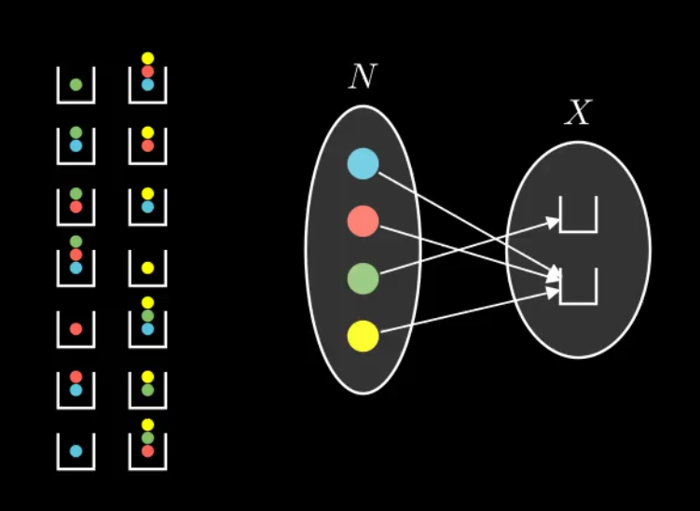
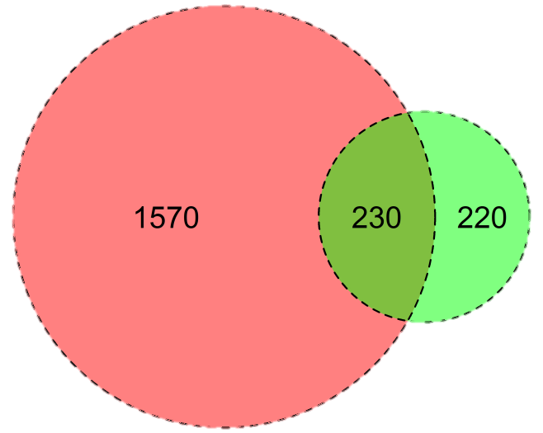
Visualization
Extend CoSo
Graphical Interface
Show solving steps
Breaking problem down
Help Students
(E.g. Symbolab)
Area Proportional Venn Diagrams
Circle area ~ domain size

