Slide 1
Lifted Reasoning for Combinatorial Counting

Slide 2
Lifted Reasoning
Lifted Reasoning = Lifted Inference
Graphical Probability Models
No use of symmetries/redundancies
Grounded Inference
Initial Proposal (David Poole)
Shift of Focus
Machine learning

Slide 3


Lifted Reasoning
Conditional Dependencies
Traditional Model (Grounded)
2 Seperate functions
Lifted Model
Generalization
Faster processing
Age
Age
Company
Age

Slide 4
Combinatorics
Counting possible arrangements
(E.g. shuffled deck)
Constraints
(E.g. first = ace of spades)
Human solving

Slide 5
Twelvefold Way
12 Common Counting Problems
Mathematical Formula
3 Function Types
Any, Injective, Surjective
4 Distinguishibilities
≠, =x, =y, =xy

Slide 6




≠
=
X
=
=
X
Y
Y

Slide 7
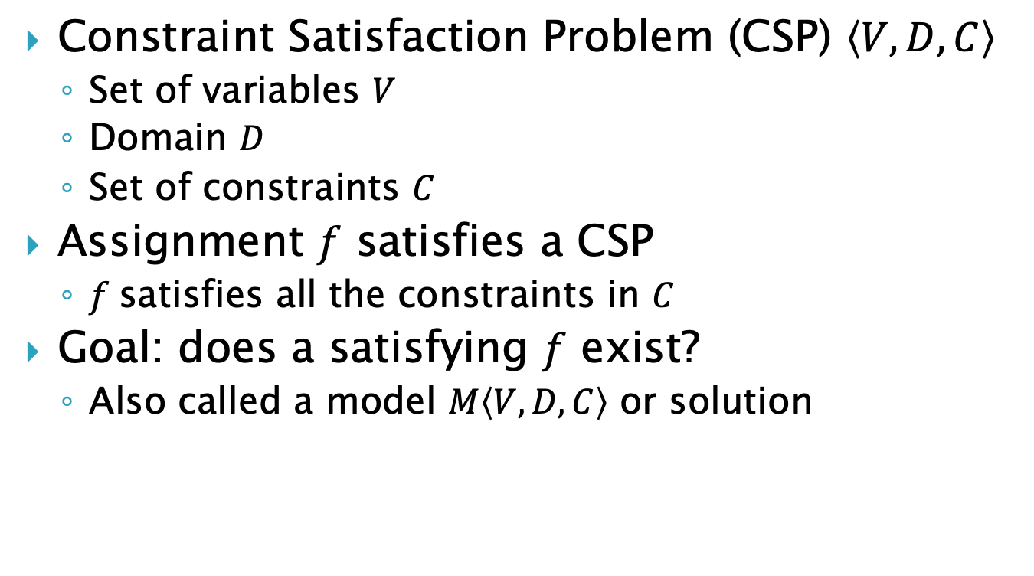
CSP
Constraint Satisfaction Problem (CSP) $\left\langle V,D,C\right\rangle$
Set of variables $V$
Domain $D$
Set of constraints $C$
Assignment $f$ satisfies a CSP
$f$satisfies all the constraints in $C$
Goal: does a satisfying $f$ exist?
Also called a model $M\left\langle V,D,C\right\rangle$ or solution

Slide 8
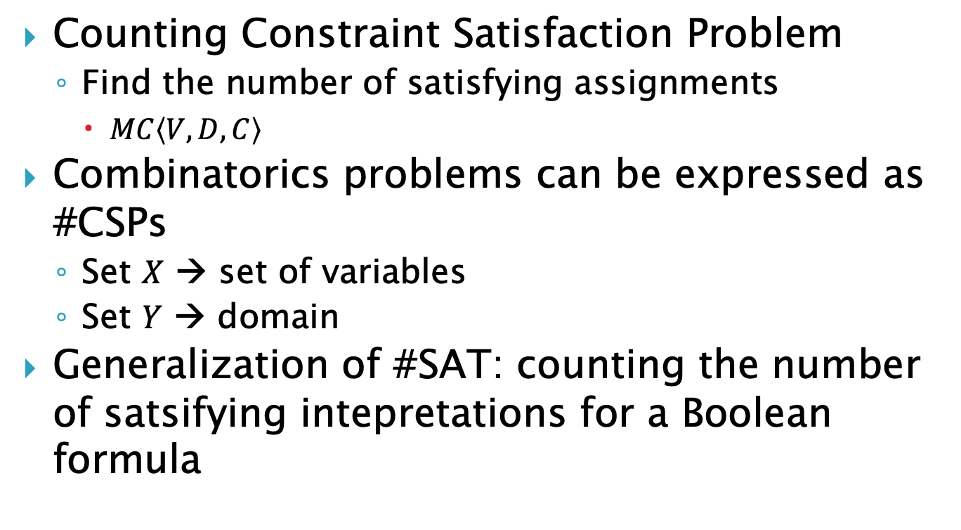
#CSP
Counting Constraint Satisfaction Problem
Find the number of satisfying assignments
$MC\left\langle V,D,C\right\rangle$
Combinatorics problems can be expressed as #CSPs
Set $X$ → set of variables
Set $Y$ → domain
Generalization of #SAT: counting the number of satsifying intepretations for a Boolean formula

Slide 9
#SAT and #CSPs
#CSPs generalize #SAT
#SAT is #P-complete
#P: class of counting problems
All counting problems can be reduced to #SATs

Slide 10
CoLa
Elements
Atomic objects
Domains
Sets of elements
Structures
Twelvefold way problem
(D, F)

Slide 11
CoLa (Constraints)
Domain Formulas
Set operations
Choice Constraints
Fixed position
Counting Constraints
Limit on domains
Boolean operators (>, <, >=, <=, =)

Slide 12
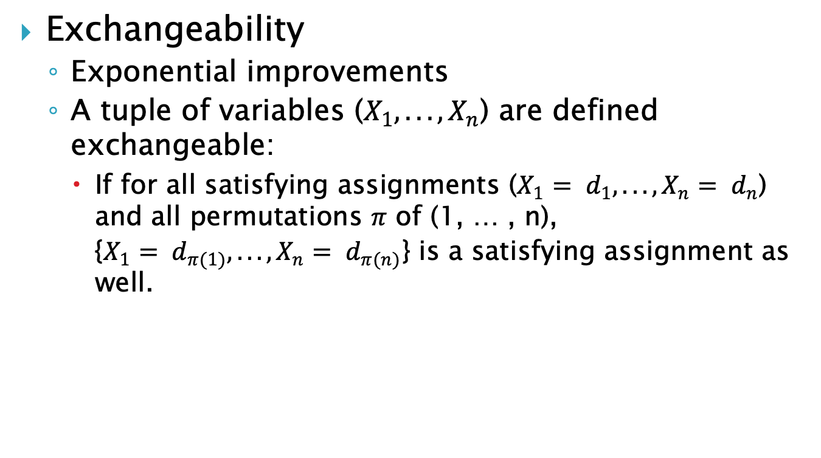
Lifted Reasoning Strategies
Exchangeability
Exponential improvements
A tuple of variables ($X_{1},. . . , X_{n}$) are defined exchangeable:
If for all satisfying assignments ($X_{1}= d_{1},. . . , X_{n}= d_{n}$) and all permutations $π$ of (1, … , n), {$X_{1}= d_{π(1)},. . . , X_{n}= d_{π(n)}$} is a satisfying assignment as well.

Slide 13
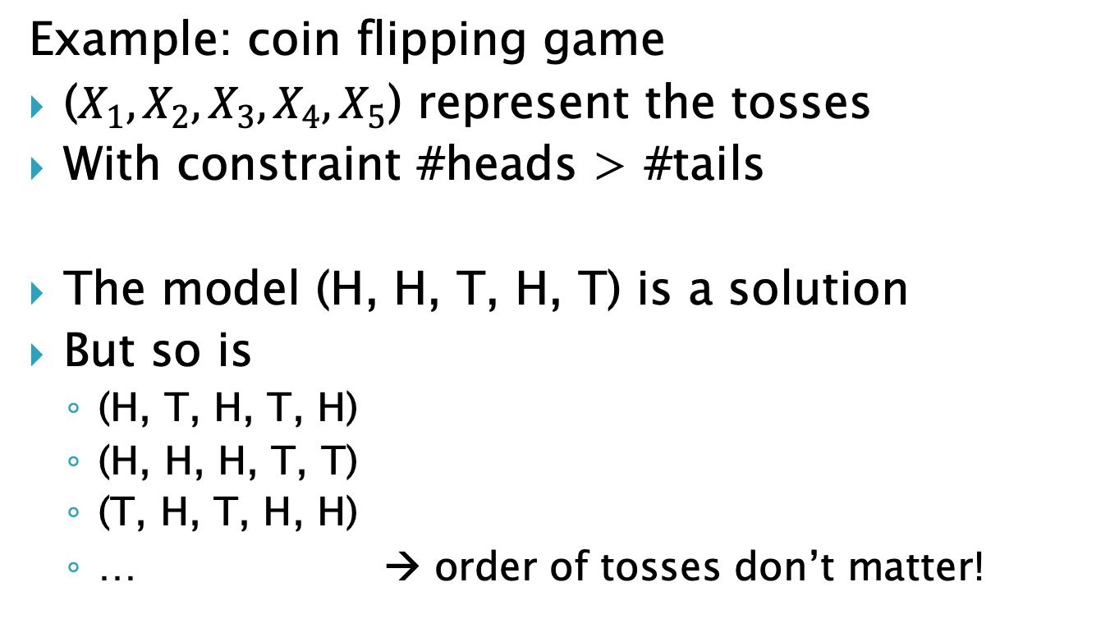
Lifted Reasoning Strategies
Example: coin flipping game
($X_{1}, X_{2},X_{3}, X_{4},X_{5}$) represent the tosses
With constraint #heads > #tails
The model (H, H, T, H, T) is a solution
But so is
(H, T, H, T, H)
(H, H, H, T, T)
(T, H, T, H, H)
… → order of tosses don’t matter!

Slide 14
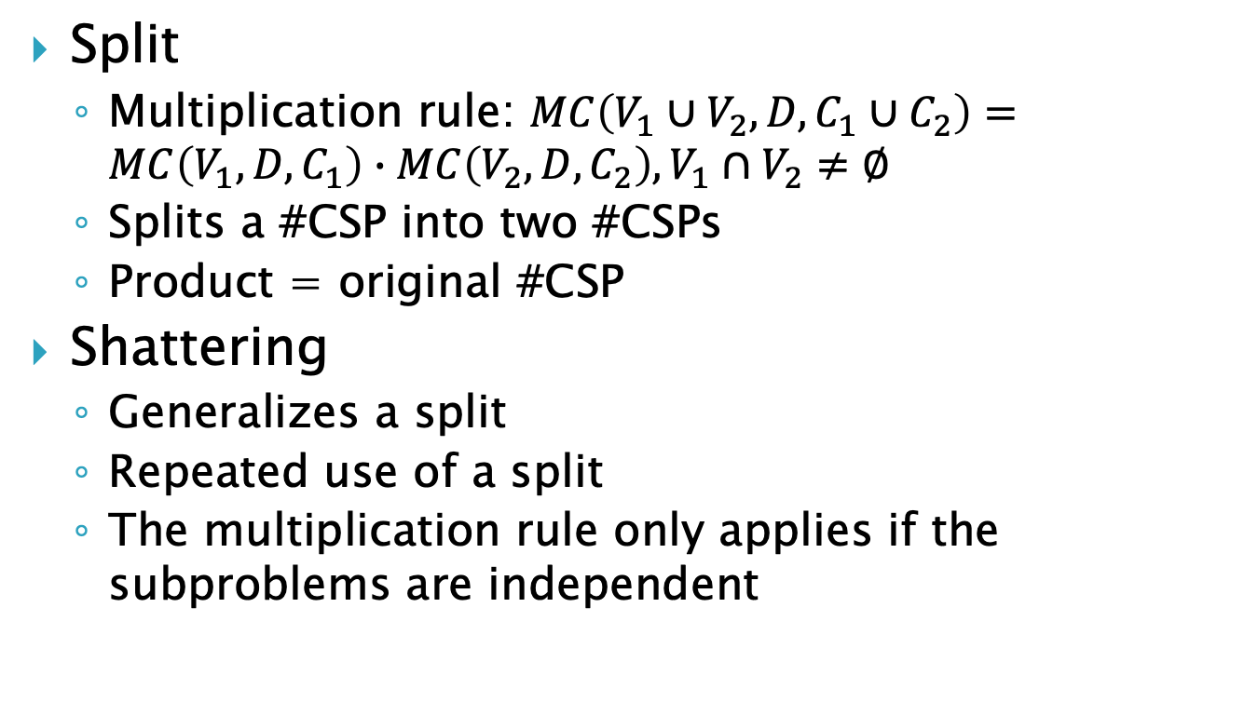
Lifted Reasoning Strategies
Split
Multiplication rule: $MC\left(V_{1}∪V_{2},D,C_{1}∪C_{2}\right)=MC\left(V_{1},D,C_{1}\right)∙MC\left(V_{2},D,C_{2}\right),V_{1}∩V_{2}≠∅$
Splits a #CSP into two #CSPs
Product = original #CSP
Shattering
Generalizes a split
Repeated use of a split
The multiplication rule only applies if the subproblems are independent

Slide 15
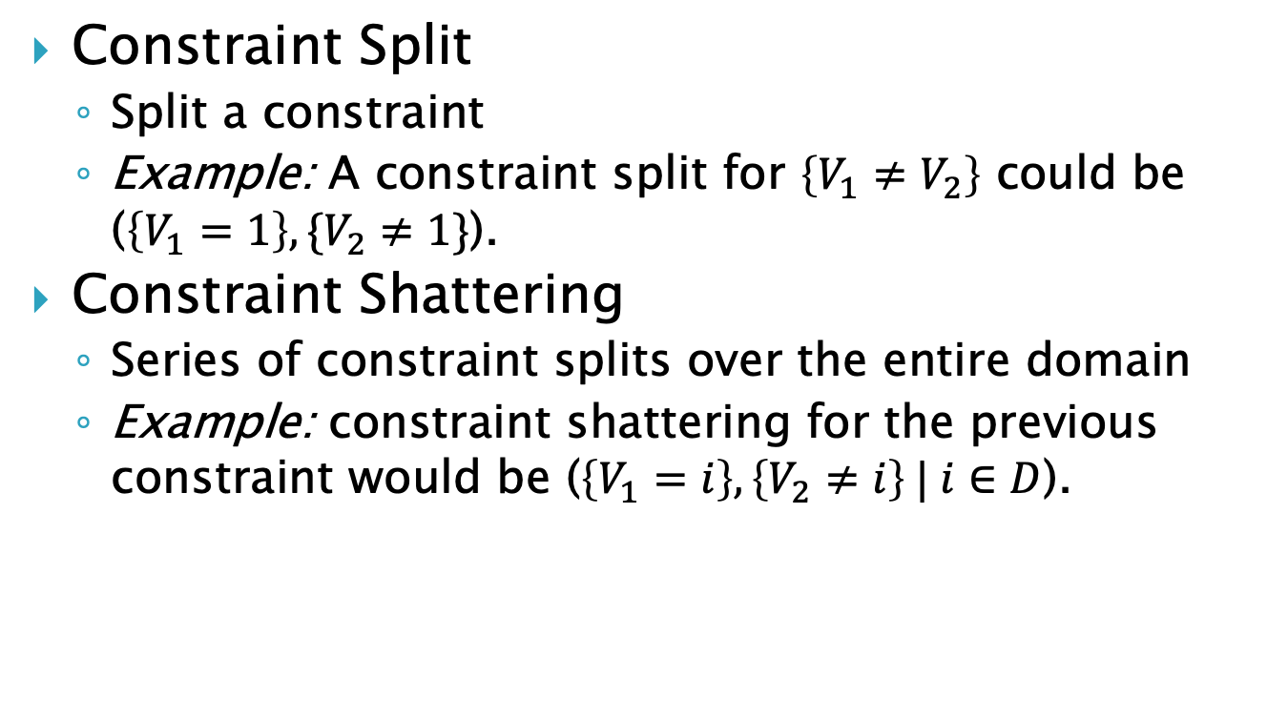
Lifted Reasoning Strategies
Constraint Split
Split a constraint
Example: A constraint split for $\left\{V_{1}≠V_{2}\right\}$ could be ($\left\{V_{1}=1\right\},\{V_{2}≠1\}$).
Constraint Shattering
Series of constraint splits over the entire domain
Example: constraint shattering for the previous constraint would be ($\left\{V_{1}=i\right\},\left\{V_{2}≠i\right\} | i∈D$).

Slide 16
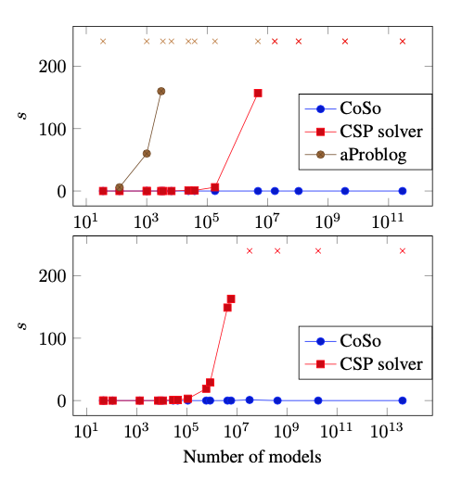
CoSo
Solver for combinatorial problems
Based on exchangeability and constraint shattering
Outperforms existing approaches based on enumeration

Slide 17
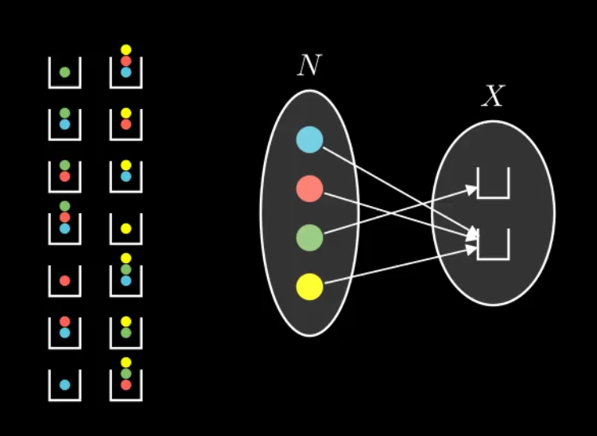
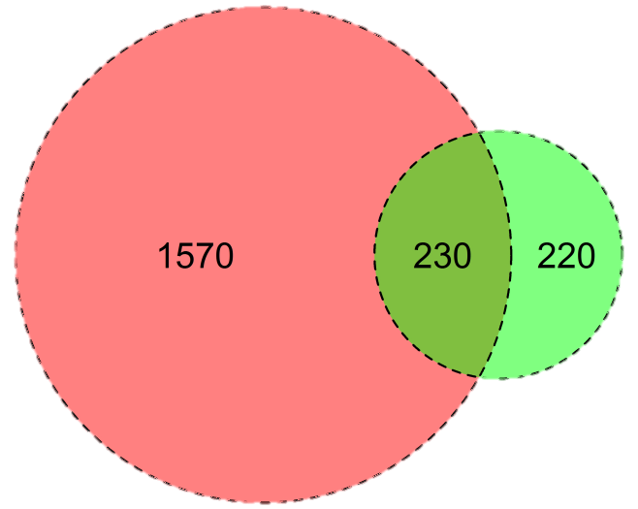
Visualization
Extend CoSo
Graphical Interface
Show solving steps
Breaking problem down
Help Students
(E.g. Symbolab)
Area Proportional Venn Diagrams
Circle area ~ domain size

Slide 18
Questions?

