Slide 1
Visualizing Combinatorial Problem Resolution

Slide 2

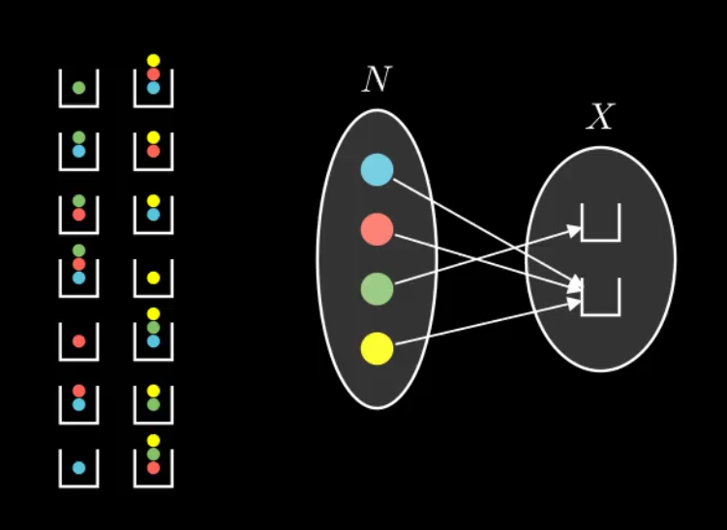
Why is it Relevant?
Cfr. Symbolab
Mathematical problems
Step-by-step solving
Help Students
Our Visualization
Didactic tool
Focus = Combinatorics
Lifted Reasoning

Slide 3
Bibliography
Lifted Reasoning for Combinatorial Counting
Towards High-Level Probabilistic Reasoning with Lifted Inference
Constructing Area-Proportional Venn and Euler

Slide 4


Lifted Reasoning
(= Lifted Inference)
Conditional Dependencies
Traditional Model
2 Seperate functions
No use of symmetries
Grounded Inference
Lifted Model
Generalization
Faster processing
Age
Age
Company
Age

Slide 5
Lifted Reasoning
Initial Proposal (David Poole)
High-level Reasoning
Shift of Focus
Machine learning
Now: Combinatorics

Slide 6
Combinatorics
Counting possible arrangements
(E.g. shuffled deck)
Constraints
(E.g. first = ace of spades)
Human solving

Slide 7
Twelvefold Way
12 Common Counting Problems
Mathematical Formulas
3 Function Types
Any, Injective, Surjective
4 Distinguishibilities
≠, =x, =y, =xy

Slide 8




≠
=
X
=
=
X
Y
Y

Slide 9
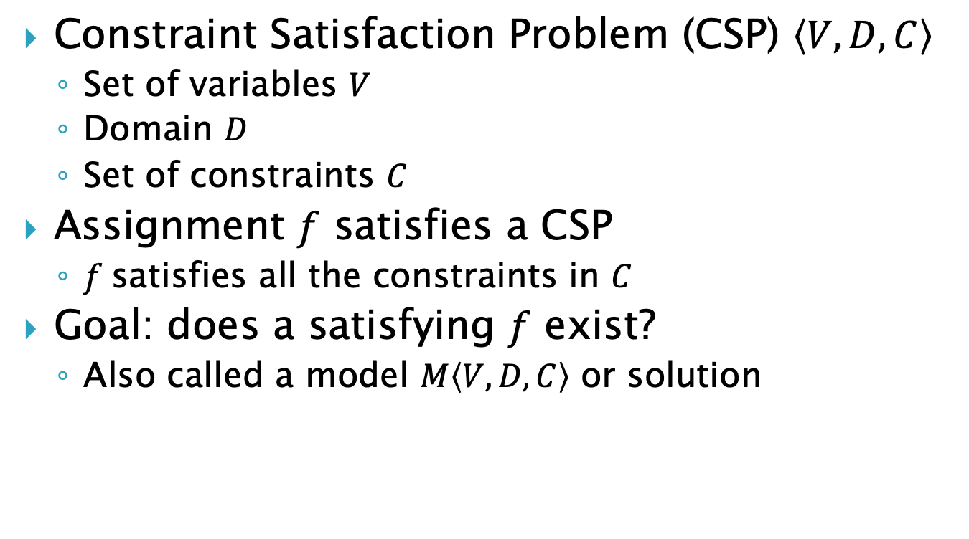
CSP
Constraint Satisfaction Problem (CSP) $\left\langle V,D,C\right\rangle$
Set of variables $V$
Domain $D$
Set of constraints $C$
Assignment $f$ satisfies a CSP
$f$satisfies all the constraints in $C$
Goal: does a satisfying $f$ exist?
Also called a model $M\left\langle V,D,C\right\rangle$ or solution

Slide 10
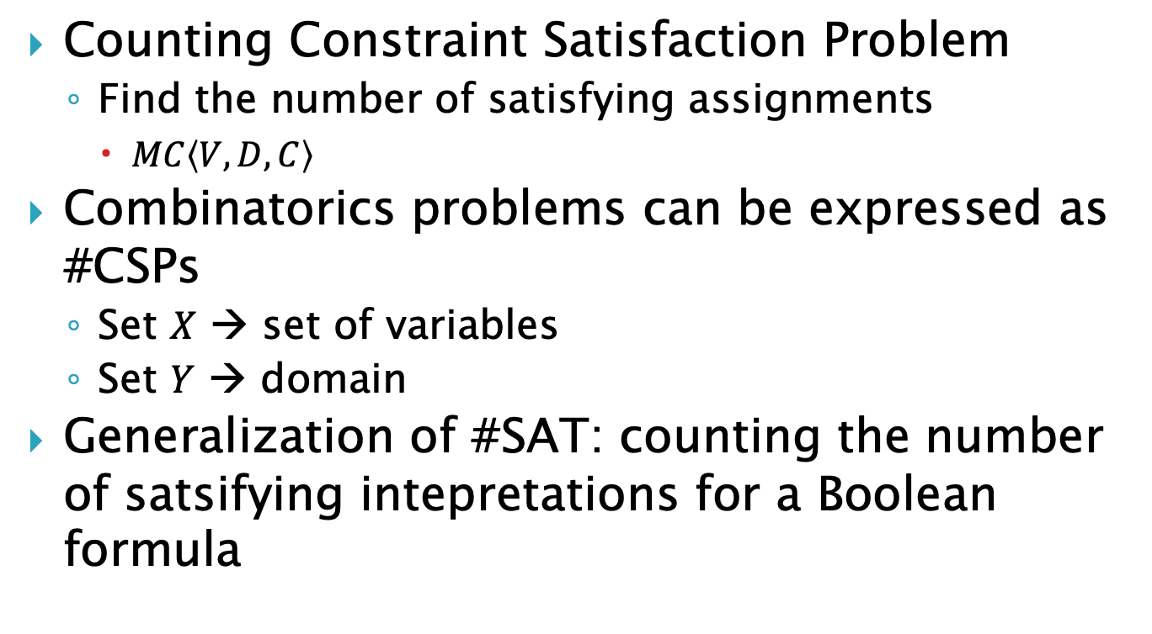
#CSP
Counting Constraint Satisfaction Problem
Find the number of satisfying assignments
$MC\left\langle V,D,C\right\rangle$
Combinatorics problems can be expressed as #CSPs
Set $X$ → set of variables
Set $Y$ → domain
Generalization of #SAT: counting the number of satsifying intepretations for a Boolean formula

Slide 11
#SAT and #CSPs
#CSPs generalize #SAT
#SAT is #P-complete
#P: class of counting problems
All counting problems can be reduced to #SATs

Slide 12
CoLa
Elements
Atomic objects
Domains
Sets of elements
Structures
Twelvefold way problem
(D, F)

Slide 13
CoLa (Constraints)
Domain Formulas
Set operations
Choice Constraints
Fixed position
Counting Constraints
Limit on domains
Boolean operators (>, <, >=, <=, =)

Slide 14
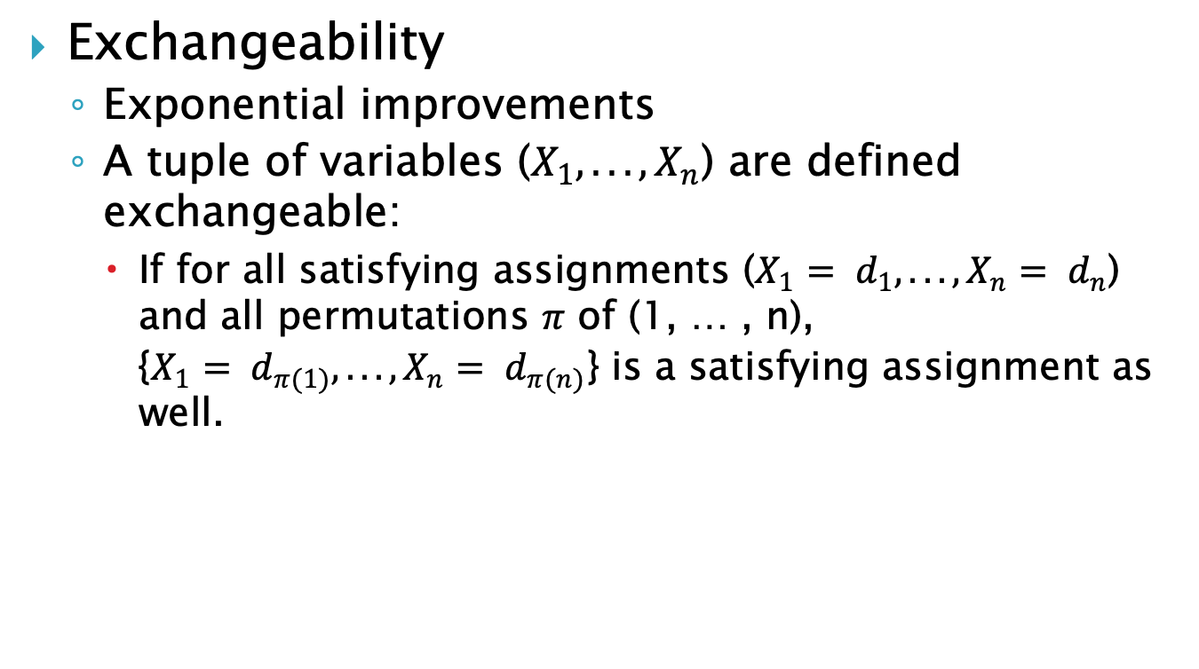
Lifted Reasoning Strategies
Exchangeability
Exponential improvements
A tuple of variables ($X_{1},. . . , X_{n}$) are defined exchangeable:
If for all satisfying assignments ($X_{1}= d_{1},. . . , X_{n}= d_{n}$) and all permutations $π$ of (1, … , n), {$X_{1}= d_{π(1)},. . . , X_{n}= d_{π(n)}$} is a satisfying assignment as well.

Slide 15
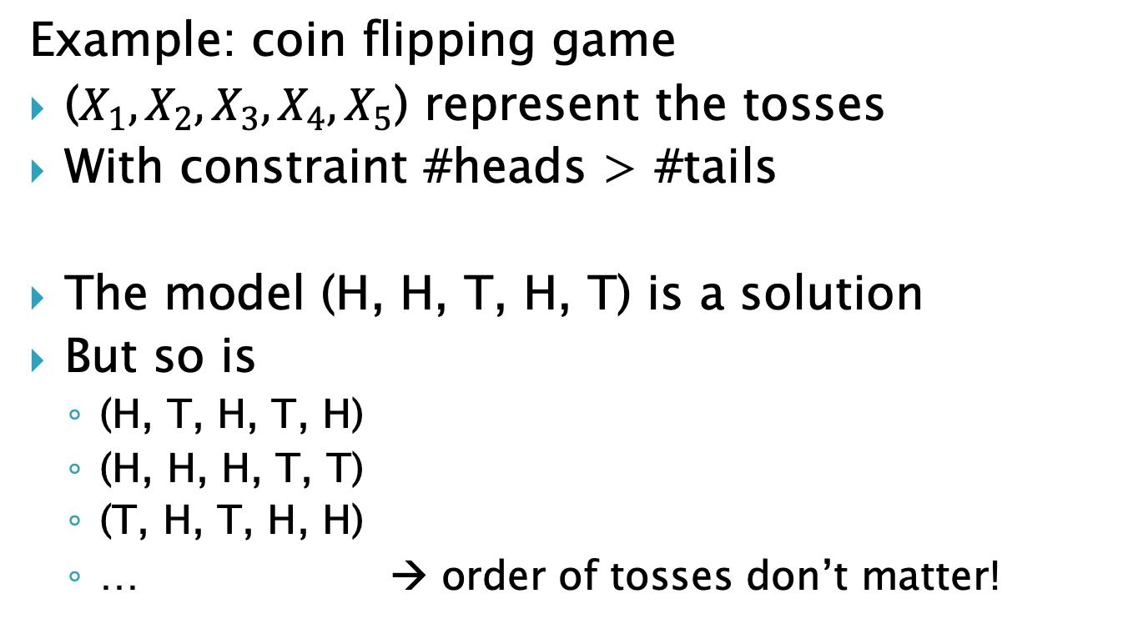
Lifted Reasoning Strategies
Example: coin flipping game
($X_{1}, X_{2},X_{3}, X_{4},X_{5}$) represent the tosses
With constraint #heads > #tails
The model (H, H, T, H, T) is a solution
But so is
(H, T, H, T, H)
(H, H, H, T, T)
(T, H, T, H, H)
… → order of tosses don’t matter!

Slide 16
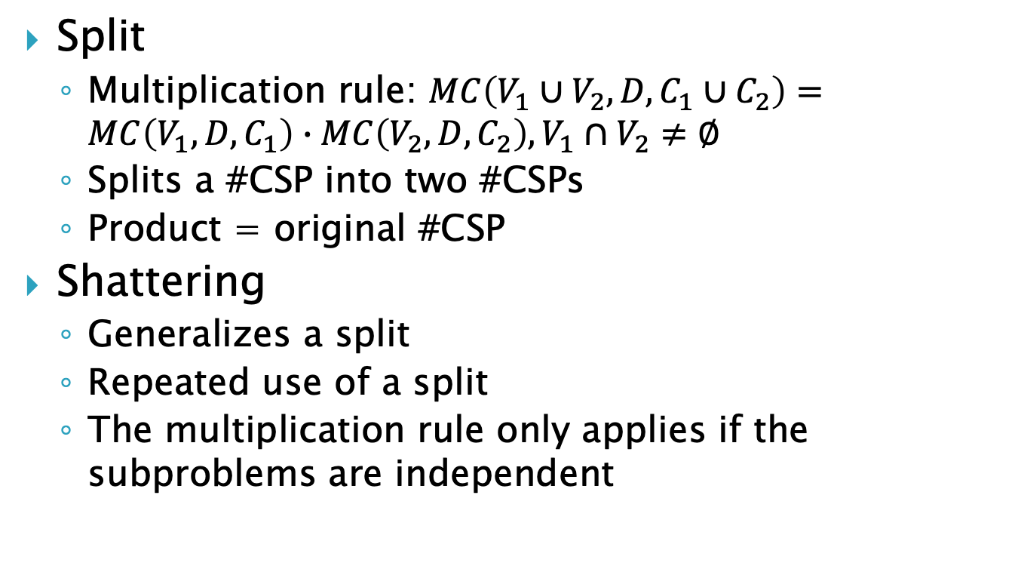
Lifted Reasoning Strategies
Split
Multiplication rule: $MC\left(V_{1}∪V_{2},D,C_{1}∪C_{2}\right)=MC\left(V_{1},D,C_{1}\right)∙MC\left(V_{2},D,C_{2}\right),V_{1}∩V_{2}≠∅$
Splits a #CSP into two #CSPs
Product = original #CSP
Shattering
Generalizes a split
Repeated use of a split
The multiplication rule only applies if the subproblems are independent

Slide 17
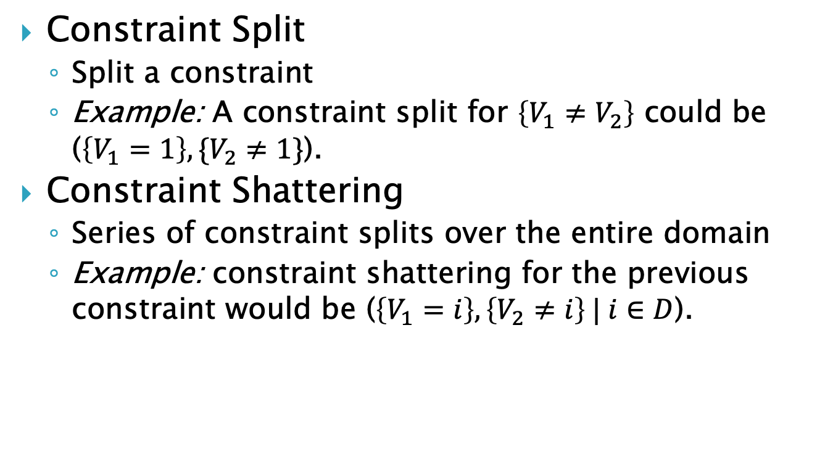
Lifted Reasoning Strategies
Constraint Split
Split a constraint
Example: A constraint split for $\left\{V_{1}≠V_{2}\right\}$ could be ($\left\{V_{1}=1\right\},\{V_{2}≠1\}$).
Constraint Shattering
Series of constraint splits over the entire domain
Example: constraint shattering for the previous constraint would be ($\left\{V_{1}=i\right\},\left\{V_{2}≠i\right\} | i∈D$).

Slide 18
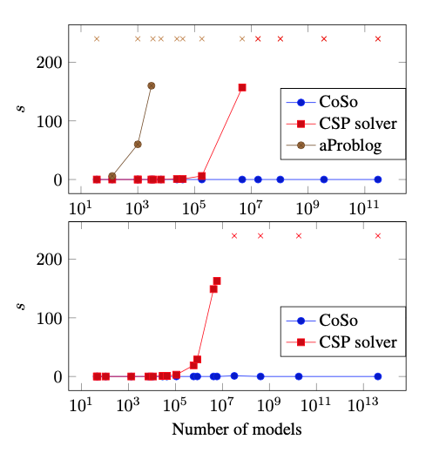
CoSo
Solver for combinatorial problems
Based on exchangeability and constraint shattering
Outperforms existing approaches based on enumeration

Slide 19
Visualization
Extend CoSo
Graphical Interface
Show solving steps
Breaking problem down
Human thinking
Help Students

Slide 20

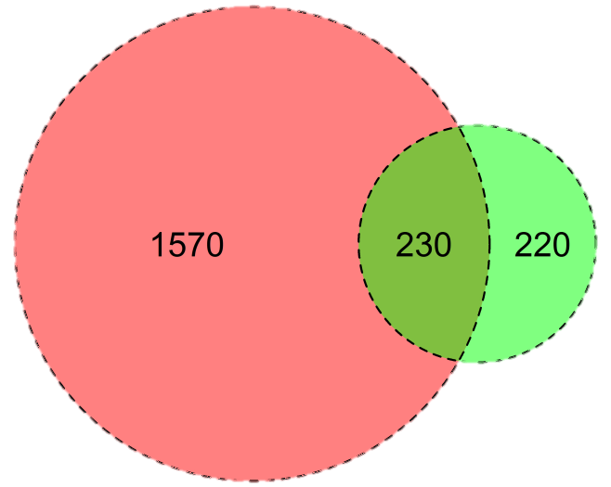
Visualization (Implementation)
Godot Engine
GDscript
External files
Steps
Venn diagrams
Basic problems
Constraints
Area Proportional Venn
Circle area ~ domain size
Python library

Slide 21
Questions?

