Slide 1
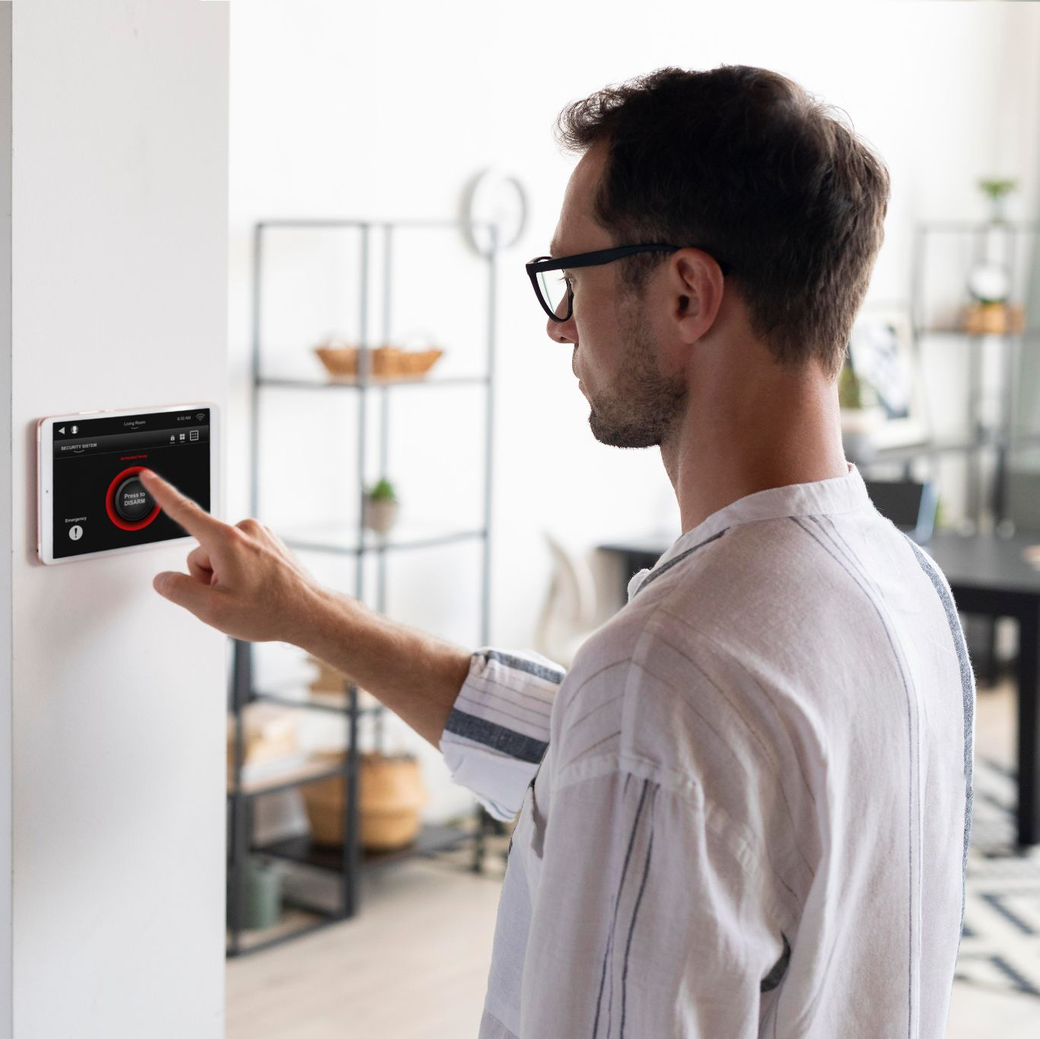
AIR SENSOR DETECTOR
INTERNET OF THINGS- UNIVERSITY OF PISA
MICHAEL ASANTE

Slide 2
TABLE OF CONTENTS
ABOUT THE PROJECT
01
02
PROJECT ARCHITECTURE
03
DB
Scope of the Project
CoAP
MQTT
COLLECTOR
Schema Structure
04
DEMO

Slide 3
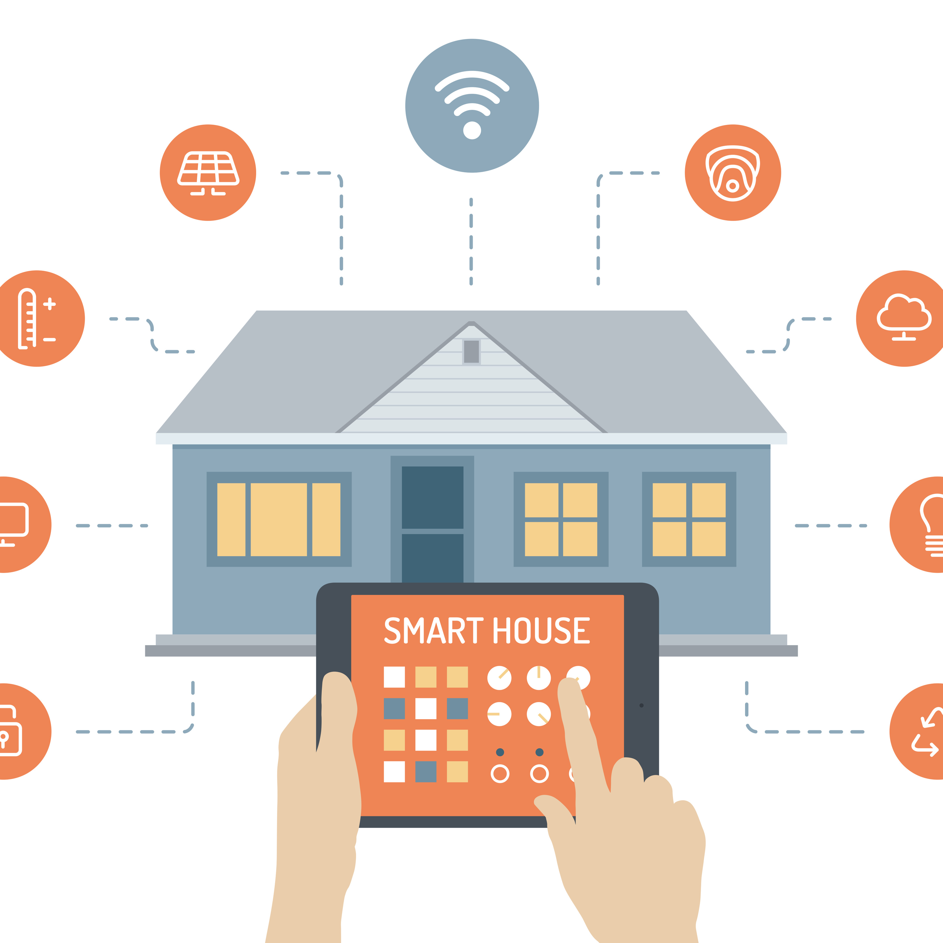
ABOUT THE PROJECT
As the number of pollutants in the air tends to increase, this project focuses on creating an Air Detection system within homes to monitor the temperature, humidity, intensity of light and poisonous gases as a pre-caution for the older people. If any poisonous gas is detected within the home, an extractor is started and its speed increases based on the quantity of gas sensed.
Photo Credit: CC BY-SA

Slide 4
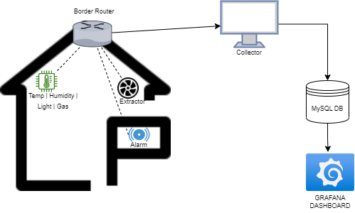
PROJECT ARCHITECTURE
Project Consists of 3 Main parts:
CoAP
MQTT
Collector

Slide 5
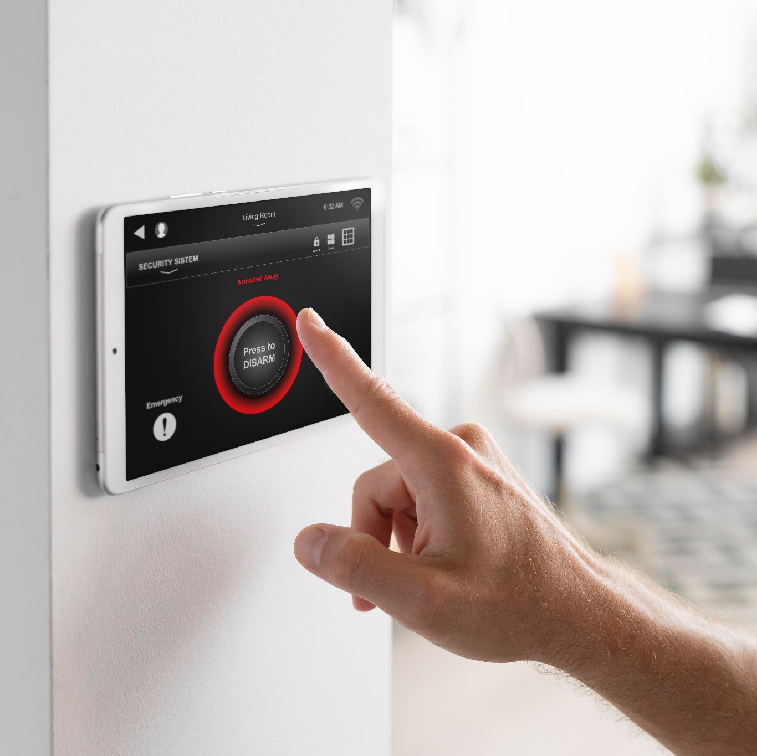
02.
MQTT

Slide 6
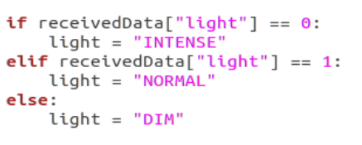

PROCEDURE
MQTT Sensors are responsible for recording temperature, humidity, light intensity and gas recordings.
Message from the sensor is constructed using random values to simulate a real sensor, these values are concatenated into a buffer, with the length and the message itself as a plain text.
Message is loaded in JSON format, splitted into the variables recorded and stored in the database.
Once the payload is received from the sensor, the light intensity value is converted.

Slide 7
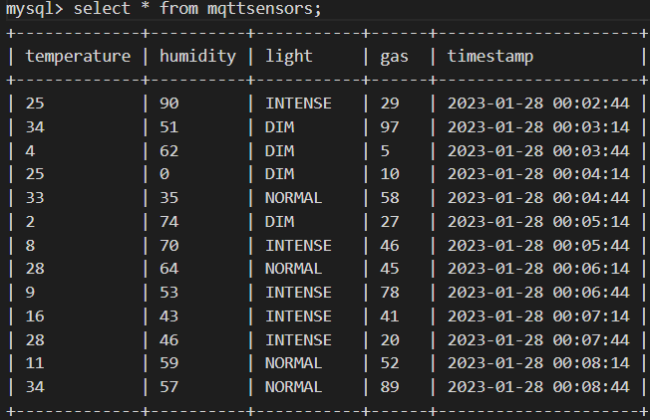
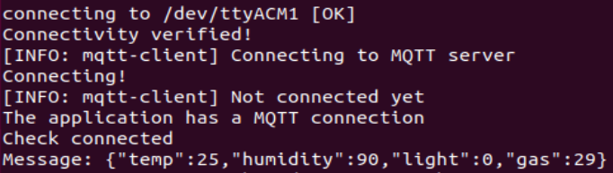
PROCEDURE
Data is stored in a MySQL tabled called ‘mqttsensors’. Certain control logics are placed on the values collected here.

Slide 8
02.
CoAP

Slide 9

PROCEDURE
CoAP Sensor within this architecture senses poisonous gases and triggers an extractor which expels the air out.
Basically, the analogy is that there are sensors within the house that is able to sense the presence of poisonous gases and triggers an extractor and increases the speed of it.
There are two tables managing this architecture in the MySQL database which are coapsensorextractor, coapsensormotion

Slide 10

PROCEDURE
When the poisonous gas is detected, the extractor automatically starts. The speed intensity is measured and increases progressively till it reaches 100.
Message is concatenated and a buffer together with its length is concatenated and sent as a JSON file.
Once the data is received, data is split and stored in the Database.
Actually, the extractor can be controlled with the button on the sensor which stops and the extractor until pressed again.

Slide 11
02.
COLLECTOR

Slide 12
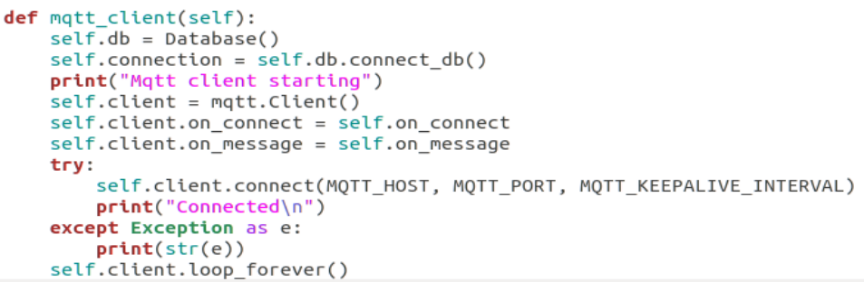
The Collector is written in Python and a separate file is written for the MQTT as well as a separate to initiate the thread for different architectures

Slide 13

DB
03.
This Photo by CC BY-NC

Slide 14
The Schema

Slide 15
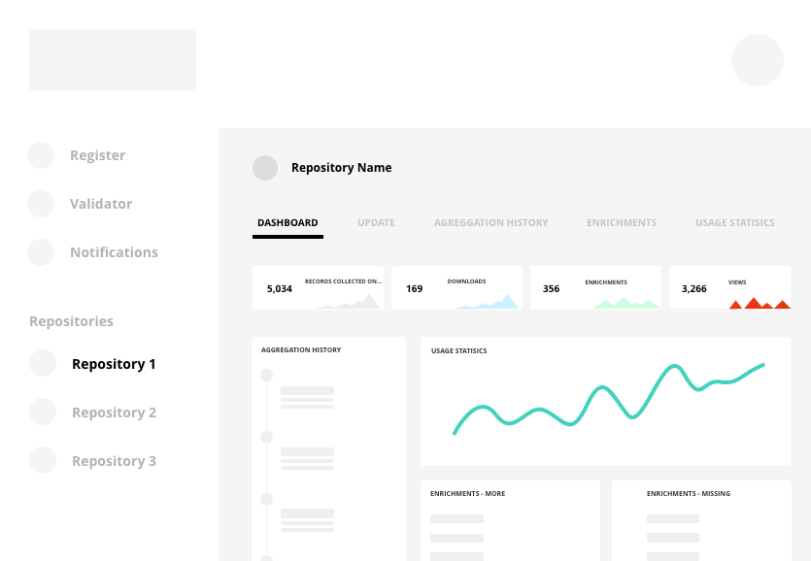
04.
GRAFANA
This Photo by CC BY

Slide 16
PROCEDURE
CoAP Sensor within this architecture senses poisonous gases and triggers an extractor which expels the air out.
Basically, the analogy is that there are sensors within the house that is able to sense the presence of poisonous gases and triggers an extractor and increases the speed of it.
There are two tables managing this architecture in the MySQL database which are coapsensorextractor, coapsensormotion

Slide 17
THANKS
PLEASE KEEP THIS SLIDE FOR ATTRIBUTION

