Slide 1
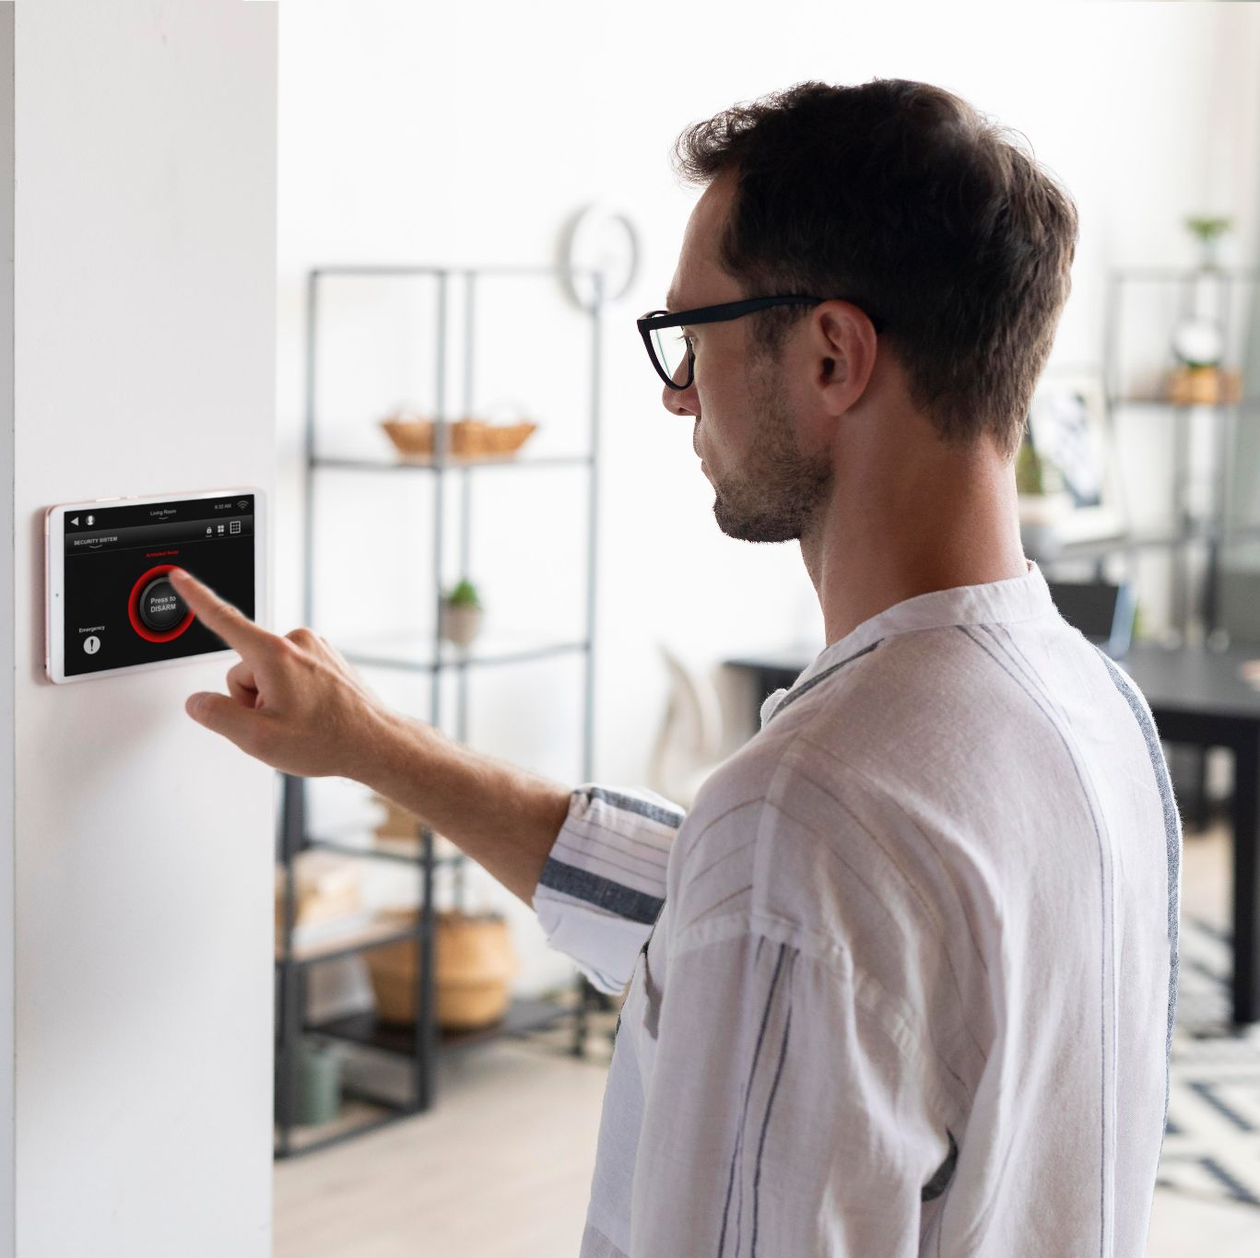
AIR SENSOR DETECTOR
INTERNET OF THINGS- UNIVERSITY OF PISA
MICHAEL ASANTE

Slide 2
TABLE OF CONTENTS
ABOUT THE PROJECT
01
02
PROJECT ARCHITECTURE
03
DB
Scope of the Project
CoAP
MQTT
COLLECTOR
Schema Structure
04
DEMO

Slide 3
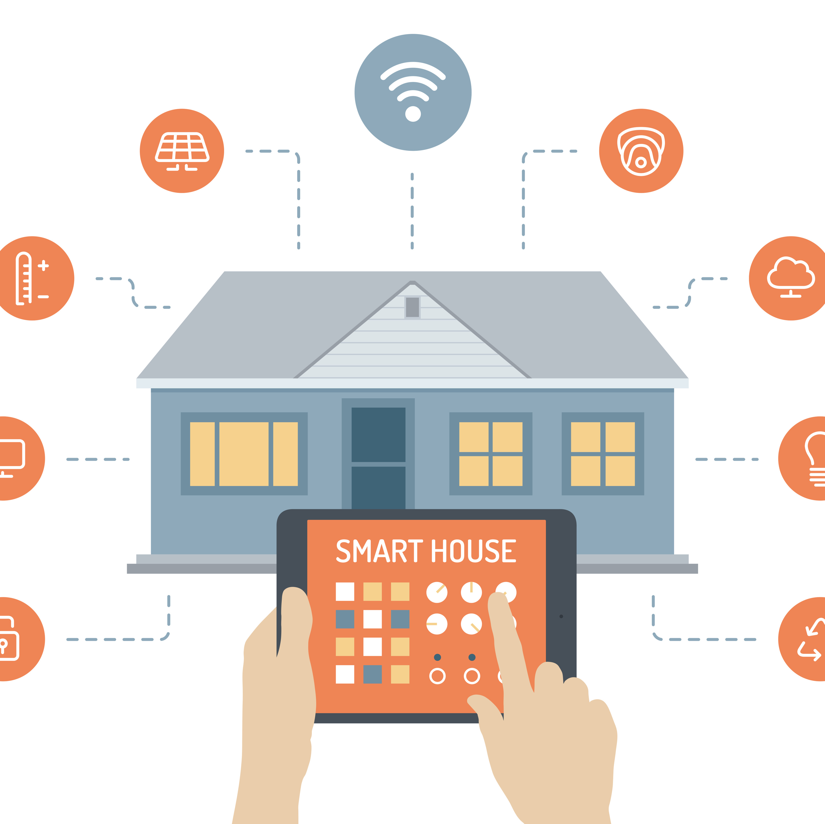
ABOUT THE PROJECT
As the number of pollutants in the air tends to increase, this project focuses on creating an Air Detection system within homes to monitor the temperature and humidity as a pre-caution for monitoring the health of old people in a home simulation. It also measures the presence of the air and indicates either it safe, normal or toxic.
Photo Credit: CC BY-SA

Slide 4
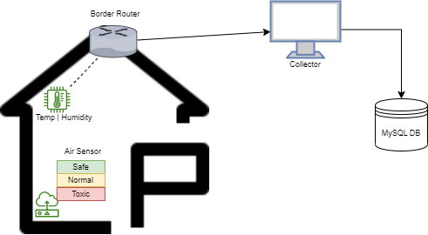
PROJECT ARCHITECTURE
Project Consists of 3 Main parts:
CoAP
MQTT
Collector

Slide 5
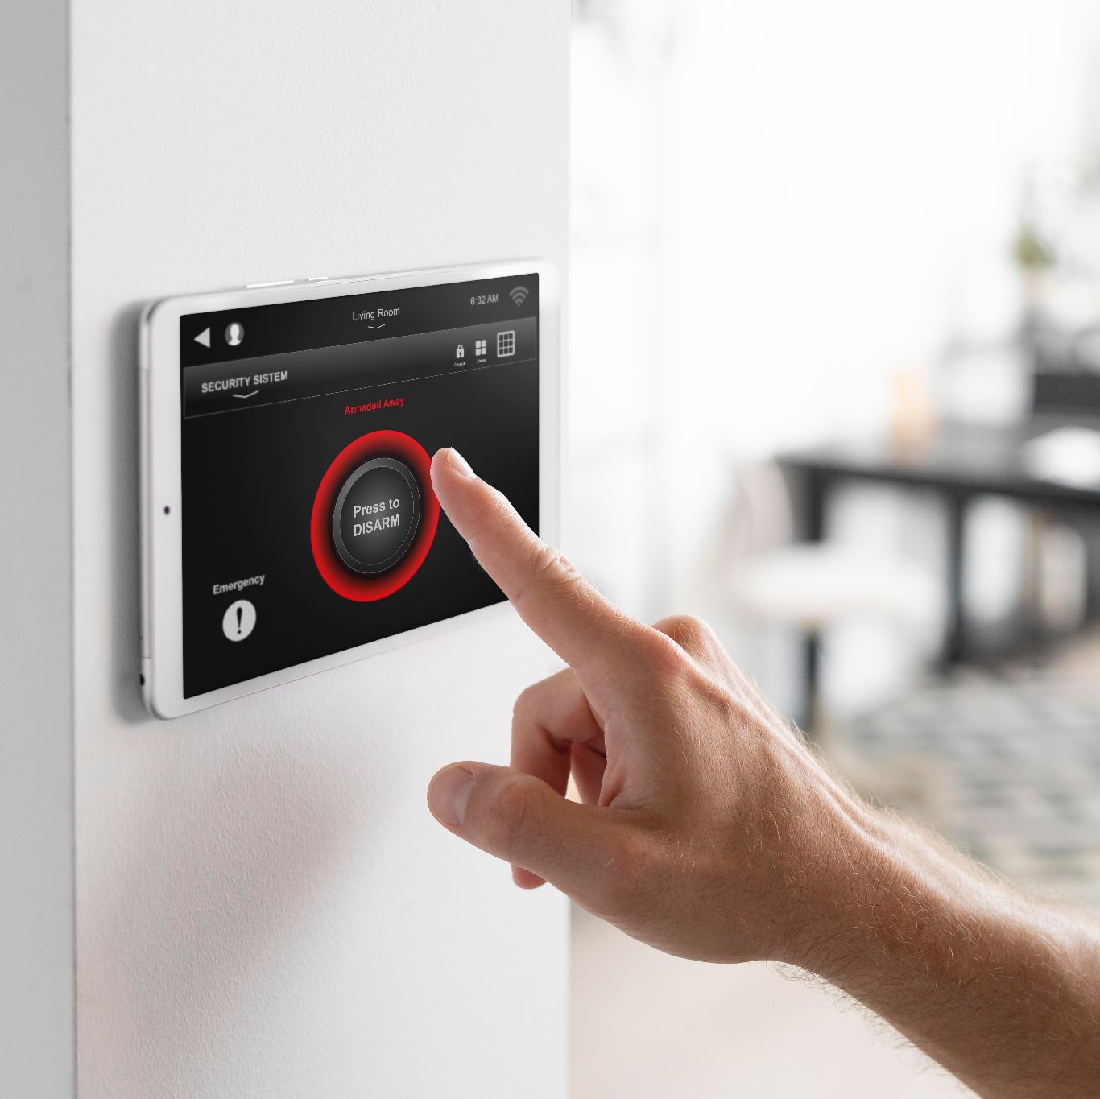
02.
MQTT

Slide 6
PROCEDURE
MQTT Sensors are responsible for recording temperature and humidity.
Message from the sensor is constructed using random values to simulate a real sensor, these values are concatenated into a buffer, with the length and the message itself as a plain text.
Message is loaded in JSON format, splitted into the variables recorded and stored in the database.
Once the payload is received from the sensor, the light intensity value is converted.

Slide 7
PROCEDURE
Data is stored in a MySQL tabled called ‘mqttsensors’. Boundaries of values generated for the temperature and the humidity are controlled.

Slide 8
02.
CoAP

Slide 9
PROCEDURE
CoAP Sensor within this architecture senses for the quality of air within the house.
Based on the value sensed, an information is triggered, and the corresponding LED light is turned on.
The MySQL table, `coap` stores the air-quality value and the timestamp.

Slide 10
PROCEDURE
The Air Quality value is generated by a random function which ranges from 0-199.
Message is sent as a buffer in the form of a JSON data
Once the data is received, data is split using the key-value and is stored in the Database.

Slide 11
02.
COLLECTOR

Slide 12
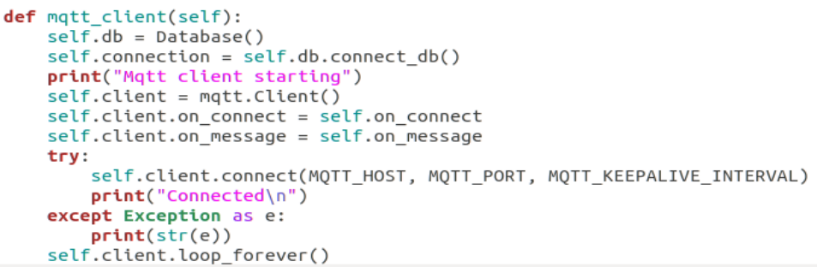
The Collector is written in Python and a separate file is written for the MQTT as well as a separate to initiate the thread for different architectures

Slide 13

DB
03.
This Photo by CC BY-NC

Slide 14
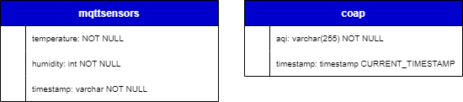
The Schema
The structure of the database(`air_sensor_iot`) and tables(mqttsensors & coap) are represented in the diagram below

Slide 15
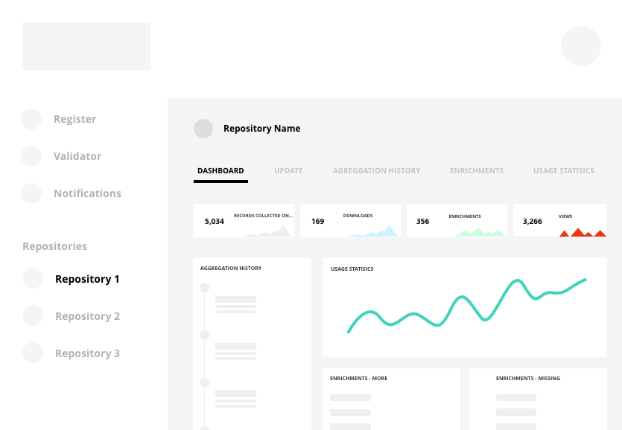
04.
GRAFANA
This Photo by CC BY

Slide 16
PROCEDURE
To visualize the data inflow visually, Grafana was set up and used as a dashboard and the charts are refreshed every 30 seconds.

Slide 17
THANKS
PLEASE KEEP THIS SLIDE FOR ATTRIBUTION

