Slide 1
CSC 555
Mining Big Data
Lecture 6
Alexander Rasin
College of CDM, DePaul University
February 13th, 2019
Notes:
http://infolab.stanford.edu/~ullman/mmds/ch3.pdf

Slide 2
Tonight
Star schema / SSBM
Hive / Pig
Performance considerations and compression
Hadoop streaming
NoSQL

Slide 3


Star-Schema
“Dimension” table
Products
“Fact” table
pid
name
desc
1
Transactions
2
3
4
LCD Monitor
…
“Dimension” table
tid cid pid date amount
Customers
1
3
4
01-01-10
200.00
cid
name
address
2
1
10
01-01-10
45.95
3
3
9
01-02-10
110.00
1
…
2
…
3
Alex
“Dimension” table
Date
date
day
holiday

Slide 4
SSBM Schema
4 Dimension tables
  Part: manufacturer, name, size, ...
  Supplier: name, address, phone, …
  Customer: name, address, …
  Date: month, year, dayofweek, …
1 Fact table: lineorder
  Composite key (orderkey+linenumber)
  4 foreign keys (one per dimension)
  Orderpriority, quantity, discount, tax, …

Slide 5
Outer Join / External Table
Normal tables: /user/hive/warehouse/Table1
External Tables
  Data not owned by Hive (/data/Data2)
SELECT * FROM u_data
FULL OUTER JOIN u_data_new ON
(u_data.rating = u_data_new.weekday)
WHERE u_data.rating > 3;
Notes:
hadoop fs –mkdir /user/ec2-user/movie_ratings2
CREATE EXTERNAL TABLE movie_ratings2
(movieid INT, rating INT)
ROW FORMAT DELIMITED FIELDS TERMINATED BY '\t' STORED AS TEXTFILE
LOCATION '/user/ec2-user/movie_ratings';

Slide 6
Map-Join
Hive StarSchema optimization
SELECT Address, Count(*)
FROM SmallTable st JOIN
BigTable bt ON (st.id = bt.id)
GROUP BY Address
2 MapReduce jobs
Network transfer

Slide 7
Map-Join
SELECT /*+ MAPJOIN(st) */
Address, Count(*)
FROM SmallTable st JOIN
BigTable bt ON (st.id = bt.id)
GROUP BY Address
Replicate the SmallTable
set hive.auto.convert.join = true;
  hive.mapjoin.smalltable.filesize (25MB default)

Slide 8
Hive Partitioning
CREATE TABLE u_data ( userid INT,
movieid INT, rating INT, unixtime STRING)
PARTITIONED BY(country STRING)
ROW FORMAT DELIMITED FIELDS
TERMINATED BY '\t' STORED AS TEXTFILE;
LOAD DATA LOCAL INPATH 'ml-100k/u.data'
OVERWRITE INTO TABLE u_data
PARTITION(country='USA');
show partitions u_data;
Notes:
wget http://rasinsrv07.cstcis.cti.depaul.edu/CSC555/hive-0.8.1-bin.tar.gz
gunzip hive-0.8.1-bin.tar.gz
tar xvf hive-0.8.1-bin.tar
export HIVE_HOME=/home/ec2-user/hive-0.8.1-bin
export PATH=$HIVE_HOME/bin:$PATH
export HADOOP_HOME=/home/ec2-user/hadoop-0.20.205.0/

Slide 9
Pig Use
UData = LOAD 'u.data' USING PigStorage('\t') AS (userid:int, movieid:int, rating:int, unixtime:chararray);
DESCRIBE UData;
DUMP UData;
UDataS = ORDER UData BY userid;
DUMP UDataS;
Notes:
wget http://rasinsrv07.cstcis.cti.depaul.edu/CSC555/pig-0.15.0.tar.gz
gunzip pig-0.15.0.tar.gz
tar xvf pig-0.15.0.tar
export PIG_HOME=/home/ec2-user/pig-0.15.0
export PATH=$PATH:$PIG_HOME/bin

Slide 10
Pig Use
UDataSample = SAMPLE UData 0.01;
DUMP UDataSample;
STORE UDataSample INTO 'UDataSample'
USING PigStorage ('_');
ONE_USER = FILTER UData BY userid == 251;
DUMP ONE_USER;
STORE ONE_USER INTO 'myUser' USING PigStorage (',');

Slide 11
Pig Use
GoodRatings = FILTER UData BY rating > 2;
UserSet = GROUP GoodRatings BY userid;
DUMP UserSet;
UserRatings = FOREACH UserSet GENERATE COUNT(GoodRatings);
DUMP UserRatings;
ILLUSTRATE UserRatings;

Slide 12
Pig Use
UserSet2 = GROUP UData BY userid;
UserRatings2 = FOREACH UserSet2 GENERATE UData.userid, AVG(UData.rating);
DUMP UserRatings2;

Slide 13
Pig Use
UDataNew = LOAD 'u.data.new' USING PigStorage('\t') AS (userid2:int, movieid2:int, rating2:int, weekday2:chararray);
DESCRIBE UDataNew; DUMP UDataNew;
DataJoin=JOIN UData BY (userid, movieid), UDataNew BY (userid2, movieid2);
FilterDataJoin = FILTER DataJoin BY rating != 2;
FDL_LG = GROUP FilterDataJoin BY (UDataNew::userid2, UDataNew::rating2);
Result = FOREACH FDL_LG GENERATE group, COUNT(FilterDataJoin);
Notes:
Case sensitive!

Slide 14
Pig Use
UDataNew = LOAD 'u.data.new' USING PigStorage('\t') AS (userid2:int, movieid2:int, rating2:int, weekday2:chararray);
DESCRIBE UDataNew; DUMP UDataNew;
DataJoin= JOIN UData BY ($0, $1),UDataNew BY ($0,$1);
STORE DataJoin INTO 'DataJoin' using PigStorage(',');
DataJoinL = LOAD 'DataJoin' USING PigStorage(',') AS (uid1:int, mid1:int, r1:int, ut1:chararray, uid2:int, mid2:int, r2:int, wd2:chararray);
DataJoinLG = GROUP DataJoinL BY wd2;
DataJoinG = ORDER (FOREACH DataJoinLG GENERATE group, AVG(DataJoinL.r1)) BY group;
Notes:
DataJoinG = ORDER (FOREACH DataJoinLG GENERATE group, AVG(DataJoinL.r1)) BY group;

Slide 15
Pig Use
cd hdfs:///
ls
mkdir testpig
copyFromLocal /etc/passwd passwd
passwd = LOAD 'hdfs:///testpig/passwd' USING PigStorage(':') AS (user:chararray, passwd:chararray, uid:int, gid:int, userinfo:chararray, home:chararray, shell:chararray);

Slide 16
Pig Use
DUMP passwd;
groupShell = GROUP passwd BY shell;
DUMP groupShell;
groupCount = FOREACH groupShell GENERATE group, COUNT(passwd);

Slide 17
Performance
Query cost
  Load data
  Map-time
  Reduce-time
Tuning actions
  Replication
  Compression
  Balancing: blocks and keys

Slide 18
Replication
Number of times a block is copied in HDFS
Expected performance change?
  Load
  Map-Runtime
  Reduce-Runtime
Configuration (JobConf)
  setMapSpeculativeExecution
  setReduceSpeculativeExecution
_<number>

Slide 19

A Break
Notes:
ssh-keygen -t rsa
cat ~/master_key >> ~/.ssh/authorized_keys

Slide 20
Data Compression
Reduce the data set (file)
  Save space when storing the file
  Save time when reading/sending the file
  Pay overhead for compression/decompression
Applications
  Gzip, Zip, etc.
  MP3, JPEG, MPEG, …
  Built-in (databases, file systems, etc.)

Slide 21
Encoding and Decoding
data
E
N
C
O
D
E
R
Data: binary data set D to compress
  Encode: generate a “compressed” representation D_{c} (hopefully smaller)
  Decode: reconstruct D (or almost D)
Compression ratio: Size(D_{c})/Size(D)
Lossless/Lossy
  Text, files
  Images, MP3, Video, …
compressed
D
E
C
O
D
E
R
data

Slide 22
Simple Ideas
Run Length Encoding (RLE)
  Convert (AAAAACCCCDDDDDDD)
  Into (A,5;C,4;D,7)
Fixed length (dictionary) coding
  Assign codes to every letter
    E.g., a = 00001, b = 00010, … z = 11000
  Encode character => code
  Have to store the mapping

Slide 23
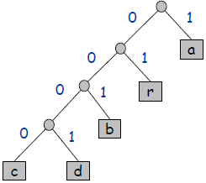
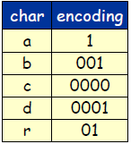
Variable Length Encoding
Fewer bits for frequent letters (E, T, A)
More bits for rare letters (J, Q, Z)
Potential ambiguity
  (E=0, T=01, Z=0001101)?
Use a binary tree
110010000010100011

Slide 24

Compression Quality
Huffman coding/Huffman tree
  Build a tree based on character frequency
Difficult to compress
  Random data (or compressed data)
All compression algorithms exploit bias in data
  Images have white patches
  Letters E/T/A occur more frequently

Slide 25
Compression in Hadoop
Multiple opportunities
  HDFS => Mapper => Reducer => HDFS
  Input to Mapper
  Output from Mapper
  Output of the Reducer

Slide 26
Hadoop Streaming Idea
  hadoop jar hadoop-streaming.jar
  -input myInputDirs
  -output myOutputDir
  -mapper myPythonScript.py
  -reducer myOtherPythonScript.py
  -file myPythonScript.py
  -file myDictionary.txt
/bin/wc

Slide 27
Hadoop Streaming
Map: cat binary
Reduce: value count in python
hadoop jar hadoop-streaming-2.6.4.jar -input /user/ec2-user/mlens -output /data/output1 -mapper /bin/cat -reducer myReducer.py -file myReducer.py
Notes:
http://rasinsrv07.cstcis.cti.depaul.edu/CSC555/myReducer.py

Slide 28
Hadoop Streaming
Map: Timestamp=>Weekday in python
Reduce: value count in python
hadoop jar hadoop-streaming-2.6.4.jar -input /home/ec2-user/mlens -output /data/output4 -mapper myMapper.py -reducer myReducer.py -file myReducer.py -file myMapper.py

Slide 29
Hadoop Streaming Options
-D stream.map.output.field.separator=|
-mapper org.apache.hadoop.mapred.lib.IdentityMapper
-partitioner org.apache.hadoop.mapred.lib.KeyFieldBasedPartitioner
-D mapred.reduce.tasks=2
-D mapred.text.key.comparator.options=-nr

Slide 30
Hadoop Streaming
Map: cat binary
Reduce: value count in python
hadoop jar hadoop-streaming-2.6.4.jar -D mapred.reduce.tasks=3 -D mapred.output.key.comparator.class=org.apache.hadoop.mapred.lib.KeyFieldBasedComparator -D mapred.text.key.comparator.options=-nr -input /home/ec2-user/mlens -output /data/output3 -mapper /bin/cat -reducer myReducer.py -file myReducer.py

Slide 31
MapReduce Debuging
!#/usr/bin/python
Map code:
  cat test.txt | python myMapper.py
Shuffle code:
  cat test.txt | python myMapper.py | sort
Reduce code:
  cat test.txt | python myMapper.py | sort | python myReducer.py

Slide 32
We Stopped Here

Slide 33
Hadoop DistributedCache
Lookup tables
Data transferred before JVM starts
  -file myMapper.py
Hive
  add FILE weekday_mapper.py;

Slide 34
Assigning Data to Mappers
HDFS-based
Mapper executed locally for best performance
Everything is managed in blocks
  Replication
  Balancing

Slide 35
Assigning Data to Reducers
Partitioner
  JobConf.setPartitionerClass()
Uses Java hash function + MOD by default
Sub any function (based on # of reducers)

Slide 36
Partitioning Function
Function assigning Key-value pairs to Reducers
Expected performance change?
  Load
  Map-Runtime
  Reduce-Runtime
Sorting

Slide 37
Block Rebalancing
How the data is distributed on HDFS nodes
Expected performance change?
  Load
  Map-Runtime
  Reduce-Runtime

Slide 38
Running the Rebalancer
Runs in background
Specify the threshold
  hdfs balancer -threshold X
  Percent of node usage
  (default 10%)
Configuration
  dfs.balance.bandwidthPerSec limits the amount of data each node spends on rebalancing (1MB default)
Notes:
--help

Slide 39
SQL to MapReduce
SELECT AVG(Grade) as GPA, FirstName, COUNT(DISTINCT LastName)
FROM Student s, Grades g
WHERE s.ID = g.SID
GROUP BY FirstName
ORDER BY GPA

Slide 40
NoSQL
No SQL / Not Only SQL
Non-relational databases (data-store) systems
Relax some of the relational database rules
  Integrity constraints
  Rigid schema (some)
  Update/synchronization guarantees
  Flexible
  Highly-scalable
Always a trade-off

Slide 41
Key Value Stores
For a (key, value) combination
  Key is a key
  Value is a “blob”
  Insert
  Update
  Delete
  Get
Many implementations
  DynamoDB, Riak, Redis, BerkeleyDB, …

Slide 42
Document Stores
Similar to key value stores
Value is not a blob, but a document, e.g.
  {"Subject": "I like Plankton“
  "Author": "Rusty"
  "PostedDate": "5/23/2006"
  "Tags": ["plankton", "baseball", "decisions"]
  "Body": "I decided today that I don't like baseball. I like plankton." }
You may have heard of
  MongoDB, CouchDB, Terrastore, RavenDB

Slide 43
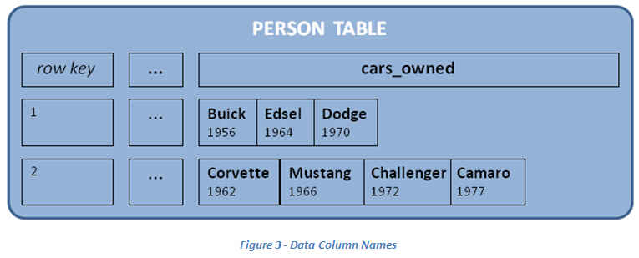
Column Family Stores
Similar to document stores
Add the concept of “column family”
Helps optimize read access and updates

Slide 44
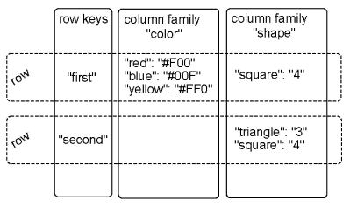
Column Family Stores
  Keys and Values
  Optimize column family distribution
  Add columns (no penalty)

Slide 45
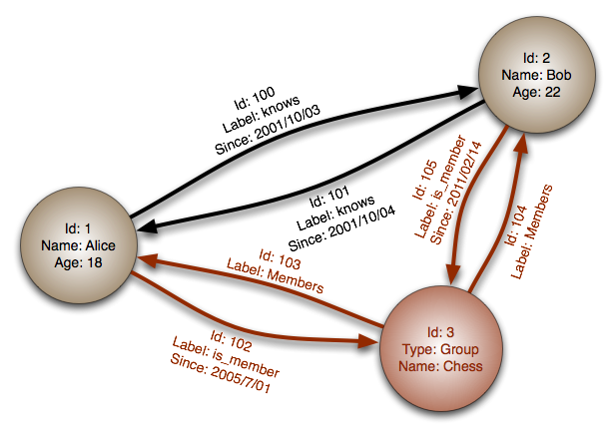
Graph Databases
Database stores the set of items
Items are connected to each other
Can query recursively
DBs
  Neo4j
  InfiniteGraph
  OrientDB

Slide 46

Zookeeper
“Because coordinating distributed systems is a zoo”
Coordinate service for distributed applications
  Naming
  Configuration
  Synchronization
  Group management/leader election

Slide 47
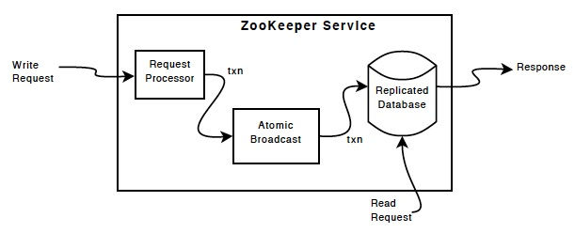
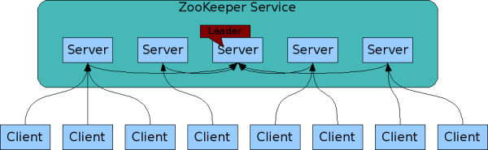
Zookeeper Overview

Slide 48
Zookeeper Uses
Barriers
  Delay processing until a condition is met
Queues
  (priority) Distributed queue
Locks
  Exclusive access to data
Leader election
  Select one “leader” node
  Find a replacement when needed

Slide 49
HBase
Column-oriented store
  Bigtable
Random, real-time updates
  Individual record access
Highly available/distributed
No SQL
  No joins
  (some) indexing

Slide 50
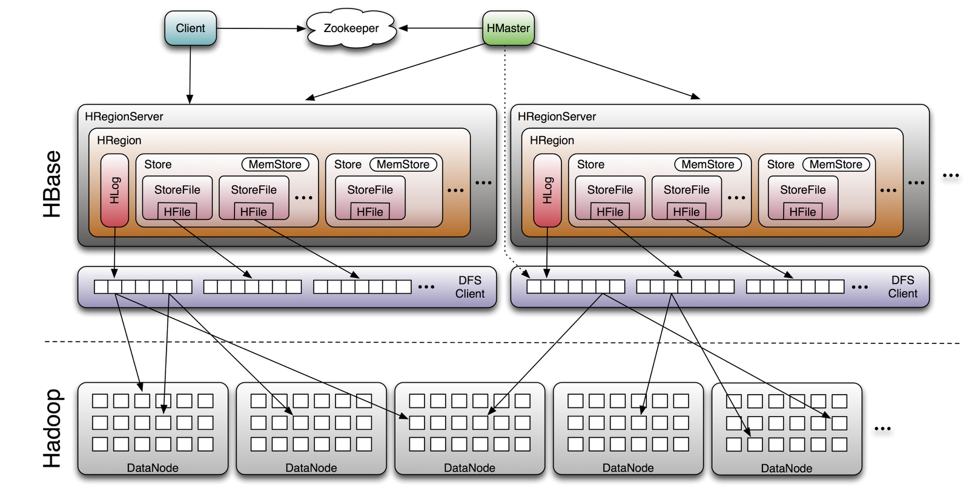
HBase Architecture

Slide 51
HBase Example
Create/populate a table:
    create 'test', 'col_fam'
    list 'test'
    put 'test', 'row1', 'col_fam:a', 'value1'
    put 'test', 'row2', 'col_fam:b', 'value2'
    put 'test', 'row3', 'col_fam:c', 'value3'
    put 'test', 'row5', 'col_fam:a', 'value4'
    put 'test', 'row3', 'col_fam:b', 'value5'
    scan 'test'
Notes:
list
status
status 'simple'
http://rasinsrv07.cstcis.cti.depaul.edu/CSC555/hbase-0.90.3.tar.gz
bin/start-hbase.sh

Slide 52
Using of HBase
    put 'test', 'row1', 'col_fam:z', 'value6'
    put 'test', 'row5', 'col_fam:z', 'value7'
    put 'test', 'row6', 'col_fam:z', 'value8'
    scan 'test', {COLUMNS => 'col_fam:c'}
    scan 'test', {STARTROW => 'row3'}
    put 'test', 'row3', 'col_fam:b', 'newValue5'
    scan 'test', {COLUMNS => 'col_fam:b'}
    scan 'test', {TIMERANGE=>[a, b]}
Notes:
status

Slide 53
Using HBase
More script commands
  http://hbase.apache.org/book.html#shell
  https://learnhbase.wordpress.com/2013/03/02/hbase-shell-commands/

Slide 54
Next Time:
More on Hadoop Ecosystem
Mahout
Link analysis

