Slide 1
CSC 555
Mining Big Data
Lecture 5
Alexander Rasin
College of CDM, DePaul University
February 6th, 2019

Slide 2
Tonight
MapReduce
Multi-node clusters
Hive / Pig
Hadoop Streaming
(NoSQL)

Slide 3

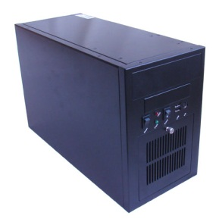
/data/text.txt = 6 X blocks
#1-a
#5-a
NameNode: /data/text.txt, 6 blocks
Block #1 – { Node1, Node2 }
Block #2 – { Node2, Node3 }
…
Block #6 – { Node3, Node1 }
Node1
#3-a
#6-b
#1-b
#5-b
Node2
#4-a
Job: Perform wordcount (a.k.a. word distribution)
#2-a
Node3
#3-b
#6-a
#2-b
#4-b

Slide 4
/data/text.txt = 6 X blocks
#1-a
#5-a
NameNode: /data/text.txt, 6 blocks
Block #1 – { Node1, Node2 }
Block #2 – { Node2, Node3 }
…
Block #6 – { Node3, Node1 }
Mapper
Node1
#3-a
#6-b
Mapper
#1-b
#5-b
Node2
JobTracker:
Step 1: Talk to the NameNode
Step 2: Identify TaskTrackers with available slots (near data)
Wait/monitor TaskTrackers
#4-a
#2-a
Mapper
Node3
#3-b
#6-a
#2-b
#4-b

Slide 5
/data/text.txt = 6 X blocks
Locally store map output of Blocks #1 and #5
Mapper
Cost: Read and process 2 blocks on each node
(plus write a local copy)
NOTE: Local map output could be larger (e.g., 3 blocks)
Optional: Apply a Combiner to the locally stored output
Node1
Locally store map output of Blocks #2 and #4
Mapper
Node2
Mapper
Locally store map output of Blocks #3 and #6
Node3

Slide 6
/data/text.txt = 6 X blocks
Node1
Cost: Send each key to the respective reducer
NOTE: Over the network transfer (slow).
Keys arrive sorted:
Reducer1: (a {1, 4, 5})
(cat {2, 5, 7})
(zing {1, 2, 1})
Reducer5: (bat {2, 1})
(pie {1, 1}}
(young {1, 8})
Locally store map output of Blocks #1 and #5
Reducer1
Reducer2
Node2
Locally store map output of Blocks #2 and #4
Reducer3
Reducer4
Reducer5
Locally store map output of Blocks #3 and #6
Reducer6
Node3

Slide 7
/data/text.txt = 6 X blocks
Node1
Cost: Process the aggregation and write to HDFS (2X replication)
One file per reducer (outputs.per.reducer can be set to generate several files per reducer)
Write aggregated output back to HDFS
Reducer1
Reducer2
Node2
Reducer3
Write aggregated output back to HDFS
Reducer4
Reducer5
Write aggregated output back to HDFS
Reducer6
Node3

Slide 8
Common Issues
DataNode not running
  Stop and Reformat
    stop-all.sh
    Don’t forget to delete dfs directory!
      rm -rf /tmp/hadoop-ec2-user/dfs/
      hadoop namenode -format
Output file already exists
Hive commands in Linux prompt

Slide 9

FS and HDFS
get
put
/
/
tmp
home
tmp
data
D
j
E
idcuser
D
j
outputX
txt
q
n
n
G
hadoop-…
out.txt
o
p
bin

Slide 10
Host Names/IP
Nodes addressed by
  Internet Protocol (IP) Address
    140.192.5.61
  Domain Name
    www.depaul.edu
IP and Domain name are interchangeable
  (Domain is alias for IP address)

Slide 11
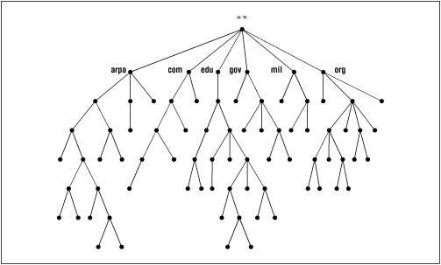

Domain Reverse Hierarchy

Slide 12
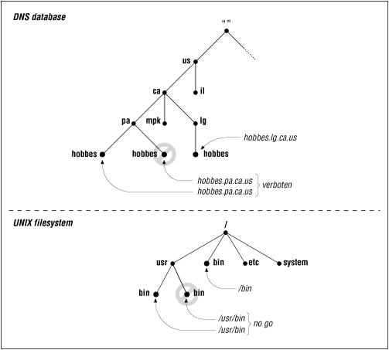
DNS <> IP Address

Slide 13
Conventions
Hosts
  ec2-54-187-35-9.us-west-2.compute.amazonaws.com
  54.187.35.9
PublicIP vs PrivateIP
localhost = “This machine”

Slide 14
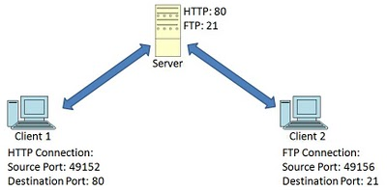
Machine Address + Port
Address always includes a port
  Sometimes not explicitly specified
  Well known defaults
    ssh = 22
    www = 80
    ftp = 21
    mail = 25
  Lesser known
    Hadoop status report = 50070
Notes:
time hadoop jar hadoop-2.6.4/share/hadoop/mapreduce/hadoop-mapreduce-examples-2.6.4.jar wordcount /data/bioproject.xml /data/wordcount1

Slide 15
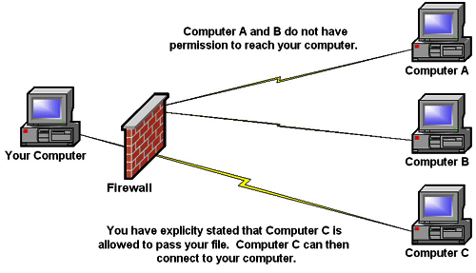
Firewall
Controls the individual port access

Slide 16
Cluster Setup
Passwordless login
  Public/private key
  Localhost to Localhost
  Master to Worker
Firewall / Security groups
Hadoop logs
Notes:
ssh-keygen -t dsa -P '' -f ~/.ssh/id_dsa
cat ~/.ssh/id_dsa.pub >> ~/.ssh/authorized_keys
ssh-keygen -t rsa

Slide 17
HDFS Shell Commands
HDFS Commands
hdfs dfsadmin [-safemode enter / leave /get / wait]
hdfs fsck <dir>
hadoop fs -du /
hdfs dfsadmin -report
HDFS Commands
  HADOOP_HOME
  Environment variables (~/.bashrc)

Slide 18
Hive
CREATE TABLE u_data ( userid INT,
movieid INT,
rating INT,
unixtime STRING)
ROW FORMAT DELIMITED FIELDS
TERMINATED BY '\t' STORED AS TEXTFILE; (not compressed)
show tables; describe u_data;
wget http://www.grouplens.org/system/files/ml-100k.zip
LOAD DATA LOCAL INPATH 'ml-100k/u.data'
OVERWRITE INTO TABLE u_data;
Notes:
wget http://rasinsrv07.cstcis.cti.depaul.edu/CSC555/apache-hive-2.0.1-bin.tar.gz
gunzip apache-hive-2.0.1-bin.tar.gz
tar xvf apache-hive-2.0.1-bin.tar
export HIVE_HOME=`pwd`
export PATH=$HIVE_HOME/bin:$PATH
$HADOOP_HOME/bin/hadoop fs -mkdir /tmp
$HADOOP_HOME/bin/hadoop fs -mkdir /user/hive/warehouse
$HADOOP_HOME/bin/hadoop fs -chmod g+w /tmp
$HADOOP_HOME/bin/hadoop fs -chmod g+w /user/hive/warehouse
p

Slide 19
Recording Tables in Hive
INSERT OVERWRITE DIRECTORY 'movie_ratings'
SELECT movieid, rating
FROM u_data_new; (/user!/ec2-user)
CREATE TABLE movie_ratings
(movieid INT, rating INT) ;
hadoop fs -cp movie_ratings/000000_0 movie_rat.dat
LOAD DATA INPATH 'movie_rat.dat'
OVERWRITE INTO TABLE movie_ratings;

Slide 20
Joins in Hive
SELECT COUNT(*)
FROM u_data JOIN MovieSample ON (u_data.movieid = MovieSample.movieid);
CREATE VIEW AS
SELECT *
FROM u_data JOIN MovieSample ON (u_data.movieid = u_data_new.movieid)
WHERE Rating = 2;

Slide 21
Outer Join / External Table
External Tables
  Data not owned by Hive
SELECT * FROM u_data
FULL OUTER JOIN u_data_new ON
(u_data.rating = u_data_new.weekday)
WHERE u_data.rating > 3;
Notes:
hadoop fs –mkdir /user/ec2-user/movie_ratings2
CREATE EXTERNAL TABLE movie_ratings2
(movieid INT, rating INT)
ROW FORMAT DELIMITED FIELDS TERMINATED BY '\t' STORED AS TEXTFILE
LOCATION '/user/ec2-user/movie_ratings';

Slide 22
Map-Join
Hive StarSchema optimization
SELECT Address, Count(*)
FROM SmallTable st JOIN
BigTable bt ON (st.id = bt.id)
GROUP BY Address
2 MapReduce jobs
Network transfer

Slide 23
Map-Join
SELECT /*+ MAPJOIN(st) */
Address, Count(*)
FROM SmallTable st JOIN
BigTable bt ON (st.id = bt.id)
GROUP BY Address
Replicate the SmallTable
set hive.auto.convert.join = true;
  hive.mapjoin.smalltable.filesize (25MB default)

Slide 24
Hive Partitioning
CREATE TABLE u_data ( userid INT,
movieid INT, rating INT, unixtime STRING)
PARTITIONED BY(country STRING)
ROW FORMAT DELIMITED FIELDS
TERMINATED BY '\t' STORED AS TEXTFILE;
LOAD DATA LOCAL INPATH 'ml-100k/u.data'
OVERWRITE INTO TABLE u_data
PARTITION(country='Canada');
show partitions u_data;
Notes:
wget http://rasinsrv07.cstcis.cti.depaul.edu/CSC555/hive-0.8.1-bin.tar.gz
gunzip hive-0.8.1-bin.tar.gz
tar xvf hive-0.8.1-bin.tar
export HIVE_HOME=/home/ec2-user/hive-0.8.1-bin
export PATH=$HIVE_HOME/bin:$PATH
export HADOOP_HOME=/home/ec2-user/hadoop-0.20.205.0/

Slide 25
Hive Partitioning
CREATE TABLE u_data2 ( userid INT,
movieid INT, rating INT, unixtime STRING)
PARTITIONED BY(country STRING)
CLUSTERED BY(movieid) INTO 10 buckets
ROW FORMAT DELIMITED FIELDS
TERMINATED BY '\t' STORED AS TEXTFILE;
LOAD DATA LOCAL INPATH 'ml-100k/u.data'
OVERWRITE INTO TABLE u_data2
PARTITION(country='Canada');
Notes:
SORTED BY (unixtime)

Slide 26


Slide 27
MapReduce Sort
Distributed sort operation
Caveats
  Can only sort by the key
  Keys sorted within reducer
  Special partitioner

Slide 28
SQL to MapReduce
SELECT FirstName, AVG(GPA)
FROM Student
GROUP BY FirstName
ORDER BY AVG(GPA)
SELECT EName, MName
FROM Employee e, Manager m
WHERE e.SID = m.ID
ORDER BY e.Salary;

Slide 29
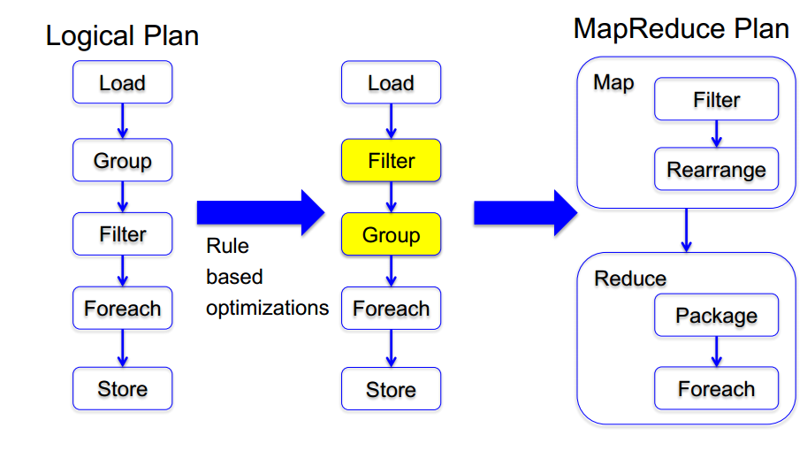
Pig Architecture

Slide 30
Pig Use
UData = LOAD 'u.data' USING PigStorage('\t') AS (userid:int, movieid:int, rating:int, unixtime:chararray);
DESCRIBE UData;
DUMP UData;
UDataS = ORDER UData BY userid;
DUMP UDataS;
Notes:
wget http://rasinsrv07.cstcis.cti.depaul.edu/CSC555/pig-0.15.0.tar.gz
gunzip pig-0.15.0.tar.gz
tar xvf pig-0.15.0.tar
export PIG_HOME=/home/ec2-user/pig-0.15.0
export PATH=$PATH:$PIG_HOME/bin

Slide 31
Pig Use
UDataSample = SAMPLE UData 0.01;
DUMP UDataSample;
STORE UDataSample INTO 'UDataSample'
USING PigStorage ('_');
ONE_USER = FILTER UData BY userid == 251;
DUMP ONE_USER;

Slide 32
Pig Use
GoodRatings = FILTER UData BY rating > 2;
UserSet = GROUP GoodRatings BY userid;
DUMP UserSet;
UserRatings = FOREACH UserSet GENERATE COUNT(GoodRatings);
DUMP UserRatings;
ILLUSTRATE UserRatings;

Slide 33
Pig Use
UserSet2 = GROUP UData BY userid;
UserRatings2 = FOREACH UserSet2 GENERATE UData.userid, AVG(UData.rating);
DUMP UserRatings2;

Slide 34
Pig Use
UDataNew = LOAD 'u.data.new' USING PigStorage('\t') AS (userid2:int, movieid2:int, rating2:int, weekday2:chararray);
DESCRIBE UDataNew; DUMP UDataNew;
DataJoin=JOIN UData BY (userid, movieid), UDataNew BY (userid2, movieid2);
FilterDataJoin = FILTER DataJoin BY rating != 2;
FDL_LG = GROUP FilterDataJoin BY (UDataNew::userid2, UDataNew::rating2);
Result = FOREACH FDL_LG GENERATE group, COUNT(FilterDataJoin);
Notes:
Case sensitive!

Slide 35
Pig Use
UDataNew = LOAD 'u.data.new' USING PigStorage('\t') AS (userid2:int, movieid2:int, rating2:int, weekday2:chararray);
DESCRIBE UDataNew; DUMP UDataNew;
DataJoin= JOIN UData BY ($0, $1),UDataNew BY ($0,$1);
STORE DataJoin INTO 'DataJoin' using PigStorage(',');
DataJoinL = LOAD 'DataJoin' USING PigStorage(',') AS (uid1:int, mid1:int, r1:int, ut1:chararray, uid2:int, mid2:int, r2:int, wd2:chararray);
DataJoinLG = GROUP DataJoinL BY wd2;
DataJoinG = ORDER (FOREACH DataJoinLG GENERATE group, AVG(DataJoinL.r1)) BY group;
Notes:
DataJoinG = ORDER (FOREACH DataJoinLG GENERATE group, AVG(DataJoinL.r1)) BY group;

Slide 36
Pig Use
cd hdfs:///
ls
mkdir testpig
copyFromLocal /etc/passwd passwd
passwd = LOAD 'hdfs:///testpig/passwd' USING PigStorage(':') AS (user:chararray, passwd:chararray, uid:int, gid:int, userinfo:chararray, home:chararray, shell:chararray);

Slide 37
Pig Use
DUMP passwd;
groupShell = GROUP passwd BY shell;
DUMP groupShell;
groupCount = FOREACH groupShell GENERATE group, COUNT(passwd);

Slide 38
Hadoop Streaming Idea
  hadoop jar hadoop-streaming.jar
  -input myInputDirs
  -output myOutputDir
  -mapper myPythonScript.py
  -reducer myOtherPythonScript.py
  -file myPythonScript.py
  -file myDictionary.txt
/bin/wc

Slide 39
Hadoop Streaming
Map: cat binary
Reduce: value count in python
hadoop jar hadoop-streaming-2.6.4.jar -input /home/ec2-user/mlens -output /data/output1 -mapper /bin/cat -reducer myReducer.py -file myReducer.py
Notes:
http://rasinsrv07.cstcis.cti.depaul.edu/CSC555/myReducer.py

Slide 40
Hadoop Streaming
Map: Timestamp=>Weekday in python
Reduce: value count in python
hadoop jar hadoop-streaming-2.6.4.jar -input /home/ec2-user/mlens -output /data/output4 -mapper myMapper.py -reducer myReducer.py -file myReducer.py -file myMapper.py

Slide 41
Hadoop Streaming Options
-D stream.map.output.field.separator=|
-mapper org.apache.hadoop.mapred.lib.IdentityMapper
-partitioner org.apache.hadoop.mapred.lib.KeyFieldBasedPartitioner
-D mapred.reduce.tasks=2
-D mapred.text.key.comparator.options=-nr

Slide 42
Hadoop Streaming
Map: cat binary
Reduce: value count in python
hadoop jar hadoop-streaming-2.6.4.jar -D mapred.reduce.tasks=3 -D mapred.output.key.comparator.class=org.apache.hadoop.mapred.lib.KeyFieldBasedComparator -D mapred.text.key.comparator.options=-nr -input /home/ec2-user/mlens -output /data/output3 -mapper /bin/cat -reducer myReducer.py -file myReducer.py

Slide 43
MapReduce Debuging
!#/usr/bin/python
Map code:
  cat test.txt | python myMapper.py
Shuffle code:
  cat test.txt | python myMapper.py | sort
Reduce code:
  cat test.txt | python myMapper.py | sort | python myReducer.py

Slide 44
Hadoop DistributedCache
Lookup tables
Data transferred before JVM starts
  -file myMapper.py
Hive
  add FILE weekday_mapper.py;

Slide 45
NoSQL
No SQL / Not Only SQL
Non-relational databases (data-store) systems
Relax some of the relational database rules
  Integrity constraints
  Rigid schema (some)
  Update/synchronization guarantees
  Flexible
  Highly-scalable
Always a trade-off

Slide 46
Key Value Stores
For a (key, value) combination
  Key is a key
  Value is a “blob”
  Insert
  Update
  Delete
  Get
Many implementations
  DynamoDB, Riak, Redis, BerkeleyDB, …

Slide 47
Document Stores
Similar to key value stores
Value is not a blob, but a document, e.g.
  {"Subject": "I like Plankton“
  "Author": "Rusty"
  "PostedDate": "5/23/2006"
  "Tags": ["plankton", "baseball", "decisions"]
  "Body": "I decided today that I don't like baseball. I like plankton." }
You may have heard of
  MongoDB, CouchDB, Terrastore, RavenDB

Slide 48
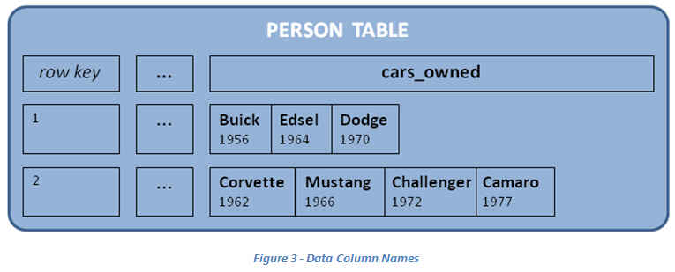
Column Family Stores
Similar to document stores
Add the concept of “column family”
Helps optimize read access and updates

Slide 49
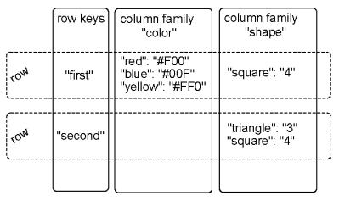
Column Family Stores
  Keys and Values
  Optimize column family distribution
  Add columns (no penalty)

Slide 50
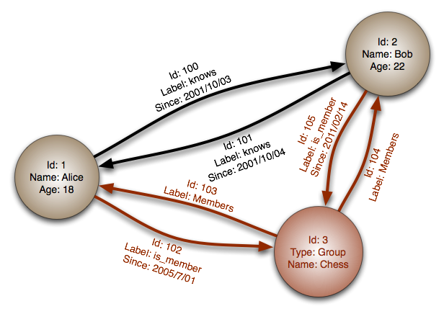
Graph Databases
Database stores the set of items
Items are connected to each other
Can query recursively
DBs
  Neo4j
  InfiniteGraph
  OrientDB

Slide 51
Next Time:
Performance and Compression
More on multi-node clusters
NoSQL
Hadoop ecosystem
  Hadoop streaming, HBase, Zookeeper

