Slide 1
CSC 555
Mining Big Data
Lecture 9
Alexander Rasin
College of CDM, DePaul University
March 6th, 2019

Slide 2
Tonight
Clustering / Mahout
Running Storm and Spark
Recommender systems
Document matching

Slide 3
K-Means Clustering
Choose an initial set of centers
  Well distributed (likely in different clusters)
  Any set will converge, but not the same
Assign every point to the closest centroid
Find the new centroids
Repeat
  N steps
  Or until converges

Slide 4
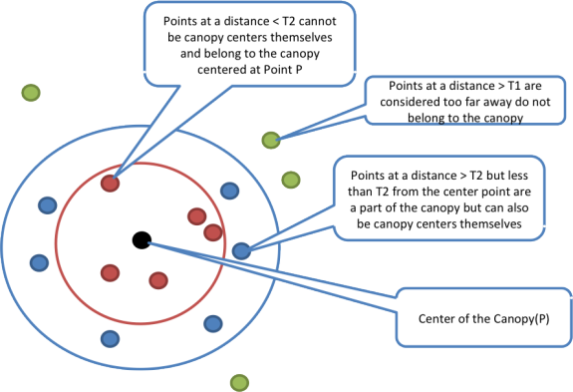
Canopy (Pre-)Clustering
Used for pre-processing
  Initialize centroids
  Repeat
    Pick random center
    Build canopy
    Remove points

Slide 5
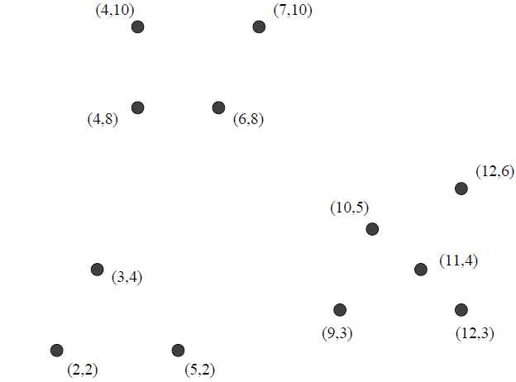
K-Means Clustering with Mahout
A different input file (12 points)
$MAHOUT_HOME/bin/mahout org.apache.mahout.clustering.syntheticcontrol.kmeans.Job --maxIter 10 --numClusters 3 --t1 5 --t2 3 --input testpoints --output kmeansResult
Notes:
mahout clusterdump --input output/clusters-10-final --pointsDir output/clusteredPoints --output clusteranalyze.txt

Slide 6
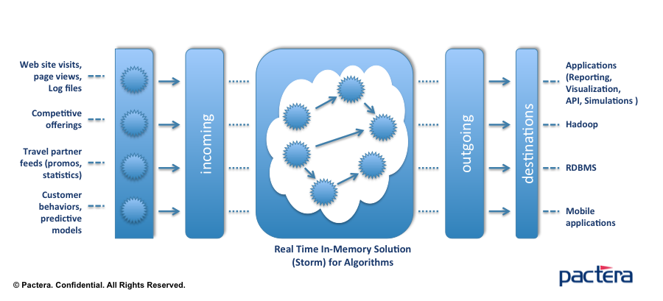

Storm

Slide 7
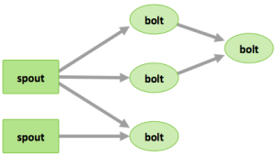
Storm Components
Spout = source of tuples
Bolt = processing operator
Topology

Slide 8
Storm Components
Nimbus node
  JobTracker
Supervisor Nodes
ZooKeeper Nodes
  Coordination
Stream
  Unbound sequence of tuples

Slide 9
Running Storm
Submit "topologies"
  WordCountTopology.java
Spouts / Bolts
Can use any language
Notes:
http://www.haroldnguyen.com/blog/2015/01/setting-up-storm-and-running-your-first-topology/
/home/ec2-user/apache-storm-0.9.2-incubating/examples/storm-starter
~/apache-maven-3.2.3/bin/mvn compile exec:java -Dstorm.topology=storm.starter.WordCountTopology
RandomSentenceSpout
WordCountTopology
Splitsentence

Slide 10
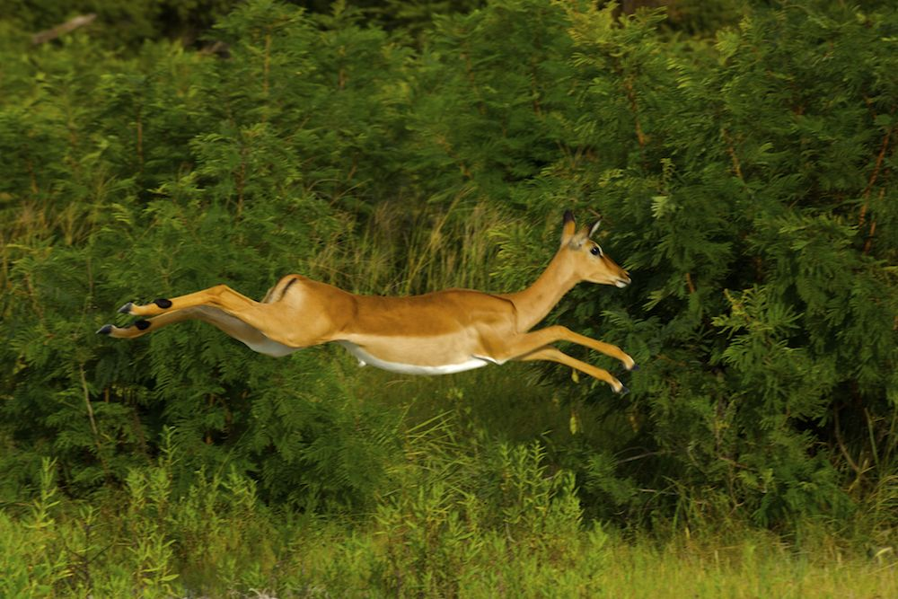
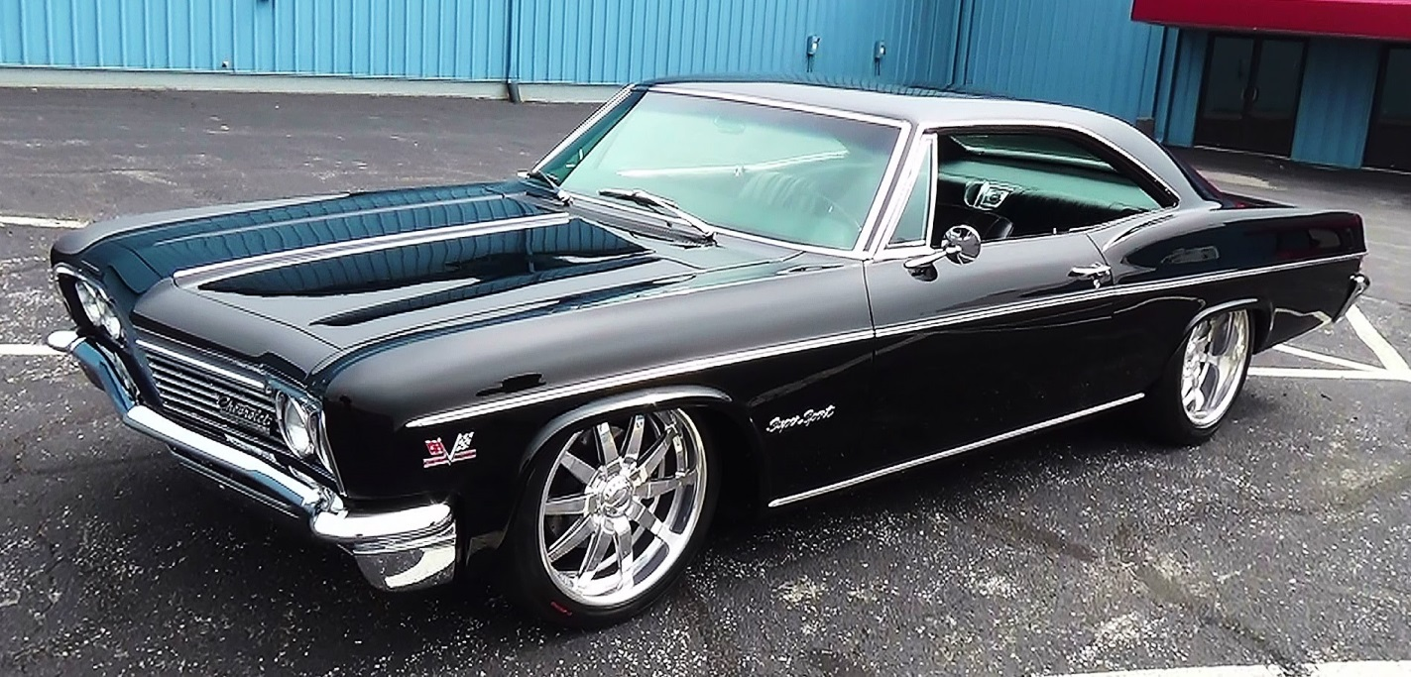
Impala

Slide 11
The Basics
Interactive SQL
Mostly SQL-compatible
Sharing the environment
  Same meta-store (MySQL or PostgreSQL)
  Can access HBase!
  Own execution engine (instead of M-R)

Slide 12
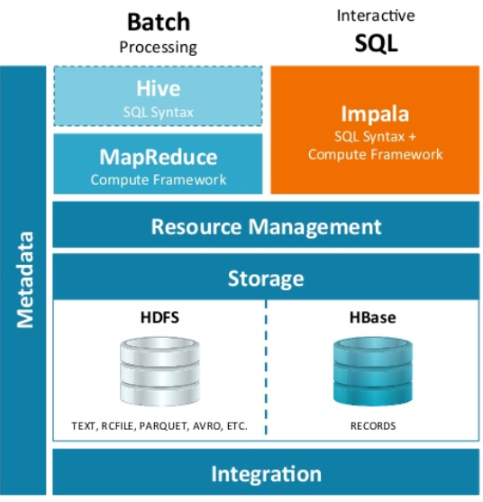

Slide 13
More on Impala
Written in C++
One Impala daemon per DataNode
Existing format storage
  Parquet = Column-oriented store
Refresh data
  No Zookeeper (no serializability)

Slide 14
In-Memory Databases
Main Memory database system (MMDB)
Data resides in main memory / backup copy on disk
Disk Resident database system (DRDB)
Data resides on disk / may be cached into memory
The primary copy lives permanently in memory
What is the difference between a MMDB and a regular database with a very large cache?
  Even if all data fits in memory, the structures and algorithms are designed for disk access.

Slide 15
Differences in properties of main memory and disk
The access time for main memory is orders of magnitude less than for disk storage
Main memory is normally volatile, while disk storage is not
The layout of data on disk is much more critical than the layout of data in main memory

Slide 16
Spark
General engine for large-scale data processing
  Batch/real-time/stream
  Machine learning
  Graph workloads
In memory processing
  Resilient Distributed Dataset (RDD)
  HDFS or in-memory*

Slide 17
Spark
bin/pyspark (shell)
  textFile = sc.textFile("README.md")
  textFile.count() # number of items/lines
  textFile.first() # first item
  linesWithSpark = textFile.filter(lambda line: "Spark" in line)

Slide 18
Spark Setup
Download Spark binary
  http://spark.apache.org/downloads.html
Mode
  Using stand-alone mode
  YARN
    Spark pre-built with support, security
Notes:
http://spark.apache.org/docs/latest/spark-standalone.html

Slide 19
Spark Setup
sbin/start-all.sh
  Slaves file
http://public-IP:8080/
  bin/pyspark (vs scala)

Slide 20
Spark Principles
Distributed datasets
  data = [1, 2, 3, 4, 5]
  distData = sc.parallelize(data)
  distData.reduce(lambda a, b: a + b)
distFile = sc.textFile("data.txt")
  hdfs://… , s3n://
  lengths = distFile.map(lambda s: len(s))
  totalLength = lengths.reduce(lambda a, b: a + b)

Slide 21
Spark Storage
As close to data as possible (HDFS nodes?)
Uses local disk to store data
  Recommended 4-8 disks per node w/out RAID
Recommend allocating up to 75% of RAM
When data in RAM, performance network-bound

Slide 22
RDD Persistence
MEMORY_ONLY
  MEMORY_ONLY_2
MEMORY_AND_DISK
  MEMORY_AND_DISK_2
DISK_ONLY
Unpersist

Slide 23
Spark Example
# Read file from HDFS
text_file = sc.textFile("hdfs://ec2-13-57-190-73.us-west-1.compute.amazonaws.com/data/big.txt")
  lengths = text_file.map(lambda s: len(s))
  print text_file.take(100)
  lengths.foreach(myprint)
  print lengths.take(100)
  totalLength = lengths.reduce(lambda a, b: a + b)
Notes:
def myprint(x):
print x

Slide 24

BREAK

Slide 25
Spark Example
# Read file from HDFS
text_file = sc.textFile("hdfs://ec2-54-67-64-123.us-west-1.compute.amazonaws.com/data.txt")
counts = text_file.flatMap(lambda line: line.split(" ")).map(lambda word: (word, 1)).reduceByKey(lambda a, b: a + b)
counts.saveAsTextFile("hdfs://ec2-13-57-190-73.us-west-1.compute.amazonaws.com/data/output2")

Slide 26
Spark Example
import random
def sample(p):
x, y = random.random(), random.random()
return 1 if x*x + y*y < 1 else 0
count = sc.parallelize(xrange(0, 5000000)).map(sample) \
.reduce(sum1)
print "Pi is roughly %f" % (4.0 * count / 5000000)

Slide 27
Recommender Systems
Recommend
  Movies/Purchases/News
Content-based systems
  Analyze user history
  Find similar items
Collaborative filtering
  Similarity between users
  Users like you also liked…

Slide 28


Slide 29
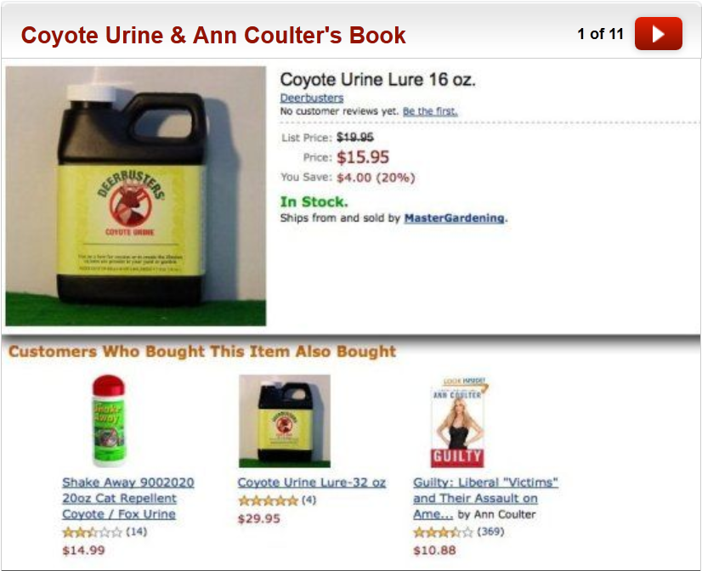

Slide 30
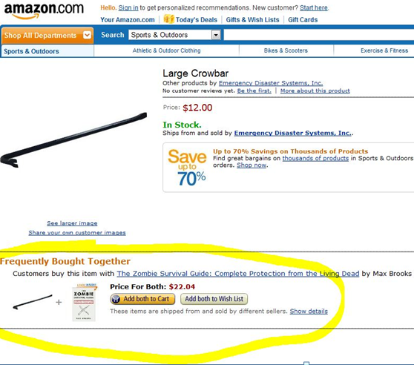

Slide 31
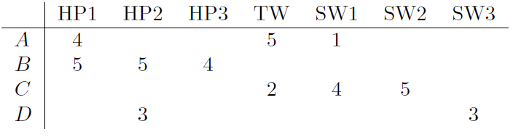
Utility Matrix
Users/ratings
Very sparse

Slide 32
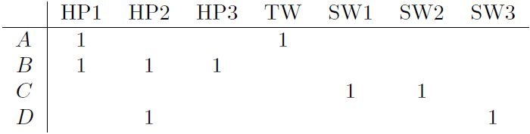
Rounding the Data
Replace
  1, 2 => No rating
  3, 4, 5 => 1
Jaccard
  A to B distance => 3/4
  A to C distance => 1

Slide 33
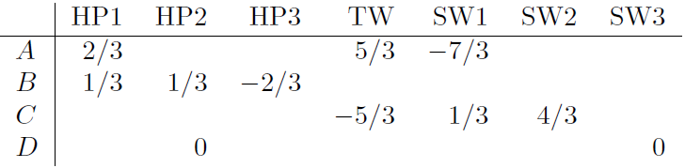
Normalizing Ratings
Subtract the average from each value
  How “different” is the rating

Slide 34
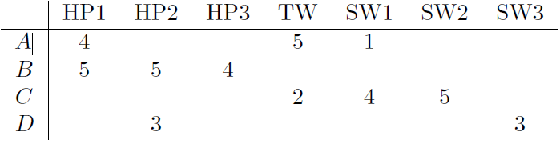
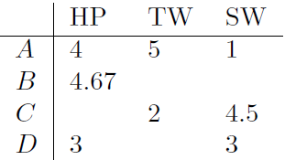
Clustering Users/Items
Utility matrix is very sparse
  Unlikely to find many matches
  Cluster to unite attributes

Slide 35
Clustering Users/Items
Hierarchical clustering
Revised matrix is denser
Can also cluster users in the same manner
Can repeat the process

Slide 36
Netflix Challenge
MovieLens data
  (User, Movie, Rating, Date)
  Predict/recommend movies
Netflix challenge
  480,000 users
  18,000 movies
  100M ratings
  Minimize RMSE (2.8M testing set)
    Netflix’s CineMatch scored 0.9514

Slide 37
Netflix Challenge
Data had been removed
Removing user info does not “anonymize”
  Can reverse-engineer users
  With 8 movie ratings and a up to 14 day error dates => 99% can be identified
  Two ratings with 3 day error => 68% identified
  6 movies outside of top 500 (without dates) => 84% accuracy
Can mine IMDB for data

Slide 38
Matrix Decomposition Example
Users X Items
5.00 | 5.00 | 2.00 | -
2.00 | - | 3.00 | 5.00
- | 5.00 | - | 3.00
3.00 | - | - | 5.00
Users X Features
Features X Items
1.12 | 1.49 | 0.48
1.31 | -0.52 | 0.59
1.13 | 0.67 | -0.52
1.39 | 0.05 | 0.45
4.78 | 5.01 | 1.97 | 3.61
1.97 | 1.96 | 2.85 | 4.80
2.75 | 4.71 | 1.40 | 2.94
2.93 | 3.30 | 2.74 | 4.79
1.81 | 2.66 | 1.73 | 3.16
1.62 | 1.71 | -0.23 | -0.24
0.74 | -1.08 | 0.78 | 0.90

Slide 39
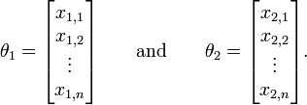
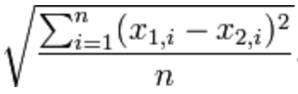
Root Mean Squared Error
Evaluate error between estimator and actual values
  Vectors:

Slide 40
We Stopped

Slide 41
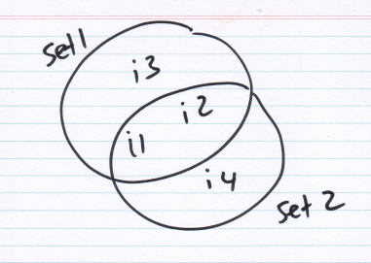
Similarity of Sets
How do you compare two sets?
Items represented by sets
  Documents
  Homeworks
  Fingerprints
  SQL Queries
Overlap = “Similarity”

Slide 42
Shingling
A mechanism to represent documents
Pick value k
Generate k-shingles to represent the document
  Document = abcdabd
  2-shingles = {ab, bc, cd, da, bd}
Compute similarity
White space? (‘ ‘, ‘\n’, …)

Slide 43
Shingle Size
What if we pick k=1?
K large enough to keep shingle appearance probability low
How many characters do you expect?
  30^2 = 900
  30^3 = 27K
  30^4 = 810K
  30^5 = ~24M combinations

Slide 44
Letter Distribution
Letter distribution is not uniform
  Scrabble values
24M combinations
Common 5-letter combinations are a much smaller subset
  The rest are unusual to impossible

Slide 45
String Overhead
Comparing strings is expensive
  For k=9, abcdefghi and abcdefghz
One of the many uses of hashing
  Similar to compression (lossy)
  Represent each shingle by a code (hash)
How much space does the hash require?
  k=9, 30^9 different potential shingles
k=9 hashed to 4 bytes better than k=4
  Effective space is much smaller

Slide 46
Shingle Cost
k=9 -> 9X document size
  Hash to 4 bytes, still 4X
  Does not fit in memory
Create signatures
  Again, hashing
  Lossy compression
  Similarity-preserving

Slide 47
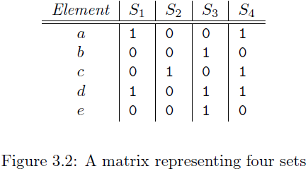
Matrix Representation
Each document = binary vector
  # elements
  # of documents
Jaccard measure
Sparse matrix
Notes:
S1 = {a,d}, etc.

Slide 48
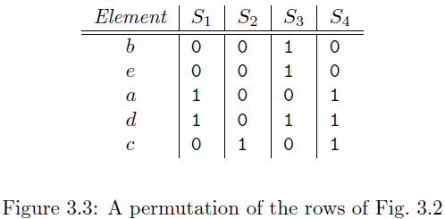
Minhashing
Select a permutation of the matrix rows
The first occurrence of 1 in the vector
  h(S₁) = a
  h(S₂) = c
  h(S₃) = b
  h(S₄) = a
Similar to the Jaccard measure

Slide 49
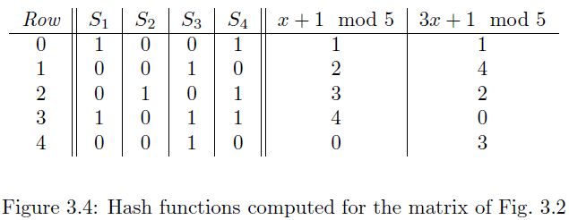

Minhash Signatures
Permute and build a Minhash signature several times
No need to build the permutation
Final result (2)

Slide 50
Comparing Document Pairs
The curse of the N²
  100,000 documents
  Enough memory to store hash/signatures
  ~100,000 x 100,000 pairs = ~10,000,000,000 comparisons
This can take a long time
  1000 comparisons/second
  115 days
(embarassingly) Parallelizable

Slide 51
Locality-Sensitive Hashing
Assign documents into “buckets”
100K => 50 buckets
  50 * 2,000 * 2,000 = 200,000K
  (vs 10,000,000K)
  115 days => 2.3 days
Split the signature matrix into “bands”
Hash each band

Slide 52
Combining the Techniques
Construct set of k-shingles (for some k)
  Optionally hash shingles to n-bit values
Arrange the documents by shingle value
Pick a length for the minhash signatures
Select a threshold t (false neg. vs speed)
Construct candidate pairs by applying LSH
Find the candidate matches
  Optionally, look at the actual matched documents

Slide 53
Next Time:
A Hadoop Ecosystem Overview
Web advertising
Mining Social Graphs
Pizza to celebrate the end of the quarter

