Slide 1
CSC 555
Mining Big Data
Lecture 7
Alexander Rasin
College of CDM, DePaul University
February 20th, 2019

Slide 2
Tonight
Hadoop Streaming/Cluster setup
NoSQL
Link analysis

Slide 3
Cluster Reformatting
Stop Hadoop
  Run stop scripts (if stop fails, killall -9 java)
Delete the old DFS storage on every node
  rm -rf /tmp/hadoop-ec2-user/dfs/
    (For master and every worker)
Reformat HDFS
  hdfs namenode -format
    (on master)

Slide 4
Hadoop DistributedCache
Lookup tables
Data transferred before JVM starts
  -file myMapper.py
Hive
  add FILE weekday_mapper.py;

Slide 5
Hadoop Streaming Options
-D stream.map.output.field.separator=|
-mapper org.apache.hadoop.mapred.lib.IdentityMapper
-partitioner org.apache.hadoop.mapred.lib.KeyFieldBasedPartitioner
-D mapred.reduce.tasks=2
-D mapred.text.key.comparator.options=-nr

Slide 6
Hadoop Streaming
Map: cat binary
Reduce: value count in python
hadoop jar hadoop-streaming-2.6.4.jar -D mapred.reduce.tasks=3 -D mapred.output.key.comparator.class=org.apache.hadoop.mapred.lib.KeyFieldBasedComparator -D mapred.text.key.comparator.options=-nr -input /home/ec2-user/mlens -output /data/output3 -mapper /bin/cat -reducer myReducer.py -file myReducer.py
Notes:
hadoop jar hadoop-streaming-2.6.4.jar -D mapred.reduce.tasks=3 -input /home/ec2-user/mlens -output /data/output3 -mapper /bin/cat -reducer myReducer.py -file myReducer.py

Slide 7
Hadoop Streaming: A Join!
SELECT SUBSTRING(tv.Plate, 0, 3), COUNT(*)
FROM TowedVehicles AS tv, RelocatedVehicles AS rv
WHERE SUBSTRING(tv.Plate, 0, 3) = SUBSTRING(rv.Plate, 0, 3)
GROUP BY SUBSTRING(tv.Plate, 0, 3)
wget http://rasinsrv07.cstcis.cti.depaul.edu/CSC555/join1/vehicleMapJoin.py
Notes:
wget http://rasinsrv07.cstcis.cti.depaul.edu/CSC555/join1/Relocated_Vehicles.csv
wget http://rasinsrv07.cstcis.cti.depaul.edu/CSC555/join1/Towed_Vehicles.csv
hadoop fs -mkdir -p /data/joinVehicles
hadoop fs -put Towed_Vehicles.csv Relocated_Vehicles.csv /data/joinVehicles
wget http://rasinsrv07.cstcis.cti.depaul.edu/CSC555/join1/vehicleMapJoin.py
wget http://rasinsrv07.cstcis.cti.depaul.edu/CSC555/join1/vehicleReduceJoin.py
hadoop jar hadoop-streaming-2.6.4.jar -input /data/joinVehicles -mapper vehicleMapJoin.py -file vehicleMapJoin.py -reducer vehicleReduceJoin.py -file vehicleReduceJoin.py -output /data/outputVehicles

Slide 8

A Break

Slide 9
Pig UDF (python)
Register 'testlib.py' using jython as myfuncs;
UserSquare = FOREACH UData GENERATE unixtime, myfuncs.square(userid);
Notes:
UData = LOAD 'u.data' USING PigStorage('\t') AS (userid:int, movieid:int, rating:int, unixtime:chararray);
UserSquare = FOREACH UData GENERATE myfuncs.square(userid);

Slide 10
NoSQL
No SQL / Not Only SQL
Non-relational databases (data-store) systems
Relax some of the relational database rules
  Integrity constraints
  Rigid schema (some)
  Update/synchronization guarantees
  Flexible
  Highly-scalable
Always a trade-off

Slide 11
Key Value Stores
For a (key, value) combination
  Key is a key
  Value is a “blob”
  Insert
  Update
  Delete
  Get
Many implementations
  DynamoDB, Riak, Redis, BerkeleyDB, …

Slide 12
Document Stores
Similar to key value stores
Value is not a blob, but a document, e.g.
  {"Subject": "I like Plankton“
  "Author": "Rusty"
  "PostedDate": "5/23/2006"
  "Tags": ["plankton", "baseball", "decisions"]
  "Body": "I decided today that I don't like baseball. I like plankton." }
Some examples:
  MongoDB, CouchDB, Terrastore, RavenDB

Slide 13
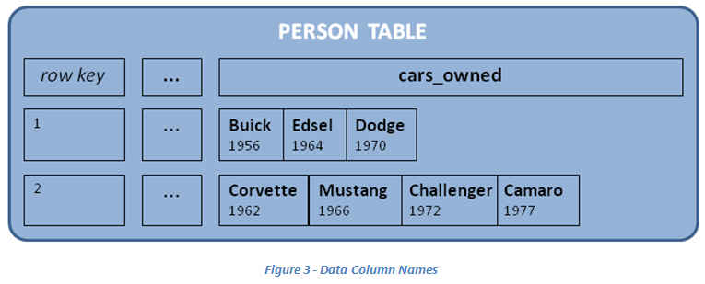
Column Family Stores
Similar to document stores
Add the concept of “column family”
Helps optimize read access and updates

Slide 14
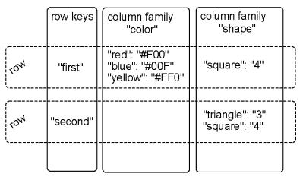
Column Family Stores
  Keys and Values
  Optimize column family distribution
  Add columns (no penalty)

Slide 15
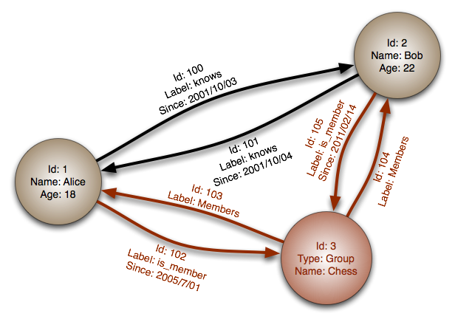
Graph Databases
Database stores the set of items
Items are connected to each other
Can query recursively
DBs
  Neo4j
  InfiniteGraph
  OrientDB

Slide 16

Zookeeper
“Because coordinating distributed systems is a zoo”
Coordinate service for distributed applications
  Naming
  Configuration
  Synchronization
  Group management/leader election

Slide 17
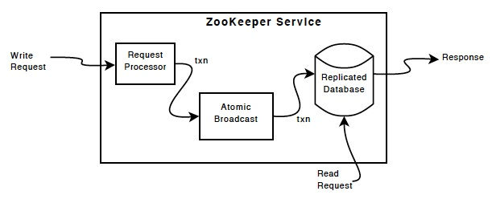
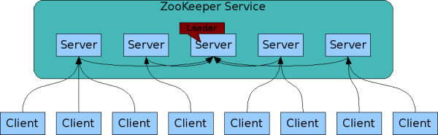
Zookeeper Overview

Slide 18
Zookeeper Uses
Barriers
  Delay processing until a condition is met
Queues
  (priority) Distributed queue
Locks
  Exclusive access to data
Leader election
  Select one “leader” node
  Find a replacement when needed

Slide 19
HBase
Column-oriented store
  Bigtable
Random, real-time updates
  Individual record access
Highly available/distributed
No SQL
  No joins

Slide 20
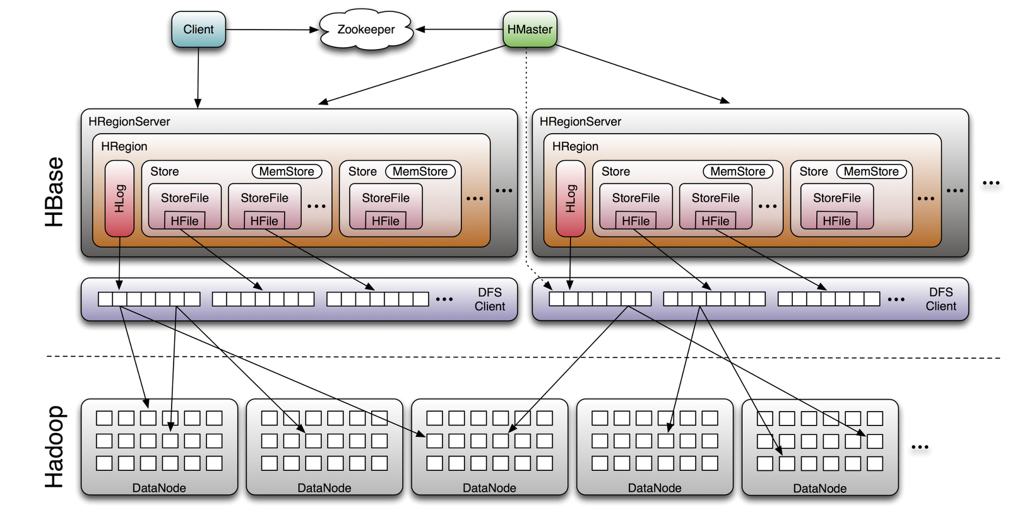
HBase Architecture

Slide 21
HBase Example
Create/populate a table:
    create 'testtbl', 'cfamily'
    list 'test'
    put 'testtbl', 'row1', 'cfamily:a', 'value1'
    put 'testtbl', 'row2', 'cfamily:b', 'value2'
    put 'testtbl', 'row3', 'cfamily:c', 'value3'
    put 'testtbl', 'row5', 'cfamily:a', 'value4'
    put 'testtbl', 'row3', 'cfamily:b', 'value5'
    scan 'test'
Notes:
http://rasinsrv07.cstcis.cti.depaul.edu/CSC555/hbase-0.90.3.tar.gz
bin/start-hbase.sh

Slide 22
Uses of HBase
    put 'testtbl', 'row1', 'cfamily:z', 'value6'
    put 'testtbl', 'row5', 'cfamily:z', 'value7'
    put 'testtbl', 'row6', 'cfamily:z', 'value8'
    scan 'testtbl', {COLUMNS => 'cfamily:c'}
    scan 'testtbl', {STARTROW => 'row3'}
    put 'testtbl', 'row3', 'cfamily:b', 'newValue5'
    scan 'testtbl', {COLUMNS => 'cfamily:b'}
    scan 'testtbl', {TIMERANGE=>[a, b]}

Slide 23
Using HBase
More script commands
  http://hbase.apache.org/book.html#shell
  https://learnhbase.wordpress.com/2013/03/02/hbase-shell-commands/

Slide 24

We Stopped Here

Slide 25
Link Analysis
Web search
Link spamming
  Search engine optimization (SEO)

Slide 26
Early Web Searches
Crawl the web
Find the search terms
  Scan collected web-page snapshots
  Inverted index
Weight the terms accordingly
  Header = more important
  Frequently used = more important

Slide 27
Inverted Index
Search term location
For popular term record
  Locations where it was found
  One-time pre-computation (needs updating)
Intersect these locations for several terms
Rank the selected results

Slide 28

Gaming the System
Term spamming
  Add Hadoop to header
  Add Hadoop 1000 times
  Hide words in background
Add related terms
  Search for Hadoop
  Copy the pages that come up first

Slide 29
The Google Solution
Find the “important” pages
  Random walk the web
    Start anywhere
    Follow random links
    See where you end up
  Cannot count the # of links instead…
Do not trust the (destination) page
  Rely on terms in the linking page
  Source page outside of destination control

Slide 30
Page Rank
Ignore the terms on the page
Only trust others to define your page
Ignore link farms
  Link farms are a closed system
Web traffic indicative of page popularity
Links indicative of page relevance

Slide 31
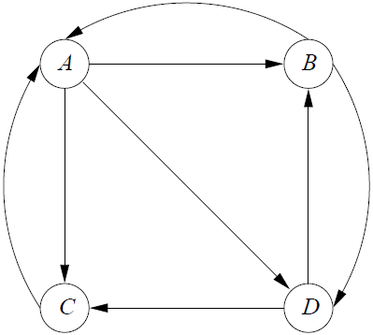
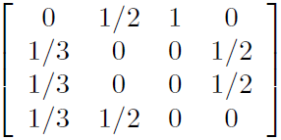
Definiton of PageRank
Imagine this is the web
  Assume random walk
  From A -> 3 places
  From B -> 2 places
  …
Define a transition matrix
A
B
C
D
A B C D

Slide 32
Surfer Probability Distribution
Randomly placed surfer [1/n, 1/n, … 1/n]
  [¼, ¼, ¼, ¼] for our example
To compute probability distribution
  Multiply the transition matrix by vector
1/41/4
1/4
1/4
3/8
5/24
5/24
5/24

Slide 33
Probability Distribution
Probability distribution after 2 steps
  M * M * v = M² * v
Eventually converge
  Strongly connected graph
  No dead ends
In practice – 50 to 75 iterations
In reality starting probability not equal

Slide 34
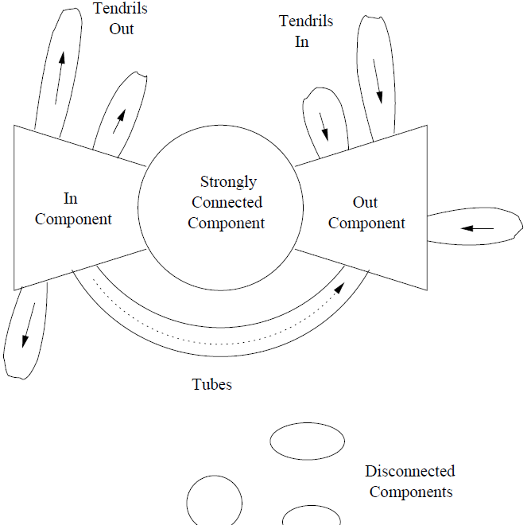

Structure of the Web
InC => SCC/OutC
SCC => OutC
Dead ends
  0% to leave
Spider traps

Slide 35

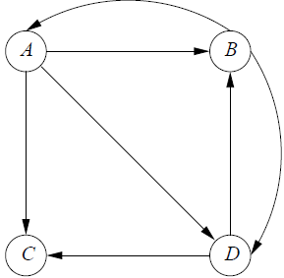
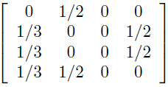
Avoiding Dead Ends
Node C = dead end
Matrix multiplication
  Converges to [0, 0, 0, 0]
  C linked to itself? (spider trap)
Solution?
  Drop dead end nodes

Slide 36
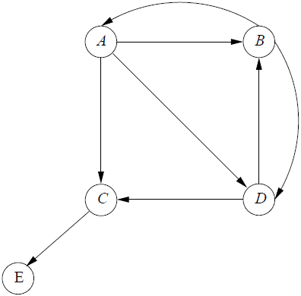


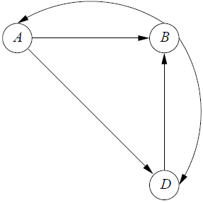


Dropping Dead Ends
A
B
D
C
PageRank C = 1/3 * 2/9 + 0 * 4/9 + 1/2 * 3/9

Slide 37
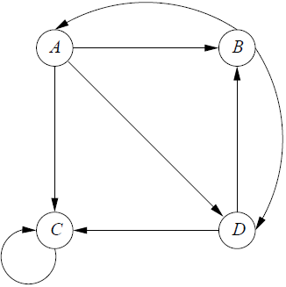
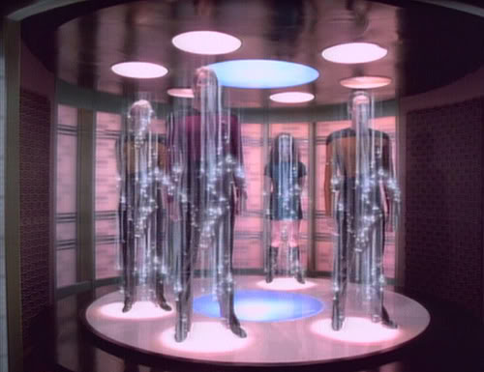
Spider Traps
PageRank converges to
Solution?
0
0
10
Random jump from any node to any node
  Small probability
With dead ends, total PageRank < 1

Slide 38
PageRank Computation
Google’s secret formula
Select pages with search terms
Apply PageRank
  Filter out unrelated/spam results
  Apply your preferences (Google+, gmail)
  Weight by topic?
PageRank is just one of the components

Slide 39
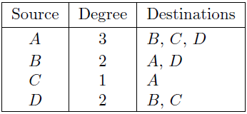
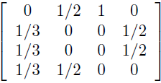
PageRank and MapReduce
Matrix multiplication
Transition matrix is (usually) sparse
  Average page has ~10 out links
  Operate on non-zero elements
Graph representation

Slide 40
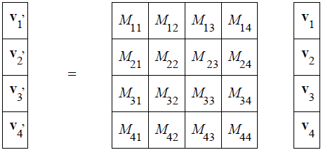
PageRank and MapReduce
Stripe the vector v (to fit in memory)
Partition the matrix into blocks
  k² map tasks
  Vector stripes sent across the network

Slide 41
Topic-Sensitive PageRank
Different user interest for pages
  Ideally, every user has individualized PageRank
Topic-sensitive PageRank
  Biased starting rank by subject
  E.g. by category (DMOZ)
Bias towards particular category
  Add a teleport factor
  Topic-specific pages (mostly) lead to related pages

Slide 42
Topic-Sensitive PageRank
Choose which topics to bias for
Select pages that match that topic (+teleport)
Determine topic(s) relevant to the query
  Determining context – very difficult
  Manual selection/key words/user info
Using keywords
  Indicative terms (words specific to topic)
  Classify pages by computing Jaccard similarity between the page and the topic word set

Slide 43
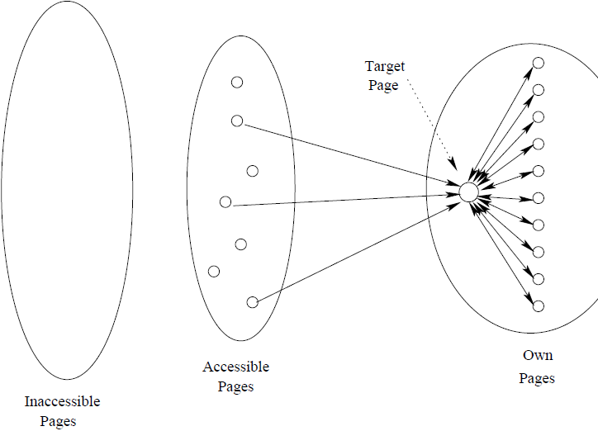
LinkSpam
Inaccessible pages
Accessible pages
Owned pages

Slide 44
Dealing with LinkFarms
TrustRank
  Topic-sensitive set of pages that is “trustworthy”
  Cannot be spam-able (blogs, etc.)
  Human selected
    Pages
    Domains
Spam Mass
  (PageRank – TrustRank)/PageRank
  Negative/small values => likely ok

