Slide 1
CSC 555
Mining Big Data
Lecture 3
Alexander Rasin
College of CDM, DePaul University
January 23rd, 2019

Slide 2
Tonight
Virtual instances
MapReduce
Cryptography (public/private keys)
Hive
(Pig?)

Slide 3
Cloud Service
A virtual machine
  Simulated environment
  Guaranteed performance
  On a shared (larger) machine
Independent from your computer

Slide 4
Hadoop/MapReduce
Many loosely connected computers
Limited centralized control
Therefore
  Mapper only sees a block at-a-time
  Reducer only sees its keys
  Reducer emits one “result” per key

Slide 5
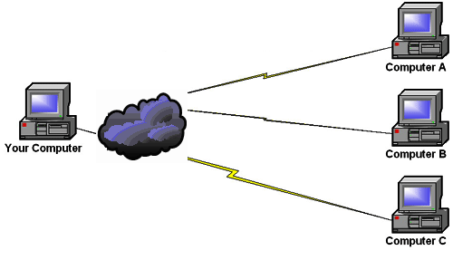
Remote Access
Remote connection (such as remote desktop)
Work is done at the destination
Your computer is the terminal

Slide 6
Host Names/IP
Nodes addressed by
  Internet Protocol (IP) Address
    140.192.5.61
  Domain Name
    www.depaul.edu
IP and Domain name are interchangeable

Slide 7
Conventions
localhost = “This machine”
Hosts
  ec2-54-187-35-9.us-west-2.compute.amazonaws.com
  54.187.35.9

Slide 8
Describing MapReduce algorithms
Examples for Map and Reduce tasks
  Describe the tasks
  What does Map do?
  (What does Combiner do, if any)
  What does Reduce do?
Code in python later

Slide 9
Student / Faculty
Student
  ID, Name, Age, Year, Advisor
  Table RDBMS / Raw file in HDFS
    1 | Jane Doe | 37 | 2021 | 3
    2 | Mike Smith | 33 | 2023 | 2
Faculty
  ID, Name, Area
    2 , Eric S. , D , 2021 , 3
    3 , Tanu M. , 33 , 2023 , 2

Slide 10
Set Union
MapReduce has to parse both files
SQL:
  SELECT ID FROM Student
  UNION
  SELECT ID FROM Faculty;

Slide 11
Union with MapReduce
Need to process 2 files
  Input == directory with 2 files
Map
  Process each file
  Emit compatible keys
Reduce
  Emit single output for every key

Slide 12
Set Intersection
MapReduce has to parse both files
SQL:
  SELECT ID FROM Students
  INTERSECT
  SELECT ID FROM Faculty;

Slide 13
Intersection with MapReduce
Process two input files
Need to identify which key is from where
  Two different Mappers
Reduce
  Iterate through keys
  Check if at least one from each file appears
  Emit that key
Does file order matter?

Slide 14
Set Difference (MINUS)
MapReduce has to parse both files
SQL:
  SELECT ID FROM Student
  MINUS (or EXCEPT)
  SELECT ID FROM Faculty;

Slide 15
Difference
Process two input files
Need to identify which key is from where
Reduce
  Iterate through all keys
  Check that only left side key appears
    Emit output
Does order matter?

Slide 16
SQL Join
SQL:
  SELECT Student.Name, Faculty.Area
  FROM Student, Faculty
  WHERE Student.Advisor = Faculty.ID;
Or:
    SELECT Student.Name, Faculty.Area
    FROM Student JOIN Faculty ON Advisor = Faculty.ID;

Slide 17
Join by MapReduce
Mapper
  Process both files
  Identify source of each row
Reducer (for same key)
  Collect all values from left file
  Collect all values from right file
  Return all (matching) combinations

Slide 18
Generalizing Join
Join by 2 attributes (A, B)
  Rewrite both Mappers to use (A+B) as key
  Leave Mappers as is and compare/join by the 2nd attribute in the Reduce function
Join without equality (non-equi-join)
  E.g., (Student.Age > Faculty.Age)
    How can we do this?

Slide 19
Grouping/Aggregation
Key-based aggregation
  MR join is also similar to an aggregate
Mapper
  Same as for join
Reduce
  Collect all values
  Perform aggregation or join

Slide 20
SQL Join + Aggregation
Join + Aggregate:
    SELECT Faculty.Name, COUNT(*)
    FROM Student, Faculty
    WHERE Student.Advisor = Faculty.ID;
    GROUP BY Faculty.Name;

Slide 21
Complex Queries
N-way joins
  SELECT *
  FROM Student, Enrollment, Course
  WHERE Student.ID = Enrollment.SID AND
  Course.ID = Enrollment.CID
Non-equi join (cannot)
Complex predicates
Complex aggregation

Slide 22
Computing GPA (by year)
Map
  Read/parse the file
  Emit pairs (year, grade)
Reduce
  Sum up all the enrollment values
  Divide by the count of values
  Produce (year, avg_grade) output
Combiner?

Slide 23

A Break

Slide 24
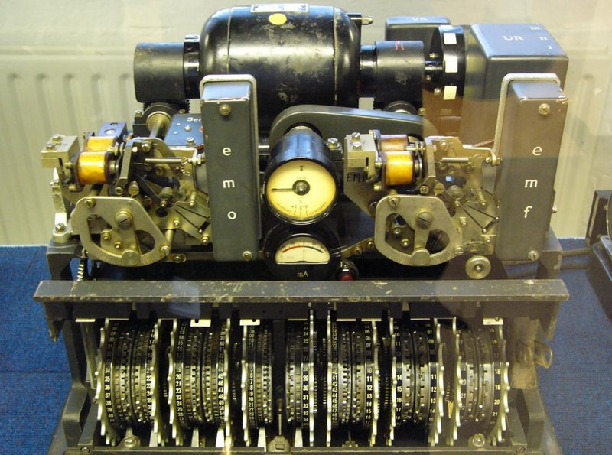

Cryptography

Slide 25
Distributing the Password
Password-protected access
How do you share the password?
  (without the risk of compromising it)
Asymmetric encryption!
  Use a joint pair of keys
  Public key + Private key

Slide 26
Public/Private Key
Private key
  Known only to the owner
  Secret code
Public key
  Known to everyone and shared freely
    Need a reliable way to publish
  Can be used to verify private key authenticity

Slide 27
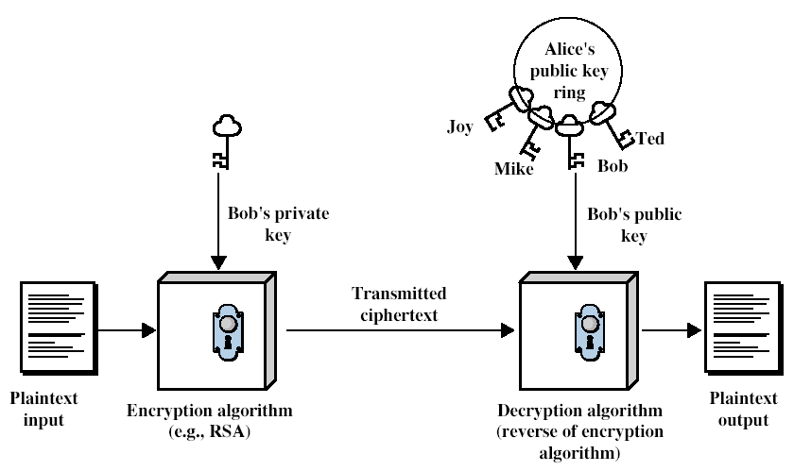
Asymmetric Encryption for Authentication
Bob
Alice

Slide 28
Public key Encryption
Alice has a key pair: public and private
  publish the public key such that the key is publicly known
  Alice keeps the private key secret
Other people use Alice’s public key to encrypt messages for Alice
Alice uses her private key to decrypt
Only Alice can decrypt since only Alice has the private key
Public key
Message
Encrypt
ρφωεκφσ
Private key
Message
Decrypt
ρφωεκφσ
Trick: To compute the private key from the public key is a difficult problem.

Slide 29
RSA
Invented by Rivest, Shamir & Adleman of MIT in 1977
Best known and widely used public-key scheme
Use large integers (e.g. 1024 bits)
Security due to cost of factoring large numbers
  factorization is expensive

Slide 30
RSA Key Setup
Each user generates a public/private key pair by
  select two large primes at random: p, q
  compute their system modulus n=p·q
    note ø(n)=(p-1)(q-1)
  select at random the encryption key e
    where 1<e<ø(n), gcd(e,ø(n))=1
  solve following equation to find decryption key d
    e·d=1 mod ø(n) and 0≤d≤n
  publish their public encryption key: KU= {e,n}
  keep secret private decryption key: KR= {d,n}

Slide 31
RSA Usage
To encrypt a message M:
  sender obtains public key of receiver KU={e,n}
  computes: C=Me mod n, where 0≤M<n
To decrypt the ciphertext C:
  receiver uses its private key KR={d,n}
  computes: M=C^{d} mod n
Message M must be smaller than the modulus n (cut into blocks if needed)

Slide 32
RSA Example: Computing Keys
Select primes: p=17, q=11
Compute n=pq=17×11=187
Compute ø(n)=(p–1)(q-1)=16×10=160
Select e: gcd(e,160)=1 and e<160
  choose e=7
Determine d: de=1 mod 160 and d<160
  d=23 since 23×7=161=10×160+1
Publish public key KU={7,187}
Keep secret private key KR={23,187}

Slide 33
RSA: Encryption and Decryption
Given message M = 88 (88<187)
Encryption KU={7,187} :
  C = 88⁷ mod 187 = 11
Decryption KR={23,187} :
  M = 11²³ mod 187 = 88
e*d ≡ 1 (mod p-1) and
e*d ≡ 1 (mod q-1)
Therefore m^{ed} ≡ 1 (mod pq)

Slide 34

Matrix Multiplication
Matrix times Vector
Unit of operation
  Value-by-value
  Vector-by-vector

Slide 35
Example Queries:
SELECT StoreID, MIN(TransactionAmt), MAX(TransactionAmt)
FROM StoreTransactions
GROUP BY StoreID;
SELECT ZipCode, MEDIAN(Age)
FROM People
GROUP BY ZipCode
SELECT d.category, COUNT(*)
FROM Employee e, Department d
WHERE e.dept = d.id
GROUP BY d.category;

Slide 36
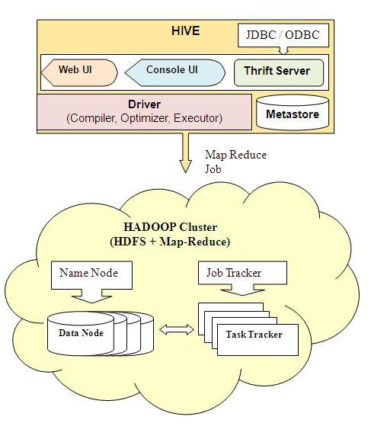
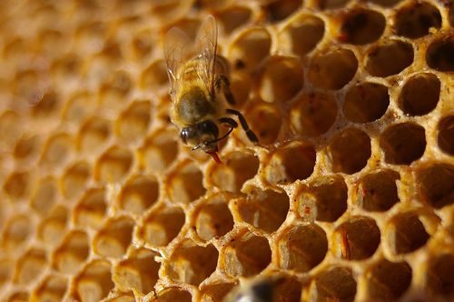
Hive Architecture

Slide 37
Hive Execution Flow
Parse the query
Get metadata from MetaStore
Create a logical plan
Optimize the plan
Create a physical plan
  DAG of MR jobs

Slide 38
We Stopped Here

Slide 39
Hive Types
TINYINT – 1 byte integer
SMALLINT – 2 byte integer
INT – 4 byte integer
BIGINT – 8 byte integer
BOOLEAN – True/False
FLOAT/DOUBLE
STRING

Slide 40
Hive Examples
CREATE TABLE u_data ( userid INT,
movieid INT,
rating INT,
unixtime STRING)
ROW FORMAT DELIMITED FIELDS
TERMINATED BY '\t' STORED AS TEXTFILE; (not compressed)
show tables; describe u_data;
wget http://www.grouplens.org/system/files/ml-100k.zip
LOAD DATA LOCAL INPATH 'ml-100k/u.data'
OVERWRITE INTO TABLE u_data;
Notes:
wget http://rasinsrv07.cstcis.cti.depaul.edu/CSC555/apache-hive-2.0.1-bin.tar.gz
gunzip apache-hive-2.0.1-bin.tar.gz
tar xvf apache-hive-2.0.1-bin.tar
export HIVE_HOME=`pwd`
export PATH=$HIVE_HOME/bin:$PATH
$HADOOP_HOME/bin/hadoop fs -mkdir /tmp
$HADOOP_HOME/bin/hadoop fs -mkdir /user/hive/warehouse
$HADOOP_HOME/bin/hadoop fs -chmod g+w /tmp
$HADOOP_HOME/bin/hadoop fs -chmod g+w /user/hive/warehouse
p

Slide 41
Using Hive
SELECT COUNT(*) FROM u_data;
SELECT * FROM u_data WHERE userid = 449;
SELECT userid, AVG(rating) from u_data GROUP BY userid;
SELECT userid, AVG(rating) as AR from u_data GROUP BY userid ORDER BY AR;
Notes:
http://52.53.223.168:19888/jobhistory

Slide 42
Custom MapReduce Plug
CREATE TABLE u_data_new ( userid INT,
movieid INT, rating INT, weekday String)
ROW FORMAT DELIMITED FIELDS
TERMINATED BY '\t';
add FILE weekday_mapper.py;
INSERT OVERWRITE TABLE u_data_new
SELECT TRANSFORM (userid, movieid, rating, unixtime) USING 'python weekday_mapper.py'
AS (userid, movieid, rating, weekday) FROM u_data;
Notes:
http://52.53.223.168:19888/jobhistory

Slide 43
Using Hive
SELECT weekday, COUNT(*)
FROM u_data_new GROUP BY weekday;
SELECT weekday, COUNT(*) as Total
FROM u_data_new GROUP BY weekday
ORDER BY Total;

Slide 44
Sampling in Hive
SELECT COUNT(*) FROM movie_ratings2
TABLESAMPLE(BUCKET 1 OUT OF 100 ON rand());
SELECT COUNT(*) FROM movie_ratings2
TABLESAMPLE(BUCKET 4 OUT OF 50 ON movieid);
CREATE VIEW MovieSample AS
SELECT * FROM movie_ratings2
TABLESAMPLE(0.1 PERCENT);

Slide 45
Joins in Hive
SELECT COUNT(*)
FROM u_data JOIN MovieSample ON (u_data.movieid = MovieSample.movieid);
CREATE VIEW JoinView1 AS
SELECT *
FROM u_data JOIN MovieSample ON (u_data.movieid = u_data_new.movieid)
WHERE Rating;

Slide 46
Outer Join / External Table
External Tables
  Data not owned by Hive
Describe u_data;
Describe u_data_new;
SELECT * FROM u_data
FULL OUTER JOIN u_data_new ON
(u_data.rating = u_data_new.weekday)
WHERE u_data.rating > 3;

Slide 47
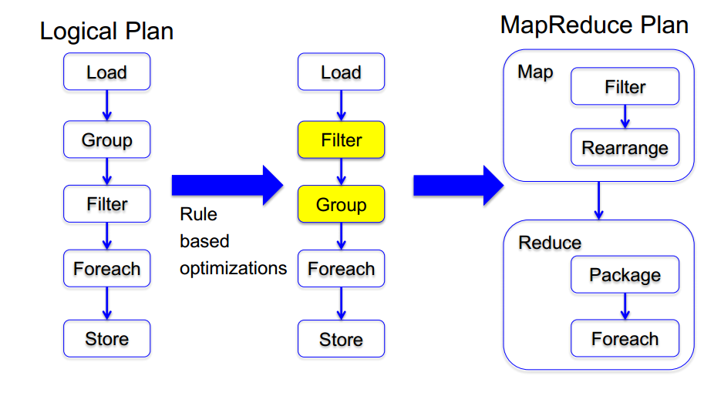
Pig Architecture

Slide 48
Pig Use
UData = LOAD 'u.data' USING PigStorage('\t') AS (userid:int, movieid:int, rating:int, unixtime:chararray);
DESCRIBE UData;
DUMP UData;
UDataS = ORDER UData BY userid;
DUMP UDataS;
Notes:
wget http://rasinsrv07.cstcis.cti.depaul.edu/CSC555/pig-0.15.0.tar.gz
gunzip pig-0.15.0.tar.gz
tar xvf pig-0.15.0.tar
export PIG_HOME=/home/ec2-user/pig-0.15.0
export PATH=$PATH:$PIG_HOME/bin

Slide 49
Pig Use
UDataSample = SAMPLE UData 0.01;
DUMP UDataSample;
STORE UDataSample INTO 'UDataSample'
USING PigStorage ('_');
ONE_USER = FILTER UData BY userid == 251;
DUMP ONE_USER;

Slide 50
Pig Use
GoodRatings = FILTER UData BY rating > 2;
UserSet = GROUP GoodRatings BY userid;
DUMP UserSet;
UserRatings = FOREACH UserSet GENERATE COUNT(GoodRatings);
DUMP UserRatings;
ILLUSTRATE UserRatings;

Slide 51
Pig Use
UserSet2 = GROUP UData BY userid;
UserRatings2 = FOREACH UserSet2 GENERATE UData.userid, AVG(UData.rating);
DUMP UserRatings2;

Slide 52
Next Time:
Hadoop ecosystem
  Hadoop config, Hadoop Streaming
  More Hive and Pig
Read:
  Mining of Massive Datasets
    Sections 2.5
  Hadoop: The Definitive Guide
    Pp162-167, "Launching a Job" to "Retrieving the Results"
    Pp204-205, "Speculative Execution"

