Slide 1
Hive
Data warehouse system
Schema
SQL-like queries
Not an RDBMS
No real-time response
No constraints guarantee (PK, FK, etc.)

Slide 2
Motivation for Hive
Lots and lots of data in Hadoop
Data is hard to load/maintain
Unstructured or semi-structured
No schema in MapReduce
Using Hadoop may require programming

Slide 3
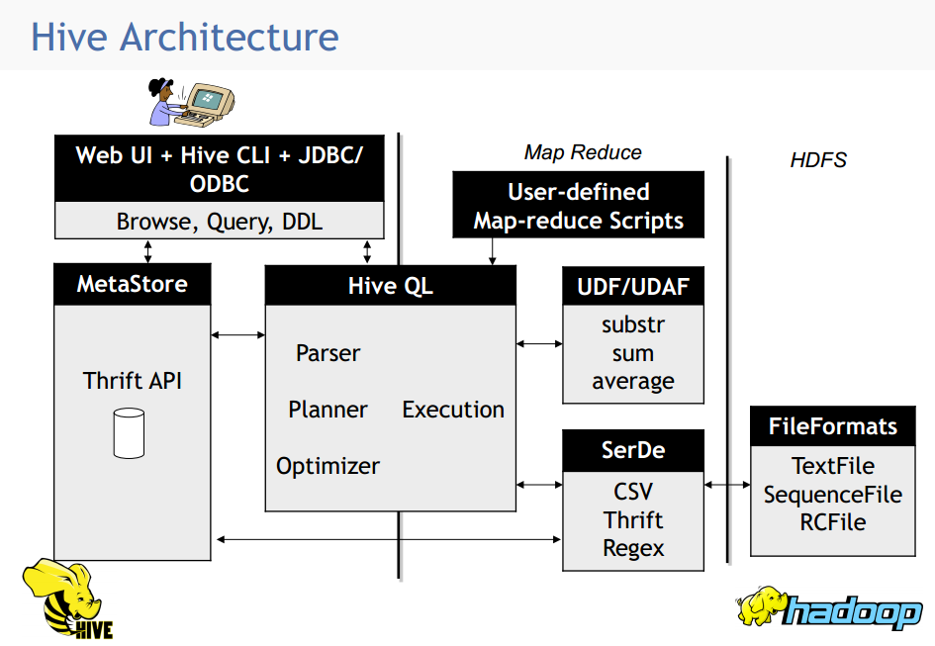

Slide 4
Hive Examples
CREATE TABLE u_data ( userid INT,
movieid INT,
rating INT,
unixtime STRING)
ROW FORMAT DELIMITED FIELDS
TERMINATED BY '\t' STORED AS TEXTFILE; (not compressed)
show tables; describe u_data;
wget http://www.grouplens.org/system/files/ml-100k.zip
LOAD DATA LOCAL INPATH 'ml-100k/u.data'
OVERWRITE INTO TABLE u_data;
Notes:
wget http://rasinsrv07.cstcis.cti.depaul.edu/CSC555/apache-hive-2.0.1-bin.tar.gz
gunzip apache-hive-2.0.1-bin.tar.gz
tar xvf apache-hive-2.0.1-bin.tar
export HIVE_HOME=`pwd`
export PATH=$HIVE_HOME/bin:$PATH
$HADOOP_HOME/bin/hadoop fs -mkdir /tmp
$HADOOP_HOME/bin/hadoop fs -mkdir /user/hive/warehouse
$HADOOP_HOME/bin/hadoop fs -chmod g+w /tmp
$HADOOP_HOME/bin/hadoop fs -chmod g+w /user/hive/warehouse
p

Slide 5
Using Hive
SELECT COUNT(*) FROM u_data;
SELECT * FROM u_data WHERE userid = 449;
SELECT userid, AVG(rating) from u_data GROUP BY userid;
SELECT userid, AVG(rating) as AR from u_data GROUP BY userid ORDER BY AR;
Notes:
http://52.53.223.168:19888/jobhistory

Slide 6
Custom Hive Transformation
CREATE TABLE u_data_new ( userid INT,
movieid INT, rating INT, weekday String)
ROW FORMAT DELIMITED FIELDS
TERMINATED BY '\t';
add FILE weekday_mapper.py;
INSERT OVERWRITE TABLE u_data_new
SELECT TRANSFORM (userid, movieid, rating, unixtime) USING 'python weekday_mapper.py'
AS (userid, movieid, rating, weekday) FROM u_data;
Notes:
http://52.53.223.168:19888/jobhistory

